Slide 1
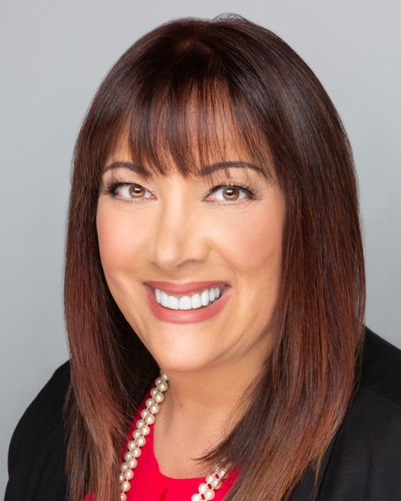

Strength in Vulnerability
Mollie Kallen, MS, CRC, CCM
CEO/President MKCM, Inc.
National Case Management Company

Slide 2
Definition of Vulnerability
Societal definitions: weakness, powerlessness, and passivity
True definition is: openess, receptivity and sensitivity

Slide 3
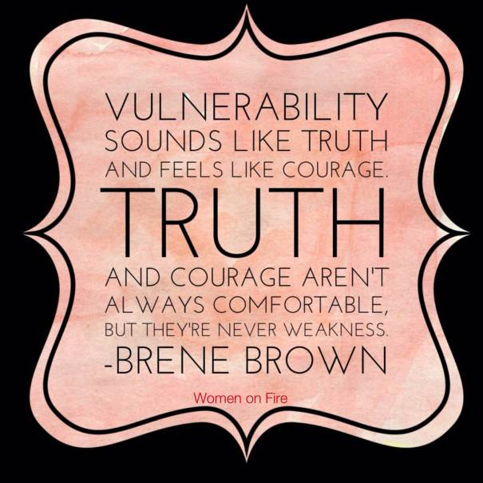

Slide 4

MYTHS of Vulnerability
Vulnerability is a weakness
Being vulnerable isn’t a choice – it’s a choice of how we RESPOND to uncertainty, risk and emotional exposure
Fear of exposure – vulnerability embraces boundaries and trust
You can go it alone

Slide 5
Vulnerability in Business
Howard Shultz, CEO of Starbucks, once said, “The hardest thing about being a leader is demonstrating or showing vulnerability… When the leader demonstrates vulnerability and sensibility and brings people together, the team wins.”

Slide 6
Value of Vulnerability in Business
Great leaders recognize the importance of bringing vulnerability to work because it is the foundation for open and nonjudgemental communications
Vulnerability FUELS the strongest relationships and ultimately, helps bring even more success to your organization
Vulnerability makes you a better leader – allows you to show your authentic self and stop worrying about others perceptions
Vulnerability promotes willingness to admit/own your mistakes and this increases credibility with others (customers and internal team)

Slide 7
Value of Vulnerability in Business ( continued)
The more transparent we are about our own process/journey and challenges, the more we create an environment that is open, authentic and conducive for individual and collective growth
Vulnerable leaders ask for help and receive help from others – it’s a sign of strength
Vulnerable leaders check their egos at the door
Vulnerability is required for authenticity
Vulnerability inspires teams
Vulnerability increases flow of ideas, creativity and innovation

Slide 8
MY CHALLENGE TO YOU AND TO ALL OF US
More than ever the world needs leaders who are vulnerable, empathetic and compassionate – SERVANT LEADERS
What type of leader are you?
How do people perceive you as a leader?
How can you incorporate more aspects of vulnerability in your personal as well as business life and relationships?

Slide 9



