Slide 1
CADILLAC THE STANDARD OF THE WORLD

Slide 2
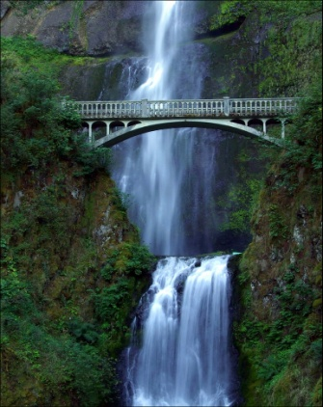
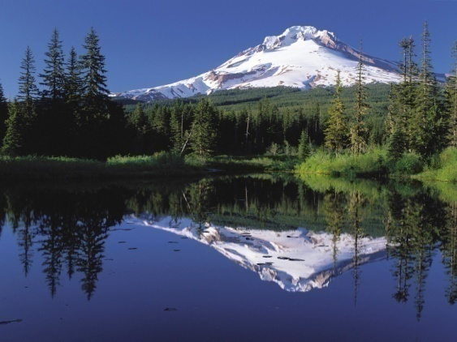
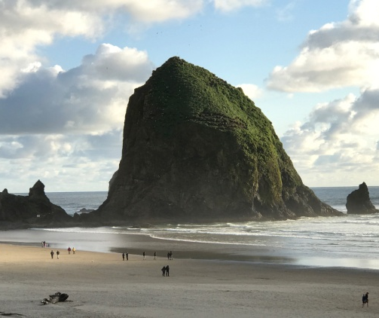
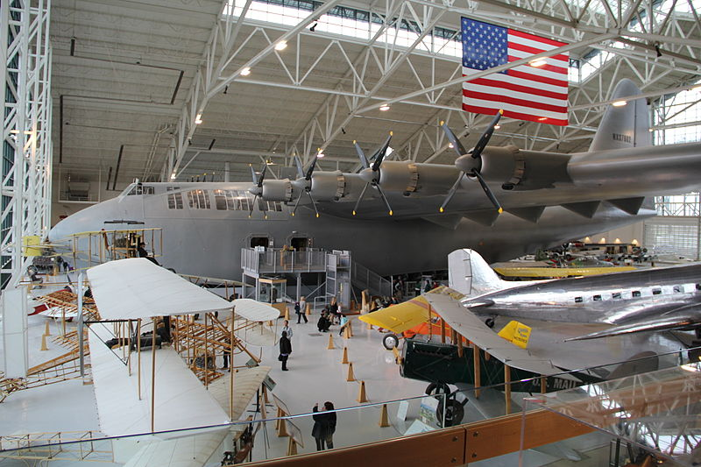
2020 National Driving Tour August 22 – 28, 2020
Notes:
I’d like to lead off with the initial slide that is in the ppt that I sent to you.

Slide 3
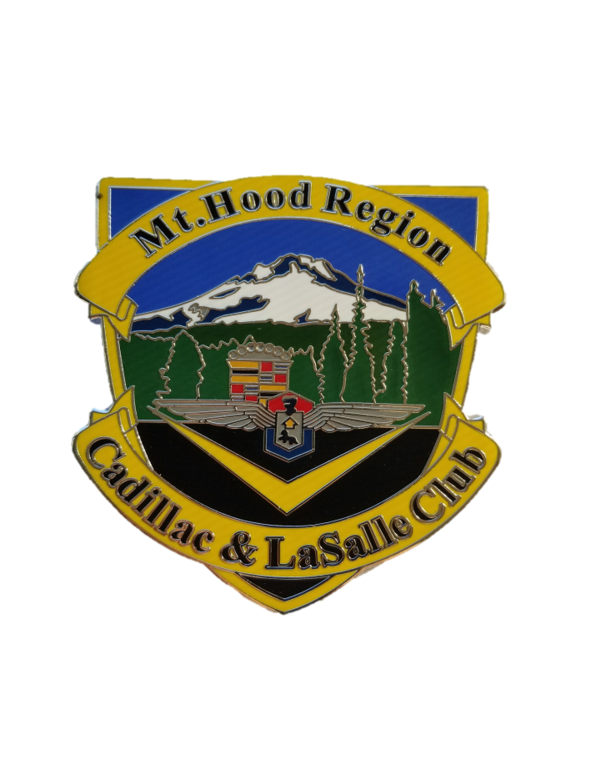
Sponsored by
Pacific NW Region CLC Seattle
Bob LeCoque - Director
Mt. Hood Region CLC Portland
Greg Duthie - Director
Notes:
I don’t think the yellow lettering will show up very well on a large screen I suggest a darker color

Slide 4
Event Summary
Seven Days of Touring Oregon and Southwest Washington
Lodging at Two Facilities
Approximately 600 Driving Miles
Co-Sponsored by the Pacific Northwest and Mt. Hood Region Cadillac/LaSalle Clubs
Notes:
Add SWW

Slide 5
Highlights
Two Historic Mountain Tours
Scenic Columbia River Gorge
Multiple Points of Interest
Oregon Wine Country
Oregon Coast

Slide 6
August Weather Averages
z
Portland
Average Weather
The Coast
Average Weather
The Mountain
Average Weather
80|57
65|51
75|54

Slide 7
Itinerary and Points of Interest

Slide 8
Day One - Saturday
Activity | Location | Time
Registration and CLC Car Show | Jantzen Beach Red Lion | 1:00PM – 5:00PM
Social Hour Appetizers provided and No Host Bar | Jantzen Beach Red Lion | 5:00PM – 6:30PM
Dinner Included in Registration | Jantzen Beach Red Lion | 6:30PM
Night Club/Dancing | Jantzen Beach Red Lion | Until late
Lodging | Jantzen Beach Red Lion
Notes:
Dinner needs to state – “cost included in registration”. Dinner and Night Club are at the Jantzen Beach Red Lion

Slide 9
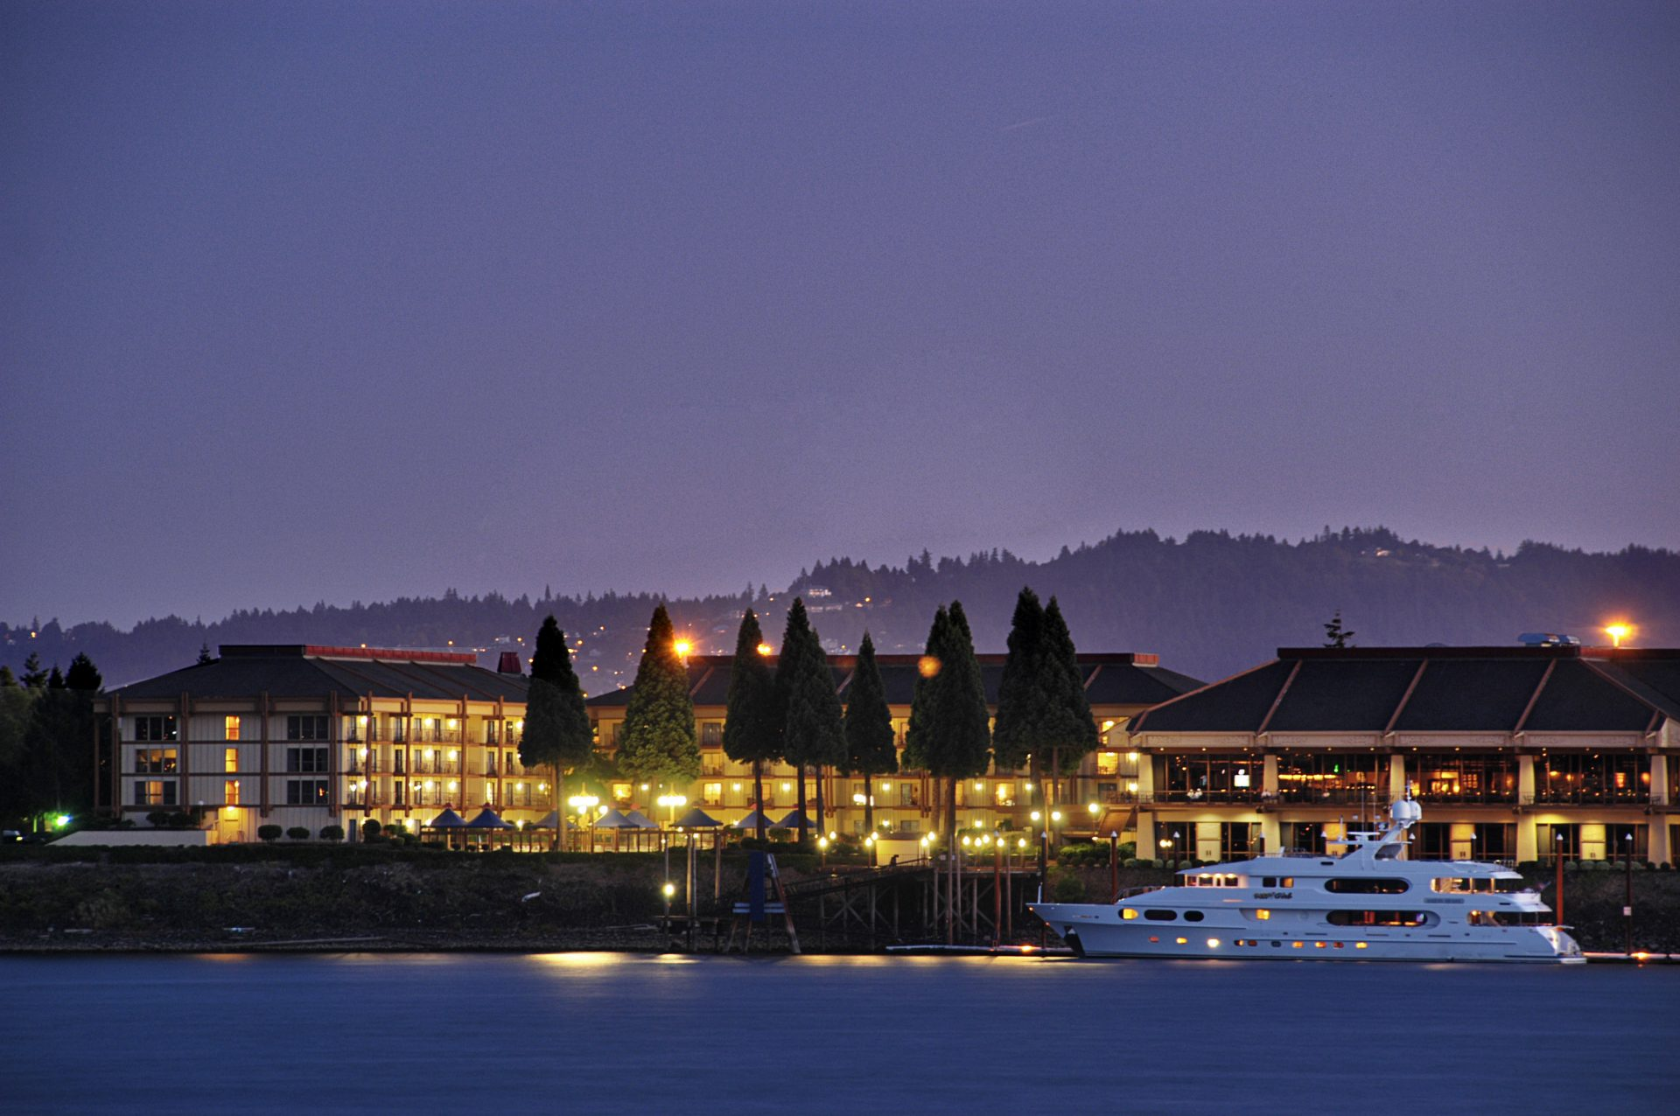
Jantzen Beach Red Lion

Slide 10
Jantzen Beach Red Lion
Host Hotel Saturday – Tuesday
320 Air Conditioned Rooms with Refrigerators and microwaves.
Columbia River Waterfront Rooms
Multiple dining locations
10% Attendee discount in on-site restaurant
Night Club and Lounge (Saturday dancing)
Hospitality Room
Espresso Bar
Quick access to I-5
Walking Distance to Jantzen Beach Mall

Slide 11
DAY 2 Sunday
Drive up the Columbia River Gorge on the Washington side and Return on the Oregon side Depart Red Lion 8 am
Bonneville Dam museum and fish ladder
WAAAM Auto/Air Museum
Hood River Brewery and Distillery tours and tastings
Pendleton Woolen Mills
Beacon Rock
Maryhill Winery
Maryhill Museum of Art
Stonehenge WWI Memorial
Mt. Hood Railway
Multnomah Falls
Vista House

Slide 12
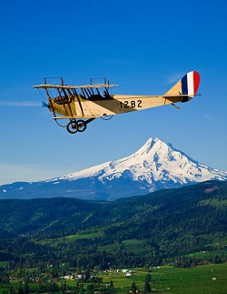
Western Air and Auto Museum

Slide 13
Day 3 Monday
Johnson Observatory – Mt. St. Helens
No fee for Golden Age Pass Holders
Depart Red Lion at 9:00 am Old Pacific Highway
Sack Lunch Provided - Cost Included in Registration
Features museum and unobstructed views of the volcano
Ilani Casino Option on Retrun
WAAAM Museum West on Return
Approximately 200 miles Round Trip
Lodging at Janzen Beach Red Lion
* An alternate route will be planned in the event of inclement weather.

Slide 14
Johnson Observatory

Slide 15
Day 4 Tuesday
Mt. Hood – Timberline Lodge
Depart Red Lion 9:00 AM
Government Camp Museum
Lunch at Timberline Lodge On Your Own
Approximately 170 Miles Roundtrip
Lodging at Jantzen Beach Red Lion

Slide 16
Timberline in Spring

Slide 17
Timberline in Winter

Slide 18
Multnomah Falls and Bonneville Dam

Slide 19
Day 5 Wednesday
Lincoln City and the Oregon Coast
Depart Jantzen Beach Red Lion - 9:am
Interstate 5 to Oregon Hwy 18.
Lunch – On Your Own
Points of Interest to be Identified
Numerous Oregon Wineries
Evergreen Air Museum and the Spruce Goose
Arrive Chinook Winds Hotel/Casino, Check-in 3pm on
Dinner on Your Own
Approximately 100 Miles

Slide 20
Evergreen Air Museum

Slide 21
Oregon Wine Country

Slide 22
Chinook Winds Hotel/Casino Host Hotel Wednesday - Thursday

Slide 23
Chinook Winds Hotel/Casino
Beach Front Hotel
243 Rooms
24/7 Casino
Five Restaurants
18 Hole Golf Course
Headline Entertainment
Pool/Spa/Sauna

Slide 24
Day 6 Thursday
Newport Oregon
Depart Chinook Winds 10 AM
Points of Interest to be Provided
Hatfield Marine Aquarium
Yaquina Head Lighthouse
Oregon Coast Aquarium
Lunch on Your Own
Return to Chinook Winds
Banquet Style Closing Dinner
Approximately 50 Miles Round Trip

Slide 25
Hatfield Marine Science Center

Slide 26
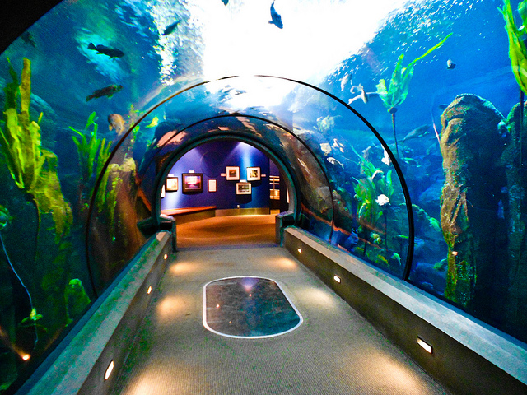
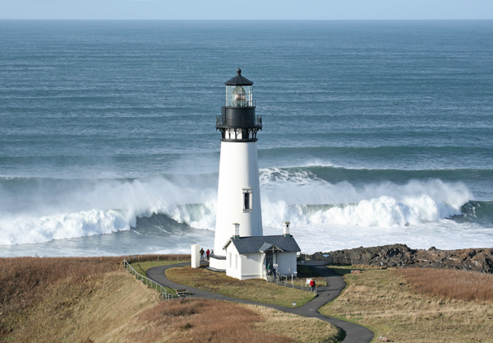
Oregon Coast Points of Interest
Hatfield Marine Science Center
Oregon Coast Aquarium
Yaquina Head Lighthouse

Slide 27
Day 7 Friday
Farewell drive to Astoria
Depart Chinook Winds at 8:00AM for Astoria
Approximately 110 mile drive
Drive Scenic Oregon Coast Highway 101
Points of interest include
Depoe Bay
Tillamook Cheese Factory
Cape Meares Lighthouse
Lodging in Astoria on your own
Alternative routes back to Portland for those departing Saturday
End of Driving Tour 2020
Notes:
Cost included in registration

Slide 28
Astoria, Oregon

