Slide 2
For Your Eyes Only
The One Dashboard Every Admin needs
Presented by Stacy O’Leary
November 14, 2019

Slide 3
Forward Looking Statement
Statement under the Private Securities Litigation Reform Act of 1995:
This presentation contains forward-looking statements about the company’s financial and operating results, which may include expected GAAP and non-GAAP financial and other operating and non-operating results, including revenue, net income, diluted earnings per share, operating cash flow growth, operating margin improvement, expected revenue growth, expected current remaining performance obligation growth, expected tax rates, the one-time accounting non-cash charge that was incurred in connection with the Salesforce.org combination; stock-based compensation expenses, amortization of purchased intangibles, shares outstanding, market growth and sustainability goals. The achievement or success of the matters covered by such forward-looking statements involves risks, uncertainties and assumptions. If any such risks or uncertainties materialize or if any of the assumptions prove incorrect, the company’s results could differ materially from the results expressed or implied by the forward-looking statements we make.
The risks and uncertainties referred to above include -- but are not limited to -- risks associated with the effect of general economic and market conditions; the impact of geopolitical events; the impact of foreign currency exchange rate and interest rate fluctuations on our results; our business strategy and our plan to build our business, including our strategy to be the leading provider of enterprise cloud computing applications and platforms; the pace of change and innovation in enterprise cloud computing services; the seasonal nature of our sales cycles; the competitive nature of the market in which we participate; our international expansion strategy; the demands on our personnel and infrastructure resulting from significant growth in our customer base and operations, including as a result of acquisitions; our service performance and security, including the resources and costs required to avoid unanticipated downtime and prevent, detect and remediate potential security breaches; the expenses associated with new data centers and third-party infrastructure providers; additional data center capacity; real estate and office facilities space; our operating results and cash flows; new services and product features, including any efforts to expand our services beyond the CRM market; our strategy of acquiring or making investments in complementary businesses, joint ventures, services, technologies and intellectual property rights; the performance and fair value of our investments in complementary businesses through our strategic investment portfolio; our ability to realize the benefits from strategic partnerships, joint ventures and investments; the impact of future gains or losses from our strategic investment portfolio, including gains or losses from overall market conditions that may affect the publicly traded companies within the company's strategic investment portfolio; our ability to execute our business plans; our ability to successfully integrate acquired businesses and technologies, including delays related to the integration of Tableau due to regulatory review by the United Kingdom Competition and Markets Authority; our ability to continue to grow unearned revenue and remaining performance obligation; our ability to protect our intellectual property rights; our ability to develop our brands; our reliance on third-party hardware, software and platform providers; our dependency on the development and maintenance of the infrastructure of the Internet; the effect of evolving domestic and foreign government regulations, including those related to the provision of services on the Internet, those related to accessing the Internet, and those addressing data privacy, cross-border data transfers and import and export controls; the valuation of our deferred tax assets and the release of related valuation allowances; the potential availability of additional tax assets in the future; the impact of new accounting pronouncements and tax laws; uncertainties affecting our ability to estimate our tax rate; the impact of expensing stock options and other equity awards; the sufficiency of our capital resources; factors related to our outstanding debt, revolving credit facility, term loan and loan associated with 50 Fremont; compliance with our debt covenants and lease obligations; current and potential litigation involving us; and the impact of climate change.
Further information on these and other factors that could affect the company’s financial results is included in the reports on Forms 10-K, 10-Q and 8-K and in other filings it makes with the Securities and Exchange Commission from time to time. These documents are available on the SEC Filings section of the Investor Information section of the company’s website at www.salesforce.com/investor.
Salesforce.com, inc. assumes no obligation and does not intend to update these forward-looking statements, except as required by law.

Slide 4
Stacy O’Leary
Owner, Sr. Admin, Consultant
Salesforce User for 11 years
Salesforce Admin for 6 years
Expert Consultant for 2.5 Years
5x Certified

Slide 5
What questions do users ask you every day?
What are the most important metrics in your org?

Slide 6
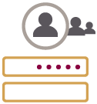
Direct Expenses
Anything that had a direct and immediate cost, either in dollars.
Usage
Ensuring that all users log in to Salesforce regularly, and identifying those that don’t.
Admin Task Tracking
Items that the Admin needs to work on, like Enhancement Requests.
Data Quality
Any data quality issues that need to be regularly reviewed or cleaned up, or trigger monitoring.

Slide 7
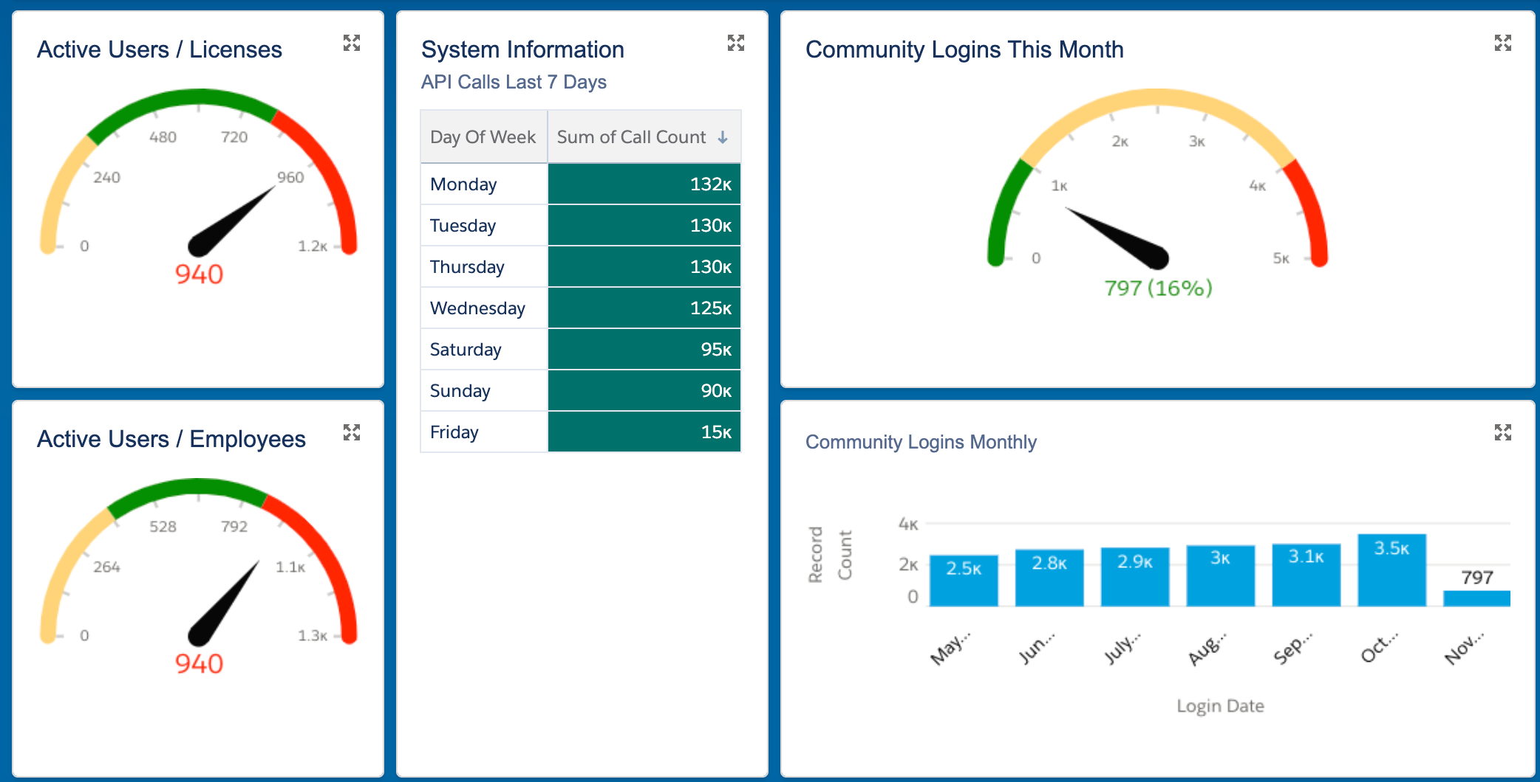
Direct Expenses

Slide 8
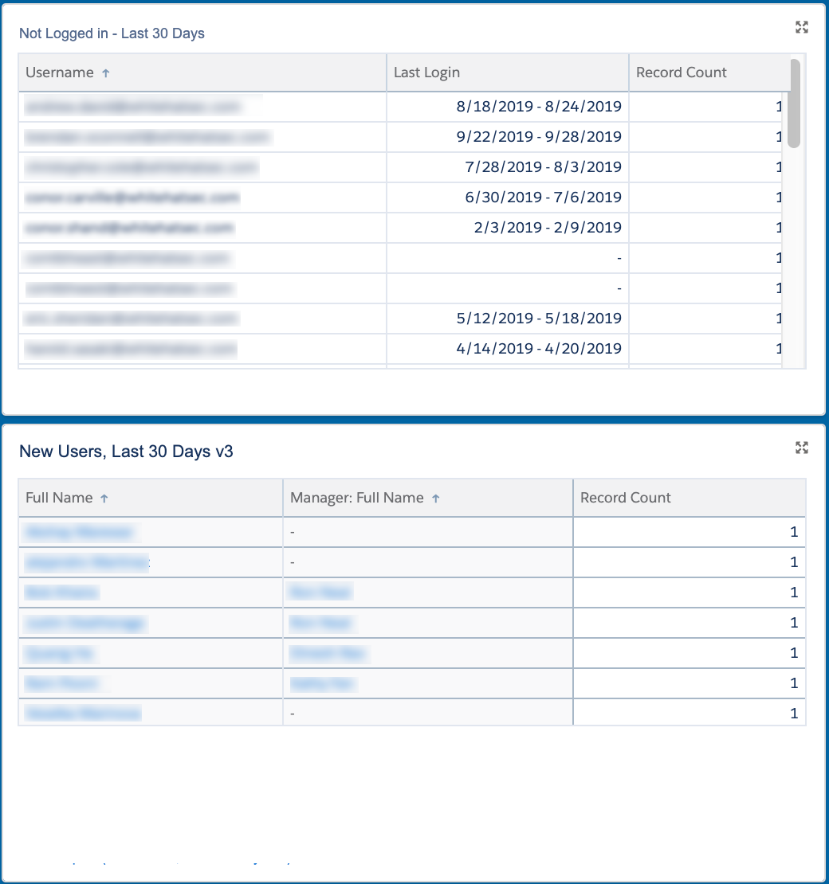
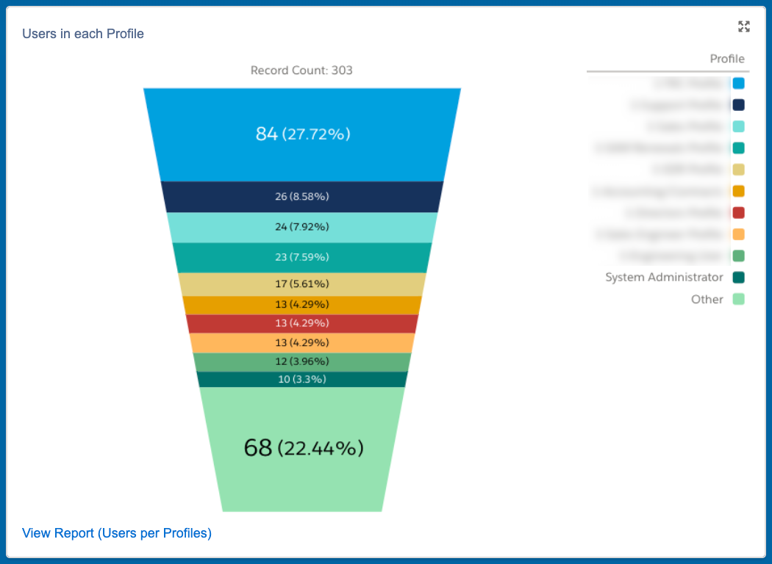
Salesforce Usage

Slide 9
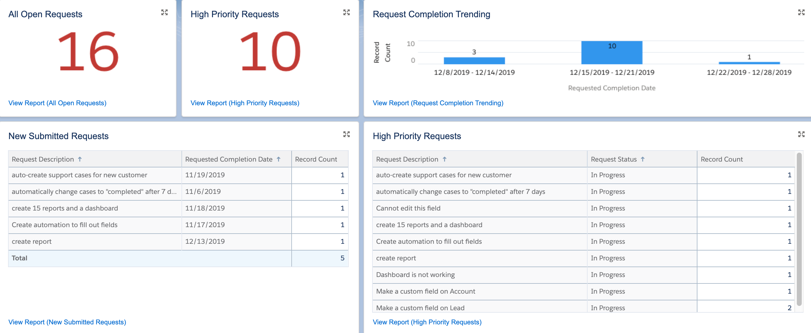
Admin Tasks

Slide 10
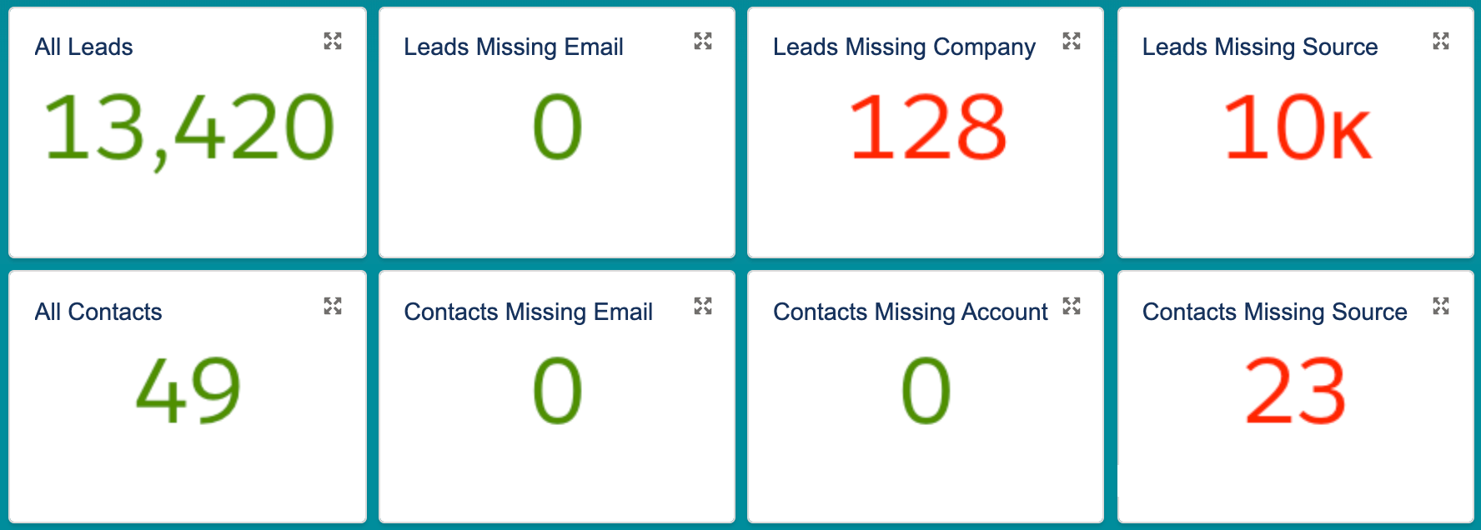
Data Quality

Slide 11
Common Components / Ideas
Current Users / Purchased Licenses
Current Users / Employees
Current Users by Location
API Usage by User
Community Member Usage
Users Not Logging In Last 7 Days
Users Not Logging In Last 30 Days
Users with least Logins
Users with most logins
Users with most API Calls
User in each Role / Profile
Newest Users in Last 30 Days
Salesforce Admin Tasks / Tickets
Salesforce Admin High Priority Tasks / Tickets
Salesforce Admin Tasks / Ticket Creation & Completion Rates
Data Quality
Leads / Contacts Missing Emails
Leads / Contacts Missing Source
Leads / Contacts Missing Company/Account
Trigger Check / Clean Up
Accounts without Opportunities
Accounts Without Contacts
Cases Missing Contacts
Report on Reports
Contacts Missing Accounts
Records with InActive Owners

Slide 12
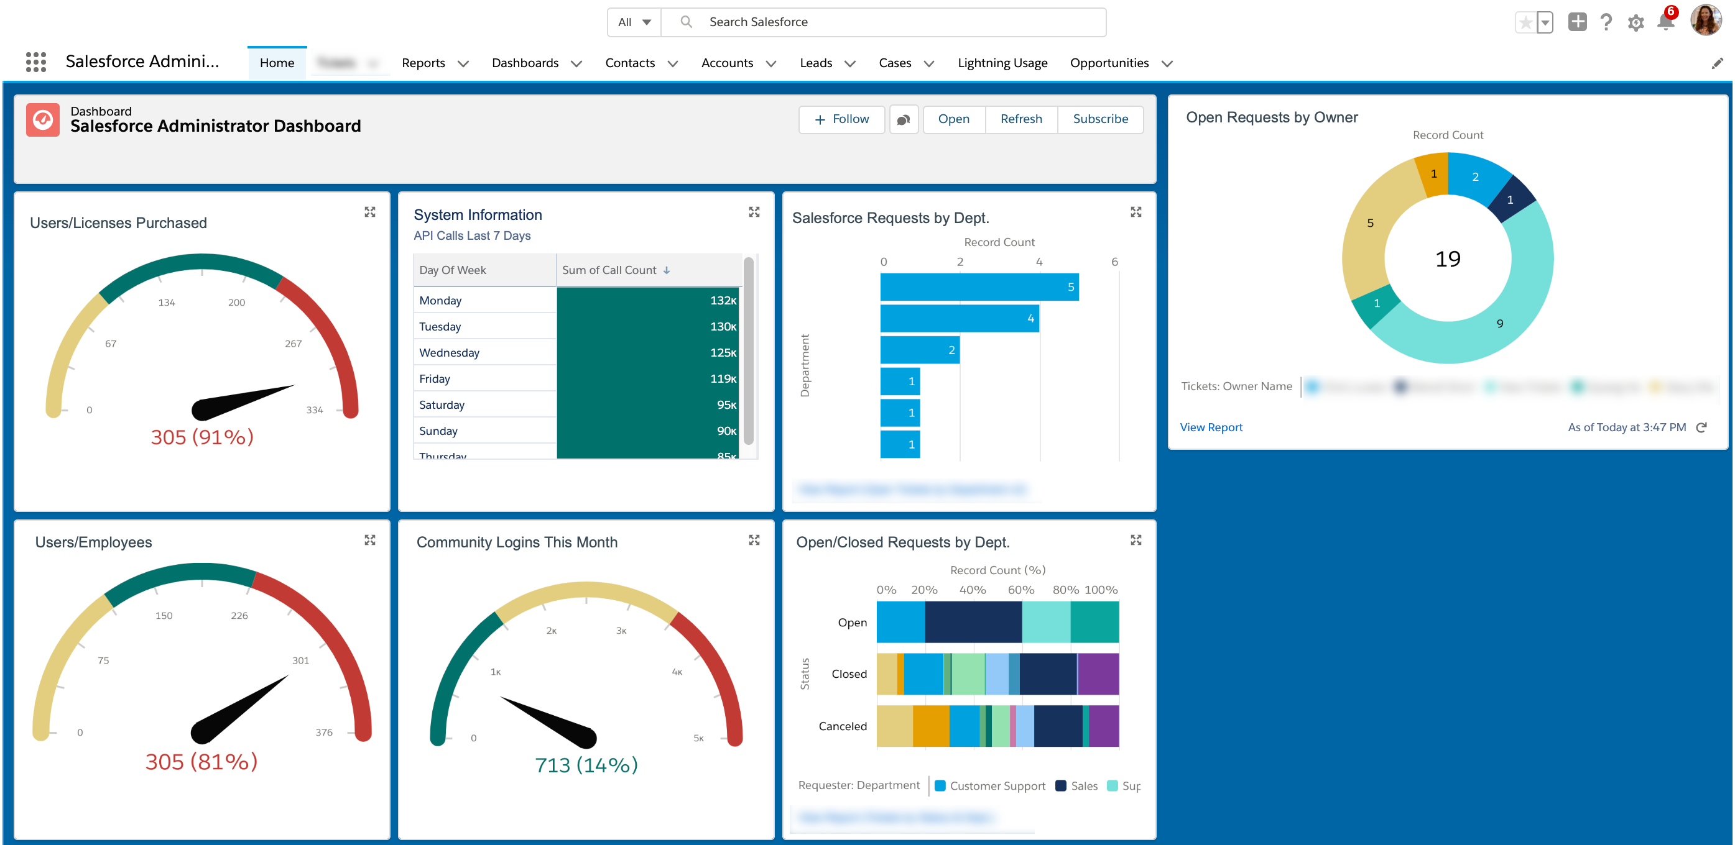
Elevate Your Dashboard

Slide 13
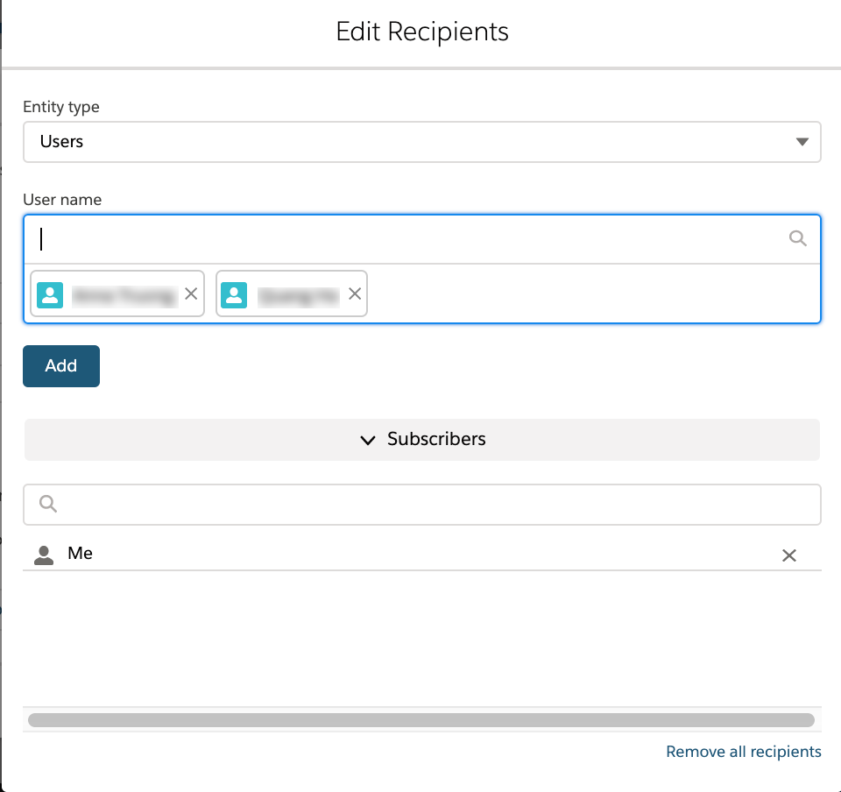
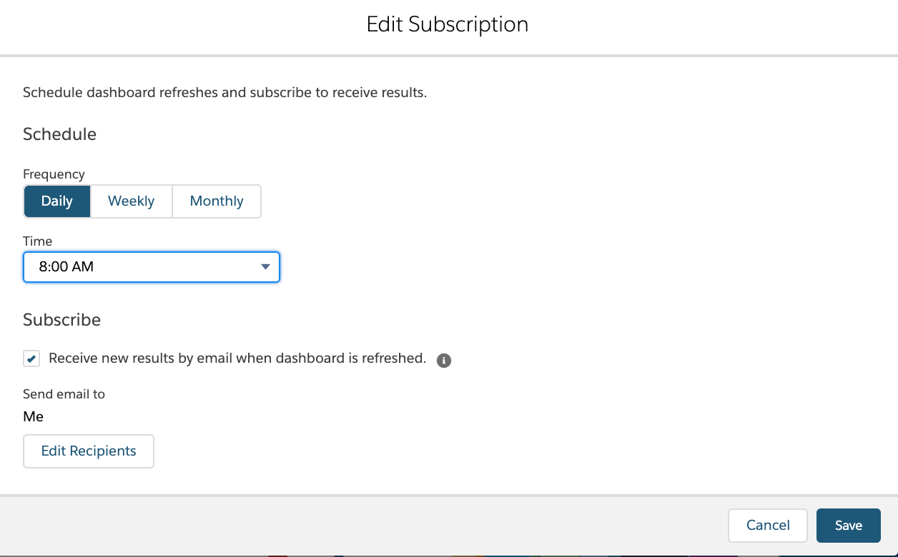
Subscribe to Your Dashboard

Slide 14
Ready to take action?
Talk to HR / Recruiting
Identify your critical data points
Build your dashboard
Run and review daily
Save money!

Slide 15
Stacy O’Leary, Quickly Consulting
stacy@quicklyconsulting.com
www.linkedin.com/in/stacy-oleary

