Slide 1
DNS Log Monitoring in a Windows Environment
Or…
Trying to prove SANS is wrong, failing and learning from it.
ACCS 2017
March 16, 2017
John York, Blue Ridge Community College
yorkj@brcc.edu

Slide 2
Slides, script snippets and sample log files
https://drive.google.com/open?id=0B5BuM

Slide 3
DNS Log Monitoring Windows Environment
Caveats and Architecture
Why maintain DNS server logs?
Executive Summary
DNS Server Debug logs and Detailed Debug logs
DNS Server Analytical Event logs, Server 2012r2 and above
PassiveDNS

Slide 4
Caveats
This was developed with a small/medium-sized Windows environment in mind. Tested on:
DNS-only server with ~1,000 clients
DNS/Domain Controller with ~300 clients
Some ideas presented here may scale, others may not
Be careful running scheduled scripts on your Windows DNS server, *especially* if it is a Domain Controller
Be careful saving logs on a DNS/DC…C:\ full is bad

Slide 5
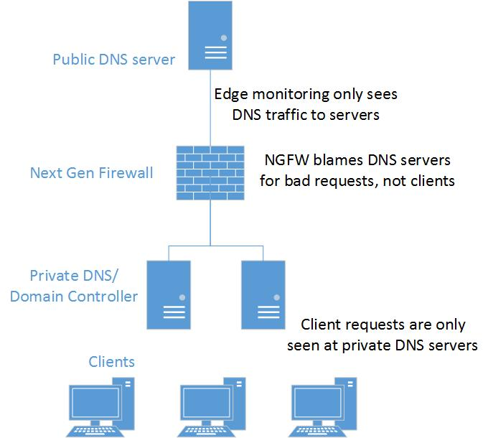
Network Architecture
Need to monitor DNS here

Slide 6
Why Maintain DNS Logs?
Identify malicious activity and identify outgoing CnC traffic
DNS logs are extremely useful for incident response and forensics
Current Next Generation Firewalls (NGFW) block on DNS—works well so small environments may just use logs for forensics
Examples:
What client caused NGFW DNS block event?
Need time, client IP, Query
Who contacted IP w.x.y.z? Who else is infected?
Need time, client IP, Query, IP Resolved by Server

Slide 7
Executive Summary
Remember caveats about running scripts and saving logs on critical servers
Windows log/debug access for Client IP, time, and Query is
SIMPLE
Windows log/debug access for Resolved IP (address returned by server) is
DIFFICULT
PowerShell is very slow if large files (like log files) get into the pipeline
Best solution is to monitor private DNS/DC traffic with an Ethernet tap or Cisco span port to a separate box.
Captures both Query and Resolved IP
Box can be small
Removes risk of taking down DNS/DC server (Résumé Generating Event (RGE))

Slide 8
Quotes
“For a while now, I've recommended moving completely away from server-specific implementations for DNS logging and moving to something closer to internal passive DNS logs. Depending on the volume of traffic, a tap feeding a system running even a very tiny logger like (wait for it) "PassiveDNS"[1] gives you normalized, easy-to-parse text logs of each DNS query and response. I like this utility because it also runs against a pcap file. This particular passive DNS logging implementation also uses a BPF via libpcap to reduce data to just port 53, so it's quite efficient, even at high volumes.”
Phil Hagen, Author, SANS Network Forensics
[1] https://github.com/gamelinux/passivedns
“Personally, I think most orgs would be better off using PassiveDNS or similar, if only to avoid the performance impact on the DNS server, especially when that DNS server is also a domain controller.”
Jason Fossen, Author, SANS Securing Windows and PowerShell Automation

Slide 9
Into the Weeds—Trying to prove SANS wrong…
My goal was to build a Windows DNS logging infrastructure
Use only tools built in to Windows
Results: It sort of works, resolved IP is still in work
Windows DNS logs get large in a hurry, process slowly
We’ll go through the options with logging on the Windows server, but will show that SANS is probably right

Slide 10
Side Note: Powershell and Large log files
The “PowerShell Way” is to use the pipeline
Get-Content “C:\users\me\file.log” | { do stuff }
Large files in the pipeline use lots of CPU time and lots of Memory
The .Net StreamReader and StreamWriter functions are much faster
Example: Parsing a 370 MB DNS debug file (28% CPU utilization) took:
Pipeline 1 hour 39 minutes, 4 GB RAM (max’d out)
Stream 39 seconds, 20 MB RAM
The initial parsing cuts the file by 90%
Using the pipeline after initial parsing works well

Slide 11
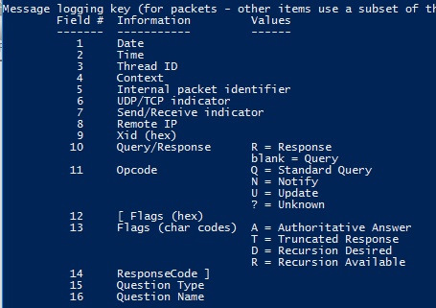
DNS Server Debug files (Legacy)
Available since Server 2003, probably longer. Note that the resolved IP address is NOT available

Slide 12
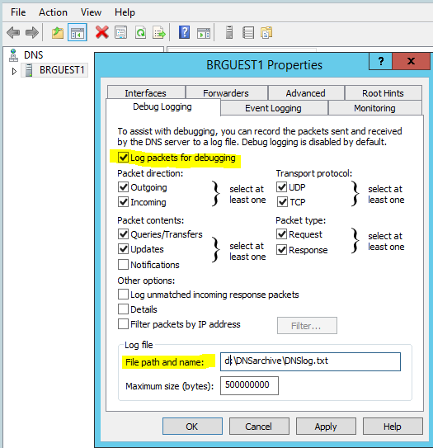
Configuring DNS Debug
Properties of DNS management console
Debug Logging tab
Select “Log packets for debugging”
Enter file path and name for logs
Somewhere other than C:\ is wise!!

Slide 13
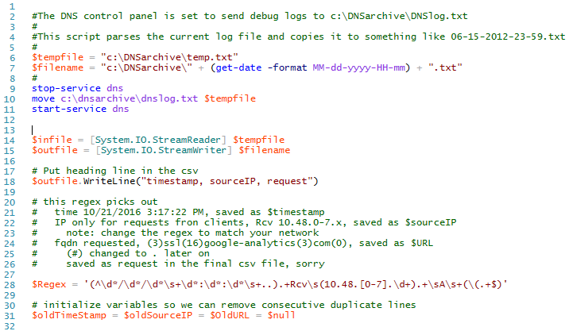
DNS Debug Parsing script (1)
Stops DNS service, copies log file
Starts DNS service. This starts a new debug log file
Done during nightly maintenance window
Be careful! What if the DNS service does not start again? Remember caveats and SANS recommendations!
Uses StreamReader/Writer
Regex looks only for queries received from client addresses, A records only
Regex saves date-time stamp, client IP address and query

Slide 14
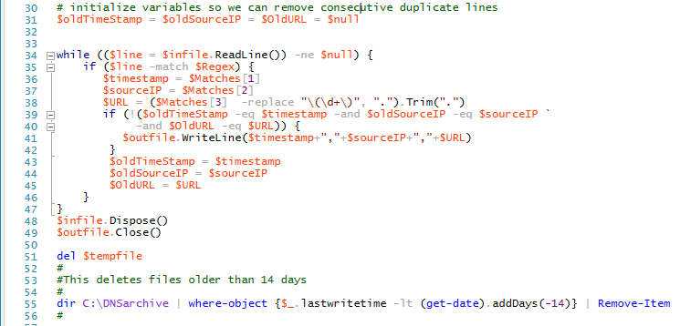
DNS Debug Parsing script (2)
Old fashioned read line and loop
Very simple duplicate check to reduce output file size
Write each line as it is parsed
Old fashioned file closing
Clean up old files

Slide 15
DNS Debug notes
Stop/Start DNS service starts new log file
Remember caveats
With ~1000 clients, DNS server but not Domain Controller
Debug log is roughly 300-500+ MB for 24 hours
Will quickly fill up a drive, remember caveats
After parsing for only DNS A requests from clients, reduces to ~60 MB per day
Works, but does not return the resolved IP address

Slide 16
DNS Detailed Debug Logs (Legacy)
Only available Microsoft log that directly returns the resolved IP address (the answer to the DNS query)
Logs get huge in a hurry, can get to GB+ size in 24 hours
Logs have multiple lines per event, parsing is more difficult
Responses may contain multiple types and addresses, often:
CNAME www.college.edu -> g45604065stuff.useast.amazonaws.com
A 192.168.5.1, with many addresses
More difficult to store
I wrote a script for this, but am reluctant to use it in a production environment (available at )

Slide 17
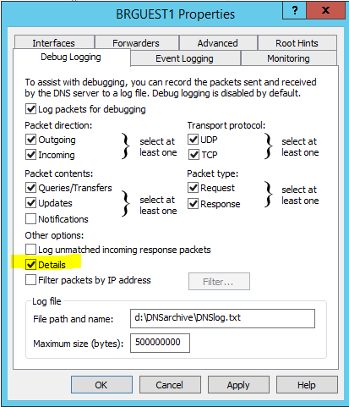
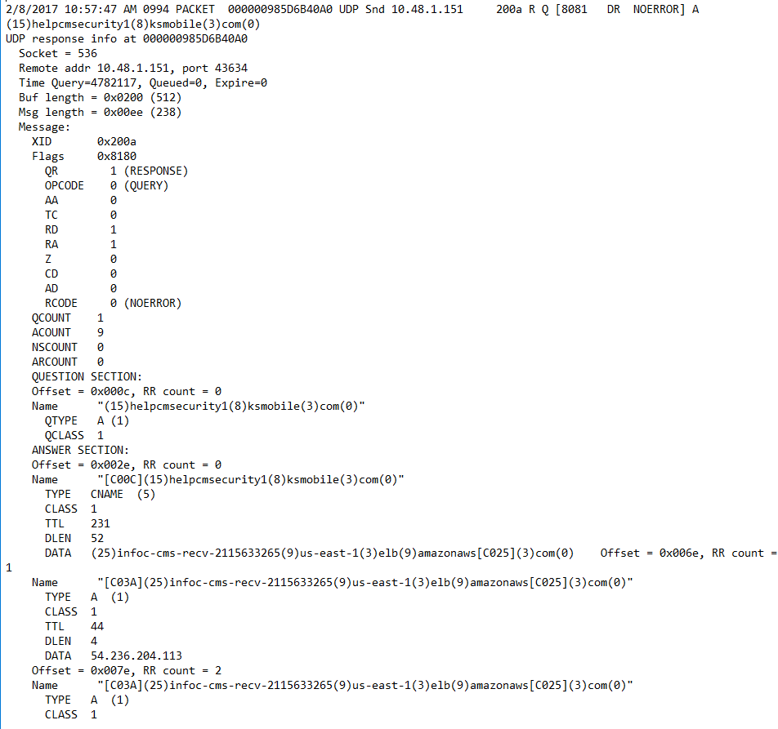
DNS Detailed Debug log configuration—if you must

Slide 18
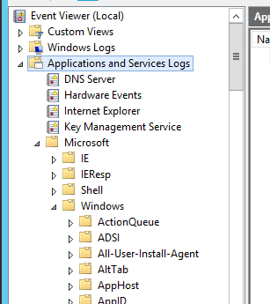
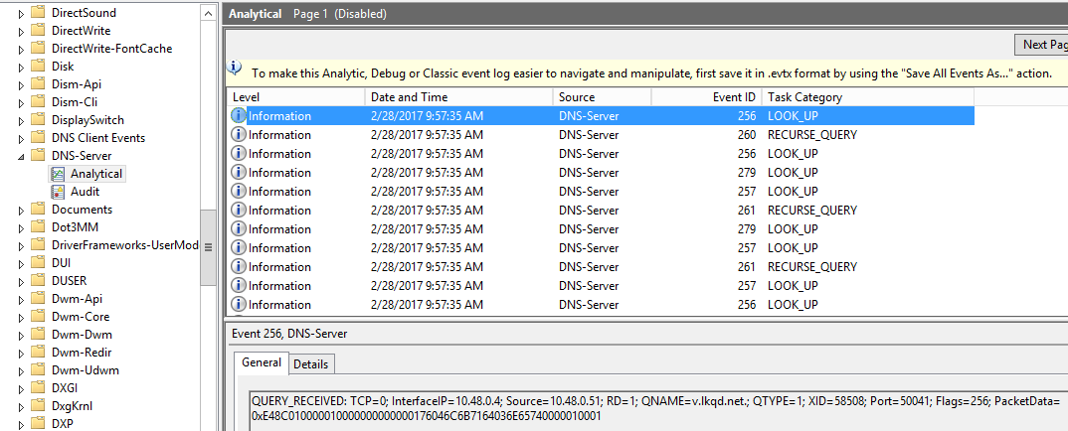
Event log: DNS Server analytical log
New in Server 2012r2 (patched) and Server 2016
Designed for low impact on the server
“DNS server running on modern hardware that is receiving 100,000 queries per second (QPS) can experience a performance degradation of 5% when analytic logs are enabled. There is no apparent performance impact for query rates of 50,000 QPS and lower.”

Slide 19
DNS-Server Analytical Logs, but…
Includes resolved IP address, but it is given as raw packet data!!

Slide 20
DNS-Server Analytical Logs, but…(2)
Log is big…DNS/DC serving 300 hosts, > 1 GB per day
Windows Event Collection (WEC) is a recent feature that allows forwarding of events to a collecting server
But, ‘Analytic’ logs are not included, to reduce impact
“tracelog [...] will record events offered by the ETW channel and write them to a file”
But, you need to install “WDK, Visual Studio, and the Windows SDK for desktop apps”
PowerShell Get-WinEvent cmdlet works
But, it is *really* slow with large files

Slide 21
wevtutil.exe works (1)
wevtutil.exe can read Analytical log or .etl files it creates, and is already installed on Windows Servers
Works best if run on the computer that holds the logs
This is true for Get-WinEvent and most other methods
Otherwise the app won’t interpret the file correctly
May be ok if server versions are same and both have DNS installed
Can convert logs to evtx (export-log), text or xml (query) format

Slide 22
wevtutil.exe works (2)
Queries run slowly, takes much RAM if run from PowerShell (cmd.exe is ok for RAM)
Resolved IP is still stuck in packet data ☹
I’m still testing, haven’t gone to production yet!!
Lots of slides with wevtutil examples here—I found syntax and documentation difficult, lots of trial and error.

Slide 23
wevtutil Log, Method 1
Stop logging, move log to workspace, restart logging
wevtutil sl "Microsoft-Windows-DNSServer/Analytical" /e:false
move C:\Windows\System32\winevt\Logs\Microsoft-Windows-DNSServer%4Analytical.etl D:\DNSarchive
echo ‘Y’ | wevtutil sl "Microsoft-Windows-DNSServer/Analytical" /e:true
(run this in PowerShell to answer “do you want to do this?”)
Read log file, create text file of DNS query (256) and response (257) events
wevtutil qe /lf D:\DNSarchive\Microsoft-Windows-DNSServer%4Analytical.etl /q:"*[System[(EventID=256 or EventID=257)]]" /f:txt > wev-test1.txt
(do this from cmd.exe, I’ve seen PowerShell take > 10 GB RAM)

Slide 24
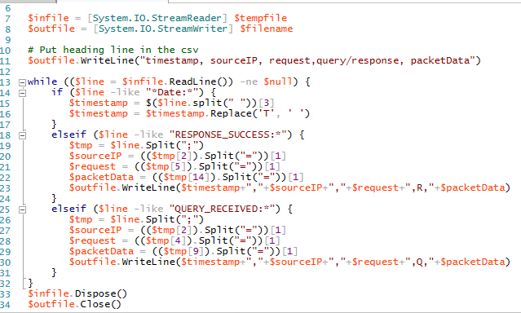
Wevtutil Log method 1 (2)
Parse text file on a separate server

Slide 25
Wevtutil Method 2
Run wevtutil query on DNS server, save output on other server
wevtutil qe “Microsoft-Windows-DNSServer/Analytical” /q:"*[System[(EventID=256 or EventID=257)]]" /f:text > //server/share/dnslog.txt
Run from cmd.exe…speed is same as PowerShell, RAM use is minimal
Then reset log
Wevtutil cl “DNSarchive\Microsoft-Windows-DNSServer/Analytical”
Parse text output on a separate server, code from Method 1

Slide 26
Wevtutil Method 3
Export logs to separate server, query to extract logs, and parse on separate server
wevtutil epl “Microsoft-Windows-DNSServer/Analytical” \\server\share\dnslog.evtx
Creates .evtx file
Query .evtx file on separate server
wevtutil qe /lf D:\dnslog.evtx /q:"*[System[(EventID=256 or EventID=257)]]" /f:txt > wev-test1.txt
Best for DNS/DC server impact, but may lose fields unless Server versions same and DNS installed
Export and query active logs on DNS server, output to separate server
wevtutil epl “Microsoft-Windows-DNSServer/Analytical” /q:"*[System[(EventID=256 or EventID=257)]]" \\server\share\dnslog.evtx
Higher impact, no missing fields
Still query .evtx on separate server to generate text file
wevtutil qe /lf D:\dnslog.evtx /f:txt > wev-test1.txt

Slide 27
Analytic Log Notes
Logging is designed for low server impact (better than debug logs?)
Analytic logs are big, > 1 GB per day for a medium/small server
Getting logs off of DNS server is harder than debug logs
Some fields missing if wevtutil query on another server
May work if DNS server installed on the other server, same server version
Response to DNS query (IP address returned) still hidden in packet data
Scapy can recover IP address
PassiveDNS and DNStap have code, can we steal it?
PassiveDNS is easier, less risky

Slide 28
Passivedns
Still in testing phase
Requires Ethernet Tap, Cisco span port, or similar
Can be installed on simple PC
One Ethernet NIC for management, one for sniffing
Installed on Ubuntu Linux, so requires some Linux familiarity
Has files for MySQL connection
More difficult that vanilla installation
Unneeded if your goal is to generate files for a SIEM

Slide 29
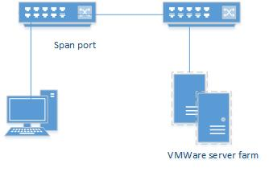
Passivedns network test
Current test unit monitors entire output of small VMWare server farm
Average 200-300 Mbps, seems to keep up ok

Slide 30
Passivedns Notes
Log file output easy to parse for SIEM, sample:
Timestamp ||dns-client ||dns-server ||RR class
||Query ||Query Type||Answer||TTL||Count
1489616974.706411||192.168.21.205||192.168.20.33||IN
||bam-436893209.us-east-1.elb.amazonaws.com.||A||34.200.173.240||60||1
Log contains all necessary information, time, client, query, and answer (resolved IP)
Management could be difficult
Medium size campus could require several PassiveDNS installations

Slide 31
Summary
DNS Analytical logs may be workable, but more work required
Confirm no data lost if logs processed on a separate server
(Same server version and DNS installation required)
Must parse pcap data for DNS resolved IP and CNAMES
PassiveDNS or equivalent workable
May require multiple installations
Appears to be able to monitor large traffic volumes

Slide 32
References
General DNS logging
http://www.networkstr.com/dnscentric/identify_threats_with_dns_logging
https://pen-testing.sans.org/blog/2015/07/10/dns-anomaly-analysis-tips-did-you-put-a-new-cover-sheet-on-that-ddd-report
https://itworldjd.wordpress.com/2016/12/01/dns-logging-and-auditing/
https://isc.sans.edu/suspicious_domains.html
https://zeltser.com/malicious-ip-blocklists/
Primary DNS Analytical log reference
https://technet.microsoft.com/en-us/library/dn800669(v=ws.11).aspx
Large DNS Analytical log installation (uses tracelog.exe)
https://blogs.technet.microsoft.com/teamdhcp/2015/11/23/network-forensics-with-windows-dns-analytical-logging/
DNS debug log concerns
https://www.solutionary.com/resource-center/blog/2016/01/dns-logging/

Slide 33
References (2)
wevtutil.exe
https://technet.microsoft.com/en-us/library/cc732848(v=ws.11).aspx
https://deploywindows.info/2013/01/08/event-viewer-how-to-manage-with-commands-wevtutil-exe/
https://www.petri.com/command-line-event-log
https://www.petri.com/managing-command-line-event-logs
http://adminontherun.blogspot.com/2010/07/wevtutil-my-new-favorite-toy.html
https://blogs.technet.microsoft.com/askds/2011/09/26/advanced-xml-filtering-in-the-windows-event-viewer/
tracelog.exe
https://msdn.microsoft.com/windows/hardware/drivers/devtest/tracelog-command-syntax
PowerShell speed issues
http://www.happysysadm.com/2014/10/reading-large-text-files-with-powershell.html

Slide 34
References (3)
PowerShell speed issues (cont.)
https://powershell.org/2013/10/21/why-get-content-aint-yer-friend/
https://learn-powershell.net/2013/01/13/quick-hits-speed-up-some-of-your-commands-by-avoiding-the-pipeline/
https://foxdeploy.com/2016/03/23/coding-for-speed/
https://rkeithhill.wordpress.com/2008/03/02/nothings-perfect-including-powershell/
https://thesurlyadmin.com/2015/06/01/read-text-files-faster-than-get-content/
PassiveDNS
https://github.com/gamelinux/passivedns
DNStap
http://dnstap.info/

