Slide 1
Media Overview
May 2020

Slide 2
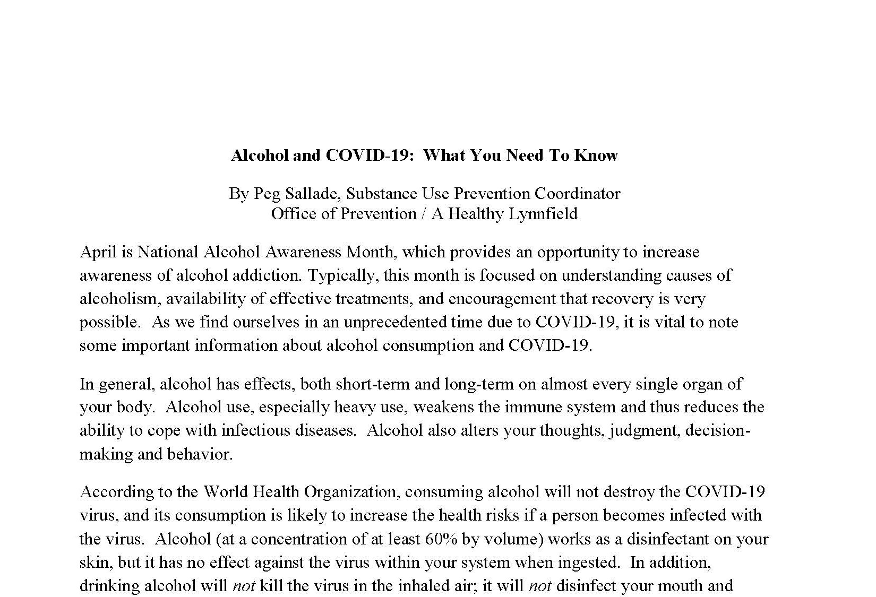
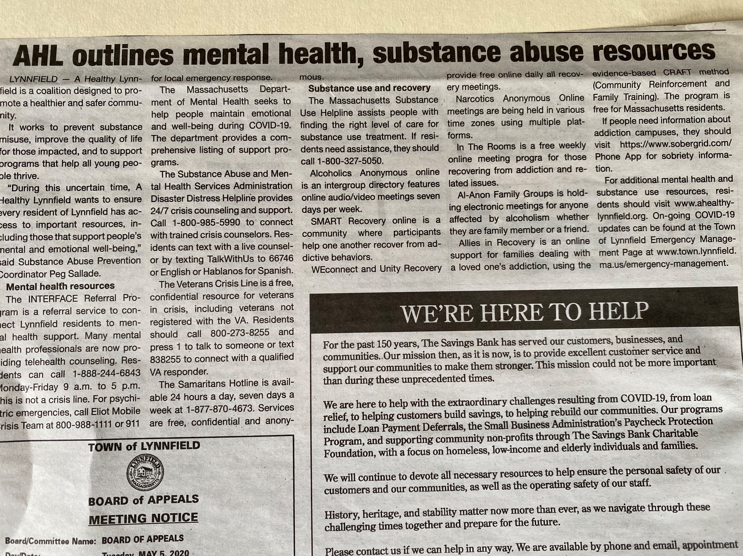
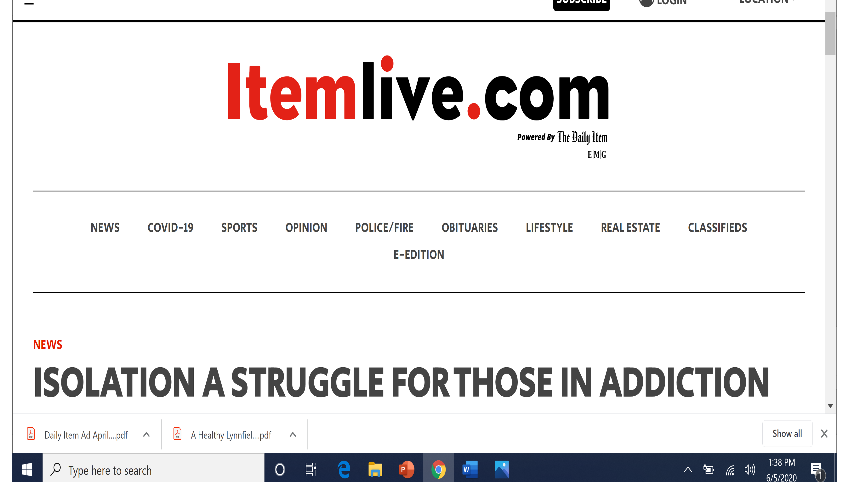
April-Initial Press: COVID Response

Slide 3

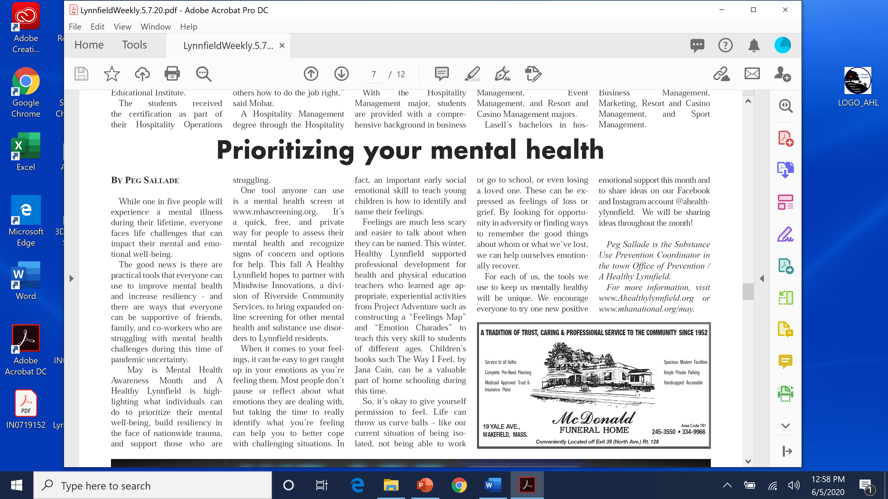
Week 1: Prioritizing Your Mental Health & MH Screening Tools

Slide 4
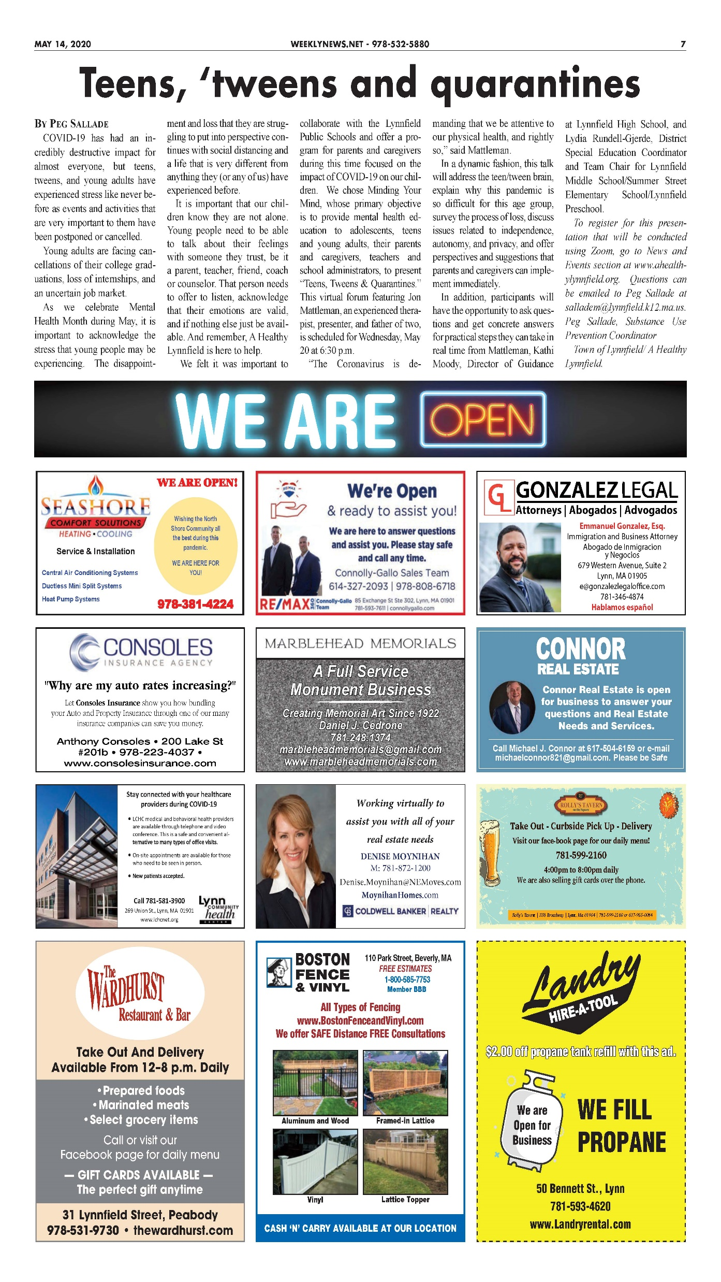
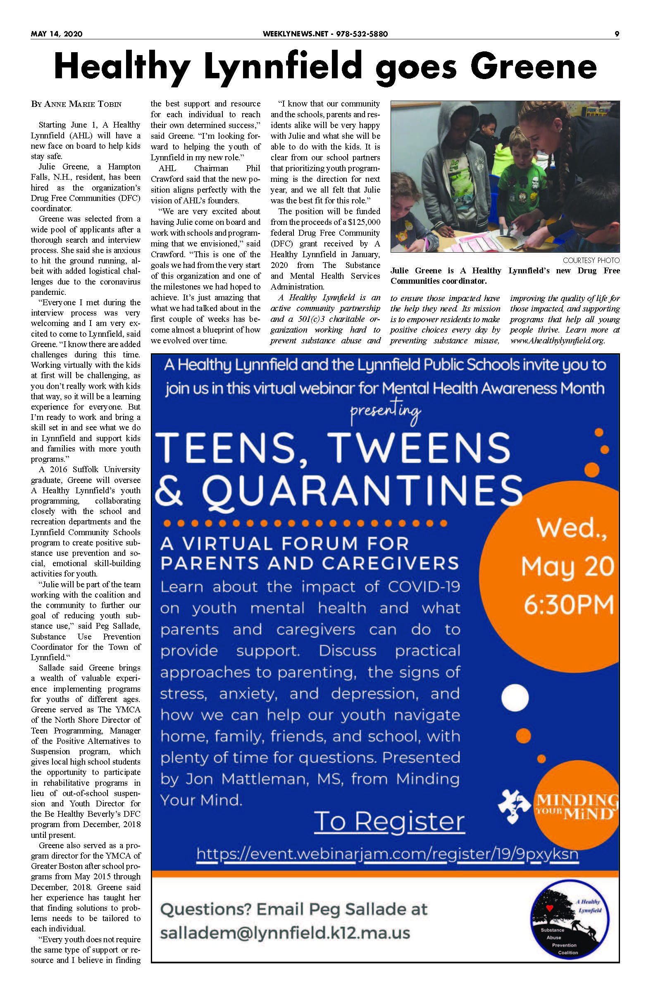

Slide 5


Week 3: Promotion of Interface

Slide 6
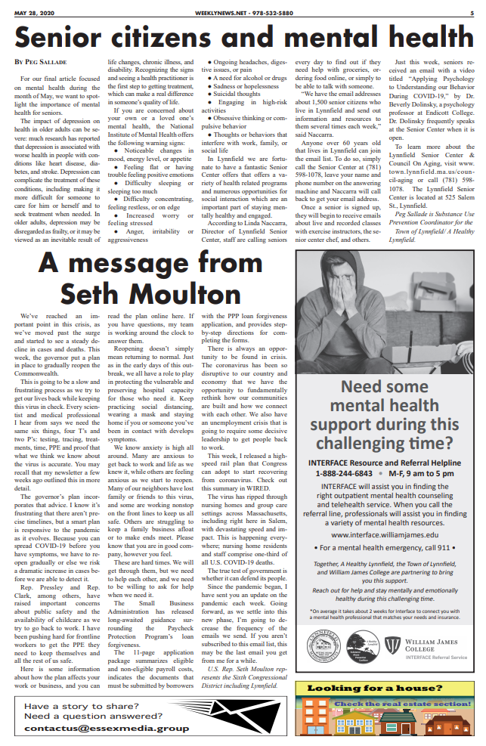
Week 4: Seniors & Mental Health

Slide 7
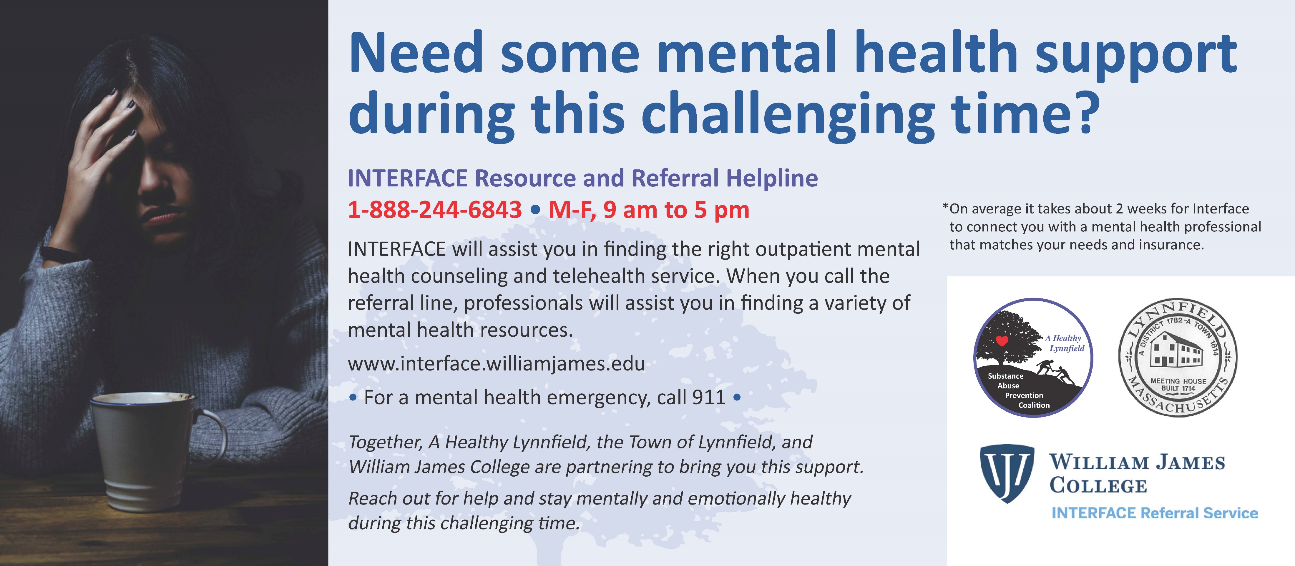
Buck Slips to All Lynnfield Residents This June

Slide 8

Coming Soon…Grad Ad and “Keeping Celebrations Safe”

