Slide 1
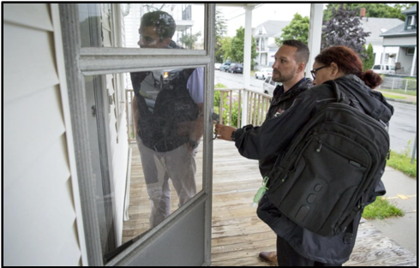
Post-Overdose Engagement Initiatives
Scott Formica, PhD
Senior Research Scientist
Social Science Research and Evaluation, Inc.
Presented to: A Healthy Lynnfield Coalition
March 8, 2021
Disclosures: Content in this presentation was supported by the Massachusetts Department of Public Health’s (MDPH) Bureau of Substance Addiction Services (BSAS) as part of the Substance Abuse and Mental Health Services (SAMHSA) State Targeted Response to Opioids (STR) and State Opioid Response (SOR) grants and by the National Institute of Health’s (NIH) National Center for Injury Prevention and Control (NCIPC) within the Centers for Disease Control and Prevention (CDC) under Research Project (R01) Number (CE003052; PI: Walley).
Opinions expressed are those of the presenter and do not necessarily reflect those of the funding sources.

Slide 2
ISSUE: Preliminary Data Show 2,023 Confirmed and Estimated
Opioid-Related Overdose Deaths in Massachusetts in 2019
Approximately 2,000 deaths per year since 2016
Estimated 2,031 deaths
Estimated 2,023 deaths
Source: Massachusetts Department of Public Health (MDPH). https://www.mass.gov/lists/current-opioid-statistics

Slide 3
The Rate of Opioid-Related Overdose Deaths Per 100,000 Stabilized in 2019
Compared with 2018 and Decreased an Estimated 5% since 2016
Impact of COVID is still emerging
Source: Massachusetts Department of Public Health (MDPH). https://www.mass.gov/lists/current-opioid-statistics

Slide 4
The Trajectory of the Opioid Epidemic May Have Been Far Worse
Substantial local, state, and federal investments in public health prevention, treatment, and recovery infrastructure likely contributed to flattening of the curve
May 2017: MDPH receives STR grant
Oct 2018: MDPH receives SOR grant
Source: Massachusetts Department of Public Health (MDPH). https://www.mass.gov/lists/current-opioid-statistics

Slide 5
Fentanyl Remains a Key Factor in Opioid-Related Overdose Deaths
Wave 1 (1990s – Rx drugs) Wave 2 (2010s – Heroin)
Wave 3 (2013 – Fentanyl) Wave 4 (2019 – Stimulants)
93%
45%
Source: Massachusetts Department of Public Health (MDPH). https://www.mass.gov/lists/current-opioid-statistics

Slide 6
Rationale for Targeted Interventions with People who have Survived an Overdose
The best predictor of an overdose is a prior non-fatal overdose
Source: Massachusetts Department of Public Health (MDPH). Data Brief: An assessment of opioid-related overdoses in Massachusetts 2011-2015. https://www.mass.gov/service-details/chapter-55-overdose-report

Slide 7
General
Post-Overdose Approaches

Slide 8



Opportunities for Targeted Intervention
 | Before OD Event (Community) | During OD Event (On-Scene) | After OD Event (Hospital) | After OD Event (Community)
People | PWUD Social network members | Social network members | OD Survivors Social network members | OD Survivors Social network members
Services | Check-ins with at-risk individuals Naloxone kits Prevention/Referral Risk, Recognition, and Response | On-scene response Prevention/Referral Risk, Recognition, and Response Naloxone kits | Contact with Recovery Coach or Health Promotion Advocate Prevention/Referral Naloxone kits Initiation of MAT | Phone/text follow-up Follow-up at home or location of overdose
Providers | Harm Reduction Public Health Public Safety Clinicians | Public Safety Clinicians | ED Staff Recovery Staff Clinicians | Harm Reduction Public Health Public Safety Clinicians Recovery Inter-Faith
Adapted from: Bagley, S.M., Schoenberger, S.F., Waye, K.M., Walley, A.Y., (2019). A scoping review of post opioid-overdose interventions. Preventive Medicine 128, 105813.

Slide 9
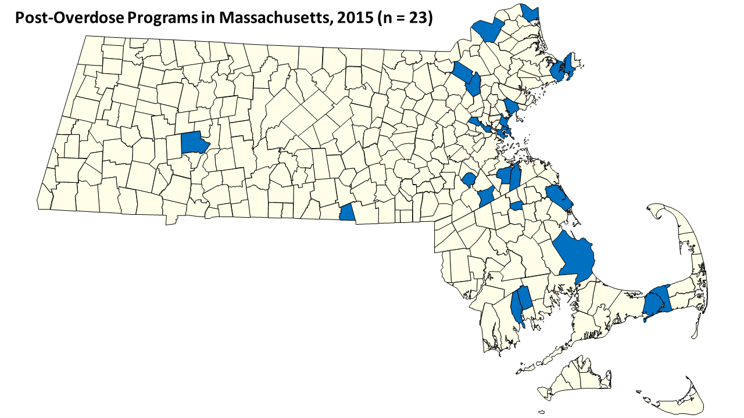
Massachusetts Communities Were Early Adopters of Post-Overdose Approaches
Dec. 2015: Statewide environmental scan for
post-overdose programs (N = 23)
Programs Represented Four Distinct Models
Public Health – Public Safety Home Visit (n=8)
Public Safety Home Visit with Referrals (n=5)
Embedded Clinician Follow-Up (n=4)
Public Safety Drop-In Center (n=2)
Why Here?
Many of these communities received earlier funding for: (1) take-home naloxone, (2) training/equipping first responders with naloxone, and (3) community-based OD prevention coalitions.
Oct. 2017: MDPH issues funding for selected OEND sites to implement the public health/public safety model.
Adapted From: Formica., S.W., Apsler, R., Wilkins, L., Ruiz, S., Reilly, B., & Walley, AY. (2018). Post Opioid Overdose Outreach by Public Health and Public Safety Agencies: Exploration of emerging programs in Massachusetts. International Journal of Drug Policy, 54, 43-50.

Slide 10
What Did We Learn From The Initial Study?
Barriers
Stigma (both in the community and within municipal departments)
Sustainability (heavily reliant on short-term external funding and grants)
Facilitators
Partnerships and networking
Finding the right staff
Communication with community
High-level support from leaders and public safety unions
Concerns
Data privacy and unintended consequences
Misuse of data
Fear of police involvement
Potential Positive Effects
Reach unknown individuals
Home is the most common site of OD
Engagement with family and network
May increase calls to 911
Another tool for first responders
Adapted From: Formica, S.W., Apsler, R., Wilkins, L., Ruiz, S., Reilly, B., & Walley, A.Y. (2017). Post Opioid Overdose Outreach and Follow-Up Services by Public Health and Public Safety Partnerships: An Examination of Knock and Talk and Referral Programs in Massachusetts. Paper presented at the 25th Annual Meeting of the Society for Prevention Research. Washington, DC. June 2017.

Slide 11
MDPH
Post-Overdose Support Team (POST) Program

Slide 12
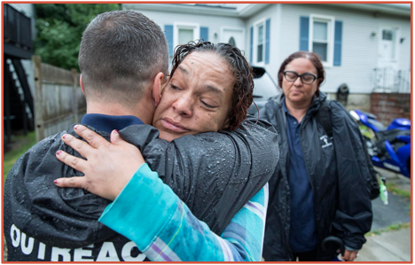
About POST
Post Overdose Support Teams (POST)
Teams are made up of a public safety representative and a staff member from a local harm reduction program.
Public safety is notified when an overdose occurs and shares the incident information with team members.
POST follows-up with the survivor, their family, or social networks to offer support and services such as access to treatment and support programs, overdose prevention training, naloxone kits, and other harm reduction materials

Slide 13
What is the goal of POST?
STATEWIDE
Program Objectives
Reduce risk of subsequent overdose
Improve general health among people who have experienced an overdose
Connect people to services
Save lives!
LOCAL
Team Goals
Engage survivors and family members
Provide local resources, harm reduction materials, referrals
Help survivors to access treatment if/when they want it
Reduce chance of subsequent overdose

Slide 14

Harm Reduction Approach
Evidence-based model which focuses on prevention of harm rather than prevention of behavior (Motivational Interviewing, OEND, etc.)
Engages people by meeting them where they’re at (Prochaska & DiClemente)
Recognizes that change isn’t linear
Abstinence may be the goal for some, but not all
Building trusting relationships with people is key to keeping them engaged in services
Non-judgemental and celebrates any positive change!

Slide 15
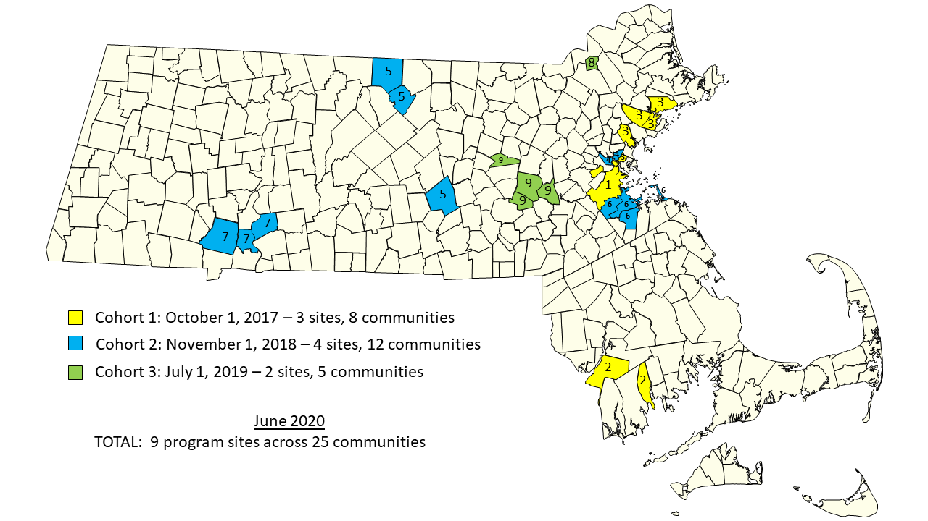
MDPH Post Overdose Support Teams (POST)
9 Agencies Operating in 25 Municipalities

Slide 16




MDPH Post Overdose Support Teams (POST)
Team Characteristics
Average team size 2–4 individuals per community.
  Harm reduction is the lead on all teams (25)
  Police are the public safety partner on 20 teams
  Fire is the public safety partner on 5 teams
  Other team members include public health nurses (4), recovery coaches (3), members of the interfaith community (2), and town social workers.
Notes:
SCOTT
The goals of POST are to:
• Reduce the risk of subsequent overdose and improve general health and well-being among individuals who recently experienced a non-fatal overdose
• Engage with overdose survivors and their family members using an outreach approach grounded in the principles of harm reduction
• Provide local resources, harm reduction materials, and referrals to services
• Help survivors to access treatment if/when they want it
Have directly or indirectly engaged 2,000 overdose survivors since October 2017 (~ 55% of those they attempted to reach)
• Social network members were present in 67% of the cases.
• 44% of outreach attempts are successful - 8,000 attempts to date.
• 73% were one-time engagements.

Slide 17
PRONTO Study

Slide 18

PRONTO Study
CDC R01 study called PRONTO (R01 CE003052)
(Principal Investigator: A. Walley)
Aim 1 (S. Formica)
Identify and describe all post-overdose outreach programs in Massachusetts.
Aim 2 (J. Carroll)
Conduct interviews with public health, public safety, and overdose survivors.
Aim 3: (Z. Xuan)
Interrupted time series analysis comparing communities with and without programs.
Aim 4 (T. Green)
Delphi panel to identify best practices.

Slide 19
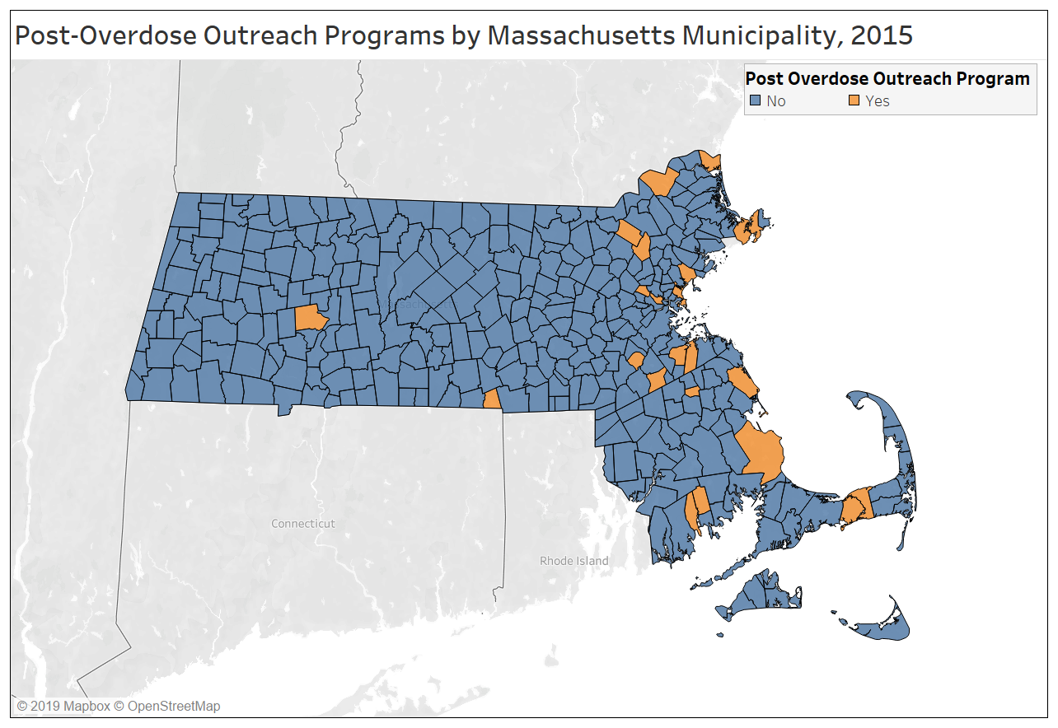
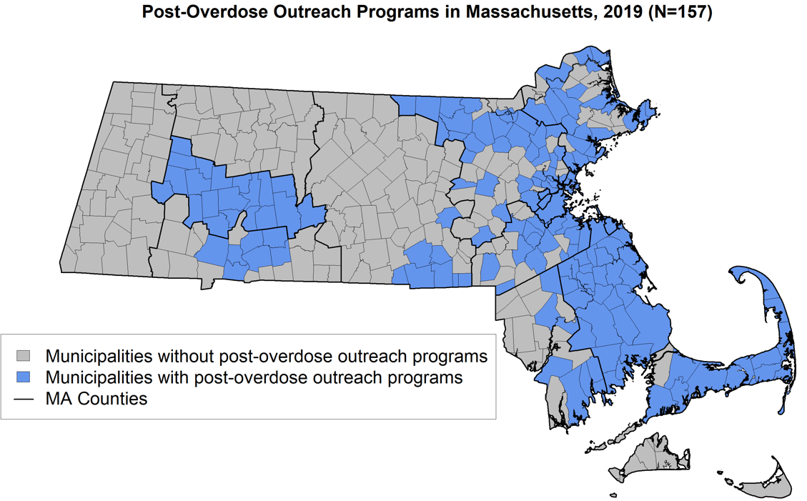
Rapid Expansion of Post-Overdose Models
75% of programs formed between 2016-2019
Status in 2015
23 Programs
7% of municipalities
Status in July 2019
157 Programs
44% of municipalities
Formica, S.W., Waye, K.M., Benintendi, A.O., Yan, S., Bagley, S.M., Beletsky, L., Carroll, J.J., Xuan, Z., Rosenbloom, D., Apsler, R., Green, T.C., Hunter, A., Walley, A.Y., (2021). Characteristics of post-overdose public health-public safety outreach in Massachusetts. Drug and Alcohol Dependence, 108499.

Slide 20
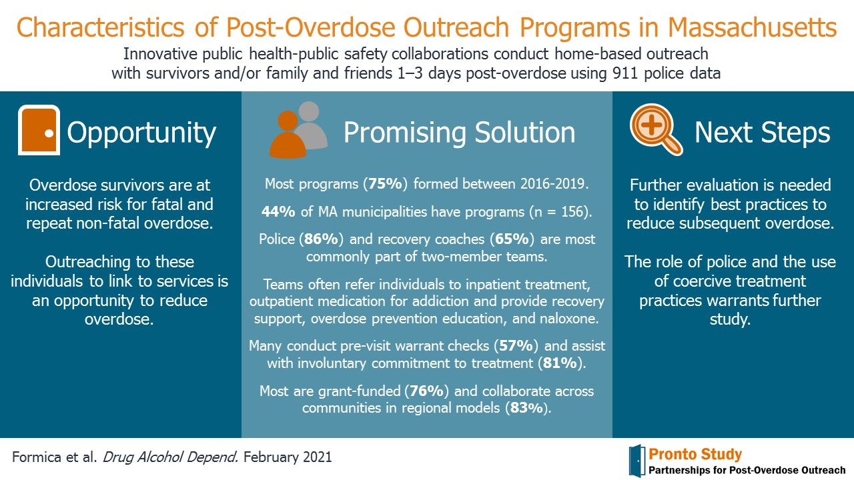
Formica, S.W., Waye, K.M., Benintendi, A.O., Yan, S., Bagley, S.M., Beletsky, L., Carroll, J.J., Xuan, Z., Rosenbloom, D., Apsler, R., Green, T.C., Hunter, A., Walley, A.Y., (2021). Characteristics of post-overdose public health-public safety outreach in Massachusetts. Drug and Alcohol Dependence, 108499.

