Slide 1
AHL December 2020

Slide 4
December 14-23
Drop off Sites
Community Schools
Lynnfield High School
School Lunch Drive Through
Personal Care Products
Toiletries/Oral Care

Slide 5
Youth Council Projects

Slide 6
Community PSA’s: Mask Up Lynnfield
https://vimeo.com/489633115
https://vimeo.com/489633217

Slide 7
Addiction Policy Forum Stop the Stigma Video

Slide 8
Addiction Policy Forum Resources
https://www.addictionpolicy.org/post/opioid-prevention-campaign-toolkit
@DAJonathanBlodgett
Opioids and the Teen Brain Video

Slide 9
Addressing Underage Drinking Logically and Locally
WHAT’S CHANGED WITH COVID?

Slide 10
If…then…with measurable interim and long term results.
If this is the problem
(Underage Drinking)
And this is why it’s happen in Lynnfield
(Local Condition)
And research shows this strategy is effective to address this condition
Then we have Success!
Long Term Impact = Reduce Underage Drinking
And we determine the route cause

Slide 11
What do think of when you think of underage drinking in Lynnfield now?
https://www.menti.com/uwat38rkfk

Slide 12
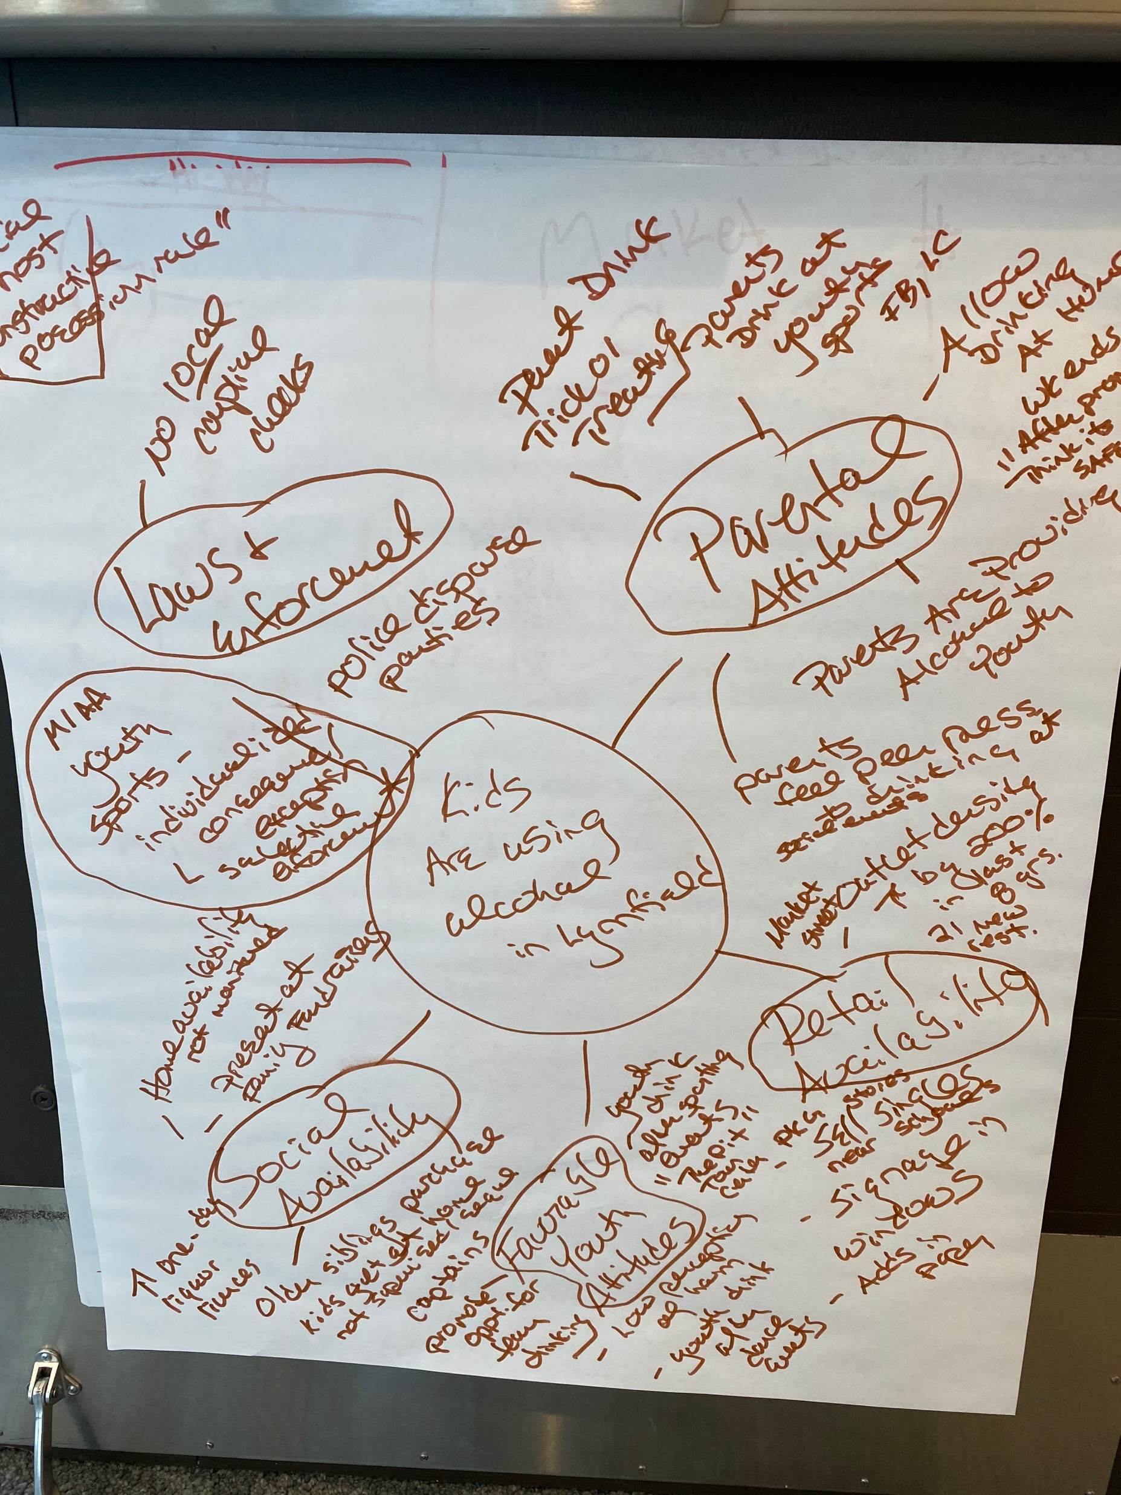
Ah ha! Root causes are the same in every community.
But local conditions are specific to each Community

Slide 15
Strategy Brainstorm
GROUP 1 | GROUP 2 | GROUP 3 | Group 4
Local Condition 1a: Parents provide alcohol to youth at post-prom parties | Local Condition 1b: Adults drink at school-sponsored sporting events and model inappropriate use of alcohol in front of youth | Local Condition 2a: Family restaurants at the outdoor retail center and local convenience/ liquor stores sell alcohol to minors | Local Condition 2b: Youth are obtaining alcohol from older siblings/peers

Slide 16
Padlet
https://padlet.com/salladem/5diljpizihasumgt
Clink the link below to see strategies members came up with to address specific local conditions.
https://padlet.com/salladem/5diljpizihasumgt

Slide 17
What Can We Do To Reduce Underage Drinking?
Individual
Environmental
Provide Information/Education
Evidence based curriculum-School Based Health Ed.
Sticker Shock Campaign
Enhance Skills/Early Intervention
Alternative to Suspension
Provide Supports/Healthy Alternatives
Youth Program/ATI
Change Norms
ATI Campaign/Parents?
Alter Access
Pledge/Recognition
Enforcement-Education
Responsible Alcohol Sales Training
Change Physical Design
Signage ?
Modify/Change Policies
Social Host (?)

Slide 18
Business pledge to prevent sales to minors
Receive public recognition
Mailed out this Month
To Be Communicated through Market Street
Need to do one on one follow up in January law enforcement partners
***Member Roles: Above The Influence
-Member Agencies volunteer to do an Above the Influence Activity!!!****

Slide 19
HAPPY HOLIDAY’s
Please Join us Networking Time!
10 to 10:30

