Slide 1
How does equity relate to substance use prevention?
Prepared for A Healthy Lynnfield
Andreanne Breton-Carbonneau, MSPH
Notes:
Good morning A Healthy Lynnfield. My name is Andreanne Breton-Carbonneau of ACBC Consulting. My expertise is in health equity, supporting the integration of equity into public health projects in towns in municipalities throughout Eastern Massachusetts in areas such as environment and climate change, food and nutrition, and of course, substance use. Thank you for having me this morning to talk about such an important topic!

Slide 2
Introduction: Why are we here today?
1
2
Understand that equity is a key component of effective, evidence-based substance use prevention
Realize the imperative of integrating principles of equity within all of A Healthy Lynnfield’s work.
Notes:
Today we will be talking about equity broadly, covering high level data of health disparities. This presentation will only cover the surface to provide a quick snapshot on equity and it’s critical role in substance use prevention. Ultimately we hope that after this presentation you all will come away with 1) an understanding of why equity is a key component of effective, evidence-based substance use prevention and 2) a call to action for integrating equity principles within all of A Healthy Lynnfield’s work.

Slide 3
Definitions: What is diversity, inclusion, and equity?
IMAGINE A DINNER PARTY...
Diversity is where everyone is invited
Who is in the room?
Inclusion means that everyone is welcome to a seat at the same table
Does everyone feel they belong to the group?
Equity means that everyone has a say in the menu and no one leaves hungry
Are everyone’s diets accomodated? Does everyone have enough to eat?
Notes:
Since we might all be coming to the table today with different understandings of equity, I thought it best to start off covering definitions of equity and principles of equity including diversity and inclusion. To do so I have an analogy: Imagine a dinner party. Look around and ask yourself: Who is in the room? Are people of different backgrounds present? Diversity is where everyone is invited. Next, think of the way people are gathered in the room: Does everyone feel welcome or that they belong to the group? Are certain groups clustered? Inclusion means that everyone is welcome to a seat at the same table. Here, the analogy of the same table is important. It’s not just about who was invited, remember that’s diversity, but who is a part of the process, which is inclusion. Lastly, are everyone’s diets accommodated? Are there folks with allergies who have been accounted for? And does everyone have enough to eat? Equity means that everyone has a say in the menu and no one leaves hungry. Ultimately equity asks who had a voice and who was accounted for?

Slide 4
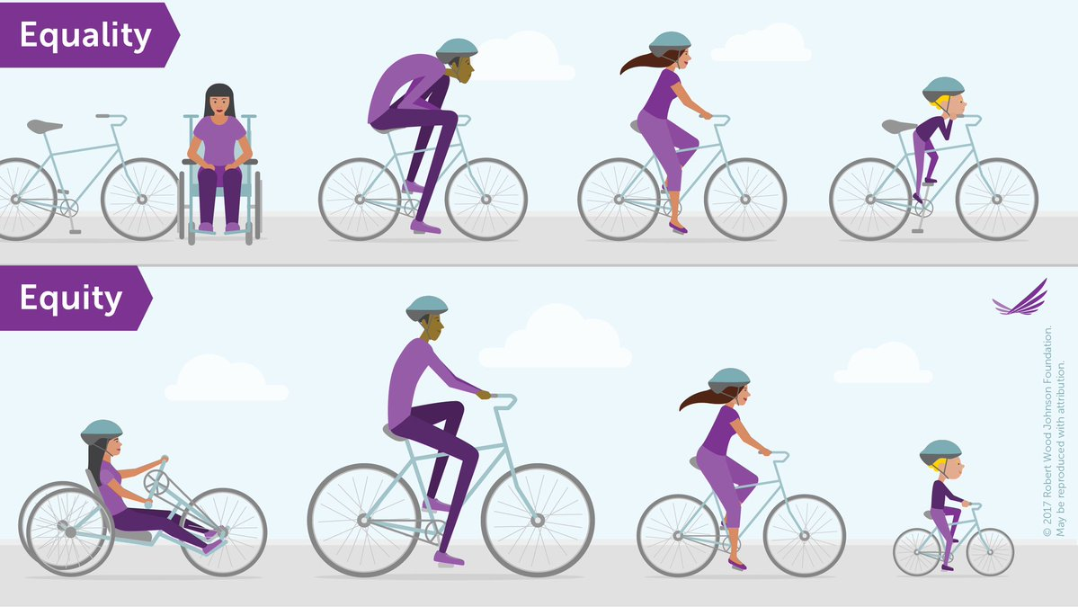
Notes:
It’s important to remember that equity is not equality. As you can see in this example, equal is not always appropriate. Even when we try to be fair and “equal” we still come to disparate outcomes. For example, with equality and handing out the same bike to everyone, the person with disabilities cannot use the bike. The taller biker cannot bike comfortably, and the child is on an unsafe bike. With equity everyone has been accounted for based on their biking needs.

Slide 5
Brief Discussion: What do we know?
What do we know about people with Substance Use Disorder (SUD) and health outcomes?
Do we know of any populations who might be more at risk for SUD?
Notes:
I’ll take a moment to pause and ask the group a couple questions. What do you know about people facing SUD and their health outcomes? Do you know of any populations who might be more at risk for SUD? [3 minutes]

Slide 6
Disparities in substance use related outcomes
01
12% more likely to use at least 1 illicit drug than those in sexual majority (NSDUH, 2015)
Disparities in use for the LGBTQ+ community
02
People with disabilities are 2-4 x more likely to experience SUD (Murray, 2021)
Disparities in SUD for people with disabilities
03
76.8% Black people and 67.1% Hispanic people are unable to receive treatment for SUD compared to 54% White people (Klomegah, 2016)
Disparities in SUD treatment by race & language
04
Despite roughly equal rates of use, Black people are 3.73 x more likely than White people to be arrested for marijuana (ACLU, 2020)
Disparities in criminal justice for BIPOC
Notes:
Thank you all for sharing what you know! This slide here shares but a few examples of disparities in substances use related outcomes. Similarly, despite great efforts in the SUP field, we still see disparate outcomes in substance use related outcomes. Disparities in use for the LGBTQ+ community are that 21% more likely to use at least 1 illicit drug than those in the sexual majority. People with disabilities are 2-4 times more likely to experience SUD. There also disparities in SUD treatment where 76.8% of Black people and 67.1% of Hispanic people are unable to receive treatment for SUD compared to 54% of White people, which is still shocking. Not to mention the disparities in the criminal justice system of substance related offenses. Despite roughly equal rates of use, Black people are 3.73 times more likely than White people to be arrested for marijuana.

Slide 7
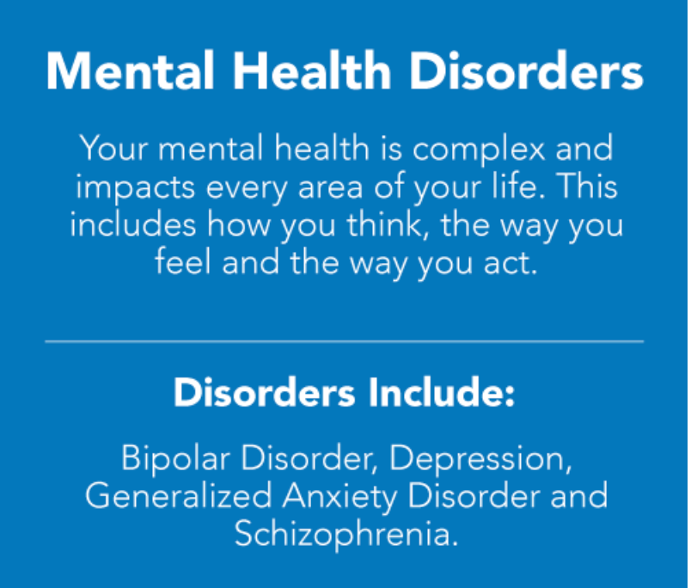
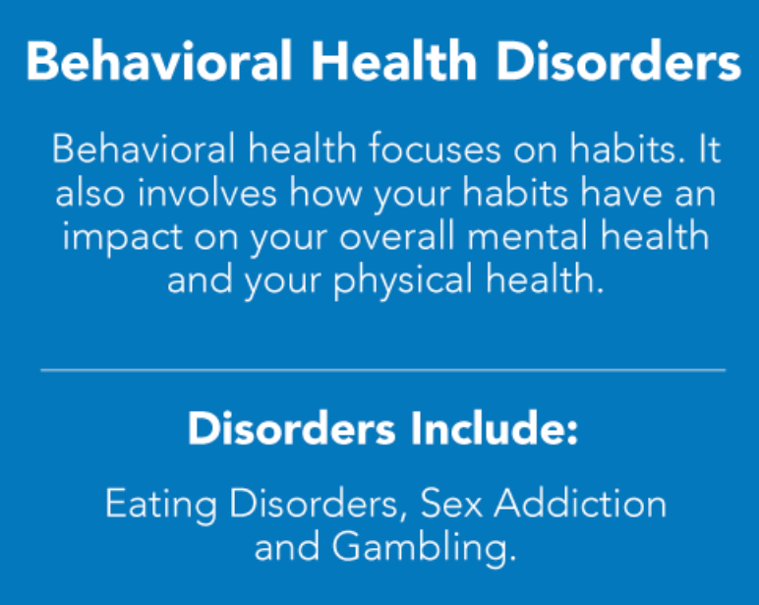
Definitions: Mental vs Behavioral Disorders
Self Injury Disorder
Substance Use Disorder
MentalHealth.gov
Notes:
Before we move on to more health disparities data, I’d like to quickly review what mental health and behavioral health disorders are and the differences between them. First, mental health is broad reaching, but mostly focus on the ways we think, feel and act. Some examples of mental health disorders are depressions and anxiety. Meanwhile, behavioral health can be seen as as a subset of mental health and focuses on our habits and the things we do. Behavioral health disorders include non-suicidal self-injury disorder and substance use disorder. It’s important to note that our mental health is intimately related to our behavioral health, which is denoted here by the double arrow.

Slide 8
50% of individuals who experience a SUD during their lives will also experience a co-occurring mental disorder and vice versa.
(NIMH, 2021)
Notes:
For example, 50% of individuals who experience a SUD during their lives will also experience a co-occuring mental disorder and vice versa. It’s important to note here the correlation of these disorders and not causation. People with mental health disorders will not necessarily develop a substance use disorder, just as someone who is LGBTQ+ or a person with disabilities will not necessarily develop a substance use disorder. However, recognizing correlations in public health is important for us to determine how we might better prevent these outcomes.

Slide 9
LGBTQ+ youth/ disparate relative risk in risk behaviors
Openly LGBTQ+ students
11.1% of Lynnfield middle schoolers
12.1% of Lynnfield high schoolers
Use is not higher in LGBTQ+ youth in Lynnfield
50.6% of Lynnfield High Schoolers have at least one teacher or other adult in the school that they can talk to if they have a problem
2020 report & recommendation by the Massachusetts Commission on LGBTQ youth
Notes:
For example, looking at state data, LGBTQ+ youth in Massachusetts show a 3.2 times higher relative risk of self injury and 3.2 times higher relative risk of suicidal ideation than their heterosexual peers. This data supports co-occurring substance use with LGBTQ+ youth showing a 5.8 times higher relative risk of using heroin than their hetorsexual peers. This correlation highlights a priority for prevention measures. These correlations are important for Lynnfield to keep in mind with 11% of Lynnfield middle school students and 12% of Lynnfield high school students openly LGBTQ+. Though use is not necessarily higher in LGBTQ+ youth in Lynnfield, only about half of Lynnfield high school students shared that they have at least one teacher or other adult in the school that they could talk about if they had a problem, which signals a potential gap in support and prevention for high school students.

Slide 10
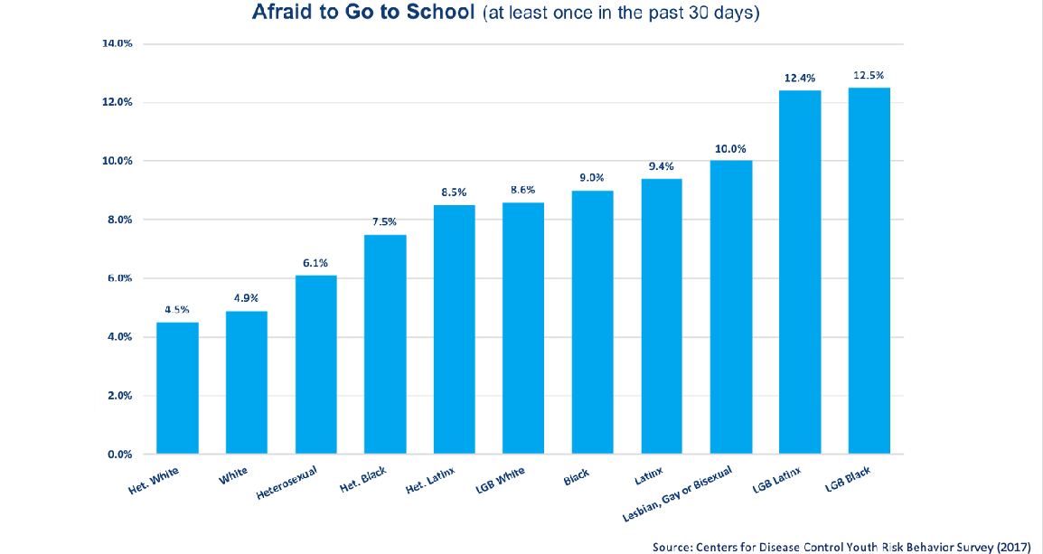
BIPOC (LGBTQ+) youth/ disparate self-reported safety
Notes:
Examples of important information for students to share with said trusted adults include instances of bullying or stigmatization. Bullying and/or stigmatization of LGBTQ+ students as well as BIPOC students can lead to low perceptions of safety at school. Across the country, BIPOC youth, particularly LGBTQ+ BIPOC youth have significantly higher reports of fear of going to school than their White and heterosexual peers. The reasons why looking at student wellbeing is important is that these low perceptions of safety can create chronic stress, and may even result in trauma. As many of us are aware chronic stress and trauma are also linked to mental health disorders, with a higher risk of using substances to cope with these experiences.

Slide 11
ELL students/ disparate self-reported acculturative stress
(Alberg, 2013)
Latinx ELL students scored 76% higher on the Coping with Acculturative Stress in American Schools Scale (CASAS) than non-ELL Latinx students
Acculturative stress refers to the stressors associated with being an immigrant or ethnic minority and going through the acculturation process
Notes:
Similarly, English Language Learners in the US show disparate rates in self-reported acculturative stress, with Latinx ELL students scoring 76% higher on self-reports of coping with acculturative stress in American schools than non-ELL Latinx students. Most notable is the disparate reporting in lack of school and community belonging, which according to Mayo Clinic is strongly associated with “Depression, anxiety and suicide.” For those of you who may not know, acculturative stress refers to the stressors associated with being an immigrant or ethnic minority and going through the acculturation process, or adapting to the dominant culture.

Slide 12
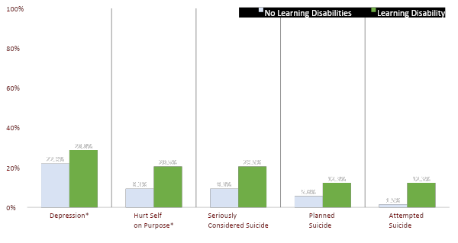
Students w learning disabilities/ disparate self-reported mental health
Learning Disabilities: “Do you have any long-term learning disabilities? Long-term means 6 months or more.“ (n=73).
Depression: “During the past 12 months, did you ever feel so sad or hopeless almost every day for two weeks or more in a row that you stopped doing some usual activities?"
Hurt Self: “During the past 12 months, how many times did you do something to purposely hurt yourself without wanting to die, such as cutting or burning yourself on purpose?"
Students who reported having a long-term learning disability were significantly more likely than their peers (p<.05) to report hurting themselves on purpose, seriously considering suicide, making a plan to about how to attempt suicide, and attempting suicide. The two groups did not differ significantly on reports of depression in the past 12 months.
(Lynnfield Youth Risk Behavior Survey, 2019 analyzed by SSRE)
Notes:
We can see similar trends in Lynnfield of minority student groups and differences in self-reported mental health. For example, students who reported having a long-term learning disability were significantly more likely than their peers to report hurting themselves on purpose, seriously considering suicide, making a plan about how to attempt suicide, and attempting suicide. [If Scott is in the room: I see that Scott is here today, who ran this analysis. Scott, is there anything that you’d like to add about this slide or from the analysis process?]

Slide 13
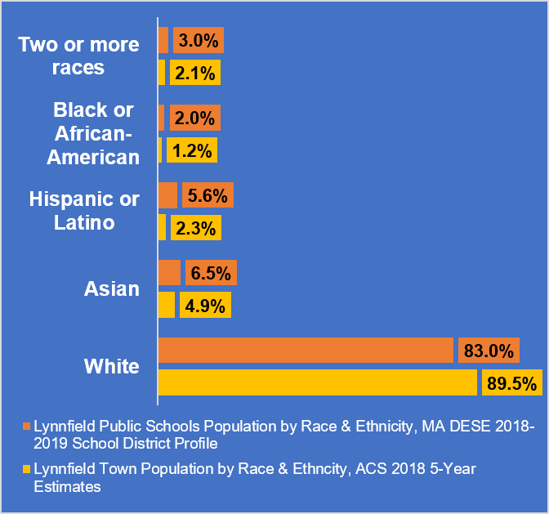
Lynnfield Schools are more diverse than Lynnfield
Notes:
In combination with Lynnfield’s diversifying student body, it’s important for Lynnfield to consider these larger trends in health disparities to better support all of our students. That is, though Lynnfield’s absolute numbers for BIPOC, LGBTQ+ or ELL students are small, Lynnfield’s schools are also becoming more diverse, which means we should be proactive in our SUP approaches, such that we integrate supportive systems for everyone.

Slide 14
Youth most at risk for substance use
A Healthy Lynnfield has a shared, universal goal of adolescent substance use prevention.
Recognize least-served and marginalized youth, while concurrently supporting and protecting all youth in substance use prevention measures
Work to support all youth within the broader school and community systems
General prevention priority: adolescent first use before 15 years old
74% of substance use treatment admissions aged 18-30 with known age of initiation began substance use at the age of 17 or younger (TEDS Report, 2014)
National, state, and local data show sub-priority populations for substance use prevention
LGBTQ+ students
ELL students
METCO students (predominantly BIPOC students)
Students with a chronic health condition
Notes:
This approach to equity is termed “targeted universalism,” where you recognize the challenges of least-served and/or marginalized youth, and address these broader challenges with a shared, universal goal. For example, A Healthy Lynnfield has a shared, universal goal of adolescent substance use prevention, such that all youth are supported and protected in substance use prevention measures. That all youth within the broader school and community systems are supported. To clarify, adolescent first use before 15 years old is the wider prevention priority: 74% of substance use treatment admissions aged 18-30 with known age of initiation began substance use at the age of 17 or younger. A Healthy Lynnfield also recognizes national, state, and local data that show the broader challenges of its minority group students and mental health, important to substance use prevention.

Slide 15
Mental and behavioral health outcomes are directly influenced by social determinants of health
(WHO, 2014)
Notes:
You may understand why mental and behavioral health outcomes are being used to correlate risk of substance use, but you may be wondering how mental and behavioral health outcomes are related to equity. The behavioral health outcomes that we just discussed are directly influenced by, what public health calls, social determinants of health.

Slide 16
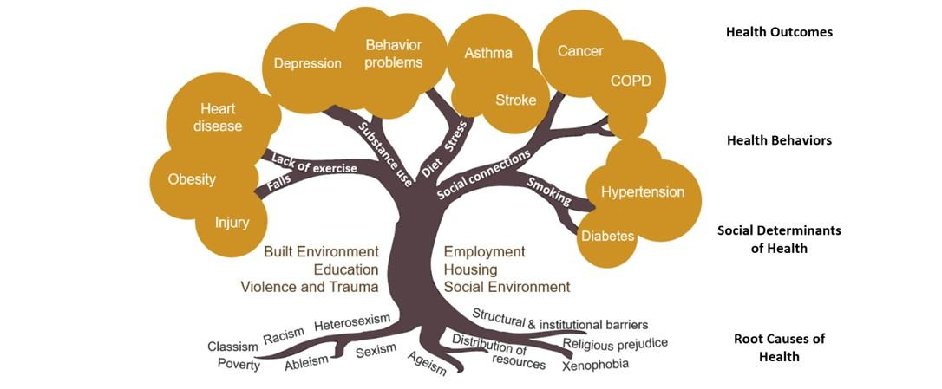
Definitions: What are the social determinants of health?
Social determinants of health demonstrate that students do not have a higher prevalence of substance use because of who they are, but because of what they experience.
Notes:
Social determinants of health are the conditions in the environments in which people are born, live, learn, work, play, worship, and age that affect a wide range of health, functioning, and quality-of-life outcomes. It’s almost everything that we experience in our lives! The major social determinants of health include the built environment (or our human-made surroundings), employment, housing, the social environment, violence and trauma, and of course education. More explicitly, which you can see here on this tree: the trunk of social determinants of poor health lead to poor health behaviors (in the branches), which in turn, lead to poor health outcomes (in the leaves). These social determinants are directly fed by root causes to poor health. As you can see these dynamics run from root to tip. Social determinants of health demonstrate that students do not have a higher prevalence of substance use because of who they are, but because of what they experience.

Slide 17
Social determinants of health for substance use
Societal and family stigma:
63% of general population see addiction as a moral failure (Richter & Foster, 2014)
Lack of proper health care:
No insurance or insurance does not cover treatment (Klomegah, 2016)
No access to appropriate treatment or services (Tran et al., 2012)
Socioeconomic status, including houselessness:
97% of unhoused people report substance use as contributing to their housing condition (Lowe & Gibson, 2011)
Homogeneous social networks, especially networks with cultures of use:
Each 10% increase in classmates who drink correlates to 5% increased odds of underage drinking (Fletcher, 2012)
Notes:
Social determinants of health for substance use specifically include societal and family stigma: 63% of the general population see addiction as a moral failure, lack of proper health care: such as no insurance or limited to no access to appropriated treatment or services, socioeconomic status, including houslessness where 97% of unhoused folks report substance use as contributing to their housing condition, and homogenous social networks, especially networks with cultures of use, which is prevalent in youth: for each 10% increase in classmates who drink, there is an associated 5% increased odds of underage drinking. On the right is a “Wordle” from Lynnfield Public School students that Peg shared with me. Ask to the group: Which of these social determinants do you see in Lynnfield? Maybe Peg can start us off by describing this Wordle a bit more [5-8 minutes depending]

Slide 18
Why should substance use prevention coalitions be interested in equity?
SUD practitioners see behavioral health disparities in people who have systematically experienced obstacles to health
SUD practitioners recognize that root causes directly impact substance use and health outcomes of substance use
SUD practitioners seek to reduce these behavioral health disparities by targeting outcomes at the root
Preventing poor outcomes at the root is an equity-centered approach
Notes:
So the ultimate questions here is: Why should substance use prevention coalitions be interested in equity? The field of substance use disorder practitioners, including those who work in prevention, treatment, and recovery have seen mental and behavioral health disparities in people who have systematically experienced obstacles to health. They’ve seen it anecdotally, first hand, as well as in the data from the national all the way down to the local level. In turn, SUD practitioners recognize that root causes directly impact substance use and subsequent health outcomes of substance use. Therefore, in order to reduce these disparities, SUD practitioners nationwide are targeting these poor health outcomes at the root. Though it seems intuitive, preventing poor outcomes at the root is, in fact, an equity-centered approach.

Slide 19
Benefits of equity: Substance use prevention
SUPPORT & ACCEPTANCE
Supportive social networks mitigate adverse effects of Sexual Minority Stigma (Hatzenbuehler, 2014)
Family acceptance of LGBTQ+ identities significantly improves relationships that lower risk for substance use (Padilla et al., 2010)
DIVERSITY
Supportive social networks that are large and culturally diverse protect against substance use (Adorno et al., 2013; Carpiano et al., 2011)
Lynnfield Public Schools is thoughtfully creating a supportive and welcoming environment for all students (new equity initiative)
83% of Lynnfield High Schoolers can talk with at least one parent or other adult family members about things that are important to them.
A Healthy Lynnfield
Lynnfield for Love
Notes:
Some examples of the benefits of equity practices as protection against first use, SUD, and addiction severity include support and acceptance, as well as diversity. The first two bullets are specific examples of equity-centered approaches for the LGTBQ+ community. This data shows how supporting and accepting social networks can mitigate the root causes of stigma and improve relationships, which both lower risk for substance use. Additionally, diversity, of a large and culturally diverse social network has also been shown to protected against substance use.

Slide 20
Benefits of equity: Substance use prevention
SUPPORT & ACCEPTANCE
Supportive social networks mitigate adverse effects of Sexual Minority Stigma (Hatzenbuehler, 2014)
Family acceptance of LGBTQ+ identities significantly improves relationships that lower risk for substance use (Padilla et al., 2010)
DIVERSITY
Supportive social networks that are large and culturally diverse protect against substance use (Adorno et al., 2013; Carpiano et al., 2011)
Lynnfield Public Schools is thoughtfully creating a supportive and welcoming environment for all students (new equity initiative)
83% of Lynnfield High Schoolers can talk with at least one parent or other adult family member about things that are important to them.
A Healthy Lynnfield
Lynnfield for Love
Notes:
Peg has shared with me that Lynnfield Public Schools is thoughtfully creating a supportive and welcoming environment for all students with the new equity initiative, which is a great example of equity in your school system. From the school data, 83% of Lynnfield High Schoolers shared that they can talk with at least one parent or other family member about things that are important to them, which is encouraging to see Lynnfield families cultivating supportive environments at home. Lastly, large and culturally diverse social networks are being nurtured by groups including Lynnfield for Love and you all here at A Healthy Lynnfield.

Slide 21
There are many examples of equity throughout Lynnfield outside SUP
Notes:
To wrap up I wanted to give a couple examples of equity-centered approaches in Lynnfield outside of substance use prevention. Some of which you may not have thought was equity work until today.

Slide 22
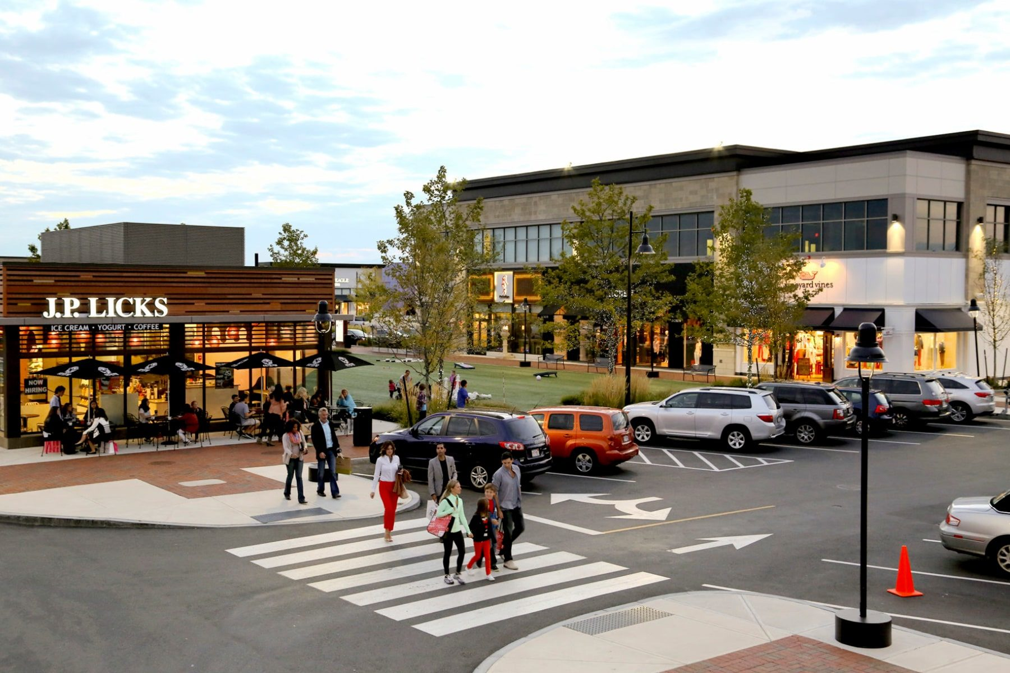
Benefits of equity: People with disabilities
Accessible infrastructure is an equity-centered approach to public spaces
Lynnfield Schools have disability support programming
ADA accessible paths at MarketStreet
Notes:
I’ll start with accomodations for people with mobility restrictions. Though you may not have thought about it as such, accessible infrastructure and ADA are equity-centered approaches to public spaces. Another school-related example of equity-centered approaches for people with disabilities are disability support programs for students, including IEPs for students with learning disabilities. This ties back to the “targeted universalism” approach I mentioned earlier. Though this physical space or IEP is created with people with disabilities in mind, this outdoor mall still benefits everyone, the school system still benefits everyone.

Slide 23
Benefits of equity: English language learners
ELL is an equity-centered approach to language acquisition
Spanish-speaking parent engagement specialist at Lynnfield High School
Lynnfield High School
Notes:
Another example of equity-centered approaches in Lynnfield include ELL programs. ELL is an equity-centered approach to language acquisition, including the recent addition of the “Spanish-speaking parent engagement specialist” at the high school, to best support and reach spanish-speaking families. Though this language program was created with English learners in mind, everyone ultimately benefits from improved communication.

Slide 24
Benefits of equity: METCO program
METCO is an equity-centered approach to school integration
Lynnfield Schools has its own METCO Director
Notes:
Lastly, the METCO program is another fantastic example of an equity-centered approach. METCO is an equity-centered approach to school integration, with Lynnfield having its own METCO Director. Though this integration program was created with students from downtown Boston in mind, composed of mostly BIPOC youth, as we’ve learned, everyone benefits from a larger and more diverse social network. Ask the group: What are other equity-centered examples from your own work? How do you think Lynnfield might further benefit from equity? [3 minutes]
Thank you for sharing your examples and ideas! I really appreciate your participation and attentiveness this morning. I’ll now pass it off to Peg to close the presentation.

Slide 25
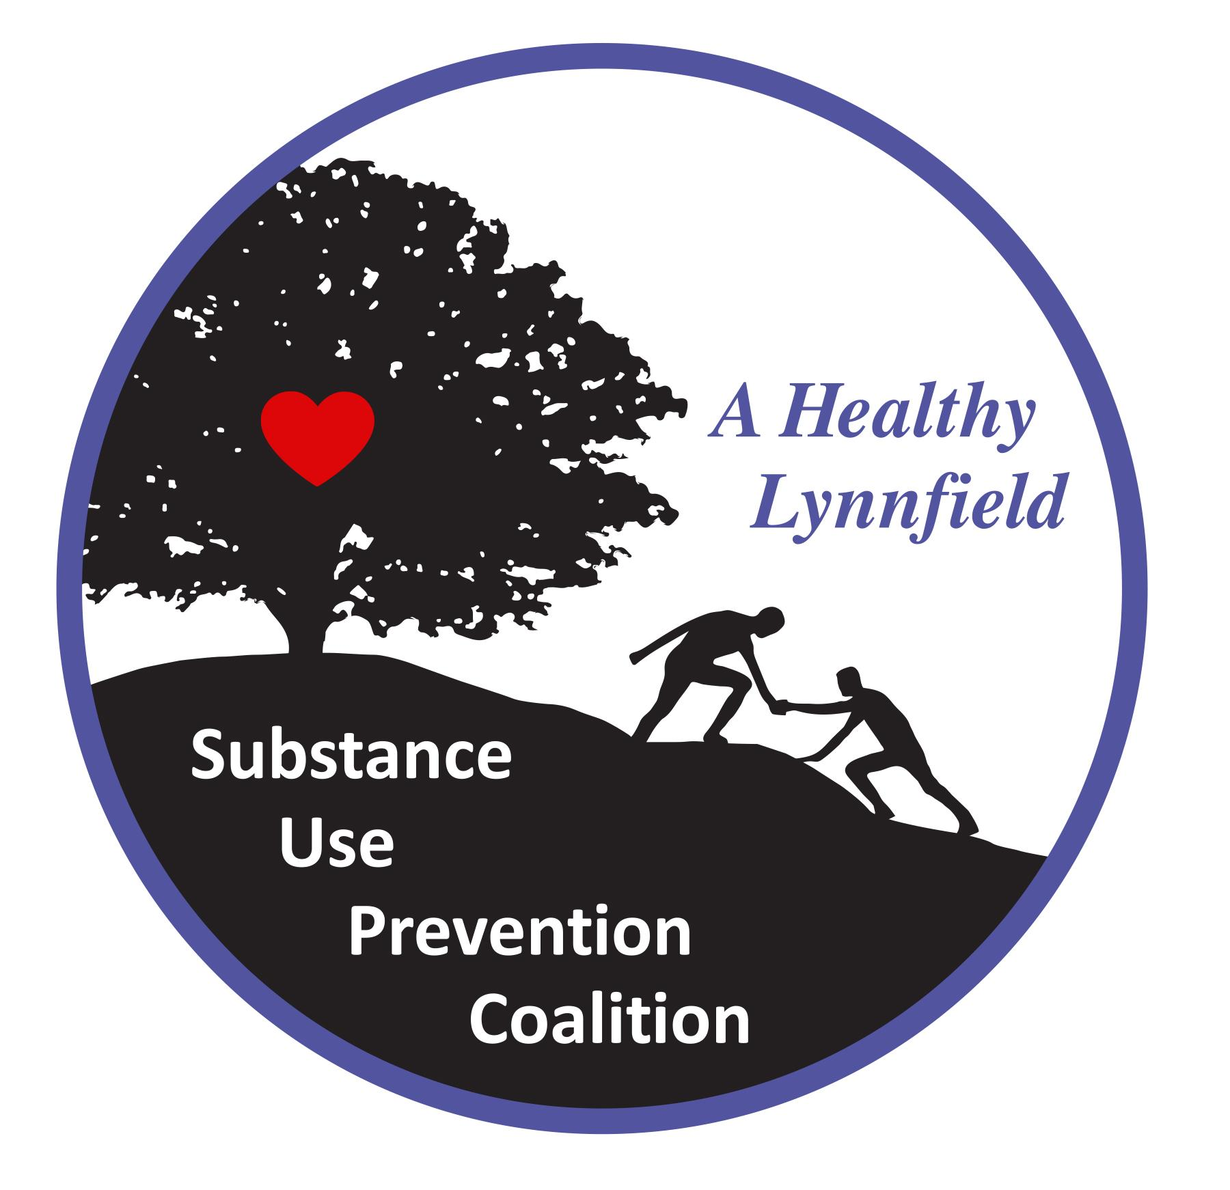
Next steps in the journey towards health equity
Establish an organizational equity lens
Organizational equity statement
Guiding principles
Health equity goal
Integrate into work plan
Develop a training/capacity building plan
Support partner organizations in this work
Notes:
@Peg - This and the next slide will be for you to close the presentation

Slide 26
Next steps for A Healthy Lynnfield
Continue A Healthy Lynnfield work plan
Explore and select evidence-based prevention curriculum

