Slide 1
A Healthy Lynnfield
MARCH 2021 COMMUNITY PARTNERSHIP MEETING

Slide 2
Agenda
I: Introductions & Welcome to Guests/New Members
II: Coalition Business
-Approve Minutes
-Youth Council Update (Julie & Youth Council Members) (10)
Presentation from youth attending CADCA-Evyenia Georges and Teanne Alfama
LMS Middle School Spring Project
-Sub Committee Updates/Programs In-Progress (5)
-DEI Workgroup-third speaker March 11, at 6:30
-Pledge Updates-(Leanne & Alex Doto) (5)
-Upcoming Programs/Action Items
Above the Influence Coalition Video (Leanne) (5)
-Press/Public Relations
Above the Influence Initiative Overview & Discussion (Dave, Peg, All) (10)
-Fiscal/Grant Updates (Kevin, Peg)
Partnering with LPS on Equity Audit-agreement on directed use of funds (5)
III: Special Topics (15)
Post Overdose Response: Best Practice Research
Scott Formica, Ph.D., Social Science Research and Evaluation
IV: Other /Community Input (5)

Slide 3
Our Time at
CADCA National Leadership Forum
Youth Training
Teanne Alfama Polanco & Evyenia Georges

Slide 4
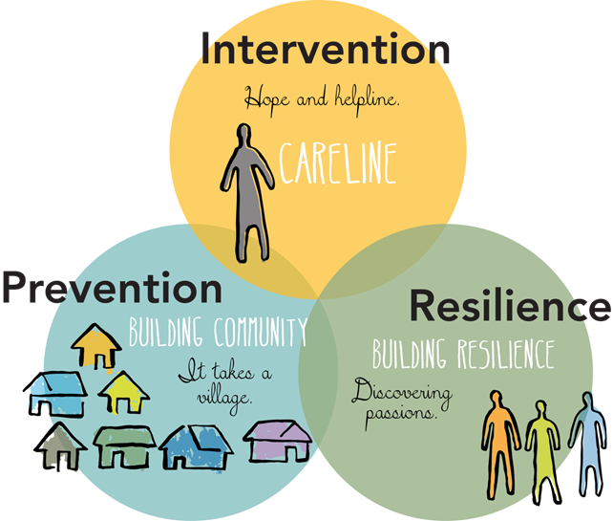
FAQs About CADCA
CADCA Stands for - Community Anti-Drug Coalitions of America
3,000 attended the National Leadership Forum
CADCA’s mission is to build the capacity of community coalitions to create safe, healthy and drug-free communities, and one of the ways CADCA accomplishes its mission is through the development of youth leaders.
CADCA has built nearly 300 coalitions in over 30 countries worldwide and provides training in 7 languages.
Notes:
How about Teanne can present the bulleted FAQs
Evy would you feel comfortable explaining this image (I stole it from you) but it a key point to our work and perfectly resembles a lot that was talked about at CADCA

Slide 5
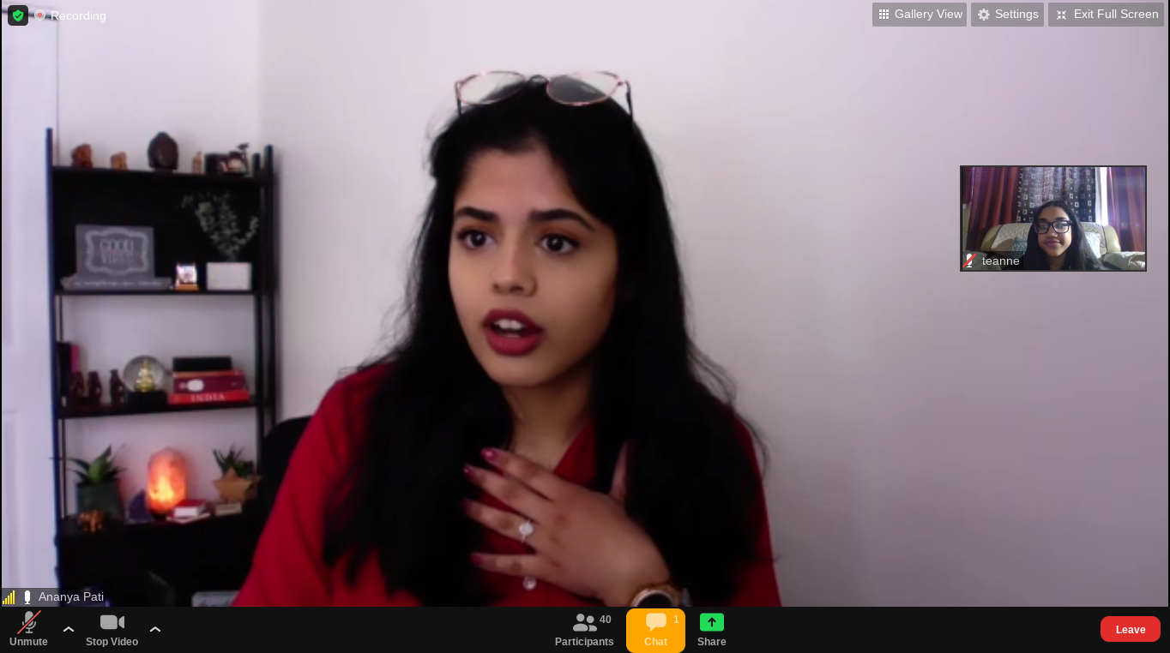
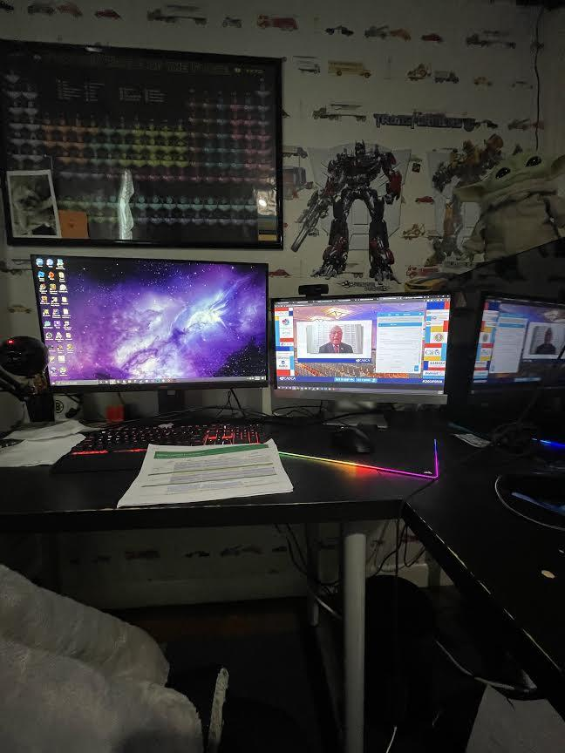
Workshops Attended :
Teanne’s Workshops:
From a Leader to an Advocate
Substance Misuse During COVID-19
Strong! Building Community Strength by Taking Care of Yourself
Marketing Misery- The Opioid Epidemic
Public Speaking on Campus and Beyond
Mental Health & Substance Misuse Prevention: Passing Policies
Evyenia’s Workshops:
Engaging Youth in Advocacy: Building a Statewide Task Force
JUULING Epidemic: Prevention for Middle Schoolers and Freshman
I’m Good Bruh!
Marketing Misery- The Opioid Epidemic
Public Speaking on Campus and Beyond
Mental Health & Substance Misuse Prevention: Passing Policies
Workshops Drew von Jako and Jemina Robins Attended:
Marijuana: Facts vs Feelings
Working for Progress: Youth and Adults Advancing Collaboration
Tackling Tobacco: How do we Address Tobacco Product Pollution
Covid-19 A Crash Course in Resilience
STRONG! Building Community Strength by Taking Care of Yourself
Empowering Youth with Brain Science: Four Neuroscientific Lessons to Increase Resiliency
Vaping..in a Pandemic?
BtheOne-Suicide Prevention Efforts
Notes:
Bolded ones are the ones girls have attended together
Workshop then Action Planning time …
Pause for coalition to read & ask questions

Slide 6
Workshop Highlights:
Evyenia Key Takeaways:
The key roles in a task force
Ways to engage the parents of the community
Sticker Shock Campaign
Doing a study on the local liquor stores
P.R.O. T.I.P.S. for Public Speaking
Evyenia Highlights:
Action Planning of Marketing Misery
The creation of a local task force
Learning how to respond to someone offering you substances
Teanne Key Takeaways:
How important mental health is
Creative ways to inform others about substances
The diagram of public speaking
How to have an open view on others
Teanne Highlights:
Main Session of Marketing Misery
Ways to take care of yourself mentally and physically
What we can do about substance use as a Community
Notes:
Key takeaways = things that were learned, main points, or messages that were learned
Highlights= what made you excited, what did you like, did you like the experience, did you meet like minded youth, were you inspired by youth or speakers, anything you wanted to highlight about your experience and what you took away as a youth leader
Try to keep it to 4-5 points, you guys will have about 10-12 minutes to get through all this info and I want to give the coalition 2 opportunities to ask you questions

Slide 7
AHL LMS Youth Project: Mindful March
Notes:
LMS “A Healthy Lynnfield” 15 student leaders created a survey for students grades 5-8 to “check in” about how their school experience has been this school year, they received about 480, questions asked levels of stress during in home learning vs at school, level of support they are feeling, what's helpful for remote learning, and coping strategies they are using during the pandemic. Through the data they created a “mindful march” calendar, each day is a challenge of a new self care or coping strategy. The calendar also offers adult resources. The calendar was student driven and creative approach to support their peers during our year long pandemic and the longest month of the school year.

Slide 8
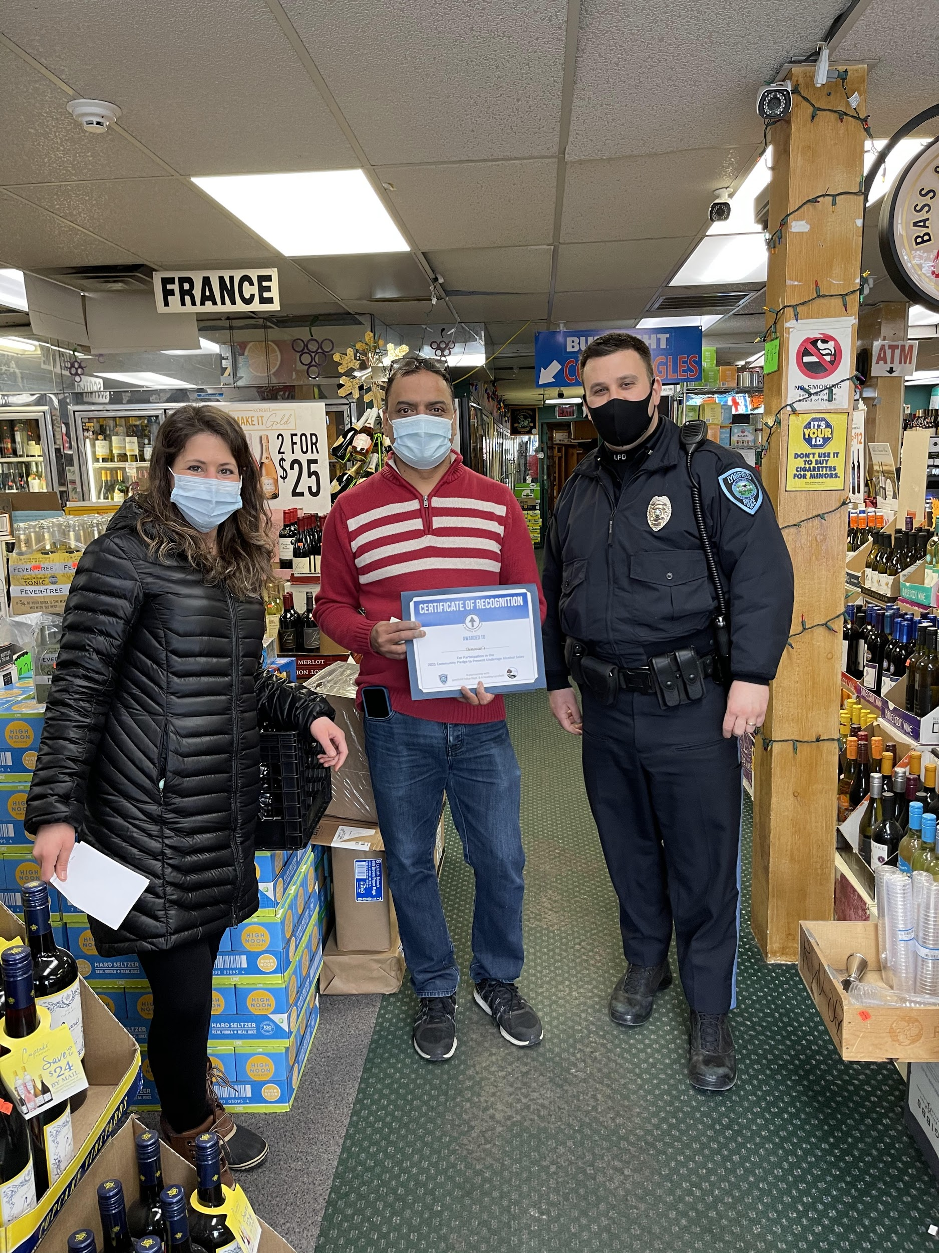
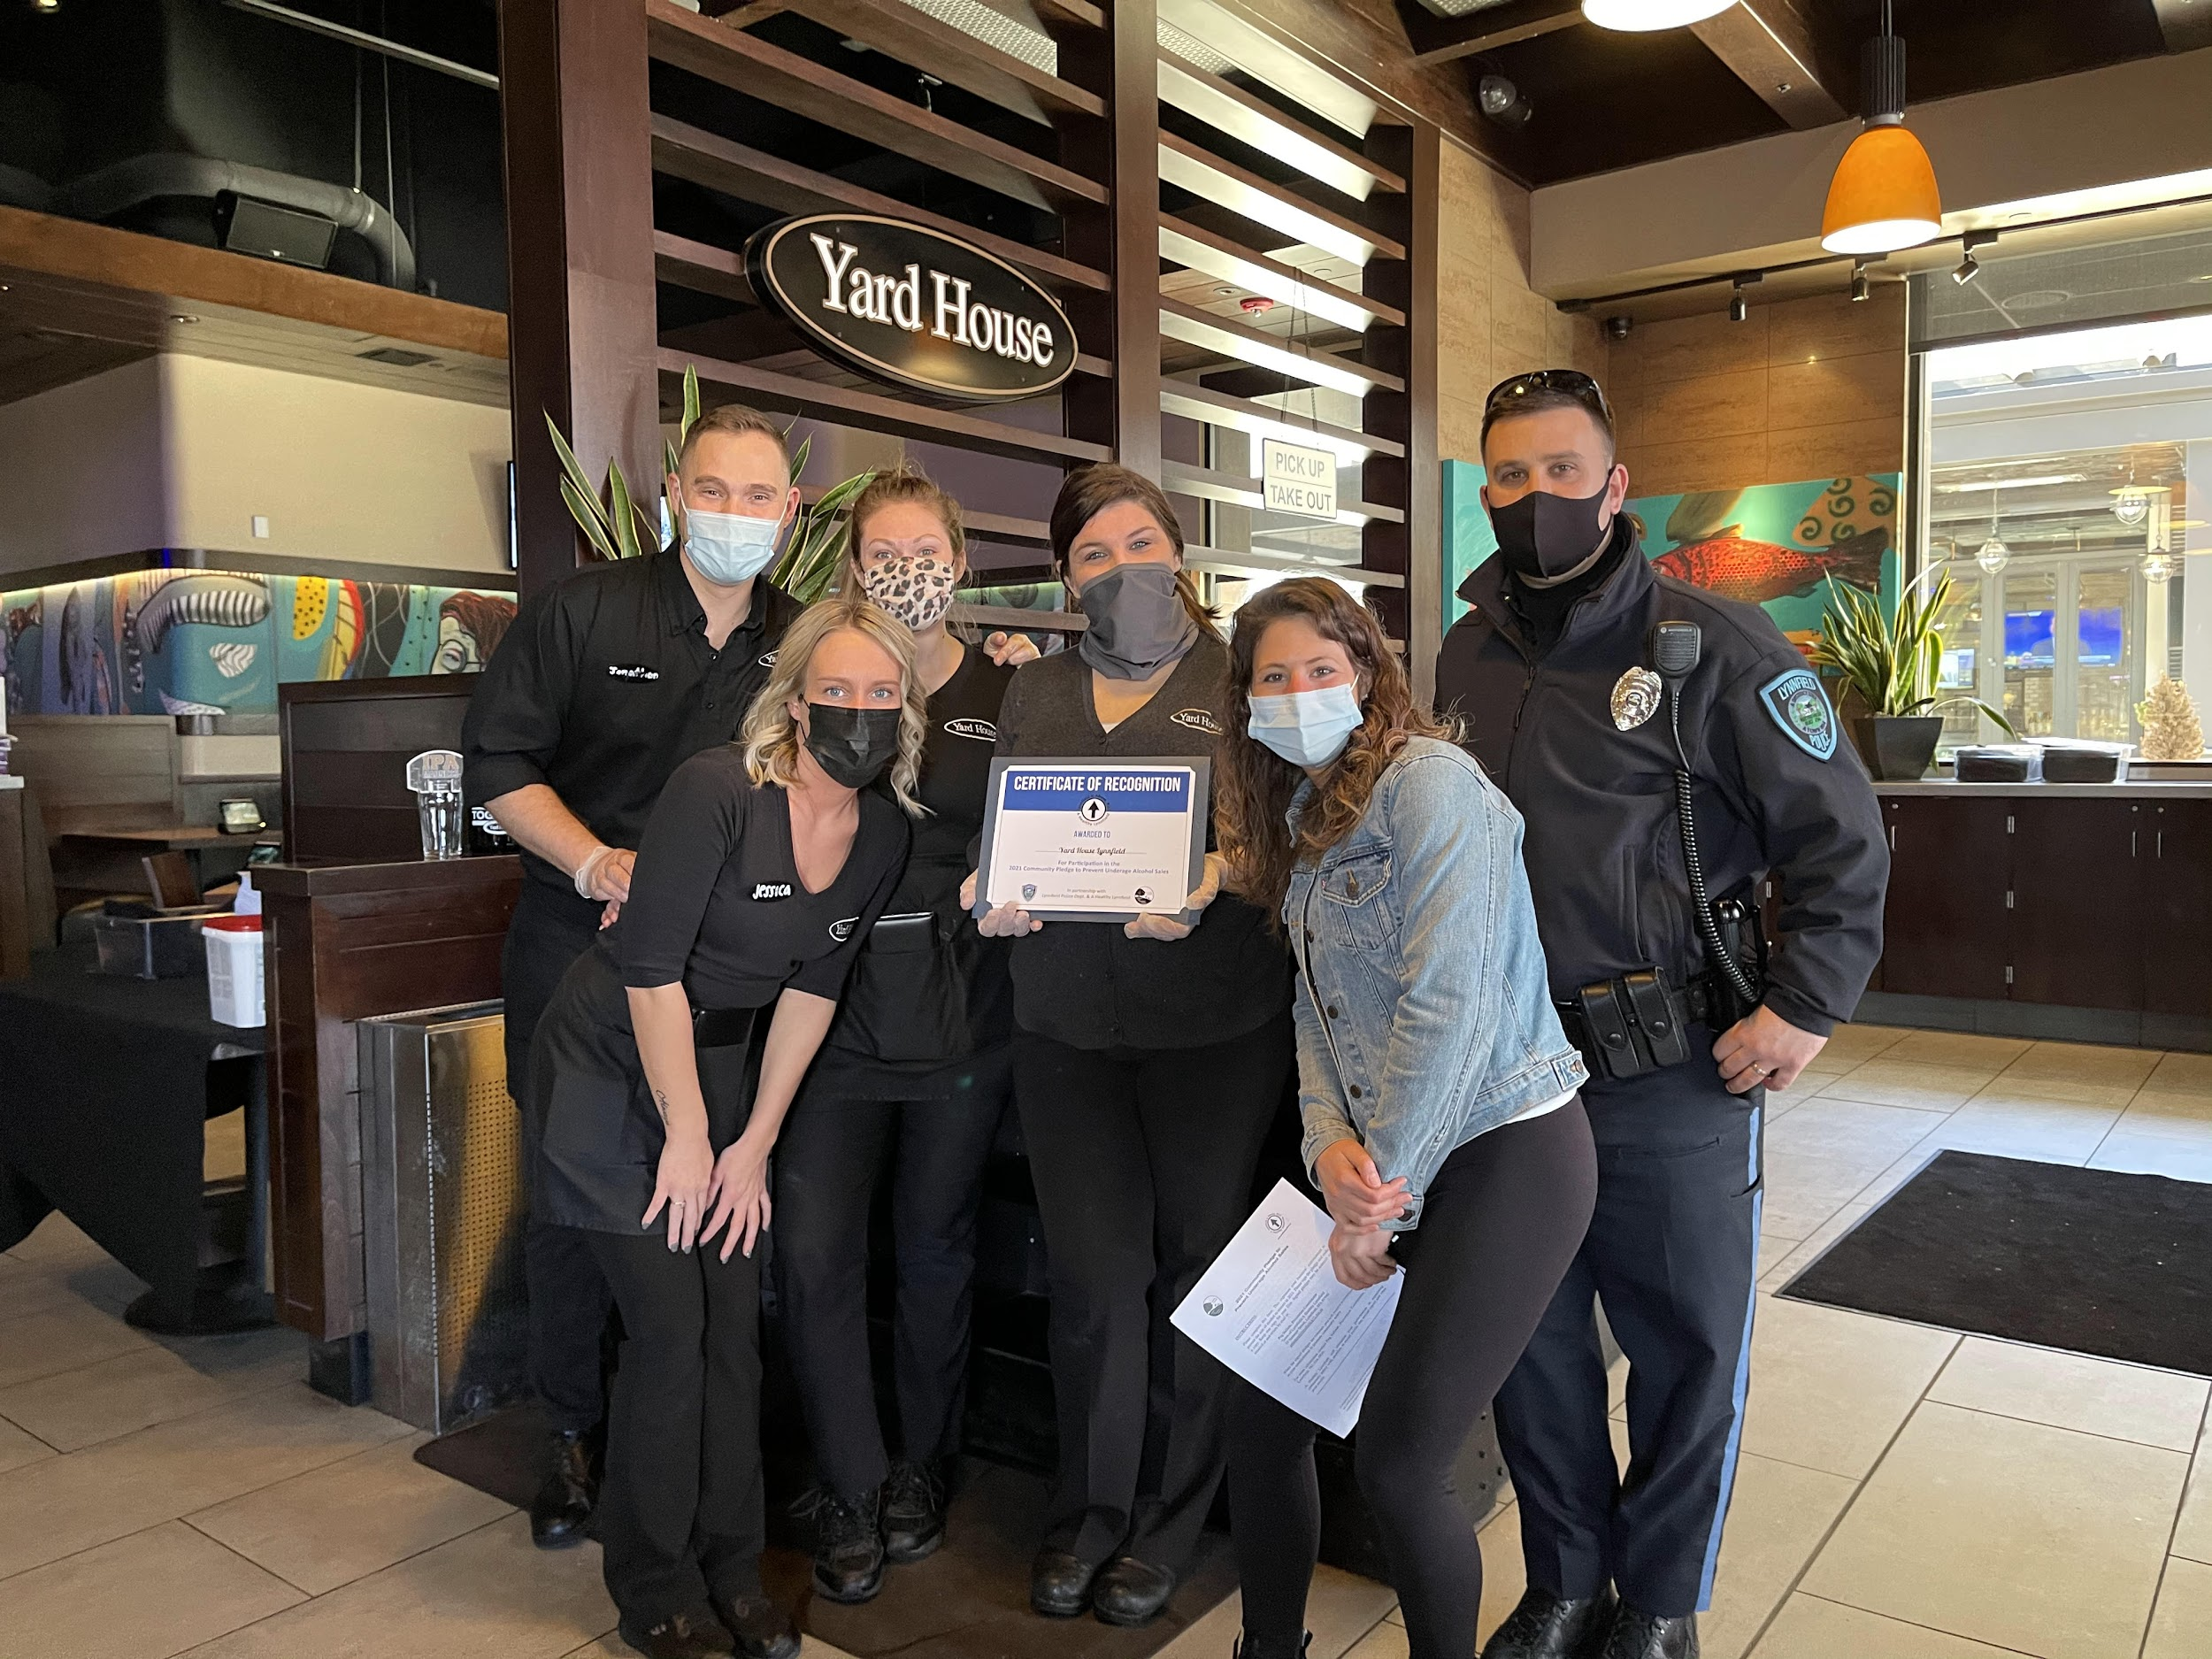
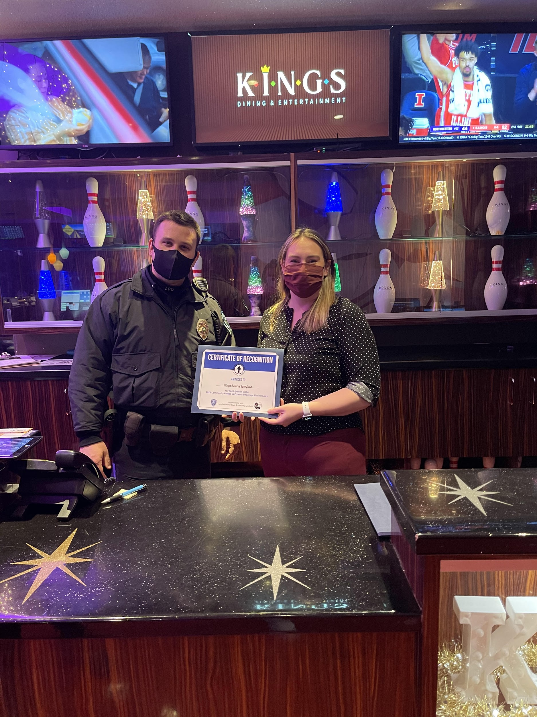
Pledge to Prevention Underage Alcohol Sales
Donovan’s liquor
Yard House
Kings Dining
Notes:
13 businesses participated in the community pledge.
Both businesses at Market Street along with liquor stores and gulf gas station.

Slide 9
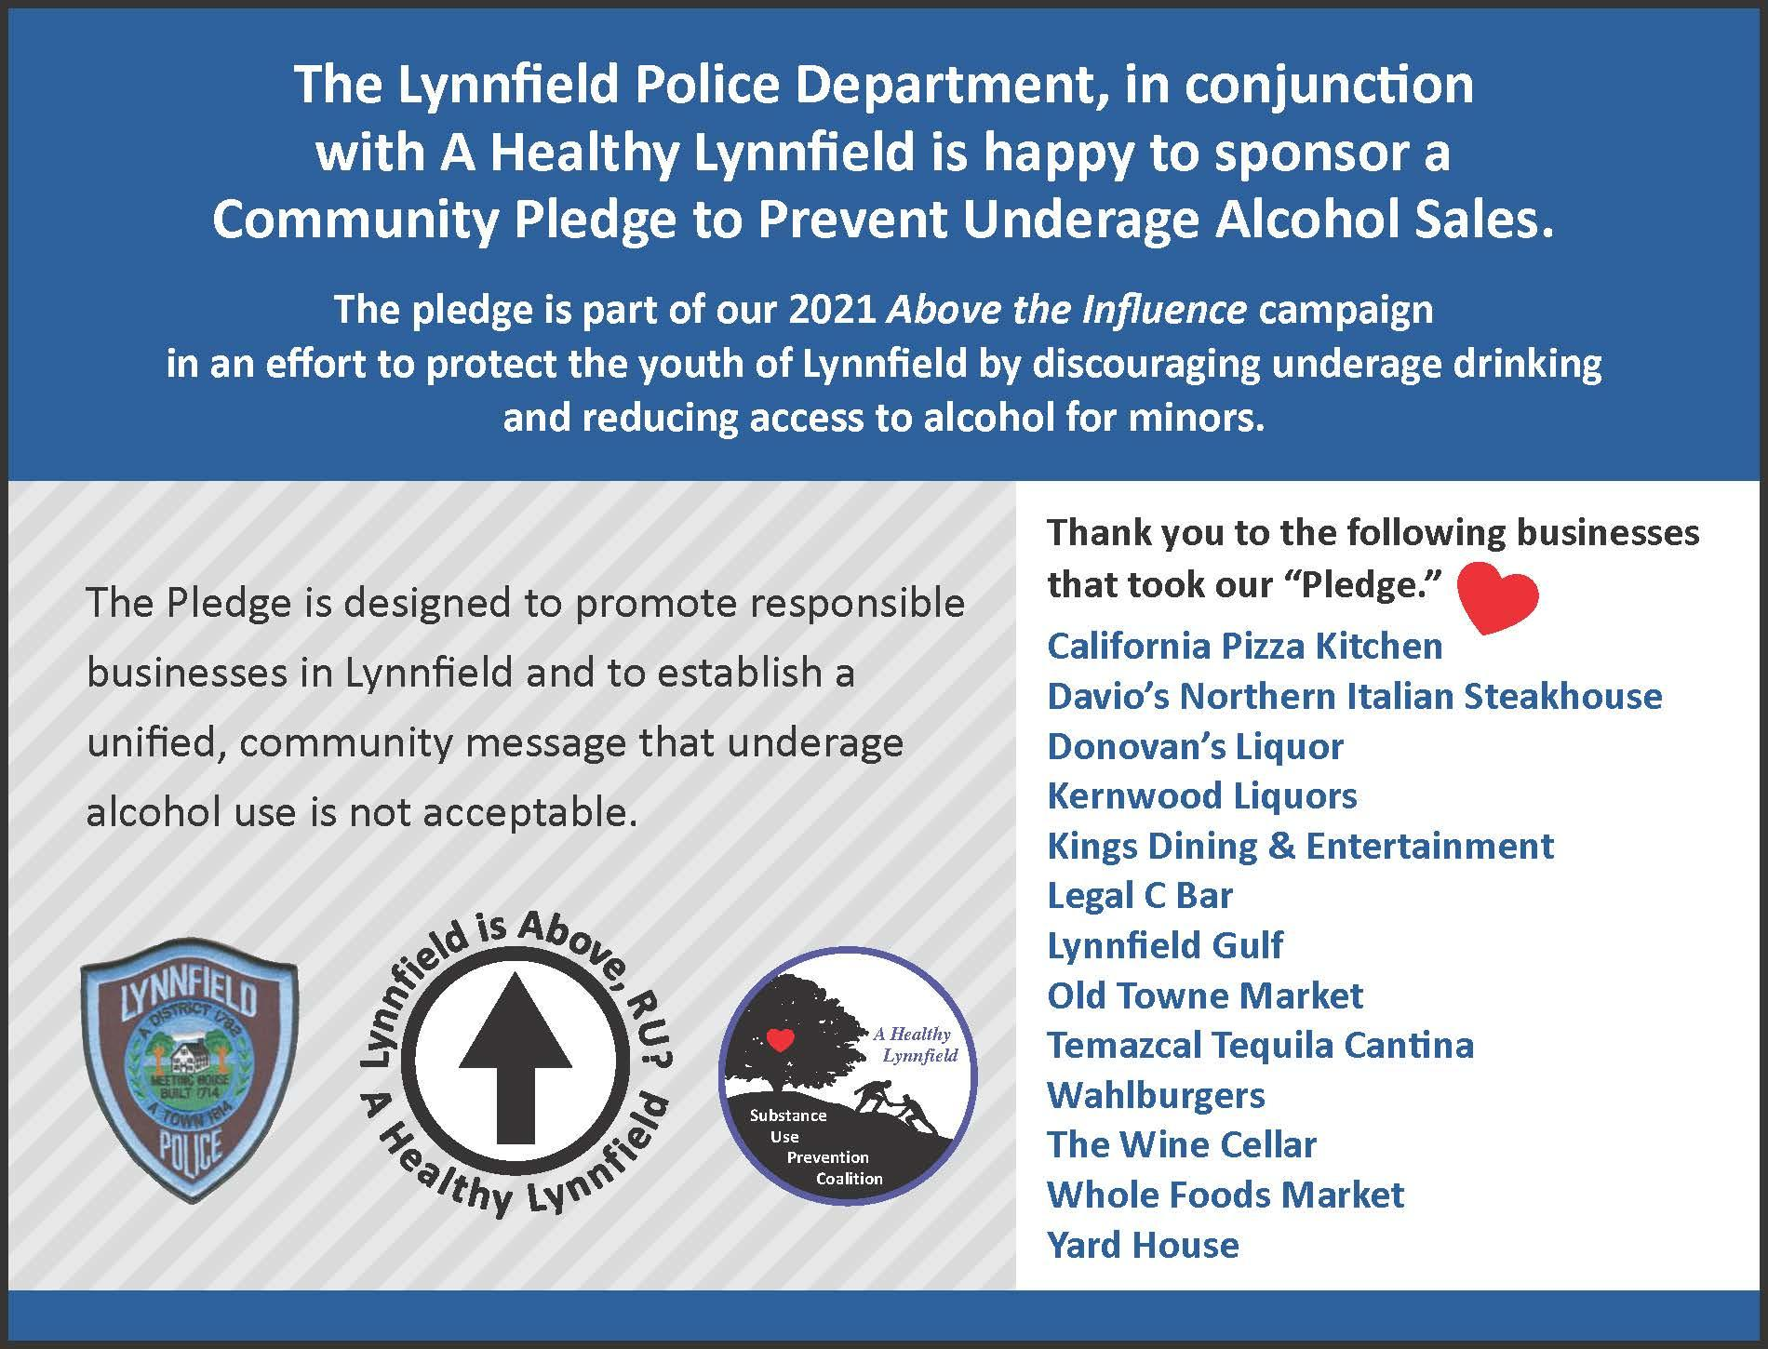

Slide 10
ATI Video
Coalition Member ATI Video

Slide 11
The Above the Influence Plan
What positive influence in your life keeps you
above the use of alcohol or other drugs?
Primary Audience: School-Aged Youth
Secondary Audience: General Community
Goal: To reinforce identification and labeling of protective factors, that are meaningful to youth and that, when widely promoted, move the community toward the norm of substance-free environments for all youth.
Most LHS students choose not to use electronic vaping products (86.8%)
Most LHS student choose not to use marijuana products. (80.2%)
Most LHS students (over ¾) choose not to use alcohol. (77.3%)
1 out of 2 youth report having a trusted adult in school they feel they can talk to about issues that concern them.

Slide 12
April Above the Influence Initiatives & National Alcohol Awareness Month
Lead Up: 13 Local Businesses Recognized for taking a “Pledge to Prevent Underage Alcohol Sales” to prevent access and discourage underage drinking.
March 29: LPS Walking Program for Educators-Healthy Way to Stay Above the Influence
April 1: Launch of Youth Council Video- “21 Ways to Stay Above the Influence”
April 8: Speaker Lynn Pantuosco, Westfield State-Recipe for Athletic Success
Weekly-Champion for Youth Awards-Youth Council members elect 4 adults that exemplify positive role models for youth.
LMS 8th Grade Health Class-Students Create Above the Influence Posters
YMCA and Girl Scout Activities (To Be Scheduled) Faith Based ?
April 29: Film Viewing “Don’t Wait” by AddictionRecovery.org -a free opportunity to tune in and watch an education video from parent to parents about talking early to your kids about substance use.
Selectman vote on Proclamation making April 29 “Above the Influence Week” + Banner
April 29: Virtual Panel Discussion with producers of “Don’t Wait”, 7 pm
Social Media Posts sharing youth to youth messages about being “Above the Influence.”
Notes:
Also screen shots/email logo
Faith based-message in church bulletins the week of 4/29

Slide 13
ATI Plan Overview

Slide 14
Look for our April Social Media Posts

Slide 15
Overview: Post Overdose Response Research, Scott Formica, Ph.D., SSRE
Link to Slides
Notes:
Lynnfield 4 in 2019--2020 numbers not published yet on MDPH

Slide 16
Actions
Our Ask: Play your part in contributing to our Above the Influence Campaign-talk it up. Get colleagues to participate.
Start the Dialogue: Ask a young person: What positive influence in your life keeps you above the use of alcohol or other drugs?
Share: Repost our Social Media
Acknowledge: If you are in a local store and see our Pledge materials-acknowledge it and thank the business for participating with AHL.
Next Meeting: April 13, 2021
Youth Foucus Group Results

