Slide 1




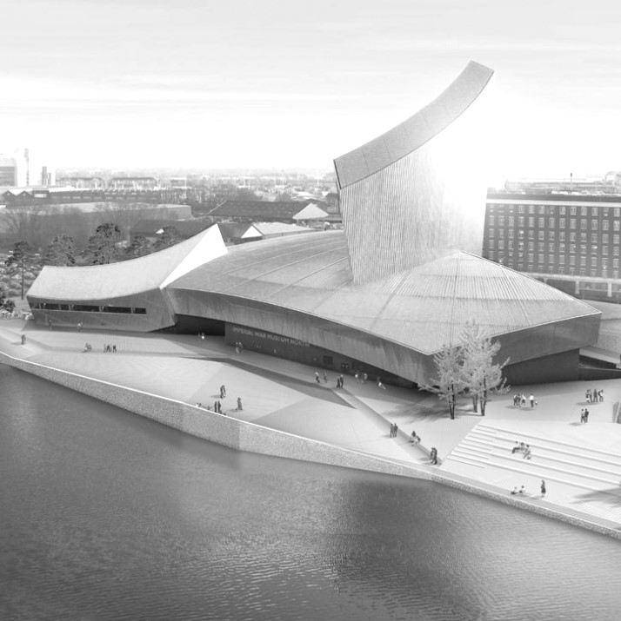

Introduction
Presented by James Morton
Managing Director
Anglo-French Interim Transition Ltd

Slide 2
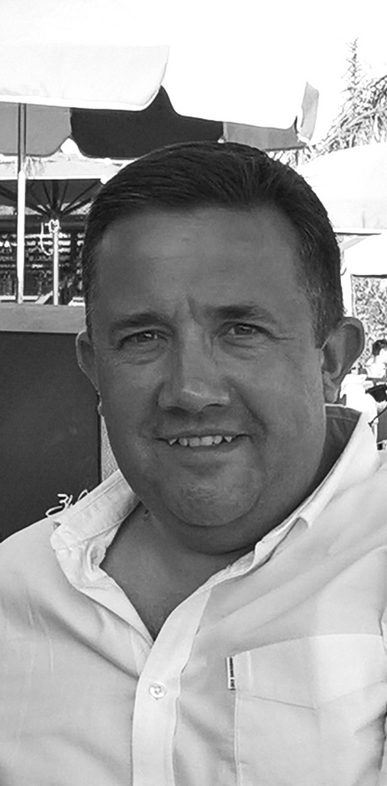
Introduction - About Me
Proud Englishman, passionate Francophile, highly experienced, trained & commercial MD
As a professional interim MD my goal is to meet your needs, from business turnaround to organization transformation, from due diligence to emergency replacement, and, most importantly, quickly deliver measurable, effective results
28 years consumer-led business experience across the UK & EU, including 7 as a professional interim, I can help you and your team succeed with a highly efficient and empathetic balanced approach to business and leadership

Slide 3

Purpose
Delivering a Positive Change at both Speed and Scale
Mission
To be a valued and trusted Interim MD level leader and advisor in France and the U.K. for SME, Mid-Cap and PE / VC businesses that need quick, efficient, and measurable solutions to their challenges & opportunities

Slide 4

The Opportunity
In a low growth cycle, full of geo-political and economic uncertainty, calm, positive, pragmatic experience and advice counts
In challenging times, full of fast paced change and constant challenges, finding the support you want to bring clarity and stability, energy and efficiency, can be difficult
Equally, if you are confident in your proposition’s potential , but are struggling to grow and develop your organization in order to breakthrough to the next level, then a professional, experienced Interim can add the value and buy the time that you need

Slide 5

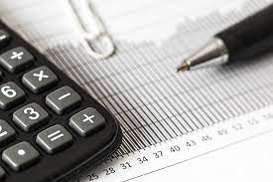



Services
Turnaround, Transformation & Optimization
Due Diligence
Commercial Strategy
& Delivery
Leadership & Coaching
In Case of Emergency
Proven long term track record of any or all of these services to drive Business Growth and/or Organisational Development
Whether for a business Sale, Acquisition or Integration, capable of providing full project leadership and management, or functional expertise for specific elements of the process
Igniting and leading change, reviewing a wider project, supporting current management by leveraging 21 years of senior commercial experience, 7 as an interim, to help you grow
Either as part of a business turnaround and transformation, or providing specific, tailored support across functions, or for team leaders, delivered via a balanced approach to leadership
For that sudden planned or unplanned departure or event, when you need experienced, calm, pragmatic leadership support, fast

Slide 6
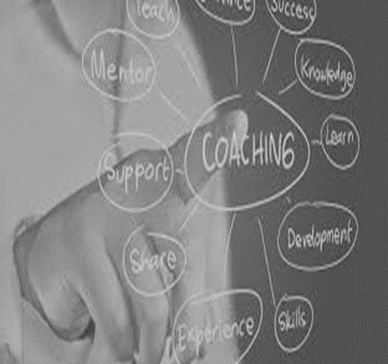
Turnaround, Transformation & Optimization
As MD led transformation & turnaround of failing £15m, team of 52, division of U.K. Health & Wellness SME, from decline to growth in just 2.5 years
Led design, build and management of first UK Company Operating Plan in Unilever to support delivery of £850m+ P&L, across 7 product categories
Experience
Due Diligence
As GM Nelsons Southern Europe twice led internal due diligence processes under NDA, as part of initial recovery plan and then later for a strategic review
Commercial lead with Boston Consulting Group on successful portfolio and customer integration plan post Allied Domecq acquisition into Pernod Ricard UK
Commercial Strategy & Development
Led an ABF plc Grocery channel team in £38m GM improvement of £250m P&L in under 9 months via commodity based cost price negotiation strategy
Led project management of Trade Terms Strategy & SAP system design for Lever Faberge UK, ensuring alignment to Unilever EU region strategy & systems
Leadership & Coaching
Awarded Team of the Year at Nelsons annual awards, achieving highest overall Employee Satisfaction Survey Ratings, and year on year score improvements
Designed & implemented new training & development strategy for my Pernod Specialist/Convenience sales team. Same year team outgrew the market by 12%
In Case of Emergency
Emergency replacement for a Start Up as Head of Sales to deliver critical cost increase in Grocery channel that ensured business survival, stabilisation & exit
Commercial lead for successful 5 days 24hrs non stop crisis management of new Domestos UK launch at Unilever, helping to avoid multiple delists nationally

Slide 7
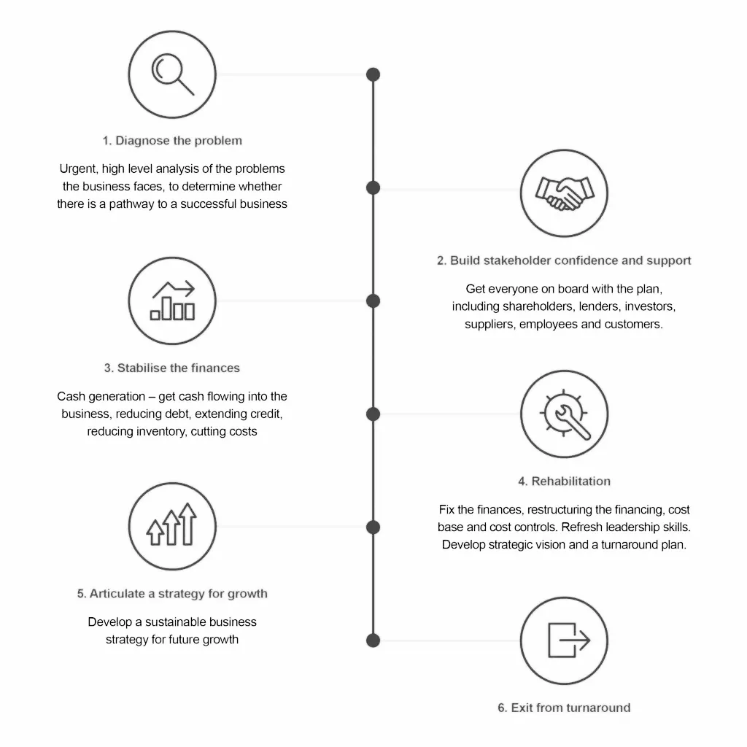
With proven successful experience of the turnaround and transformation process from start to finish, A-FIT can provide any or all of the services required to create, support and deliver the change you need to achieve your goals
Approach
Image copyright courtesy of the IRT

Slide 8
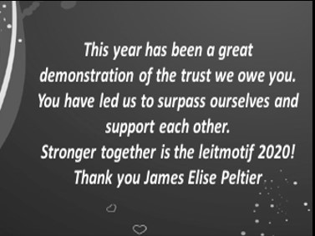
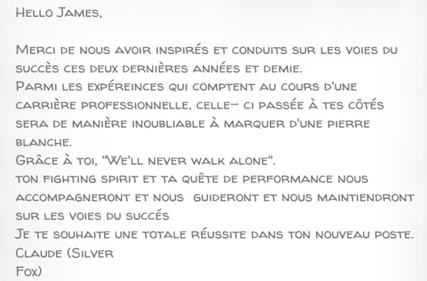
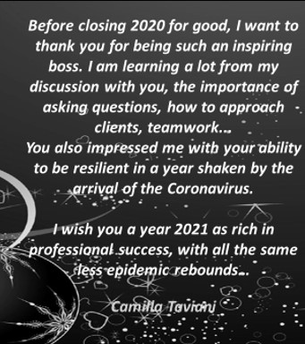
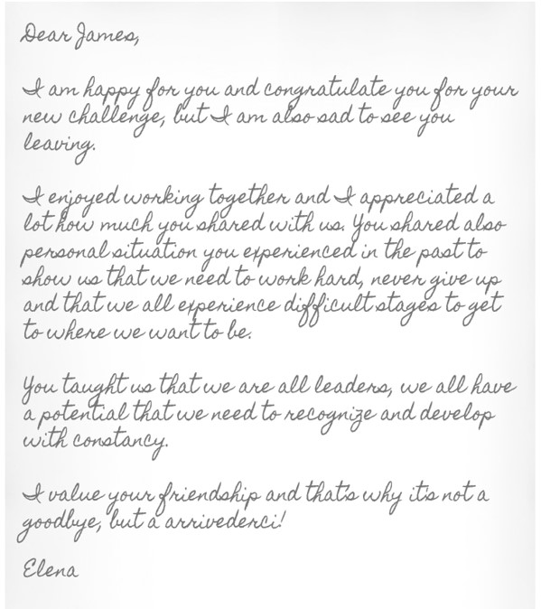
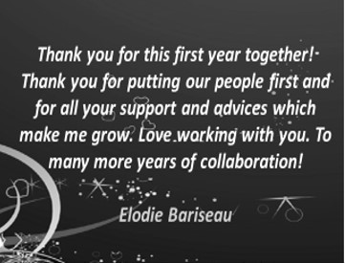

Leadership Testimony
Ultimately a truly effective leader is judged by what they deliver and how they deliver it

Slide 9

Thank you for your time
Please contact me on the details below if you think
that I can be a fit for your organsation in any way
Day Rates and References available on request.
Contracts considered inside & outside IR35.
Fully mobile Monday to Friday across the UK and France.
Full professional indemnity insurance.
Valid British Passport, Driving License and French Carte de Sejour.
Contact Me
+44 (0)7720 148593
: linkedin.com/in/james-morton-5519668
* info@afit.business

