Slide 1

Notes:
2 hour presentation
Pedals, Shoes, Frames, Components, Clothing
Segmentation>Tech>Collection>Positioning

Slide 2
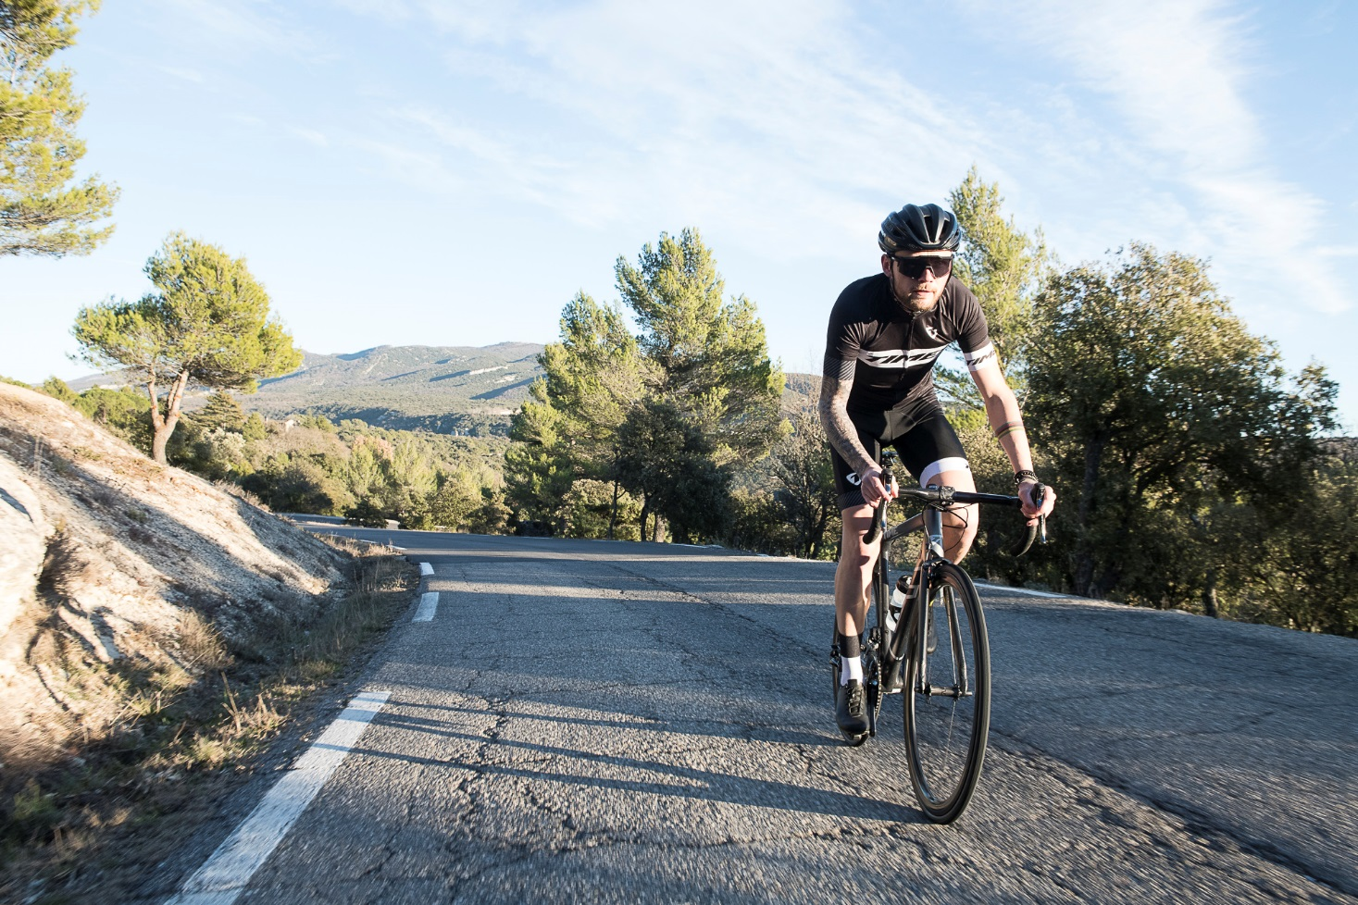
FRAMES

Slide 3
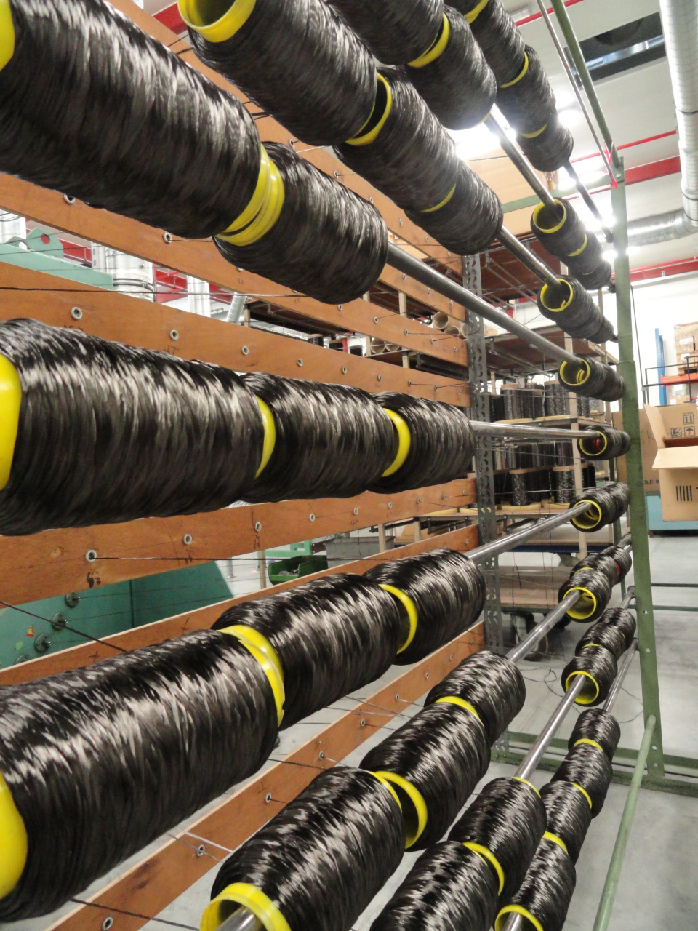

FRAME
Technology
Thread
Our frames start as simple carbon fiber threads combined with other fiber materials to begin creating the structures for our frames
Notes:
Start with a tread

Slide 4
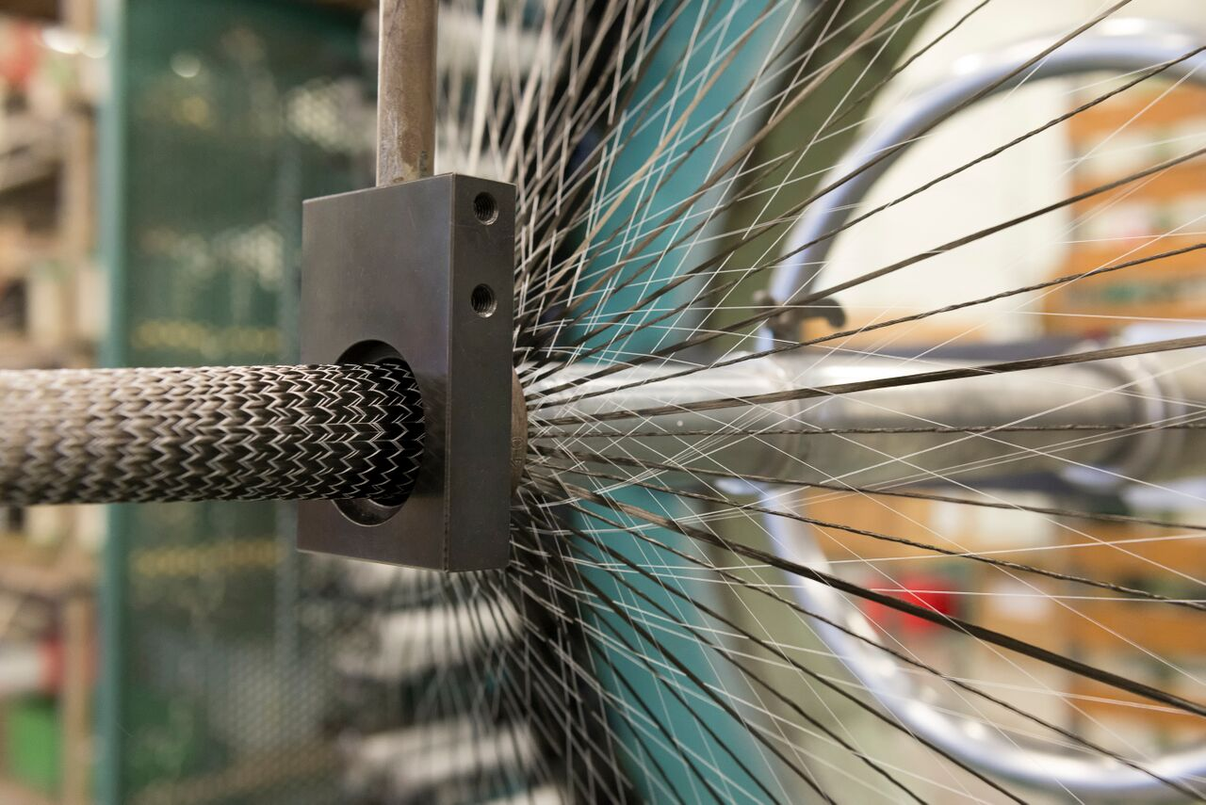
FRAME
Technology
Braiding
We control the orientation and integration of each fiber to create carbon fabric ‘socks’, ensuring individual fibers span the entire tube length, creating a more durable structure with enhanced vibration dampening and responsiveness
Notes:
Tread is braided into tubes
Able to manage materials, weave angle, density, etc

Slide 5
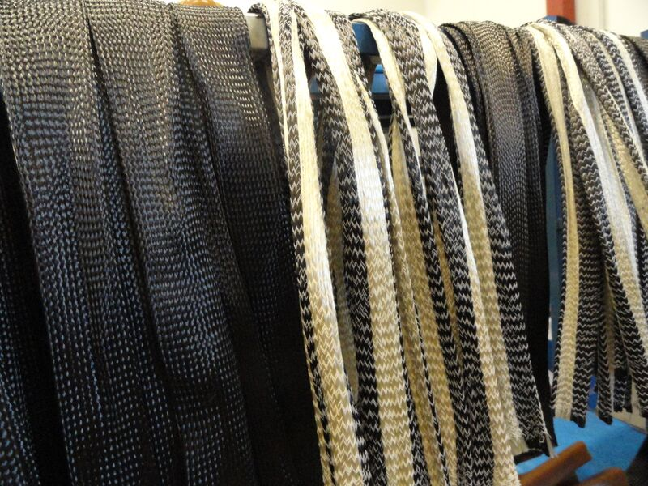
FRAME
Technology
Braided Tube Section
We braid over 100 different types of carbon fiber socks with different combinations of materials like Kevlar, Vectran, and Basalt. The orientation, angles, and integration of each fiber plays a role in determining each tubes unique stiffness or compliance
Notes:
Over 100 different braided tubes.

Slide 6
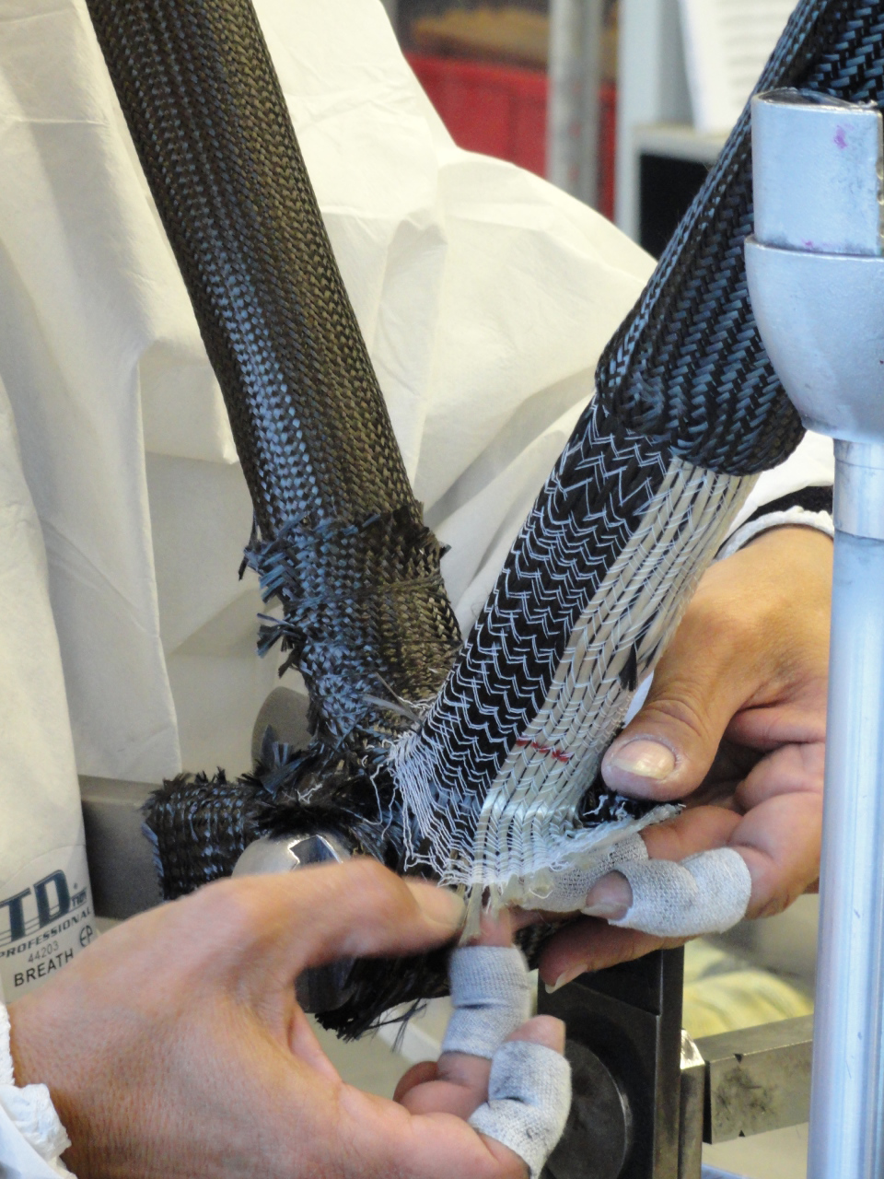
FRAME
Technology
Layup
We pull layers of braided socks over solid, fusible inner molds, ensuring exact inner tube forms, wall thicknesses, and precision placement of each and every braid
Notes:
Joining the braided tubes the frame starts to take place

Slide 7
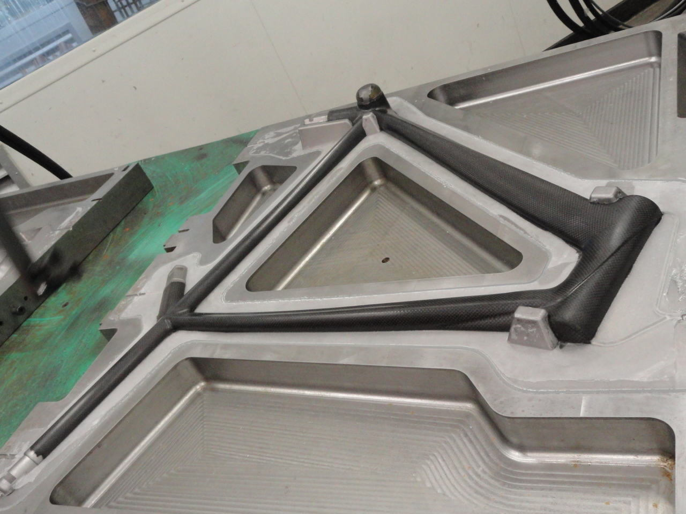
FRAME
Technology
Molding
Each raw frame structure is placed in an outer mold and sealed. Pressurized resin is injected through the dry braids, forcing out air and eliminating structure-weakening voids to ensure a homogeneous construction
Notes:
The frame lay up is placed into a mold. Next step is RTM

Slide 8
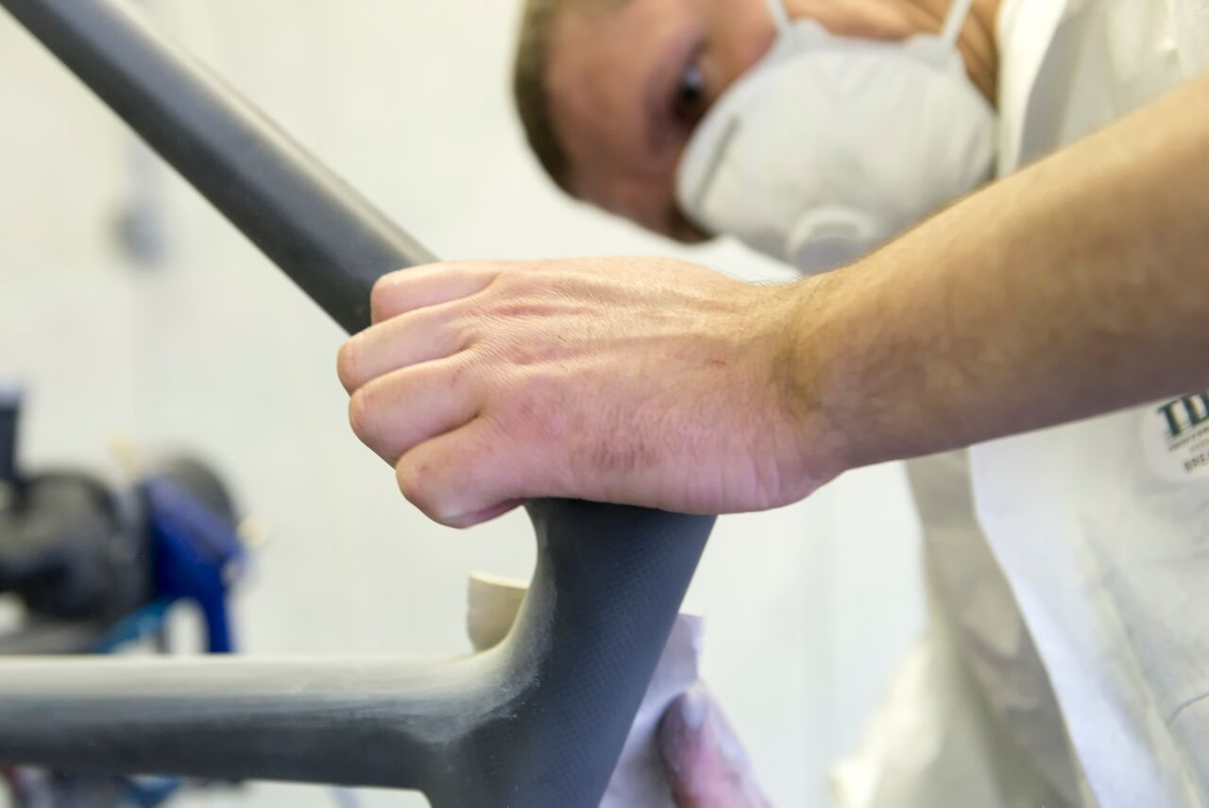
FRAME
Technology
Finishing
After the molding and curing process, the frame is prepped for paint and finishing. We apply several coats of paint and clear coat over decals to ensure a beautiful, long-lasting finish
Notes:
After molding the frame the front and rear are bonded together. CMT dropouts are added.
Sand, paint, decals, clear coat

Slide 9
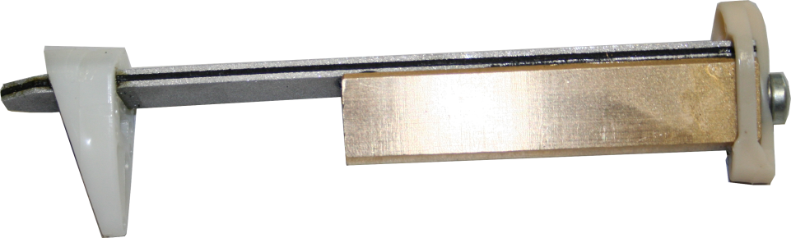
FRAME
Akitv
Two independent blades sandwich elastomer
Blade are able to flex
Blade flex creates sheering of elastomer
The sheering absorbs vibration
Attached mass
Brings amplifies blade flex

Slide 10
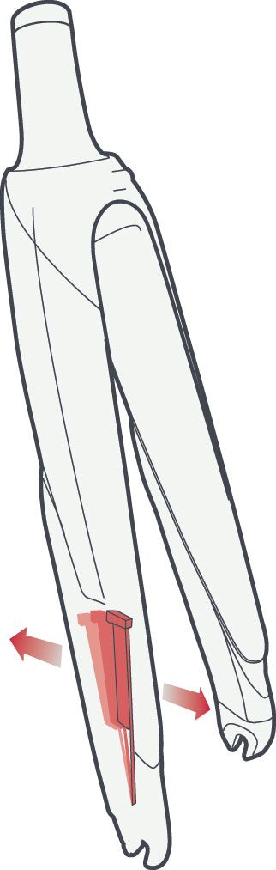
FRAME
Akitv
Comfort
Reduces vibrations by 30%
Performance
Increase in comfort improves performance over time
Steering Precision
Improves tire contact
Increased control in corners

Slide 11
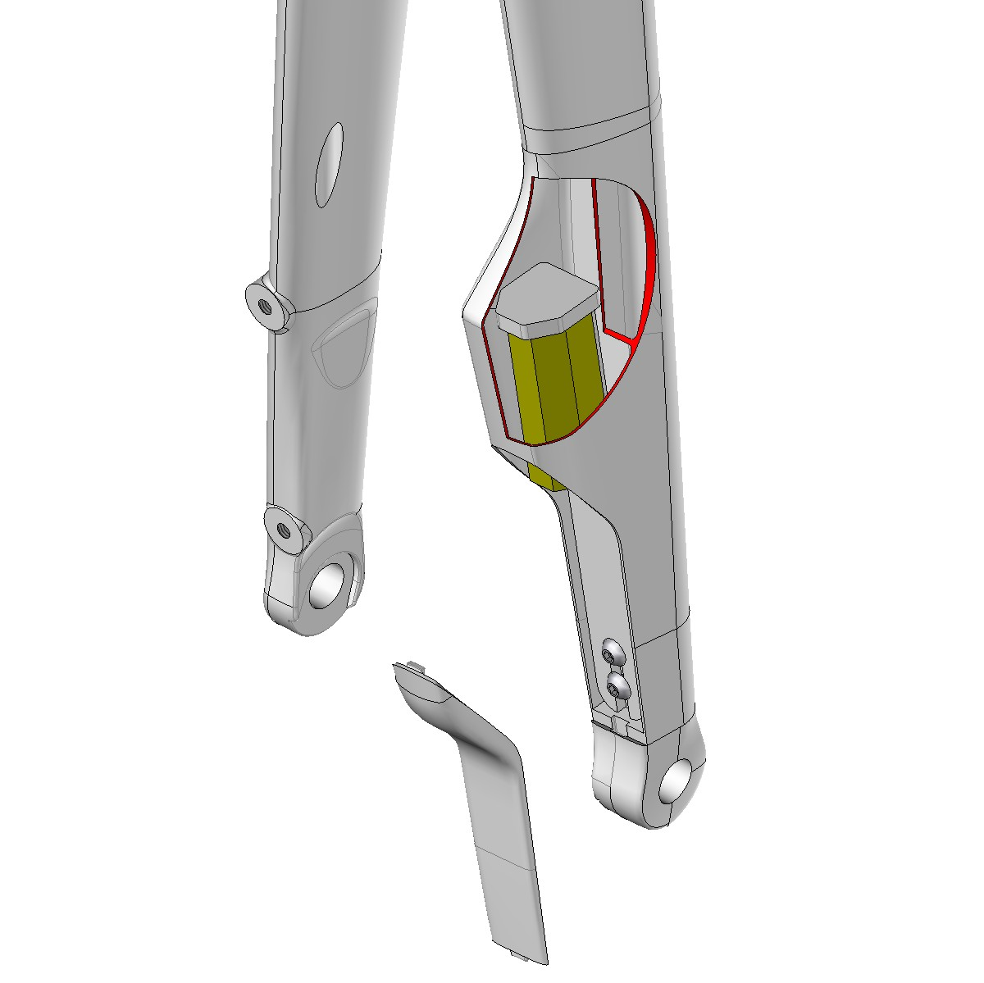
FRAME
Akitv Disc
Numerous vibration analysis have led to a brand new single damper. With an equal mass as 2 dampers, 4 mm wider, the elastomer thickness as been doubled
The additional mass of the damper compensate the mass of the caliper
The right leg is designed in 2 chambers. The damper is isolated against outside conditions while permitting easier access
The damper chamber is open but protected by a removable cover
The fork construction remains the same as the Disc Fork CMT dropouts and inserts
Notes:
New for 2018, Aktiv disc. Big project for the engineers. 1 side of the fork.

Slide 12
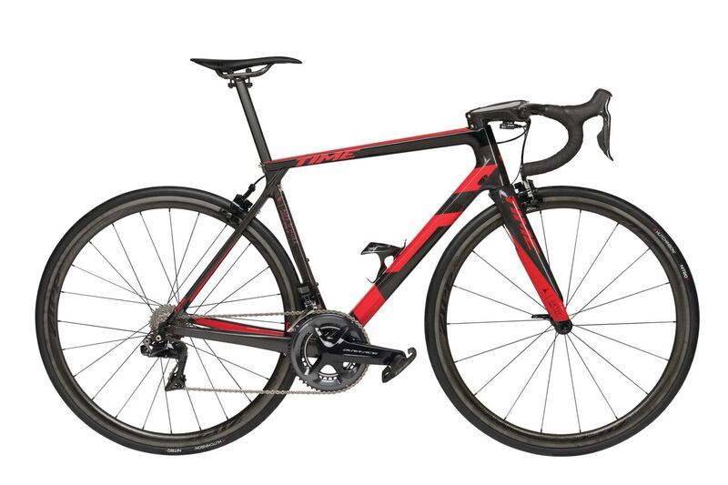
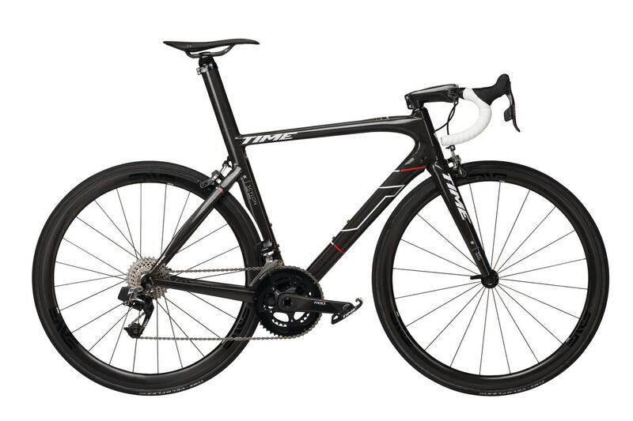
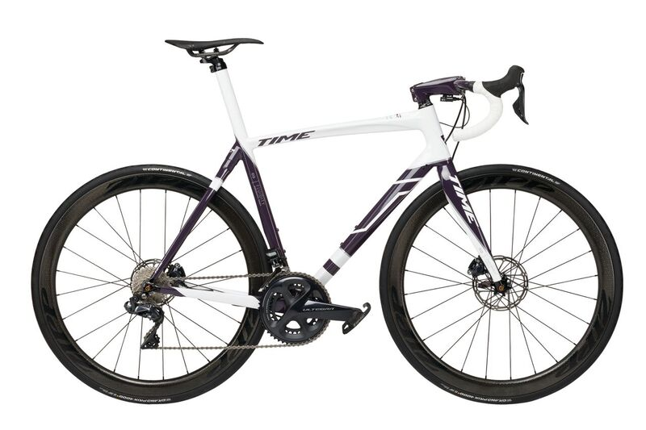
FRAME
Segmentation
Text
CLIMB
Alpe d’Huez
AERO
Scylon
COMFORT
Fluidity
Notes:
Racer or endurance rider

Slide 13
FRAME
Alpe ‘d Huez 01
01
Where lightness and stiffness meet. The new Alpe d'Huez bike is the lightest bike that TIME has ever created. But it is also competitively stiff for power efficiency as well as those surprise uphill attacks, responsive and precise for mountain descents and comfortable for long days in the saddle.
Race geometry
Light and stiff
Precise handling
Seat post only
Notes:
Launched Feb 2018
Lightest frame TIME has made – not super light be industry standard, but still under UCI limit with Aktiv and pedals
Light and stiff for good power transfer to get up a climb, but also comfortable and predictable for the decent.
With updated tube shapes and different carbon rations than our other frames, the Alpe d'Huez is a high performance bike that will fly up and down the hill, power thought a crit or handle a grand fondo with ease.
Paired with the Aktiv fork with built in mass tuned dampers this bike becomes the perfect choice for a high performance ride.

Slide 14

BIKE
Alpe ‘d Huez
Text
Notes:
I’ll let someone else tell you about this bike.
29k views in 2 days

Slide 15
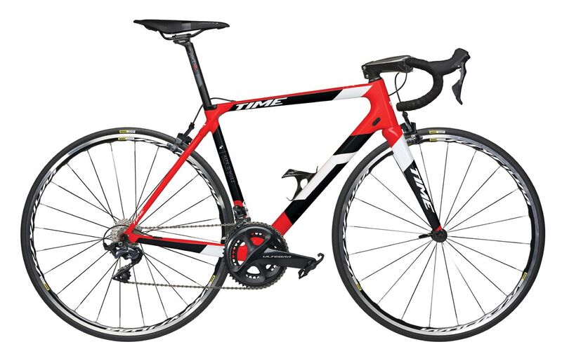
FRAME
Alpe ‘d Huez 21
21
Where lightness and stiffness meet. The Alpe d'Huez 21 is a direct descendant of the Alpe d'Huez 01. It represents the ideal climbing bike for cyclists in search of comfort and versatility in hilly terrain.
Race geometry
Add Basalt fiber
  Comfort
Light weight
Seat post only
Notes:
Two versions 01 and 21
Classic and Aktiv fork now
Disc at end of year

Slide 16
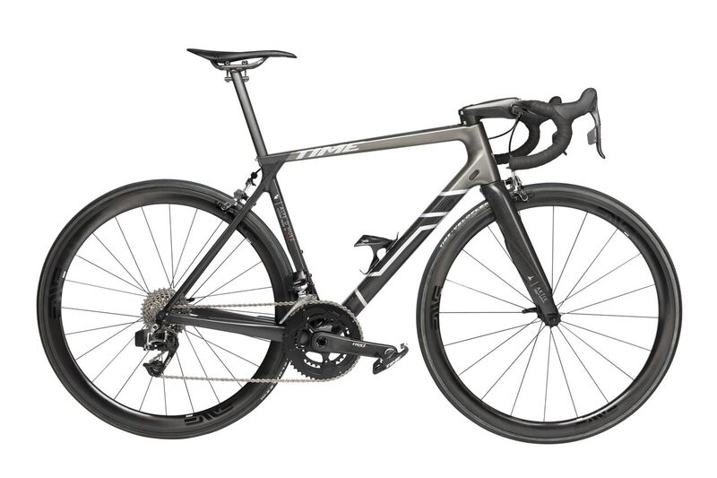
BIKE
Alpe ‘d Huez Ulteam
01 Ulteam
Where lightness and stiffness meet. The new Alpe d'Huez bike is the lightest bike that TIME has ever created. But it is also competitively stiff for power efficiency as well as those surprise uphill attacks, responsive and precise for mountain descents and comfortable for long days in the saddle.
Limited edition
Race geometry
TIME cockpit
DA Di2
ENVE SES 3.4
Notes:
Ulteam is a limited edition, unique frame lay up combined with a dream build.
Limited edition
X left in NorAm
Ultegra Di2, Deda components and Ksyrium Elite
$ USD
$ CAN

Slide 17
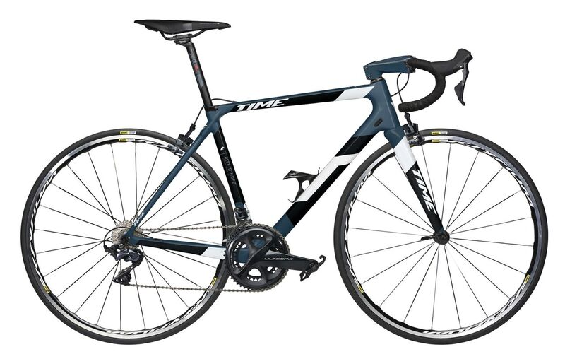
BIKE
Alpe ‘d Huez 21
21
Where lightness and stiffness meet. The Alpe d'Huez 21 is a direct descendant of the Alpe d'Huez 01. It represents the ideal climbing bike for cyclists in search of comfort and versatility in hilly terrain.
Ultegra mech and Di2 builds
Deda cockpit
Mavic Ksyrium
Notes:
New for MY19 we’re able to offer TIME’s reputation in a complete bike.
The Alpe d'Huez 21 is a direct descendant of the Alpe d'Huez 01. It represents the ideal climbing bike for cyclists in search of comfort and versatility in hilly terrain.
Change in layup - Basalt fibers, between fiberglass and carbon fibers, provide comfort without comprise.
Ultegra 8000, Deda components, Ksyrium
$ USD
$ CAN
Ultegra Di2, Deda components and Ksyrium Elite
$ USD
$ CAN
Feedback from key partners has been overwhelming.
Velo Pasadena did not book MY19 with Specialized and BMC so they can sell this bike.

Slide 18
FRAME
Scylon
Scylon
The perfect marriage of aerodynamics and power. Scylon – the ultimate racing frame – where every detail has been designed and developed to create a true racing machine.
Aero
  CFD tubes
Stiff, light and powerful
Responsive
Notes:
The ultimate blend of aerodynamics and power – Scylon is an all-around racing machine.
Light enough for serious climbs with the responsiveness for all out sprints.
The perfect ride for all situations.

Slide 19
FRAME
Fluidity
Fluidity
Perfect for long rides – resilient, comfortable and versatile. With Fluidity, every ride will exhilarate without compromise.
Endurance geometry
Add Vectron
  Comfort
Comfortable and responsive
Notes:
The Fluidity is perfect for long rides – resilient, comfortable and versatile.
The geometry of the Fluidity has been designed for longer days and increased comfort. Upright position, making it more comfortable for longer rides.
VECTRAN® fibers in Fluidity. They absorb road vibrations add optimal comfort for the rider allowing them to ride faster, longer.

Slide 20
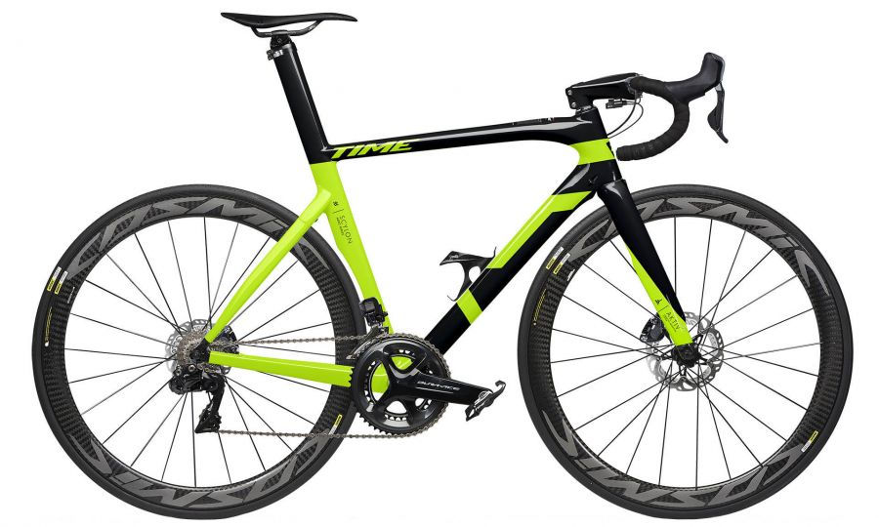
FRAME
Options
Rim or Disc Brakes
Classic or Translink Seat Post
Classic or Aktiv Fork
Stock or Custom Color
Notes:
3 frame designs
Pair with these options
Most common is Aktiv fork with classic seatpost

Slide 21
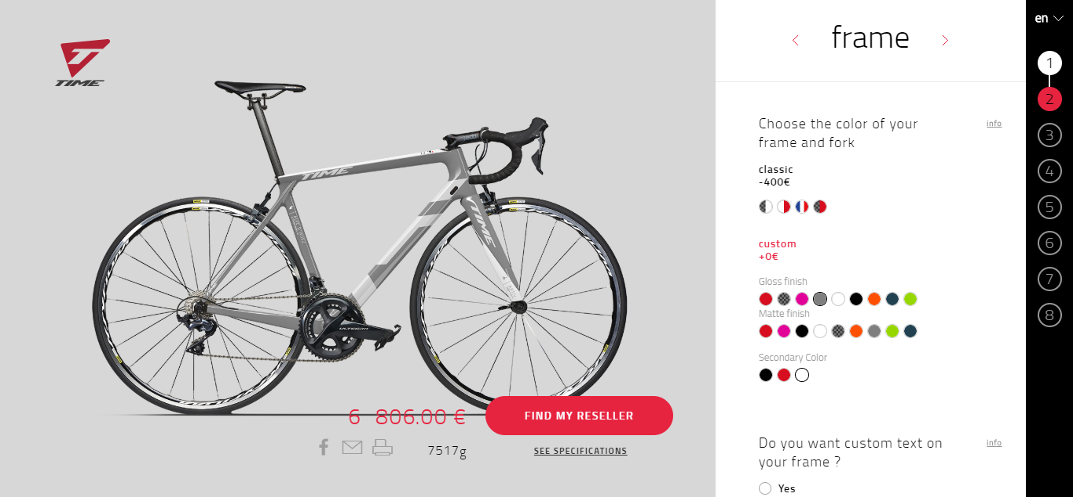
FRAME
Custom
text
Notes:
Design online
Stay in template and use color options – options vary by frame model
Gloss or matte finish
Custom text
Option to build out complete bike – we can supply complete or shop can source kit
6-8 week lead time
Upcharge $ whsle, $ M/SRP

Slide 22
COMPONENTS

Slide 23
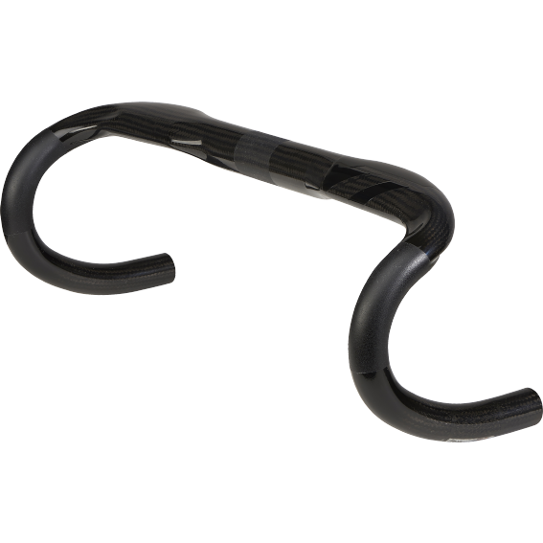
COMPONENTS
Bar
Ergodrive
HM and HR fibers integrated carbon reinforcing sleeve. Integrated cable housing channels with removable ergonomic covers.
Three sizes
  42, 44, 46
RTM
Ergo top
Notes:
RTM
Measured outside-outside
Stock is gloss carbon
Available in matching custom color with no upcharge

Slide 24
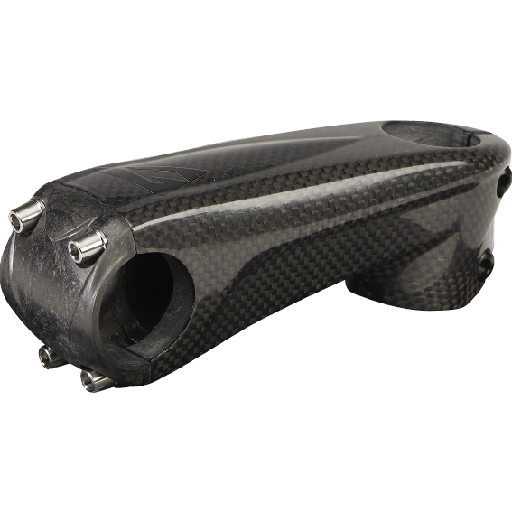
COMPONENTS
Stem
Monolink
Reliability, security and optimal tightening with a 4 bolt system (TIME patent). Carbon stem body with CMT insert and cap. The two CMT inserts are bonded by a structure in RTM.
90-130 by 10mm
RTM
CMT
Ti hardware
Notes:
RTM and CMT
90-130
Stock is gloss carbon
Available in matching custom color with no upcharge

Slide 25
CLOTHING
Notes:
Many request for TIME branded clothing by frame dealers
$1k order yesterday

Slide 26
CLOTHING
TIME by Louison Bobet
Notes:
New partnership with Louison Bobet
LB was French cyclist who race TDF. Results???
High end clothing brand with French flare
The are promoting TIME with this partnership
Unique offering to NA dealers

Slide 27
CLOTHING
TIME by Louison Bobet
Notes:
2 fits – race and relaxed

Slide 28
CLOTHING
TIME
Notes:
Made in Italy
Euro sizing
Race
French Edition
AdH

Slide 29
Notes:
A history second to none
The rebuild of the company
New resources
New products
Let’s take a break then we’ll go into detail with the 2019 collection

