Slide 1


Burnout and the Brain.
An Introduction to Cognitive and
Organizational Ergonomics.
.
Michael R Privitera MD MS
Professor Emeritus of Psychiatry, URMC
Medical Director, Medical Faculty and Clinician Wellness Program, URMC 2015-2022
Chair, MSSNY Task Force on Physician Stress and Burnout, 2015-2019
Faculty, Institute for Healthcare Improvement. Boston MA, 2022-2023
Website: www.MichaelRPriviteraMD.com
Healthcare Association of New York State (HANYS),
Healthcare Innovation and Lean Network of New York (HILNNY).
June 4, 2024.

Slide 2
Learning Objectives
By the end of this session, participants will be able to:
Define, recognize and recite ways to reduce extraneous cognitive load in an organizational system;
2. Apply principles of cognitive and organizational ergonomics that are transferable between environments and situations
Plan
Historical analogy of “invisible” hazards.
Impact of uncontrolled stress on clinician brain, wellbeing, quality and safety.
Concepts from Human Factors/ Ergonomics (HFE) Science that can be used in everyday operations to “see”, anticipate and reduce risk of harm from work environment.
Where this is headed/ Next generation development
Supplemental slides at end for more application.

Slide 3
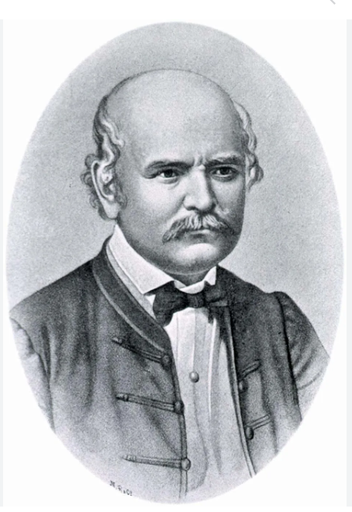
Historical Example: Invisible Hazard:
Culture, Halo Bias impaired recognition of real pathological factors.
Early pioneer of antiseptic procedures, used scientific method.
1861: Handwashing enforced to prevent puerperal fever (childbed fever).
Ideas rejected by medical establishment.
  Offended superiors, alienated colleagues, was ridiculed.
  Dealt with Halo bias. Was told: “Gentlemen don’t have to wash their hands”.
  Later: Germ theory of disease accepted 1880-1920.
  Afterward was called “Savior of mothers”
His personal journey was difficult:
  Colleagues arranged his admission to a mental institution.
  Beaten by guards while trying to escape, died of sepsis from injuries.
Ignaz Philipp Semmelweis
Hungarian Physician.
1818-1865.

Slide 4
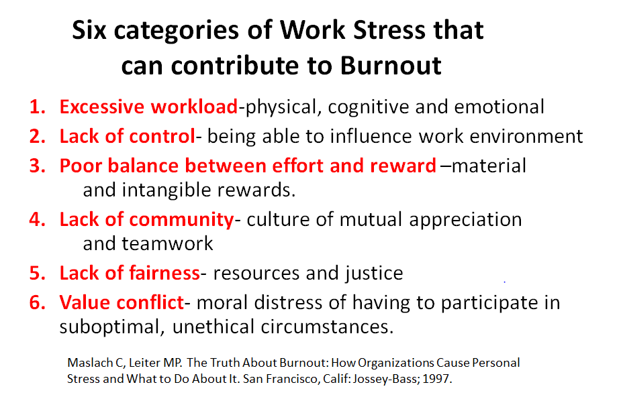
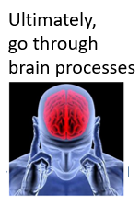
“Moral Injury", "Integrity Outages”

Slide 5
Medical Error and Clinician Burnout:
Both Have Systemic Contributions
Majority of errors in healthcare are result of systemic influences.¹ The Institute of Medicine (IOM) 1999 Report, To Err is Human: Building a Safer Health System
The majority of occupational stressors causing burnout are result of systemic factors.²
The quality paradox: Many well-intended interventions to improve quality, safety or value, when taken in total, are contributing to health system dysfunction by cumulative impact on workload and burnout at the point of care.³
The higher the cognitive load the higher the risk of burnout⁴
The higher the cognitive load the higher the risk of medical error⁵
Kohn, L.T., Corrigan, J., Donaldson, M.S. , To err is human: building a safer health system. 2000, Institute of Medicine. National Academy of Sciences: Washington, D.C
Privitera MR, Attalah F, et al . Physicians’ electronic health record use at home, job satisfaction, job stress and burnout. 2018 Journal of Hospital Administration. Vol 7, No 4.. 52-58
3. Sinsky CA and Privitera MR. Creating a Manageable Cockpit: A Shared Responsibility. JAMA Int. Med . June 2018.; 178( 6):741-42
Harry E Sinsky C et al. Physician Task Load and Risk of Burnout in US Physicians in a National Survey. The Joint Commission Journal of Patient Safety 2020 000: 1-10.
Pickering BW, Herasevich V et al. Novel Representation of Clinical Information in the ICU. Appl Clin Inform 2010 1(2) 116-131
5

Slide 6
Cognitive and Organizational Ergonomics
Cognitive ergonomics: Human/Machine & Human/Human interactions.
Addresses mental processes: Perception, memory, thinking, and how affected by the interaction with the system.
  Optimizes: Mental effort, decision making, interaction with computers, human reliability and work stress.
Organizational ergonomics: Human(s)/System interaction.
Optimization of People systems and Technical systems –
  “Socio-technical Systems” [STS]- includes organizational structure, rules and processes
STS design principles:
  Jointly optimize people and technology systems in organization
  “Environmental sensor” feedback to leadership.
[In healthcare, sensors = patients and clinicians]. Process helps efficiency, quality, sustainability, economic success and wellbeing of staff.

Slide 7
Professions Who Manage Cognitive Load Hazard
  Airline pilots
  Astronauts
  Air traffic controllers
  Nuclear power workers.
  Simultaneous Translator at UN
Yet…… little such management in the healthcare work environment.

Slide 8
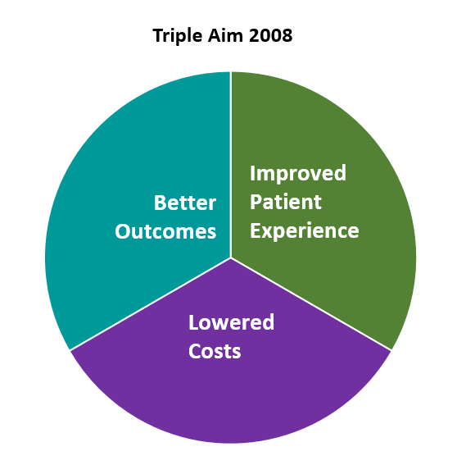
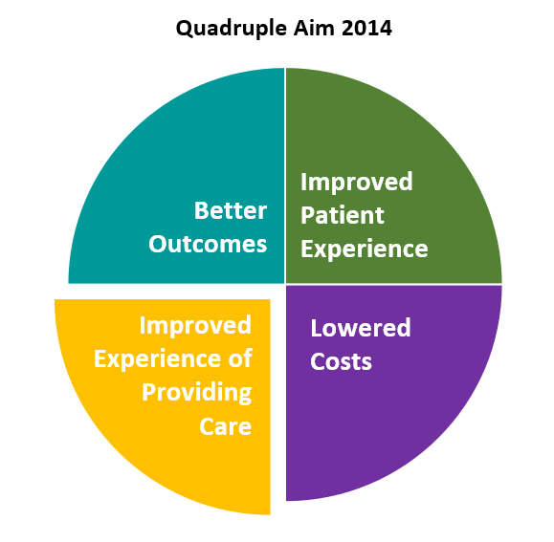
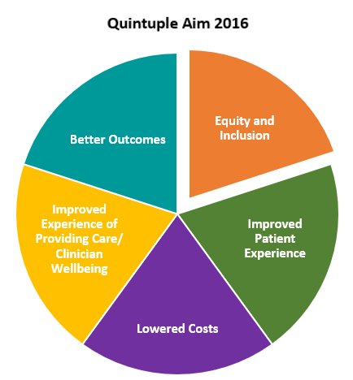
Contributory Influences in US Healthcare Delivery Framework
1999-“To Err is Human” (IOM)
2023 CDC/NIOSH
Impact Wellbeing Guide:
“Integrate Professional Wellbeing into Quality Improvement”—
As a quality metric, should be included in payment systems.
1990s-Patient Safety Movement- just get it right
2003- Centers for Medicare and Medicaid (CMS) Pay for Performance (P4P) “Quality Metrics”
2013
William Spinelli:
“Burnout is the phantom limb pain of the Triple Aim*”.
2000 Leap Frog Group (Business Consortium) influencing healthcare financially-pursuing “value”
2009 Meaningful Use Criteria
2010 Affordable Care Act
2010 Triple Aim Framework comes to payment systems:
Centers for Medicare and Medicaid (CMS) -
Payment system still remains Triple Aim based→ → →
Experience of Providing Care [Human Factors/Ergonomics and Wellbeing]
  Important as guide to device design companies, regulators, legislature and other decision-makers
8
*Spinelli W. The phantom limb of the triple aim Mayo Clin Proc . 2013 Dec;88(12):1356-7. doi: 10.1016/j.mayocp.2013.08.017.

Slide 9
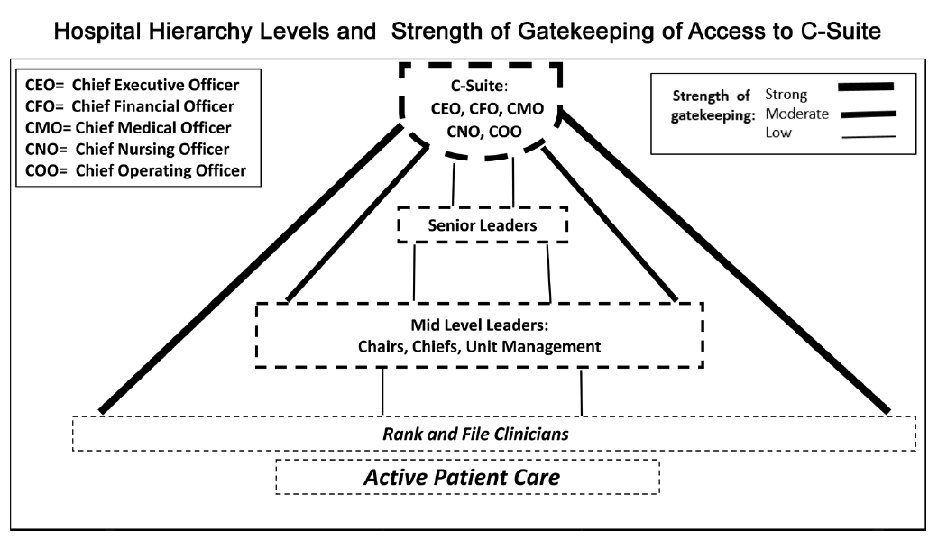

Communication Flow in Medical Centers
National, State, Local Authorities, Regulators, Accreditors, Payers, Industry thought leaders, Healthcare Consultants, etc.
Directly Influence Healthcare Leadership (C-Suite).
Missing:
Feedback
information
systems to
Leadership and
should encourage Psychosocial Safety in Culture.
Would help
optimize “people” component,
balance “technology” component, and improve quality output of
organization.
Communication flow to clinicians and staff.
Structure creates chronic
Leadership “Anosognosia*”
(don’t know what they don’t know).
*Anosognosia= In neurology is a lack of awareness of deficits due to brain injury (often right hemispheric stroke)
Body’s feedback system was damaged, don’t get needed information to the brain to make best self-protective decisions.

Slide 10
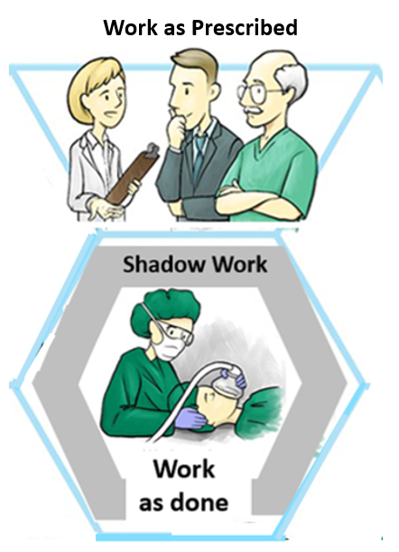
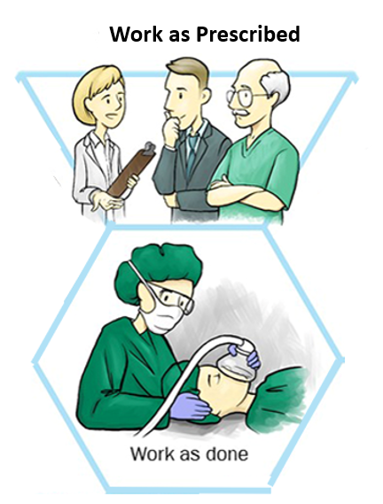
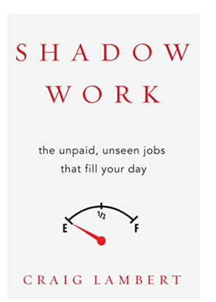
Gap between Work as Prescribed and Work as Done
Work as Prescribed + Shadow Work = Work as done
Job Metrics only pick up:
“productivity” units:
Shadow Work:
Unseen, unpaid jobs that fill their day. Work not “seen” in system metrics.
Efforts by staff- behind the scenes- making up for system deficits to keep it functional.
Major source of unnecessary Cognitive Load.
Varies one location to another (due to local management decisions). However, job metrics from one institution to another get compared (inaccurately).

Slide 11
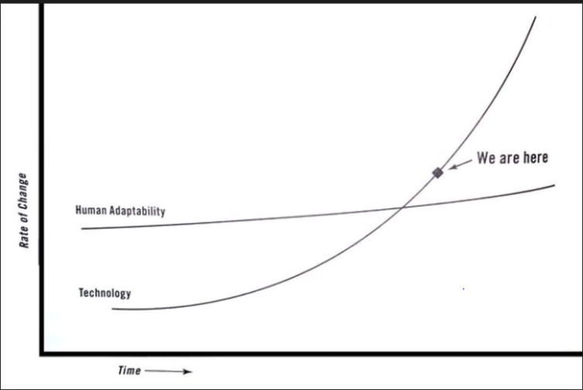
Technology Rate of Change Surpassed Human Adaptability-
Human Impact is Profound
Results in:
  Increased connectivity, tracking, accountability, and
  expectations beyond work hours
  Accelerated rate of change.
  Increased collaboration, creation of new things—
  Effects every aspect of life: Society, commerce, government, elevated expectation norms.
Need to acknowledge .
See and manage new risks.
Adapt methods of leadership, education, resource allocation.
Currently
Technology costs low, personnel costs high ->
  Leads to a decrease in staffing
Human Adaptability
Spins off more “shadow work” on remaining employees
Surrounding culture “normalizes deviance”,
Dampens internal feedback that we are living in
dangerous and unsustainable circumstances
Technology
*Adapted from Teller E. and Moore G. in Friedman T. Thank you for being Late. Farrar, Straus Giroux Publishers 2016
# Lambert C. Shadow Work. The unpaid, unseen jobs that fill your day. Counterpoint. Berkley. 2015
11

Slide 12
Neurobiology of Clinician Distress and Burnout
Burnout is linked to uncontrolled stress coming from reduction of a clinician’s sense of control over their own practice¹.
Uncontrollable stress, but not controllable stress, impairs the functioning (and structure) of the prefrontal cortex (PFC^{)1.}
Exposure to chronic stress: Cascade of events leading to cerebrovascular dysfunction.
  Leads to structural and functional effects like Hypertension (HTN):
  Endothelial injury, increases wall thickness, vessel resistance, stiffness,
  arterial atherosclerosis and impairs cerebral blood flow “auto-regulation”².
Understanding neurobiology may help clinicians have a more informed perspective to help relieve or prevent symptoms of burnout.
May help administrative leaders to optimize the work environment to create more effective organizations.¹
Efforts to restore a sense of control to physicians may be particularly helpful¹.
1.Amy F.T. Arnsten, PhD, and Tait Shanafelt, MD Physician Distress and Burnout: The Neurobiological Perspective Mayo Clin Proc.2021;96(3):763-769
2. Nada Elsaid, Ahmed Saied, Heba Kandil et al. Impact of stress and hypertension on the cerebrovasculature.. Frontiers in Bioscience-Landmark 26(12). 1643-1652,
DOI:10.52586/5057.

Slide 13

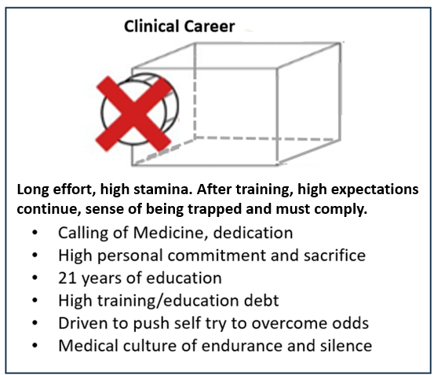
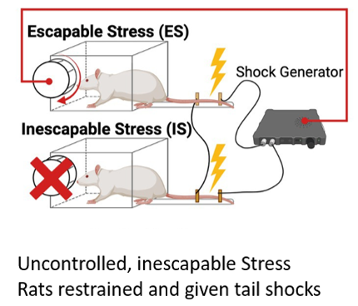
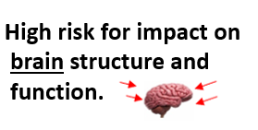
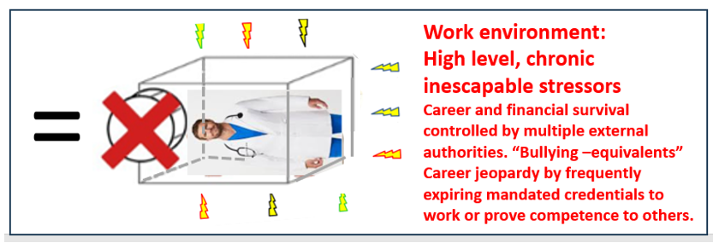
Human and Animal Research
Clinician Career Similarity
Brain performance, anatomy and physiology affected by:
Uncontrolled stress: Out of the control of the subject to escape from or end the stress.
+

Slide 14
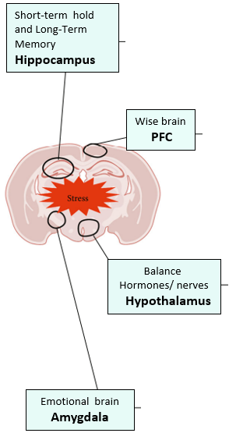
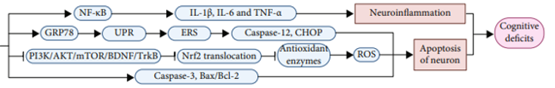
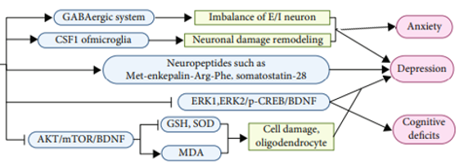
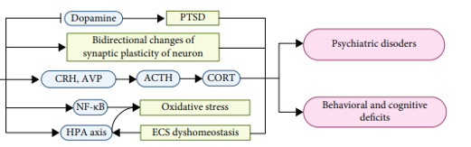
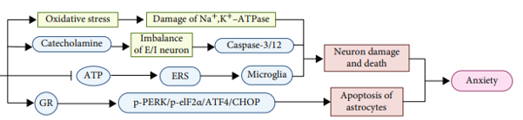
STRESS, BRAIN INJURY AND DISEASE: SUMMARY RESEARCH
Clinician Brain
Uncontrolled stress- situationally inescapable,
Pre-clinical phase biological changes. Inflammatory cytokines, cortisol, chronic glutamate (excitatory) excess , enzyme changes,
Endothelial impact-microvascular atherosclerosis, stiffness, autoregulation impaired, small bleeds and infarcts.
Brain impact Microvascular changes,
negative neuroplasticity
White matter> Grey matter.
Work Environment
Chronic Occupational Stressors
Wise brain
Prefrontal
Cortex (PFC)
Clinician
Symptomatic
Impact
Adapted from Guo H, Zheng L, Xu H et al. Hindawi. Oxidative Medicine and Cellular Longevity. Volume 2022. Article ID 8111002. Pages 1-17. Https://doi.org/10.1155/2022/8111022

Slide 15
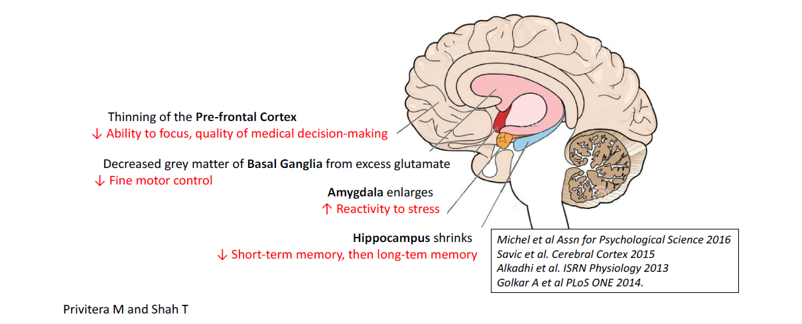
Neuroanatomical Impact of Burnout
Figure from: Privitera MR. Promoting Clinician Wellbeing and Patient Safety Using Human Factors Science:
Reducing Unnecessary Occupational Stress. Health 2022. (14) 1334-1356

Slide 16
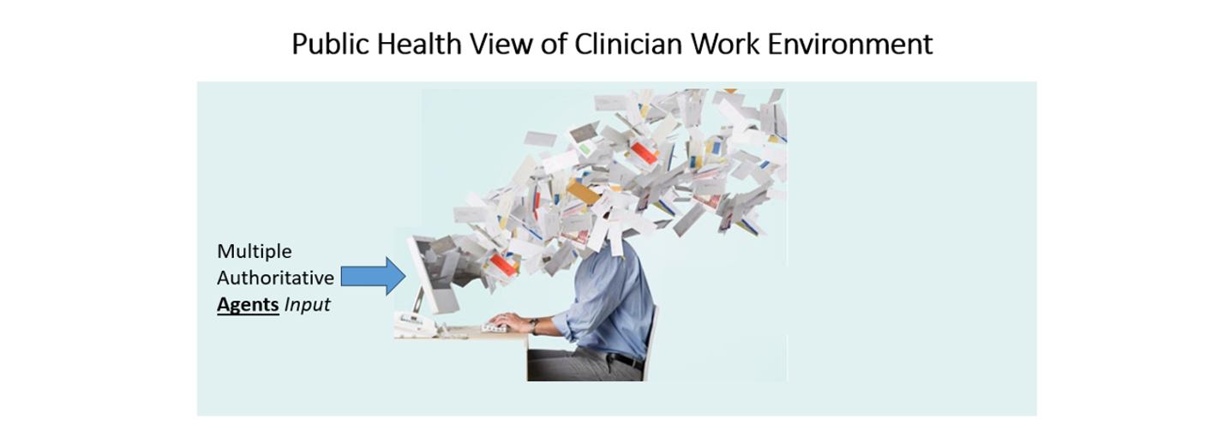

Nowadays… Less Work is Physical and More is Cognitive Work.
Cognitive Work. Harder to quantify. Multiple expectations add up to more than is possible in 1 FTE.
Leadership not aware of danger since comes from valid authorities (Halo bias).
  Authorities do not keep track of each other’s requirements.
  No single agency oversees or keeps track of total expectations.
    Only convergence path is at Hospital Administrative C Suite, through which all requirements flow.
    Only control at institution is HOW TO IMPLEMENT requirements……..enter Cognitive & Organizational Ergonomics.

Slide 17
Factors that Affect Cognitive Overload
Too much information supply
Too much information demand
Constant multitasking and interruptions
Online misbehavior increases security procedures for those legitimately using system.
Authorities that generate the information have inadequate awareness of total additive impact made.
Workplace Infrastructure inadequate to reduce the individual’s need for:
    Planning
    Facilitating
    Managing
    Monitoring
    Reminding
    Classifying
    Sorting for salience
Adapted with update additions, from Kirsh, D. A Few Thoughts on Cognitive Overload. Intellectia 1(30) 19-51. 2000

Slide 18
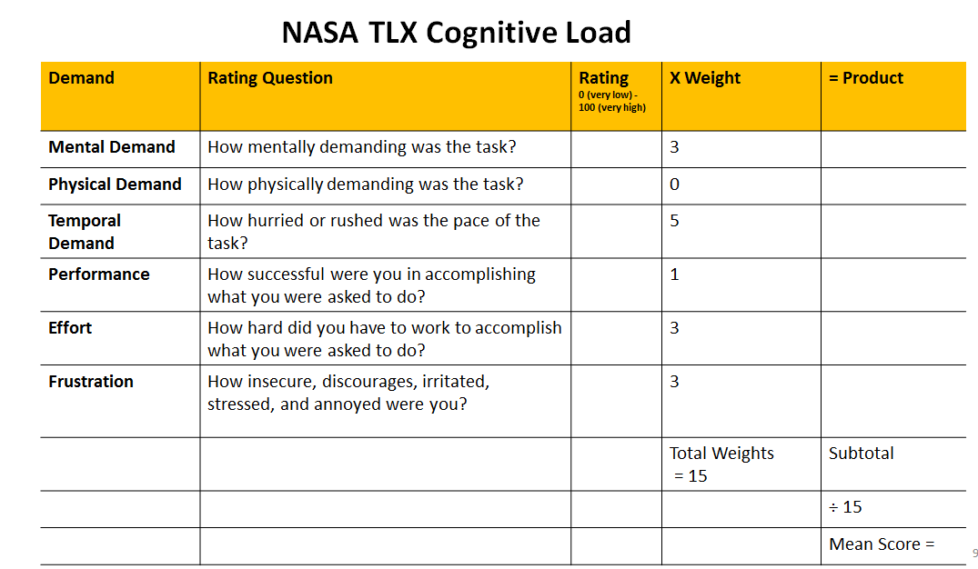
NASA TLX Cognitive Load

Slide 19




Thinking Processes
Brain cells (neurons) need glucose and oxygen
  Types of Cognition
  Automatic Thought (Low brain resource use) Habit Memory, System 1 Thinking.
    Stimulus → response in behavior. Routines.
  When low resource state, brain switches to Automatic thought (fatigue, stress, sleep
  deprivation).
  Controlled Thought (High neural resource use), Executive Function, Cognitive Flexible Memory, System 2 Thinking.
    Differential thinking in diagnosis, choosing pros/cons of treatment, etc.
    Highly trained, limited and “expensive” resource, needs to be restored.
    Predominant brain resource reason patients see us.
  Default Mode Network (DMN).
  Intuition, daydreaming, creativity, insights, meditation, mind-wandering, resting state. “Reset button” occurs here. Restorative of brain resources.
Task Positive:
Working on a Task
Task Negative:
Not working on Task

Slide 20
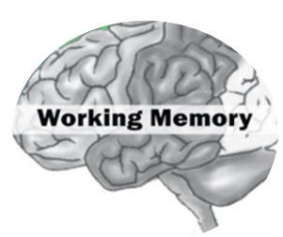
Brain Resources and
Controlled Thought Processing
Mental processing occurs in Working Memory (WM).
Utilizes brain resources, which are finite.
Operates over 15-30 seconds to process, manipulate information,
  learn new material, problem-solve, retrieve from long term memory.
  How information is presented affects quantity of brain resources used.
  “Allocating brain resources” = “allocating attention”¹.
Cognitive Load (CL): Measure of information held and processed in WM at one time.
  CL has three divisions: Intrinsic, Germane and Extraneous Cognitive Load.
  Higher Total CL → more brain resources consumed.
  All humans have Cognitive Load threshold. If exceeded can lead to medical error.
Harry E, Sweller J. Cognitive Load Theory and Patient Safety. In Ruskin KJ, Stiegler MP and Rosenbaum SH. Quality and
Safety in Anesthesia and Perioperative Care. 2016. pp 16-21. Oxford University Press.

Slide 21

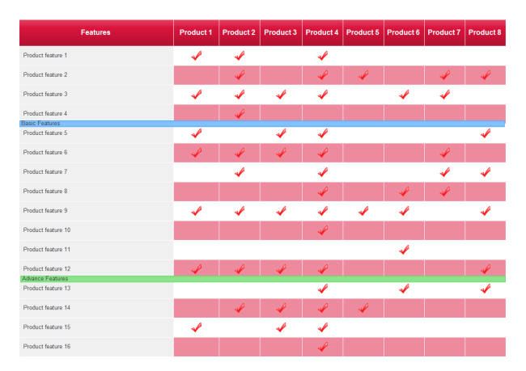
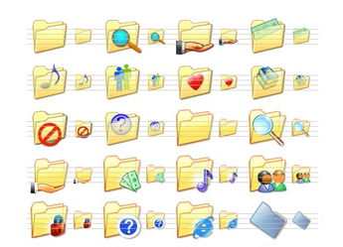
Working Memory Limitations
Examples of Our Work-arounds
Dashboards- at-a-glance views of data sets relevant to operation toward a particular objective .
Cross-comparison Chart- Side-to-side comparisons of two or more sets of data.
Helps illustrate similarities, differences, learn new material, make decisions, draw conclusions.
Folders/ Directory. Contain group of related items or documents.
    Super-ordinate, basic, sub-ordinate categories
Brain can more easily and quickly comprehend and find related information for decisions or material to be used.

Slide 22
Controlled Thought
Cognitive capacity
Germane load: Cognitive effort in making mental model into Long Term Memory(LTM) or recognition and retrieval.
Extraneous load:
Cognitive effort that is unnecessary and can be removed with better design
Intrinsic load: Inherent level of cognitive effort for task-complexity. (simplify where possible)
Healthy
Load
Mental Reserves
Effort in receiving/ sorting through and integrating three different family members calling clinician with same history-->
Solution: One Family representative elected.
Components of diagnosing Congestive Heart Failure.
Taking a history of symptoms.
Forming a
mental model
of the information obtained that matches LTM model.
Examples in Practice
Want to reduce Extraneous Cognitive Load to free up Working Memory resources to process Intrinsic Load.
Most optimal information presentation method keeps Germane Load efficient—well studied in Education Literature.
22
Notes:
The more complex the task or goal, the lower the tolerance for extraneous load.

Slide 23



Brain Resources (Attention) Used By These Activities.
If Unnecessary is Extraneous Cognitive Load
Decision making (no matter the size of decision, e.g. too many EMR clicks)
Sorting and classifying information- (e.g., device layout, where to routinely find information)
Multitasking and getting back on track after interruption
Demanding your attention (e.g. Best Practice Alerts (BPAs)-> instead consider calling attention i.e. by font size, color used, location)
Splitting attention (excessive time or distance between getting information and executing action)
Self-regulation (to maintain professionalism despite how treated or medically dealing with patient stress/injury/ bleeding, etc.- “aequinimitas” : coolness, presence of mind despite the circumstances. .
Emotion work (dealing with sadness, loss, compassion for distressed patients or families, or the moral distress from working conditions)
Notes:
This is busy but I liked it as it showed so many cog load culprits
CONSIDER TAKING OUT A COUPLE OF THE MORE DETAIL ORIENTED ONES LIKE “MAINTENANCE OF GOALS” AND “UPDATING WORKING MEMORY”

Slide 24
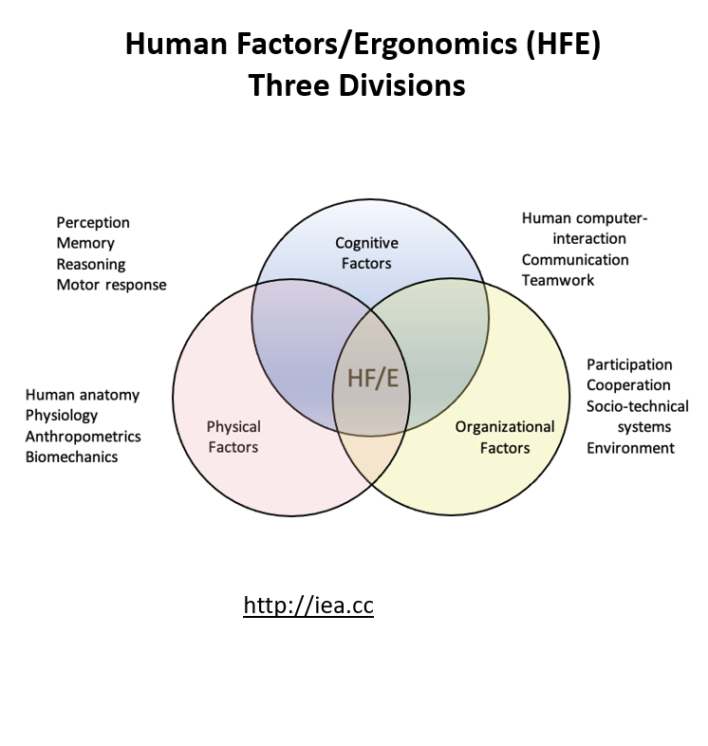
  Goal: Optimize worker well-being and overall system performance.
    Patient safety is a component of system performance.

Slide 25
Organizational (Macro) Ergonomics
Two Major Precepts:
  1) “Think big(ger)… Think Systems”
  2) “Good ergonomics is good economics¹”
  (Attributed to Hal W Hendrick: “Father of Macro-Ergonomics” )
Macroergonomics : Structure and processes of the overall work system.
  How to modify them to be more effective.
Jobs and human-machine interfaces are compatible with the work system's design²
(human/ work system interface).
Workplaces designed with HFE principles: Better performance and economic results.
“Simply and unquestionably good business”³ .
Holden, R.J., Rivera, A.J. and Carayon, P. (2015) Occupational Macroergonomics: Principles, Scope, Value, and Methods. IIE Transactions on Occupational
Ergonomics and Human Factors , 3, 1-8. https://doi.org/10.1080/21577323.2015.1027638
2. Hendrick, H. W., & Kleiner, B. M. (Eds.). (2002). Macroergonomics: Theory, methods, and applications. Lawrence Erlbaum Associates
Publishers. https://doi.org/10.1201/b12477
3. Hendrick HW.(2003). Determining the cost-benefit of ergonomics projects and factors that lead to their success. Applied Ergonomics, 34, 419-427.

Slide 26
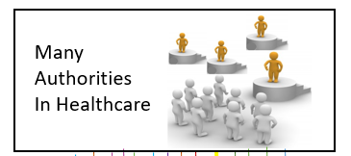
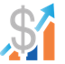
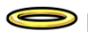
Reasons for Invisibility of Human Factor Effects
Non familiarity with terms and concepts of Human Factors/ Ergonomics
Authority effect- We do what national state or industry authorities tell us to do.
Financial measures frequently change
Surge of metrics and mandatories
“Pay for Performance”- requires “quality”, “value” or “safety” measures.
Consumes leadership attention
Costs silos—obscures how costs relate to each other
Halo bias-
Assigning the term “quality” or “patient safety” to a process may reduce questioning the science behind it.
Assumption: Must be good since termed “quality” or “safety” metrics
Logic becomes circular and self-perpetuating- despite accumulated total harm.

Slide 27
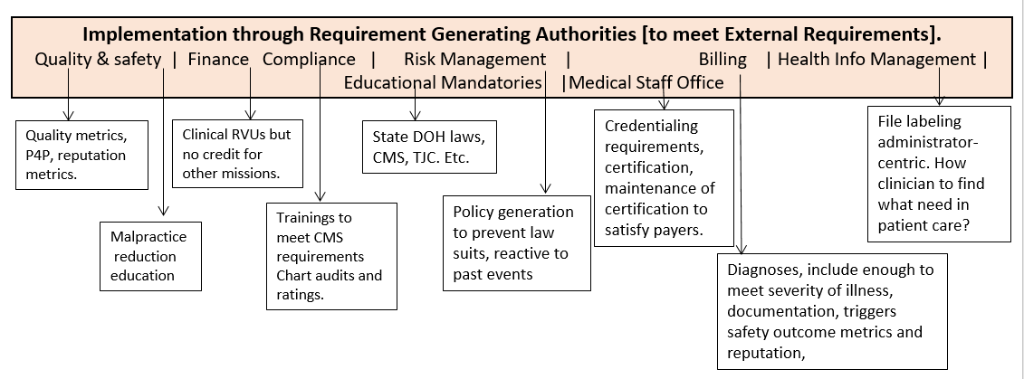
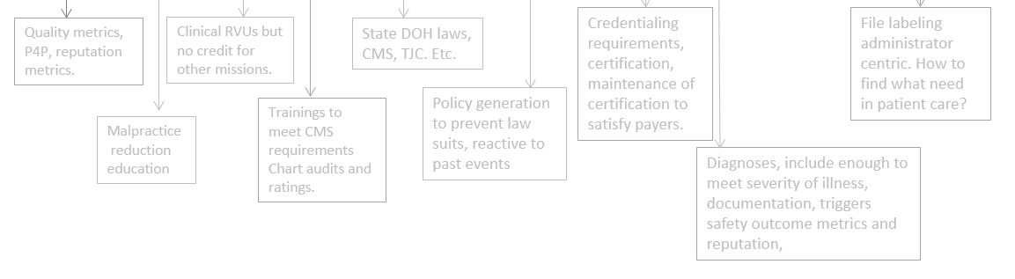
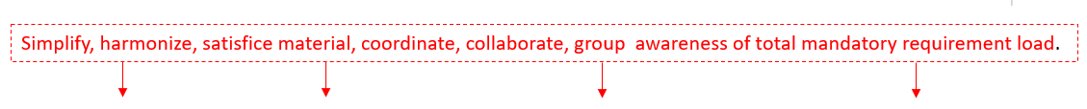
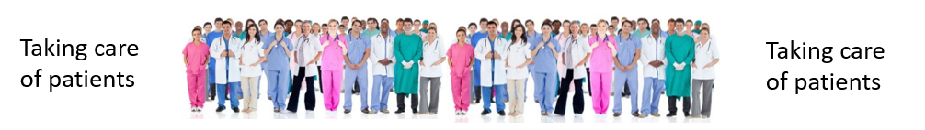
Application Illustration of HFE Used By Hospital Leadership
National, State, Local, and Industry [External]
Requirements
Basic Knowledge about Burnout and Cognitive Load
More brain power and energy to take better, more effective care of patients. Improved work satisfaction.
Being helped with compliance→ Message that leadership cares about their wellbeing.

Slide 28



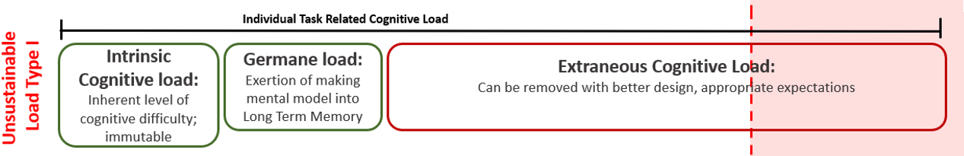
Individual Task-Specific Cognitive Load
Cognitive capacity
Individual Task Related Cognitive Load
Task
Healthy
Load
Intrinsic Cognitive Load: inherent level of cognitive difficulty; immutable
Germane Cognitive Load: Exertion of making mental model into Long Term Memory
Extraneous Cognitive Load: Can be removed with better design, appropriate expectations
Mental Reserves
Overload
Work demands exceed
neural (brain) resources.
Risk for errors
increase greatly.
Overload
Type I
(Individual Task)
These Occur In Overload:
Automatic thought- learned response from stimulus. No differential diagnosis
Load shedding- offload information, first low risk, then random shedding
Goal shielding- not allow new information into brain processing (over-focused on achieving goal)
28
Notes:
The more complex the task or goal, the lower the tolerance for extraneous load.

Slide 29
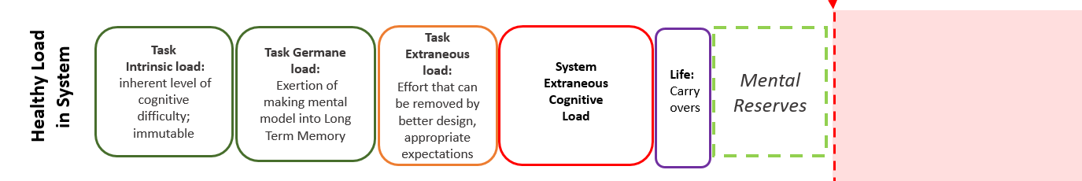
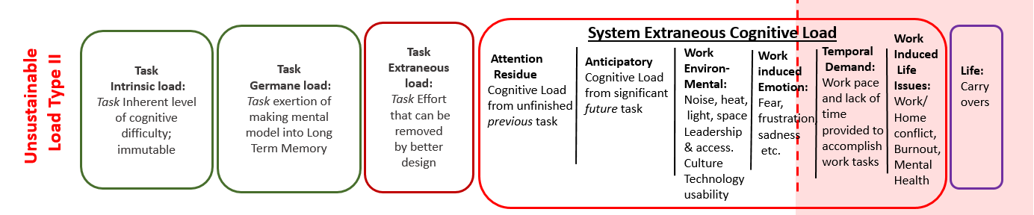
Total Cognitive Load Within The Work System
Individual Task Cognitive Load PLUS System’s Existing Extraneous Cognitive Load
Cognitive capacity
Individual Task Related Cognitive Load
Overload
Individual Task Related Cognitive Load
Overload
Type II
(Task inserted
into System.
Additive Impact).
Work demand exceeds available resources; Errors increase greatly.
If chronic, leads to high occupational stress with brain impact to clinician.

Slide 30
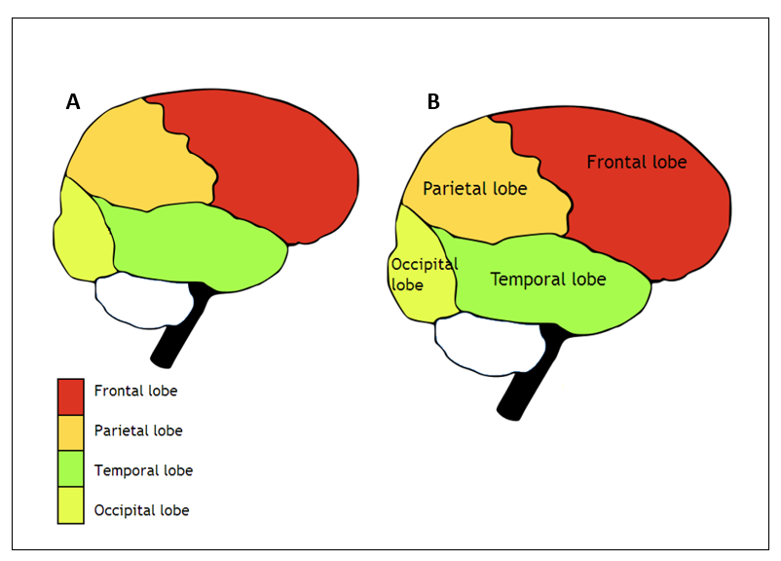
Split Attention Principle
Affects amount of brain resources used
  Space (spatial split attention)—
    Reduce space between information
    sources so it requires less
    brain power to learn.
  Time (temporal split attention)—
    Reduce time between the
    delivery of one source of information and the next
    to reduce brain power needed to code them as one unit
    in Long Term Memory (LTM).
Which one requires less cognitive load
to understand/learn?

Slide 31
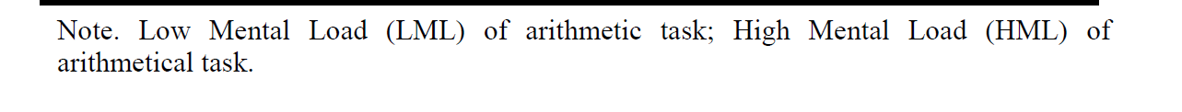
Inattentional Blindness:
Added mental load can impair your ability to see/detect what you’re looking at.
Brain issue, not eye issue.
 |  | Portion of Detected/Looked at stimuli by mental load
 |  | Mean | SE
Extra added High Mental Load. | Detection with HML | .75 | 0.03
Extra added Low Mental Load | Detection with LML | .77 | 0.03
Baseline Conditions | Detection | .89 | 0.03
Decreasing
portion of stimuli detected
Increasing
Mental
Load
Pérez-Moreno E. et al. Psicolὁgica (2011), 32, 255-278.

Slide 32
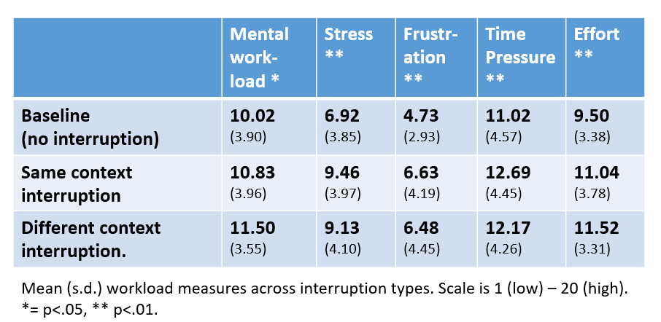
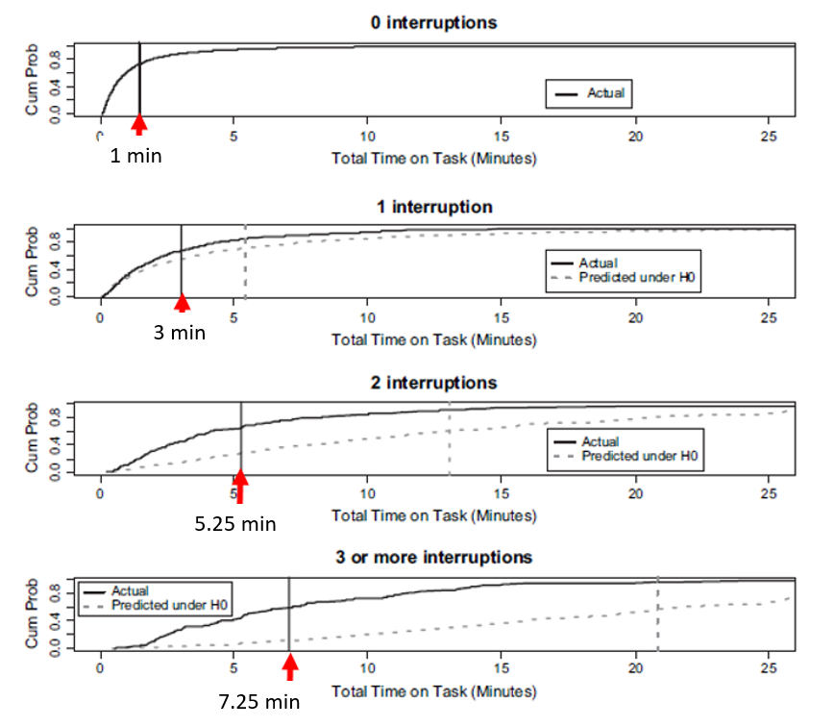
Interruptions:
Texts, pages, Best Practice Alerts, notifications, etc.
It takes 23 minutes and 15 seconds to get well focused again on what you were doing after interruption.
This increases stress, frustration, time pressure and effort¹ .
Mark G, Gudith D, Klocke U. The Cost of Interrupted Work: More speed and stress. https://www.ics.uci.edu/~gmark/chi08-mark.pdf
2. Westbrook JI, Coiera E, et al. The impact of interruptions on clinical task completion.
Qual Saf Health Care 2010 19:284-289
More interruptions cause you to take longer to complete a clinical task².

Slide 33
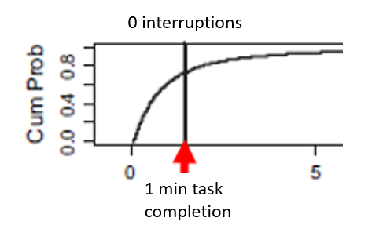
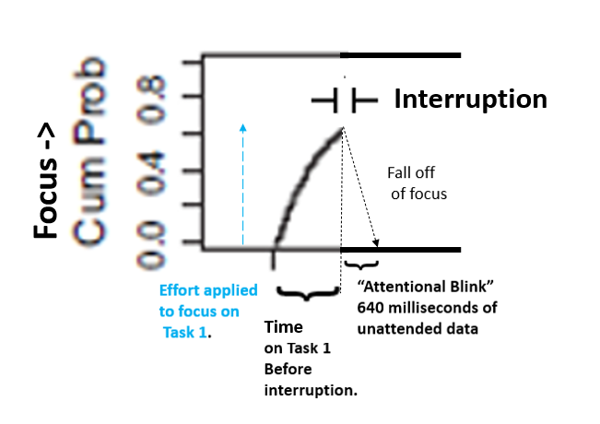
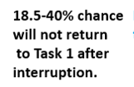
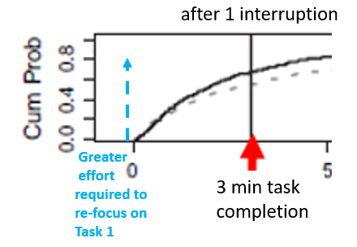
Anatomy of an Interruption:
Understanding these can
help risk/ benefit assessments
Focus ->
Effort applied
to focus upon
Task 1.
Direct Patient Safety Issue
Increased Costs/lowered efficiency
Brain (cognitive) wear and tear, decreased personal efficiency, cognitive fatigue (depletion of working memory resource)….
Leads to indirect risk to patient safety.
Personal stress, risk of Work
Outside of Work (WOW), family
strain.
*Helps if interrupter can
give reminder cue
to clinician about
where they left off
on Task 1.
Attentional Blink: Nieuwenstein M, Van der Burg, R et al. Temporal constraints on conscious vision: On the ubiquitous nature of the attentional blink Journal of Vision August 2009, Vol.9, 18. doi:https://doi.org/10.1167/9.9.18
Schmidt B. Interruptions Lead to Errors and Unfinished… Wait, What Was I Doing? February 11, 2013 PSQH

Slide 34
Satisficing^{*-}
Strategy for dealing with finite resources.
E.g., Cognitive Resources
are a Finite Resource
“Satisfactory and Sufficient”.
Optimizing productivity within existing resources.
Not the very best, but one that is satisfactory among the alternatives.
  For things that don’t matter critically
    E.g., You don’t know if your dry cleaner is the best, but is good enough
    Don’t know if local coffee shop is the best coffee but is good enough.
Effort
Benefit
*Coined by Herbert Simon: Nobel Prize winner and one of the founders
of fields of organization theory and information processing

Slide 35
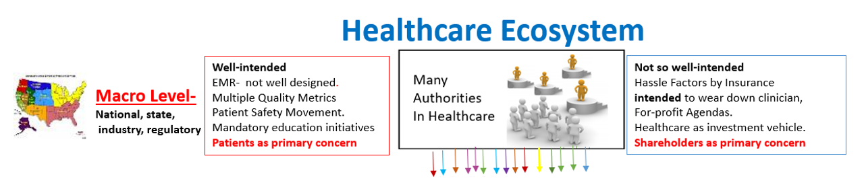


Administrative Task demands:
Mandatories, policies, laws, regulations, quality metrics, billing, prior auth’s, workflow issues, EMR software
Opportunity for control:
How these are implemented will make a difference to clinicians’ wellbeing and brainpower needed for taking care of patients.
Remove ECL, optimize GCL.
ICL remains and meets requirements.
Meso Level-
Hospital/
Healthcare
Organization
Each authority is silo of operation. No over-arching authority aware of total combined mandatory requirements , laws, policies, guidelines imparted—except at level of hospital leadership

Slide 36


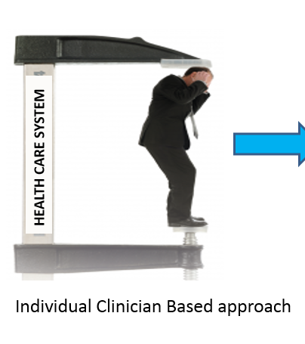


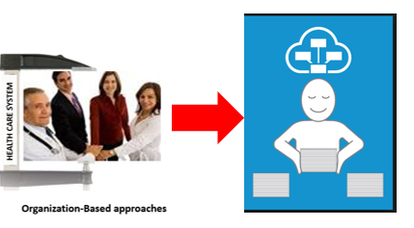




Healthcare Ecosystem
Well-intended
EMR- not well designed.
Multiple Quality Metrics
Patient Safety Movement.
Mandatory education initiatives
Patients as primary concern
Not so well-intended
Hassle Factors by Insurance
intended to wear down clinician,
For-profit Agendas.
Healthcare as investment vehicle.
Shareholders as primary concern
Macro Level-
National, state,
industry, regulatory
Administrative Task demands:
Mandatories, policies, laws, regulations,
quality metrics, billing, prior auth’s,
work flow issues, EMR software
Meso Level-
Hospital/
Healthcare
Organization
Hospital
Leader
Pathway
Business as Usual
1
Apply HFE
Human Factor Based Leadership
Programs to
Reduce Extraneous
Cognitive Load
Work outside of Work minimized. Off time protected. Physical emotional and cognitive restoration.

Slide 37
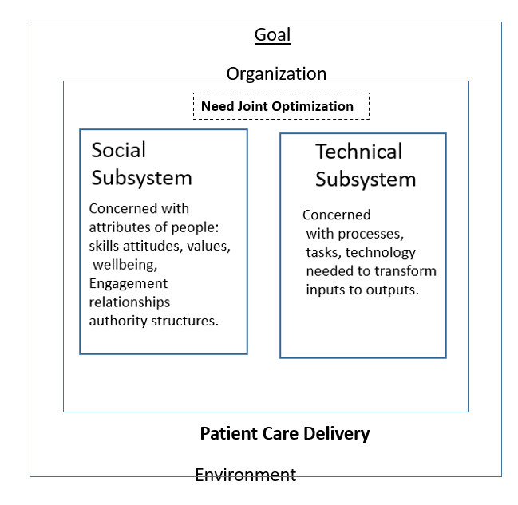
Sociotechnical System (STS) Perspective: Designing Effective Organizations
Healthcare Environment
Organization
-Clinician
Experience
feedback:
Needed
but not yet
developed
Real or
perceived
“access to
the Top” (who
have decision-
making power
to reduce the
Stress)
has a
brain
protective
effect and
improves performance under stress*.
Organizational Leadership
-Patient
Experience
feedback
to
Organizational
Leadership
Need feedback from patients and clinicians
Joint optimization
Use Human Factors/ Ergonomics (HFE) as method to optimize
-No metrics
immediately
tied
to financial
survival.
-Medical Culture
of Endurance
and Silence
impairs.
-Hierarchy and
gatekeeping Impairs.
-Reduced
awareness
and
acknowledgement
of overwhelm.
Social Subsystem
Concerned with attributes of people: skills, attitudes, values, wellbeing, engagement, relationships, authority structures
Patient Care Delivery
Clinicians are buffers of poor systems
Patient
Experience of
Receiving Healthcare
“Environmental Sensing
Devices”
Clinician
Experience of
Providing Healthcare
*Glass DC, et al.
Journal of Experimental
Social Psychology. 1971 7. 244-257.
From Privitera MR. Promoting Clinician Wellbeing and Patient Safety Using Human Factors Science :Reducing Unnecessary Occupational Stress. Health 2022. (14) 1334-1356

Slide 38
1. Acknowledge Ever-increasing Expectations without Resources as Wellbeing, Safety, Quality and Financial Problems.
2. Take on “Halo Bias”
Are they really achieving what intended?
3. Understand How and Where the Impact is Being Felt (Need feedback mechanisms).
4. Learn Methods of Assessing, Prioritizing and Addressing Overload.
Key Basics of What to Do:

Slide 39
Broad-Stroke Interventions to Reduce Extraneous Cognitive Load (ECL)
  Content Detail
Standardization
  What are operations to standardize vs.
  allow aligned autonomy, customization?
  Would standardization jeopardize patient
  safety or their unique needs?
  Is there a “wiggle room” (for special cases)
  built in?
Consolidate information.
  Reduce split attention effect.
  Bring data together needed for workflows.
  Reduce space between information sources and action needed (utilizes less brain power to understand and store in Memory).
  Process coupling.
Decrease redundancy of information – [different from system redundancy (back up systems) of engineering].
  In communication of data and design
Organizational Process Approach
Question processes and metrics currently in place-
  Are they strategic or necessary? …….. why?
  Are there less cognitively expensive ways to do so?
Prioritize Design –
  Procure equipment and use layouts with deliberate
  designs that consider Human Factors/Ergonomics (HFE).
  Anticipate situations of low cognitive resource:
    Burnout, high stress
    High volume demand
    Evening or night shift, extended work hours
    Sleep and food deprivation
Collaborate
  Among Administrative Offices, with leaders from other areas of the hospital who also roll out requirements and work expectations
  Lower cognitive load by means of this collaboration.
  Hire Human Factors professionals at your institution.
Adapted and expanded from Elizabeth Harry MD. Steps Forward AMA Webinar 3/2/21.
“Cognitive workload: a modifiable contributor to physician burnout ?”
39
Notes:
I like this slide but also feels too busy (I deleted a bit too here in the bullets) – should we just put in the 3 big things harry had – reduncancy, standardization and split attention?
SEE WHAT I WROTE ON LAST SLIDE NOTES

Slide 40

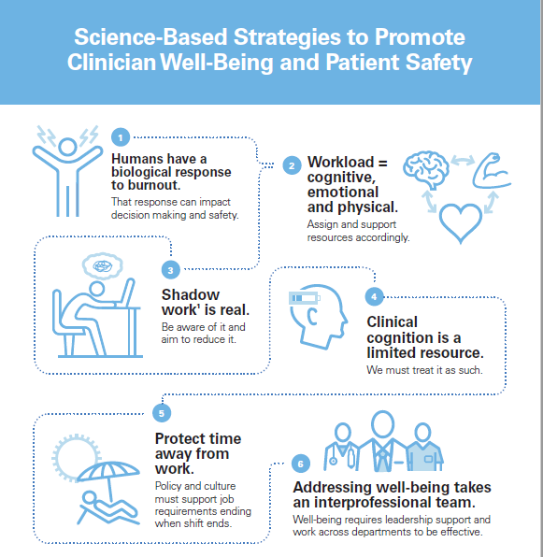


May 23, 2023

Slide 41


Slide 42
Where might this use of HFE be headed?
Leaders will need help with ways of containing this harm as:
  They recognize extraneous cognitive load (ECL) costs essential resources and money.
  They learn uncontrolled stress is harmful to clinicians and patients
  Necessary and right thing to do to sustain healthcare delivery
  Policy, law, regulation increase and external pressures mount.
Human-centered science (for all humans in the system).
  Interface of leadership, patient safety and experience, quality of care, clinician wellbeing and experience of providing care.
Strategic leadership advantage to understand, prevent or mitigate issues causing unnecessary stress and/or medical error.
Consider as a brief course in healthcare leadership education, MBA, MHA programs.
Next generation efforts: Further development with regular leadership usage, integration with existing mechanisms and application science.

Slide 43

Thank You
Michael R Privitera MD MS
Professor Emeritus of Psychiatry
University of Rochester Medical Center
Medical Director, Medical Faculty and Clinician Wellness Program, 2015-2022
Chair, MSSNY Task Force on Physician Stress and Burnout, 2015-2019
Faculty, Institute for Healthcare Improvement. Boston MA, 2022-2023
Michael_Privitera@urmc.Rochester.edu
Website: www.MichaelRPriviteraMD.com

Slide 44
Supplemental Slides
Recommended Reading References
Getting Feedback into Systems Operations
Organizational Ergonomic Strategies
CDC/NIOSH Impact Wellbeing 6 actions, emphasis: Integrating Professional Wellbeing into Quality Improvement
Comparing Traditional Lean, with HFE Augmented Lean
When Considering what to improve. Lean and HFE similarities
Shadow Work: View from Decision-makers, vs. Work as done
Shadow Work: Examples from a real practice, not all happen at same time.
Learning Curves with New Initiative Roll outs Importance of Timing and Centralized Control.
First, Second and Third Order Consequences from Leadership decisions (without feedback systems)
Reason’s Swiss Cheese Model Expansion Rationale: Collaboration of Patient Safety and Clinician Wellbeing office
Reason’s Model in Context to Systemic “Layers of Cheese” that May Thwart Good Care. Strategic vs. Non Strategic.
New Initiatives: Impact of Intuitive vs. Non-intuitive Design
Intuitive Design in Devices and Systems
Proposed Outline for Human Factors/Ergonomics (HFE) Leadership Curriculum.

Slide 45
Recommended Reading
1. Arnsten, A.F.T. and Shanafelt, T. (2021) Physician Distress and Burnout: The Neurobiological Perspective. Mayo Clinic Proceedings , 96, 763-
769.https://doi.org/10.1016/j.mayocp.2020.12.027
2. Arnsten AFT. ( 1998)The Biology of being Frazzled. Science. 12 June. 280 (5370): 1711-1712.
Sinsky, C.A. and Privitera, M.R. (2018) Creating a “Manageable Cockpit” for Clinicians:
A Shared Responsibility. JAMA Internal Medicine , 178, 741-742 https://doi.org/10.1001/jamainternmed.2018.0575
4. Privitera MR. (2022) Promoting Clinician Wellbeing and Patient Safety Using Human Factors Science:
Reducing Unnecessary Occupational Stress. Health. (14) 1334-1356
5. Harry, E., Sinsky, C., et al . (2021) Physician Task Load and Risk of Burnout among US Physicians in a National Survey.
The Joint Commission Journal of Patient Safety , 47, 76-85. https://doi.org/10.1016/j.jcjq.2020.09.011
6. Privitera, M.R. and MacNamee, K. (2021) Integrating Patient Safety and Clinician Wellbeing. Physician Leadership Journal , 5/6, 39-46.
7. Pasmore, W.A., (1988). Designing Effective Organizations: The Sociotechnical Systems Perspective. Wiley, New York.
8. Pasmore, W., Winby, S., Mohrman, S.A. and Vanasse, R. (2019) Reflections: Sociotechnical Systems Design and Organization Change. Journal of Change Management, 19, 67-85. https://doi.org/10.1080/14697017.2018.1553761
9. MacNamee, K. (2020) A Neurocognitive Approach to Developing Safer Medical Devices. Biomedical Instrumentation and Technology, 28-36. https://doi.org/10.2345/0899-8205-54.1.28
10. Farley HL, Harry EM, Sinsky CA, Boehm EW, Privitera MR, Melnick ER. ( June 2, 2023) Humans as an Essential Source of Safety: A Frameshift for System Resilience. Mayo Clin Proc Innov Qual Outcomes.;7(4):241-243. doi:10.1016/j.mayocpiqo.2023.05.001
Privitera MR, Chang CC, Chosewood LC. (2023, Dec. 13). Want to Improve the Well-Being of Health Workers? The System Itself Must Change. NIOSH Science Blog. https://blogs.cdc.gov/niosh-science-blog/2023/12/19/systems-approach-hcw-wellbeing/
12. Hollnagel E, Wears RL, Braithwaite J. (2015) Middelfart, Denmark: From Safety-I to Safety-II: A White Paper.
Resilient Health Care Net; https://psnet.ahrq.gov/issue/safety-i-safety-ii-white-paper

Slide 46
Getting Feedback into Systems.
Regular Anonymous surveys for process improvement.
Round Table discussions, leader encouraging honesty, psychological safety- Clinician led; could be moderated by Human Resources
Suggestion Boxes that get read and acted upon. Report back on major findings.
Wellness Representatives (Department/Division/Discipline).
  Constituent concerns given to them confidentially, but issues can be shared publicly to facilitate discussion with leaders without revealing source-
  Ombudsman role. Understood that their job is to voice constituency concerns.
Participatory Management Structures. Normalize these in hospital operations .
  Composition: Mixed group of administrators and clinicians.
  E.g. Mandatory training role outs, quality, safety committees, large volume equipment purchases and EHR/IT improvement.
  HFE approach since human-centric can help unify administrator and clinician collaboration.
Leadership and Communications Department play a key role in regularly reporting back to constituents on the aggregate results, next steps and promoting the culture of transparency and collaboration.

Slide 47
Organizational Ergonomic Strategies
Recognize significant danger of over-expectations on clinicians despite coming from authorities.
  Understand how this justifies your actions internally and to outside agencies.
HFE-informed leadership promotes collaboration between Patient Safety/Quality and Wellbeing efforts.
Administrative offices collaborate internally to track and manage total mandatory expectations:
  e.g., Risk Management, Financial, Compliance office, Teaching duties, Learning and Development, etc.
Jointly Optimize People Systems and Technical Systems (Sociotechnical System Design Principles)
  Feedback systems from front-line clinicians gets to leadership as “ environmental sensors” of quality output and friction points of operations.
HFE knowledge helps strategic allocation of resources:
  Recognize direct and indirect benefits that improve engagement and the bottom line.
  Need support staff positions to coordinate mandatory requirements to remove ECL from clinicians.
  Preserve highly trained clinician brain resources for quality patient care.
Successful Leaders use Integrative thinking:
  Conventional thinking would choose between choice A or B.
  Integrative Thinking take parts of each choice A, B, that together are superior to either choice alone.
Satisfice: “Satisfactory and sufficient” to comply with requirements, extras are voluntary.
Summarizing Mantra: Clinician Brain resources are a finite resource- use them strategically.
  “ Don’t make them think more than they need to.”

Slide 48

CDC/NIOSH: Impact Wellbeing™ Guide:
Taking Action to Improve Healthcare Worker Wellbeing
Impact Wellbeing Guide | NIOSH | CDC

Slide 49


Comparing Lean and HFE
Each have role of Senior Sponsors to make directional decision remove barrier, minimize risks, dedicate resources, prioritize efforts. Strategic use of their presence, influence and recognition of successes
49

Slide 50

From Lean Training; applies to HFE approach as well.:

Slide 51




Introduction to Shadow Work: “Unseen, unpaid jobs that fill your day”
Prescribed work
Shadow
Work
Prescribed work + Shadow work= Real work as done
Shadow
Work
Adapted from Lambert C. Shadow Work:
The unpaid Unseen jobs that fill your day. Counterpoint Press 2015
Real work

Slide 52

Shadow Work: A Real Practice… Just Not All At Same Time.
1. Office Start up
2. Warm up computer
Software booting
EMR booting
3. Patient Arrive On time, right location
4. Financial Pre-meeting
5. Waiting Room receptionists
Clinical based forms given to patient
6. Nursing
vs taken and documented
7. EMR record review preparation
Prescribed Work
New EMR security restrictions
longer warm up
Password expired, think of new one
New EMR software roll out,
need to learn it to operate EMR.
Not working: time on
phone with IT support.
Intro letter to patient
has wrong clinic
address.
EMR software not link
correct letter with
correct address
…….Delays
Patient insurance
letter too much
information. Patient
confused, not bring
correct information
with them for
financial counselor
……..Delays
Substitute secretary, not
familiar with customized
EMR screen interface for
this location.
Pre-visit clinical rating
scales were not given
to patient to fill out,
Different budget line clinics
co-located physically, each
has different EMR interface.
Substitute nurses not think
allowed to help on clinic.
Vital Signs not obtained
before visit
Old records received but scanned into EMR
by Health Information Management (HIM)
under name coined by vendor and learned by
HIM staff who use it regularly, but non-intuitive
to clinician. Clinician cannot find them.
Have to call Health Information
Management (HIM) to find info if time.
Office environment
Temperature
too warm, too cold
Window crack- draft,
Noise outside
Shadow Work
8. Patient
Interview/
Evaluation/ Procedures
9. Writing Orders and Labs
10. Writing Notes and Diagnosis
Billing
Shadow Work= unnecessary (Extraneous) Cognitive Load on clinician
Prescribed Work
Meaningful Use (MU) criteria
must be met regardless of
reason for visit.
Smoking cessation
Send for old records
Pain score
Multiple screening questions
Well meaning but creates competing mental demands. Require more mental effort to re- focus on why the patient is here.
Ordering a drug level: EMR build requires exact drug spelling and singular name. No drug synonyms allowed
Must hunt, trial and error
to find out exact word/spelling
“happy path” that works.
Ordering controlled substance:
State requires checking a data
base before allowed to prescribe,
Password expired without warning.
While patient is with you, must
create new password,
never used within the last 50
passwords, with complex security
requirements.
Do not make mistake!
(despite competing
mental demands).
Choose correct note template type based upon budget line decisions.
Template operation to get to next field
not consistent:
More documentation expected by local
Compliance Office for “abundance of
caution” to meet requirement (Compliance Creep”).
Voice recognition software
not working. (If call for
support I will be on phone
loosing time to do work).
Chose to type without it.
“Best Practice Alerts”, ‘Hard
stops’ —demands an
answer before can proceed.
Interrupts clinician thought
while thinking of DDx and
Treatment plan.
Software “Autocorrect” function
won’t stop putting in wrong word.
ICD-10 diagnosis has “hard stop”
demanding high specificity of dx- Out
of administrative fear that may
not be covered by insurance.
Interrupts clinician train of thought.
Don’t make a mistake!
Constant mental overwork to
compensate for poorly designed
system-
Chronic high stress at work.
Shadow Work
52

Slide 53


Learning Curves, Clinical Functionality of Staff and System.
New Initiative Roll Out
Importance of Timing and Centralized Authority

Slide 54
Understanding Consequences Without Feedback Systems.
Leaders Don’t Know What They Don’t Know.
Example: Insurance Payer is denying claims for inpatients as by Day 2 they require documented reasons
for continued hospitalization.
Leader Decision:
Best Practice Alert (BPA) to pop up on Inpatient EMR Screens -requiring documentation of reason patient still in the hospital before EMR can be used for other functions- (writing orders, or clinical notes).
1st Order consequences: Billing Department pleased. More claims getting paid. Seems like a success
-----------------------------------------------------------------------------------------------------------------------------------------------------
2nd Order Consequences:
  Clinicians and Patients —
    Timing of BPA occurs during critical clinical thinking. Forced shift to business/ insurance thought. Derailed clinical thought on Differential Diagnosis (DDx), Treatment, needed tests to order. Memory information decay of the clinical information occurs with time.
      Extra brain resources required to refocus, get back on track after interruption
      Some clinical ideas lost on DDx and treatment options.
      Emotion triggered by frustration and effort to reconcile cognitive dissonance- forced priority of insurance over clinical thinking.
      Load shedding of information in plan. Forgot to call patient’s family, angering the family, Family feels “they don’t care” at that hospital.
      Malpractice risk goes up if adverse event occurs.
3rd Order Consequences-
  Patient outcome not as good. Not as satisfied.
  Clinician: Extra Cognitive efforts drain brain resources, leads to reduced efficiency of documentation.
    Salaried and not paid by the hour, clinician finishes documentation in evening.
      Work Outside of Work (WOW) – work/ home conflict effect on relationship with spouse and children.
      Chronic marital tension. Considering Separation or Divorce.

Slide 55


Collaboration with Patient Safety and Quality Office.
Traditional “Swiss Cheese Model” (series of protective barriers) in Whole Work System.
“Swiss Cheese” Layers (barriers) need to be strategic and well designed.
Potential unintended negative consequences of “layers” (thwarted care) to be avoided
55

Slide 56



Non-Strategic Defense Barriers (Thwarted Care) Increases Cognitive Load and Causes Incidents
Systemic Influences: Administrative Policy, Regulatory Bodies, Hospital Infrastructure
POTENTIAL
CARE QUALITY
Cognitive
Deterioration (CD)
POOR CARE
AVERAGE CARE
EXCELLENT CARE
CARE DELIVERY ISSUES
CD
CD
Thwarted Care
Thwarted Care
Thwarted Care
Non- strategic
BARRIERS TO CARE
Provision of Care
BARRIERS TO CARE
Provision of Care
BARRIERS TO CARE
Provision of Care
ACTUAL
CARE QUALITY
GOOD CATCHES &
NEAR MISSES
POOR CARE
AVERAGE CARE
EXCELLENT CARE
Strategic
DEFENSE
BARRIERS
INCIDENT
Privitera M, MacNamee K. Physician Leadership Journal May/June 2021 p 39-46
56

Slide 57


Learning Curves, Clinical Functionality with New Initiatives Importance of Intuitive Design
Intuitive design.
Based on known processes.
Little to no training required.
Easily inserted into usual workflows.
Low adaptation.
Lower cost to organization
Lower risk of overwhelm and error.
Non-intuitive design.
Requires significant training.
Not harmonize with current usual workflows
High adaptation.
Higher costs to organization
Higher risk of overwhelm and error.
Functionality
“Expert”
Learning required
Minimal dysfunction
Functionality
Time

Slide 58

Intuitive Design in Devices and Systems
Based upon McKay EN. Intuitive Design. Eight Steps to an Intuitive UI, Black watch Publishing 2018.and
Rao M. Intuitive design” How you can use these 8 steps for better user interfaces. Jan 4, 2019.
https://yourstory.com/2019/01/intuitive-design-better-user-interface

Slide 59
Proposed Curriculum for Leadership Applications of Cognitive and Organizational Ergonomics
Effects to Cover
Cognitive Load: Intrinsic, Germane and Extraneous subtypes.
Cognitive Overload Type I (task) and Type II (task in system)
Inattentional Blindness
Split Attention Principle
Interruptions, Pop-ups , Best Practice Alerts
Decision making effects and environmental condition effects
Novice vs. Expert, when learning non-intuitive new material.
Work as Prescribed + Shadow Work = Work as done.
Reconciliation efforts if Cognitive dissonance for value differences, Moral Injury, “integrity outages”.
Attention residue, anticipatory attention: Carry over cognitive load impacting current task.
Emotion work effort
Suppression of unwanted behavior, new environment efforts
Self-regulation and “professionalism” despite how treated.
Uncontrolled stress vs. controlled stress impact on brain.
Clinical Career conditions match uncontrolled stress conditions. Recognize public health and patient safety issues
Methods to Mitigate/ Prevent.
Recognizing dangers of extraneous cognitive load, and uncontrolled stress on brain in current healthcare work environment.
Satisficing (satisfactory + sufficient) to meet requirements.
How successful leaders think: Integrative thinking
Intuitive design in technology and in workflows, new initiatives, new policies and guidelines
Recognizing Extraneous Cognitive Load (ECL) to be reduced.
Value mapping for patients and for clinicians
Utilizing Lean methods with HFE principles to remove waste of extraneous cognitive load and enhancing value.
HFE methods preventive of problems and corrective of existing ones.
Socio-technical System Design:
  Jointly optimizing people and technology
  Feedback systems from patients and from clinicians regularly get to senior leadership. “access to the top” brain protective and helps performance during stress.
Participatory Management structures for wellness, safety, and balance human side of new technology.
Strategic use of staff infrastructure to remove ECL involved in planning, monitoring, reminding, reclassifying, communicating with needed authorities and patients.
Putting back methods of aligned autonomy and control where possible to convert uncontrolled stress to controlled stress.

