Slide 1


OFFERING MEMORDANDUM
1234 Sample Road,
Marcos Island, FL, 34145
Taylor Baker
502-593-3419
Taylor@bnbcohosts.com

Slide 2
IMPORTANT NOTICES AND DISCLOSURES
This document is confidential and may not be reproduced or redistributed. The information presented herein has been prepared for informational purposes only and is not an offer to buy or sell, or a solicitation of an offer to buy or sell any security or fund interest or any financial instrument and is not to be considered investment advice. This presentation is for institutional use only and is not to be distributed to any party other than its intended recipient.
The following materials present information regarding a proposed creation of a special purpose vehicle (the "Issuer") which would offer securities (the “Securities”) to finance its acquisition of a portfolio of financial assets to be selected and managed by the portfolio manager referred to herein (the "Manager"). These materials have been prepared to provide preliminary information about the Issuer and the transactions described herein to a limited number of potential underwriters of the Securities for the sole purpose of assisting them to determine whether they have an interest in underwriting the Securities.
The views and opinions expressed in this presentation are those of The Sponsor Team (“Defined as any and all owners and members of Bnb Cohosts”) and are subject to change based on market and other conditions. Although the information presented herein has been obtained from and is based upon sources The Sponsor Team believe to be reliable, no representation or warranty, expressed or implied, is made as to the accuracy or completeness of that information. No assurance can be given that the investment objectives described herein will be achieved. Reliance upon information in this material is at the sole discretion of the reader.
This data is for illustrative purposes only. Past performance of indices of asset classes does not represent actual returns or volatility of actual accounts or investment managers, and should not be viewed as indicative of future results. The investments discussed may fluctuate in price or value. Investors may get back less than they invested.
Forward-looking information contained in these materials is subject to certain inherent limitations. Such information is information that is not purely historical in nature and may include, among other things, expected structural features, anticipated ratings, proposed or target portfolio composition, proposed diversification or sector investment, specific investment strategies and forecasts of future market or economic conditions. The forward-looking information contained herein is based upon certain assumptions, which are unlikely to be consistent with, and may differ materially from, actual events and conditions. In addition, not all relevant events or conditions may have been considered in developing such assumptions. Accordingly, actual results will vary and the variations may be material.
Prospective investors should understand such assumptions and evaluate whether they are appropriate for their purposes. These materials may also contain historical market data; however, historical market trends are not reliable indicators of future market behavior. Information in these materials about the Manager, its affiliates and their personnel and affiliates and the historical performance of portfolios it has managed has been supplied by the Manager to provide prospective investors with information as to its general portfolio management experience and may not be viewed as a promise or indicator of the Issuer's future results. Such information and its limitations are discussed further in the sections of these materials in which such information is presented.
Past performance of indices or asset classes does not represent actual returns or volatility of actual accounts or investment managers and should not be viewed as indicative of future results. The comparisons herein of the performances of the market indicators, benchmarks or indices may not be meaningful since the constitution and risks associated with each market indicator, benchmark, or index may be significantly different. Accordingly, no representation or warranty is made to the sufficiency, relevance, important, appropriateness, completeness, or comprehensiveness of the market data, information, or summaries contained herein for any specific purpose.
Past performance is not indicative of comparable future results. Given the inherent volatility of the securities markets, it should not be assumed that investors will experience returns comparable to those shown here. Market and economic conditions may change in the future producing materially different results than those shown here. All investments have inherent risks.
The following information is an investment summary provided to prospective investors and others. This information is not an offering to sell either a security or a solicitation to sell a security. At the request of a recipient, the Company will provide a private placement memorandum, subscription agreement and the Limited Liability Company Operating Agreement. The Managing Member in no way guarantees the projections contained herein. Real estate values, income, expenses and development costs are all affected by a multitude of forces outside the Managing Member’s control. This investment is illiquid and only those persons that are able and willing to risk their entire investment should participate.
Please consult your attorney, CPA and/or professional financial advisor regarding the suitability of an investment by you.
All Rights Reserved. No part of this document may be reproduced, stored, or transmitted by any means with the express written consent of Bnb Cohosts.

Slide 3
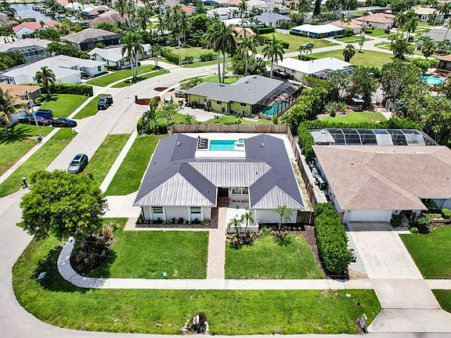

Project Summary
Luxury Single Family Home
4bd, 3ba, 1,888 sqft
$80k Price Reduction
Sold Furnished
Purchase Price
Hold Period
Equity Required
$950,000
5 Years
$228,000
*Avg Cash on Cash Return
*Average Internal Rate of Return
*Equity Multiple
13-16%
21-24%
1.97x
*Projected Returns

Slide 4
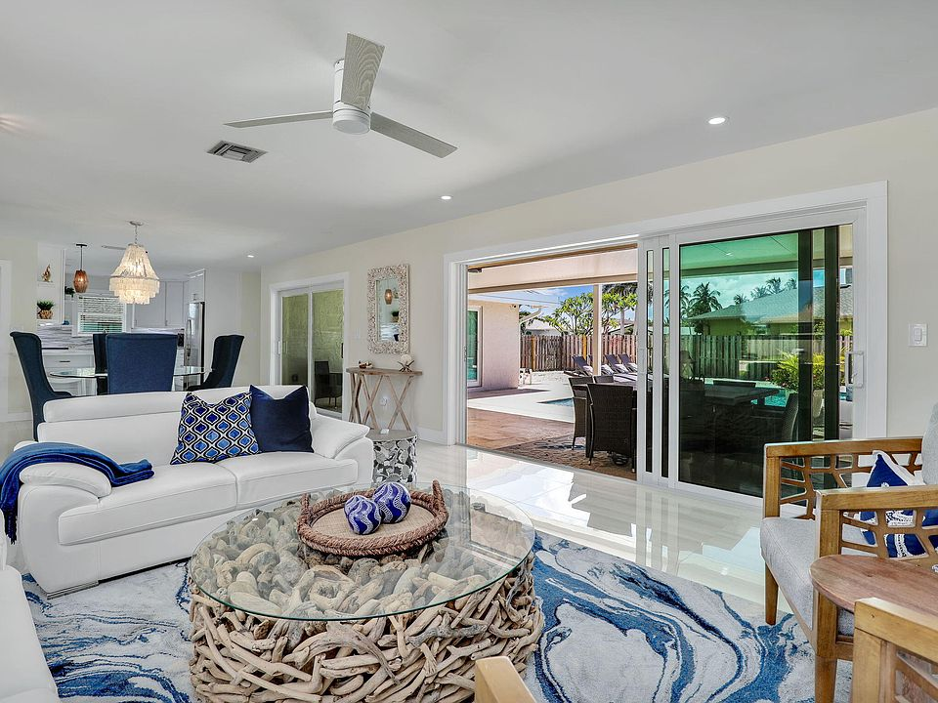


No Renovations = Less Operational Risk
Major Interior Renovations
Large CapEx Projects
The property was completely remodeled over the past two years and comes 90% furnished.
This presents less operational risk to investors!

Slide 5
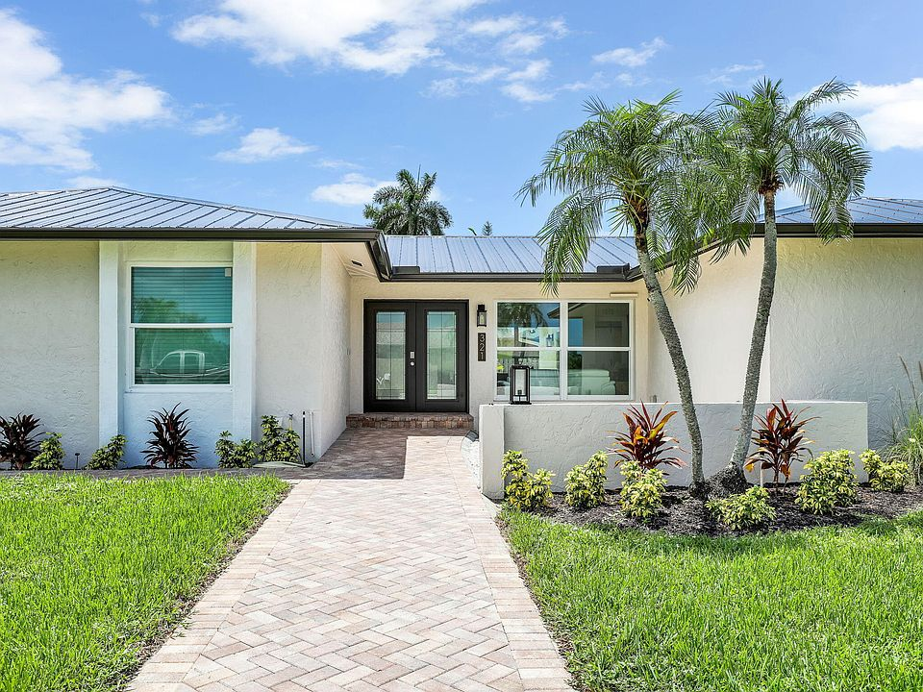


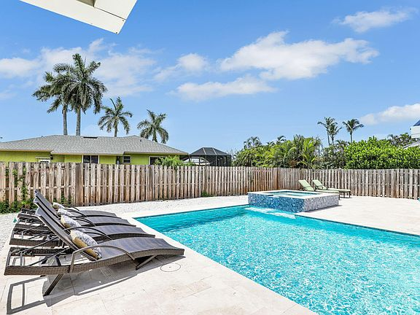
Our Business Plan
01 Go Live ASAP
Peak season is Q1, so we need to get live, work out any kinks and build the brand
02 Bookings and Reviews
Use our network to maximize bookings and reviews in the first 90 days
03 “Guest Favorite” Status
This status places us in the Top 10% of homes on Airbnb and gets us on the front pages for searches, leading to increased bookings
04 75% Occupancy
Achieve 75% occupancy for Q1 peak season where average daily rates typically 2-3x. March occupancy repeatedly exceeds 85%
05 Increase Rates
Gradually increase our average daily rates and minimum threshold over the next 24 months leaning into our “Super Host” and “Guest Favorite” statuses

Slide 6
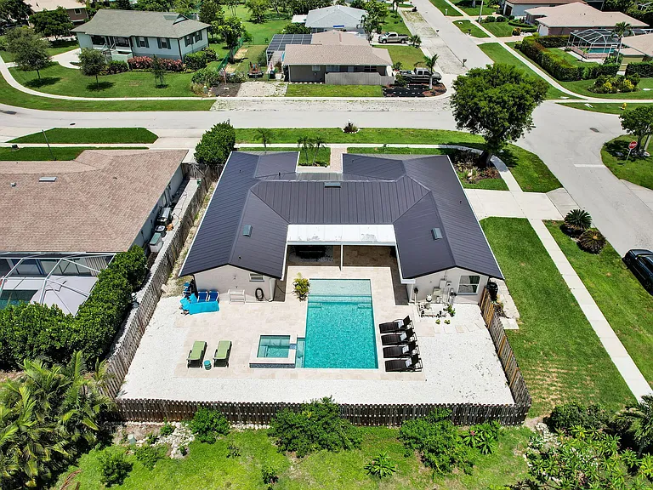
WHY WE LOVE THIS DEAL
Collier County Home Prices
Home prices in Collier County have shown incredible appreciation over the last decade (roughly 45%) but have cooled off tremendously this year, showing a decrease in value of 2% in 2024. We believe with homes sitting on the market longer we have a unique buying window before competition floods the market as interest rates continue to drop.
Marco Island Airbnb Demand
Average occupancy for Florida Airbnb’s is 50-55%
Average occupancy for Naples market is 57% (down 4%) with an Average Daily Rate (ADR) of $395 (up 6%)
The submarket of Marco Island has an occupancy rate of 61% with a strong ADR of $440 (up 8%)
Strong Comps
To project this assets performance, we used an average of 6 comps within a 3-mile radius ON Marco Island.
All 6 comps have been active on Airbnb’s platform for at least 85% of the year, giving us good insight to seasonality trends and performance.
We’re Local
Being in Fort Lauderdale not only gives us a proximity advantage, but we were also founded in South Florida, operate in South Florida, and have robust knowledge of the market area and its performance

