Slide 1
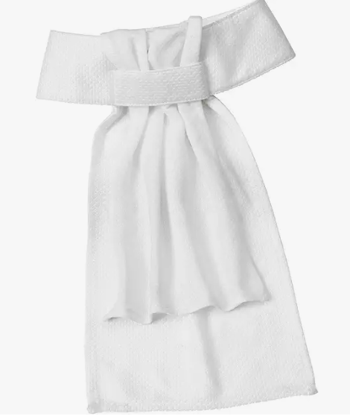
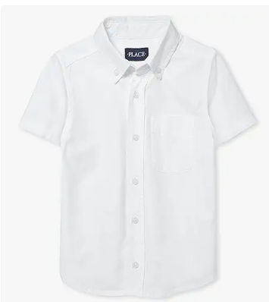
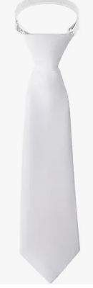
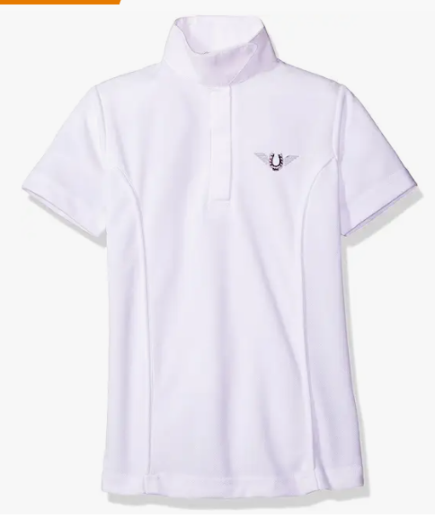
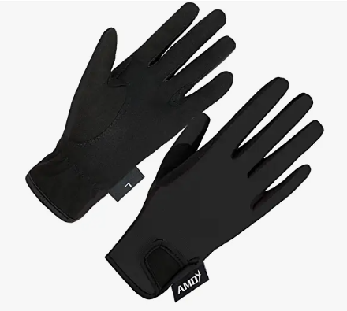
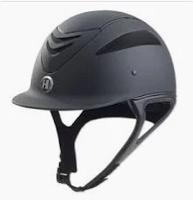
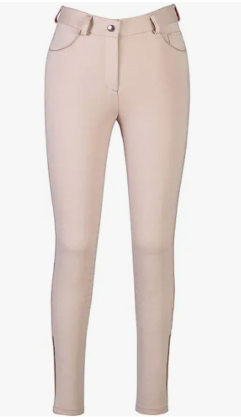
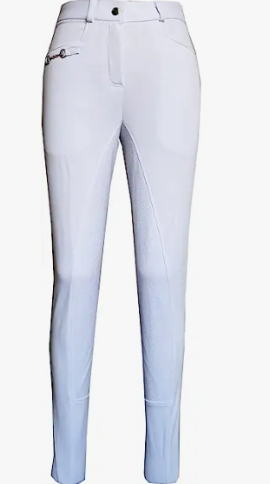
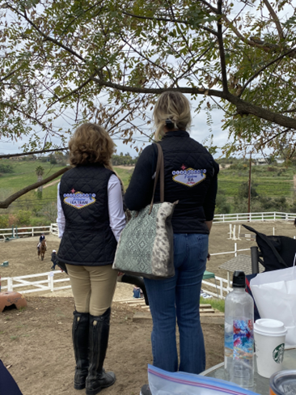
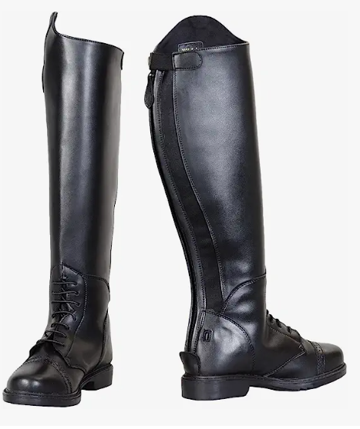
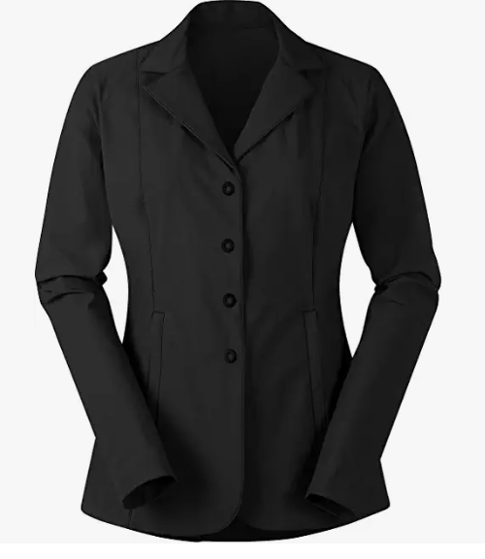
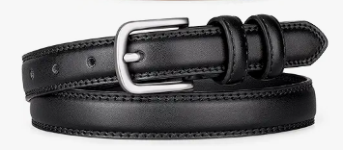
Boys: dress shirt with
collar for both hunt
seat and dressage
Boys: add neck tie for both hunt seat and dressage
black riding gloves for both hunt seat and dressage (white gloves OK for upper level dressage classes
Girls: Show shirt with collar for both hunt seat and dressage
Girls: For dressage add white stock tie
For hunt seat competition: tan/beige riding breeches
ASTM certified black helmet (any brand)
black tall boots for both hunt seat and dressage (garters with paddock boots OK for beginner level classes)
For dressage competition: white riding breeches
black or navy blue show jacket for both hunt seat and dressage (other pastel colors can be allowed for upper level dressage)
Optional: Black or Navy vest with team logo (Blue Ribbon or Meadowbrook logo OK)
Belt if breeches
have belt loops

