Slide 1
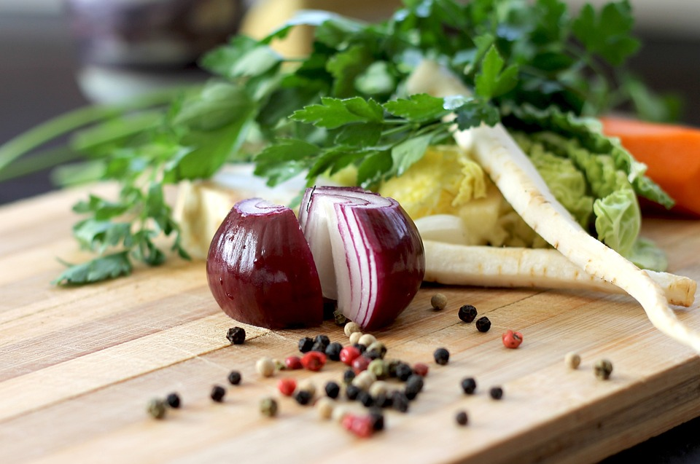
Bayside HOA
Cookbook
Bayside Home Owner’s Association Cookbook
Recipe Collection & Sale
Bayside Home Owners Association is creating a custom cookbook featuring favorite recipes from Pot-Nets Bayside residents. These cookbooks will be professionally published and are sure to be a treasured keepsake for us all. Money raised will be used for BHOA legal fund and charitable contributions.
For information on how to submit recipes or order a cookbook, email d.wentworth70@gmail.com Recipes are being collected now through 1 Aug 2025 with cookbook delivery in October. Makes a perfect holiday gift!
Info and recipe collection sheets available at the annual BHOA meeting on 28 June 2025.
Learn more about BHOA: https://bayside-hoa.com/home

