Slide 1
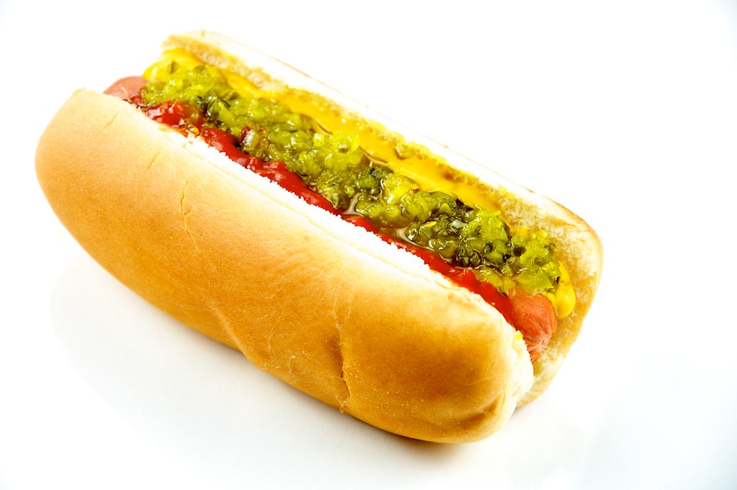
Get Ready!
Hot Dogs and Brats on the Beach!
*************************************When: Saturday August 9 11am-2pm
Where: Bayside Beach
What: Hot Dogs, Brats, Soda, Water, Chips
Joins Bayside Homeowners Association for lunch on the beach!
See you then!
This Photo by Unknown Author is licensed under CC BY

