Slide 1
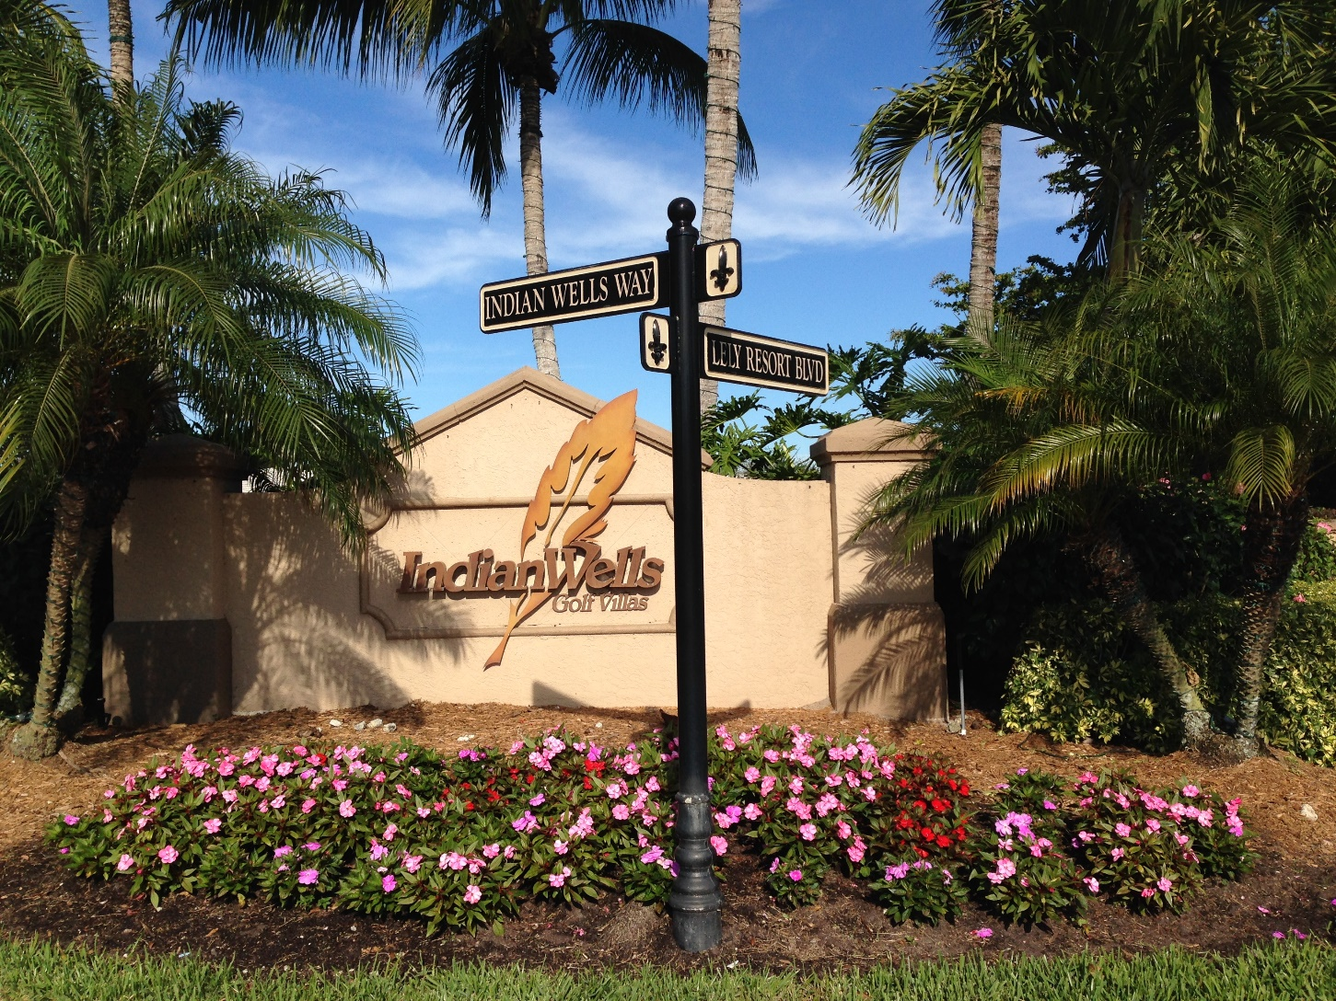
Indian Wells HOA Board Mtg. 20 Nov 2023
IndianWellsHOA.net

Slide 2
Zoom info
Date: Monday, November 20, 2023
Time: 6:00 PM
Place: Via Zoom
Meeting ID: 239 649 6357
Passcode: anchor

Slide 3
Agenda
Call to Order
Certification of the Presence of a Quorum and Proof of Notice
Approval of Prior Meeting Minutes
  Ask Michael to send us 8 June 2023 minutes
Unfinished Business
New Business
  Mulch
  Streetlights
  Holiday Decorations
  HOA Light by entrance keypad
  Landscaping & Irrigation
  Website change
  Owner’s Home and Lawn Upkeep
  Declaration Updates needed
  Proposed Lely Master POA Declarations & Guideline changes
  Aerators
  Mailboxes
Adjournment

Slide 4
Mulch
The low bid was $8622 for Cypress mulch provided and put down by Southeast Spreading. This is the same type of mulch as we have always used.
Meagan and Paul Harvey express an interest in the Coco brown. Southeast Spreading quoted that at $9759 due to needing more mulch for color change.
  Coco brown is created by mulching various woods and adding dye.

Slide 5
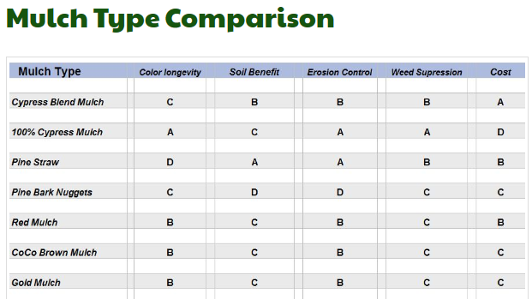
Mulch Type Comparison

Slide 6
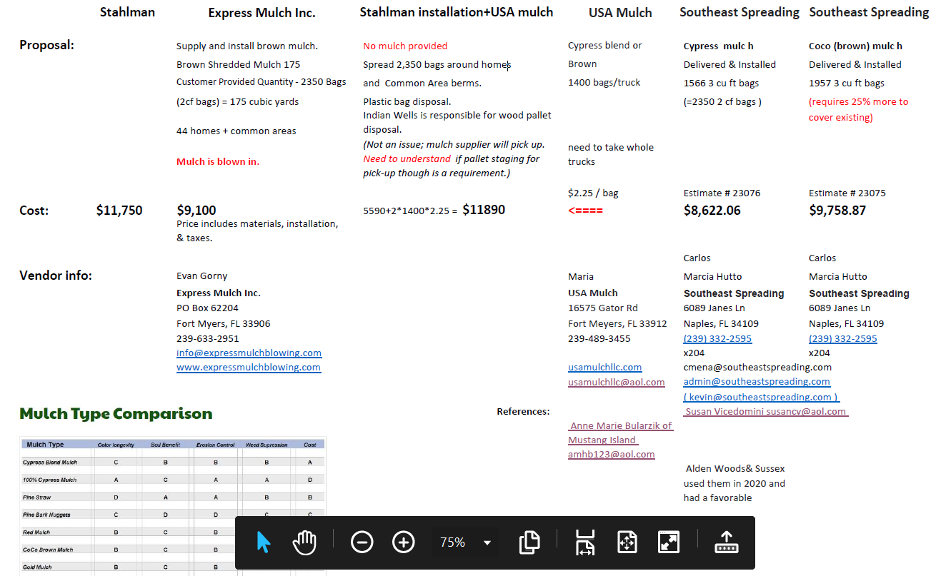
Mulch Bid Tab (emailed to Board 7 Nov 2023)

Slide 7
Streetlights
Ownership of our streetlights is unique in Lely Resort. We are the only gated community in Lely that doesn’t own or pay for electricity or repairs for streetlights.
  Original capital funding was part of a bond circa ‘96 for Tiger Island Estates. Our lights are maintained by LCDD (Kevin Carter 239-775-6502) and the LCDD pays the electric bill.
We have had numerous interactions (emails & calls) with Kevin Carter over the last 6 weeks to fix. There were multiple issues with the streetlights uncovered and all 8 were working ~ 1week ago.
Six have gone dark since. Something appears to be still tripping the fuse or circuit breaker for these lights.
  Left voicemail with Kevin this morning.

Slide 8
Holiday Decorations
If we plan to put up lights & decorations this year, we need to:
  pick a date
  ask for volunteers
  decide if we are going to use the existing decorations or replace some items
    The lights are all cheap, relatively short string, incandescent bulb. The number and type of connections as well as how the bulbs are connected likely lead to the frequent tripping of the GFIC(s) we experience.

Slide 9
Landscaping and Irrigation
This was an unusually dry summer. Just before the last rain…Naples was running a 27.47” deficit for the year…the worst in recorded history
Area immediately southeast of entrance…
  was not getting water; Stahlman was authorized to add sprinkler heads at a cost of $300.
  may have carpet grass in this area and if so, we will need to replace kill it and put in new sod

Slide 10
Website change
Our website, IndianWellsHOA.net is built using obsolete and difficult to edit software. The fees for this site are due 15 Jan 2023.
Fox picked up IndianWellsHOA.com URL a while back and wants to build a new website to replace the old one soon, allowing approximately 1 month overlap before cancelling the old site.

Slide 11
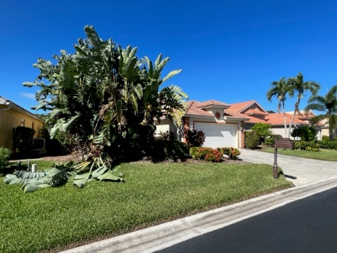
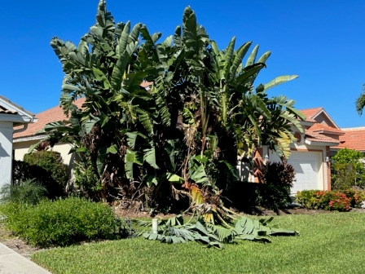
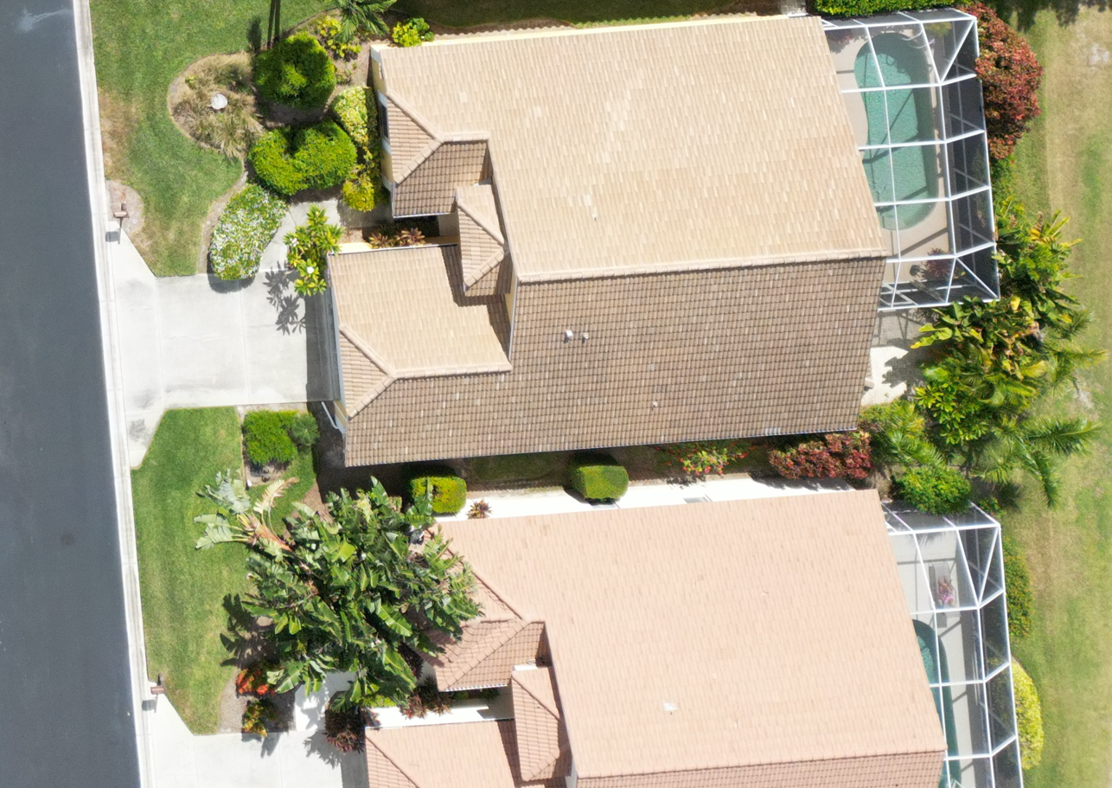
Owner’s Home and Lawn Upkeep
8469 – Need to formally send letter to remove over-growth and palm tree trunk
8473 – Need to formally send letter to remove over-growth in rear
8473
8469
Did Sara send note to 8469 to remove dead palm tree in response to my email to her on 20 Dec 2021?

Slide 12
Proposed Lely Master POA Declarations & Guideline changes
Any comments regarding the proposed Lely Master POA Declarations & Guideline changes that was emailed to you on October 30th?

Slide 13
Other issues and concerns:
HOA Light by Entrance Keypad
Aerators
Mailboxes
Our Declarations

Slide 14
Back-up slides

Slide 15
Our Cameras DVR has failed
See email from Fox on 4 Nov 2023
Should we continue to have a surveillance system?
If we say yes, who will be responsible to provide pictures and video upon request?
If we say yes, who will maintain the system?
If we say yes, do we want the same capabilities we had before?
If we say yes, who will take the responsibility to research and recommend the system to replace?
After answering questions 2-5, should we continue to have a surveillance system?

Slide 16
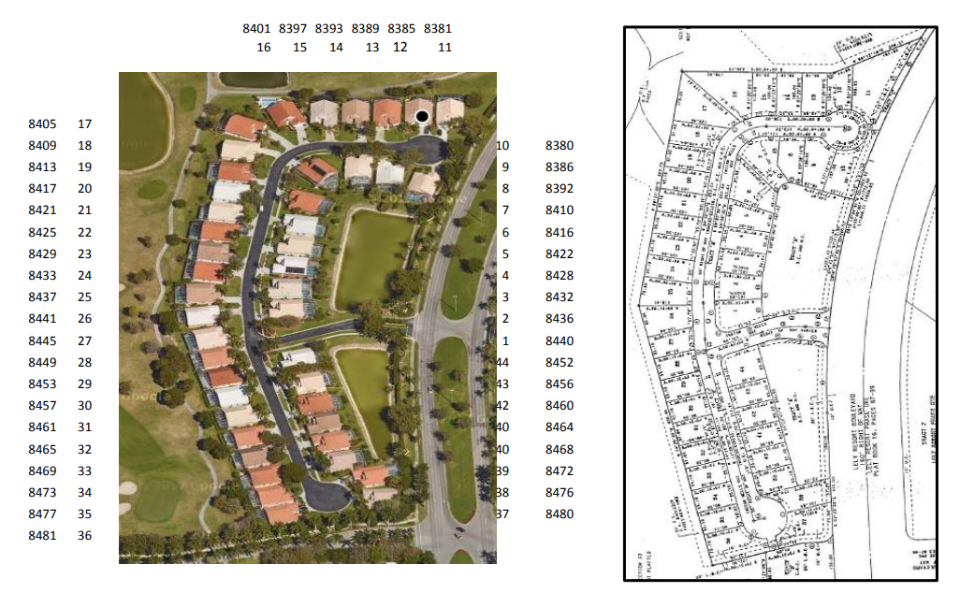

Slide 17
Reserves
Reserves are for major infrequent capital / expense considerations. Items earmarked include:
Street resurfacing & sidewalk repairs
Major gate projects
Major landscape projects along road and possibly in landscape barrier easements
Aerators
Repair, Repaint Common Walls and Fencing,
Major hurricane damage to common area
Possibly mailbox repainting or subsidizing replacements if we chose to do something across the whole neighborhood

Slide 18
Governance Document Issues
 | Section(s) | Issue | Recommendations
1 | 10.3 B&C & 10.4 | We seem to say things in one place that seem to be in conflict elsewhere. We actually allow more people to stay for the situation where the tenant is absent. Also "unit" is not defined in the Declarations. | Occupy, Occupant, Home, Family and Guest are all defined in the Declaration. A lease should include all occupants. Therefore, we could simply say: “10.3 Occupancy during lease term when an adult tenant is there - The home may be occupied by the tenants and their Family and Guests”; “10.4 Occupancy without an adult tenant present is not allowed without prior approval be the Board.”
2 | 6.2 | Time between ARB request submission and ARB decision and Board Decision given need to have noticed open meetings is not adequate. The former may need to be a little longer and the latter should be shorter if possible for the Association member sake. | Increase the maximum time for an ARB Decision from 30 days to 36 days to allow for once a month ARB or ARB/HOA Board monthly meetings. Secondly, reduce the 30 day maximum time currently allowed for the Board to accept or reject an ARB decision to 6 business days. Change ARB named based on ARB recommendation
4 | Section 11 | When we voted down the amendment regarding change of ownership, we left ourselves without any controls for transfer of property. Secondly, we have a sale application process and application but our Declarations are silent on sales given we did not pass that amendment. | The vote was fairly evenly split. Consider the same amendment again?
4 | Fining | Does the current fining process adequately address landlords that don't comply with Declarations?

