Slide 1
Indian Wells HOA
L.B.E. issue where the easement is on Owner’s Property
This document is prepared by Bill Fox to facilitate BOD discussion on this topic at the 4 March 2022 mtg.
L.B.E: The 15’ or 20’ wide barrier separating IW from Lely Blvd and Mustang

Slide 2
What is the issue?
IWHOA does not own any land.
There are 5 Owners in IW that have either a 20’ or 15’ LBE on their property.
The recorded IW Plat Dedication gives the responsibility of maintenance of this easement to IWGVHOA Inc.
Our Declarations statement: “Where landscaping has been installed prior to the transfer of a Home to the Owner, the Owner shall not remove or add to the existing landscaping without the prior written approval of the ARB. Once landscaping is installed, it shall be maintained by the Association at the Owner’s expense, including right-of-way areas.”
Due to time (aging), possible invasive species growth and/or weather events, the LBE landscape needs attention
Problem statement: How do we proceed in a way that meets Plat and community obligations and interests without putting an undue cost burden on individual owners and/or denying them a voice in what is done with landscaping on their lot?

Slide 3
Walking BOD Mtg. Agenda and Goals
Develop a BOD consensus of what the HOA obligations are with regards to maintenance of the Landscape Barrier Easement (LBE)
Develop a proposed policy as to who determines and pays for new plantings where the LBE is on owner's property in cases where the community benefits from the plantings and in cases where the owner is the only beneficiary
Develop a BOD consensus of what the HOA obligations are with regards to maintenance of the current perimeter hedge where it is not in a Landscape Barrier Easement (LBE)

Slide 4
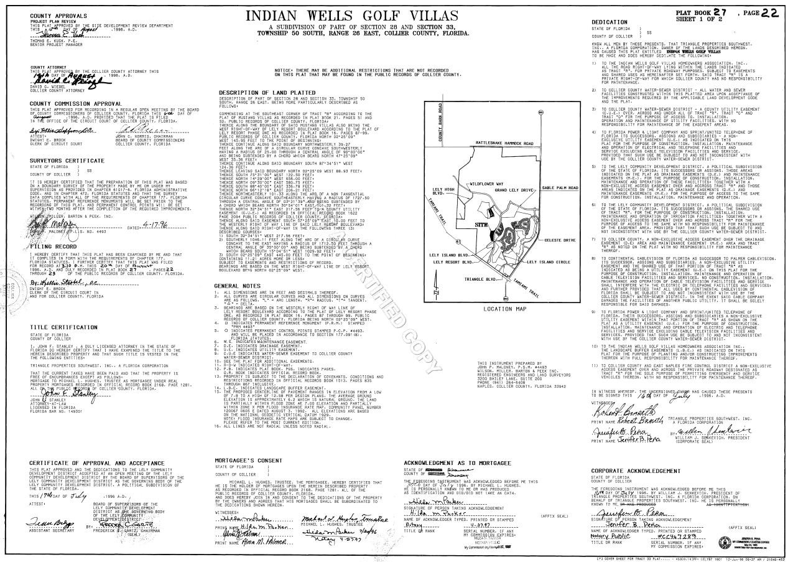

The obligation:
This is a common statement required by CC Land Development Code

Slide 5
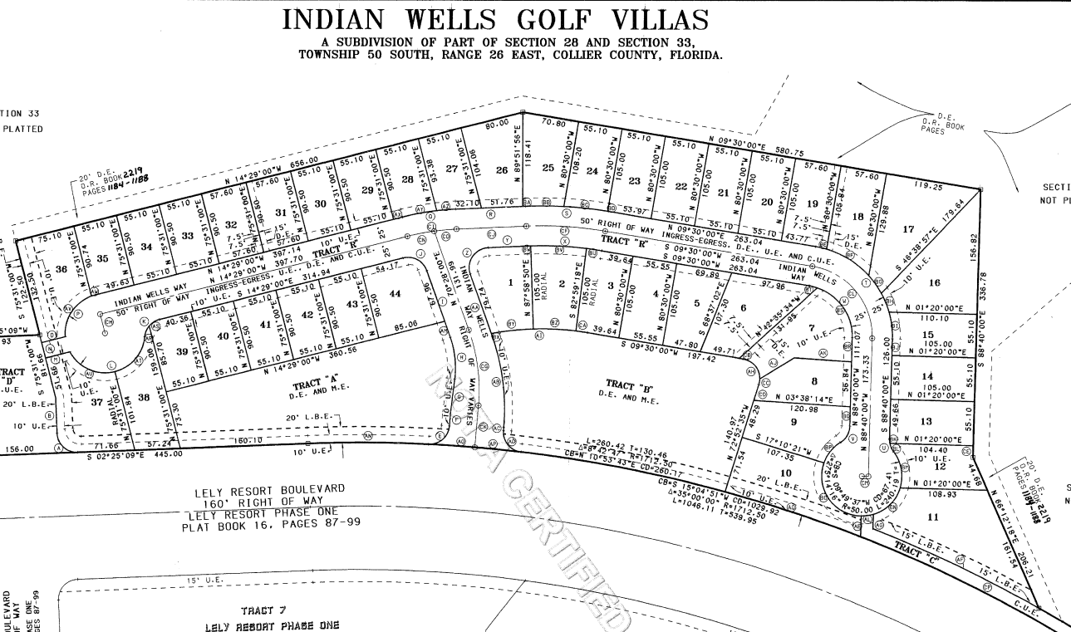
LBE areas on IWGV Plat
Interestingly, the actual landscape appears to be in Tract C and not in the Plat LBE in this area. Also, maintenance of this area is not called out on the Plat dedication even though CC land code suggests it should have been.

Slide 6
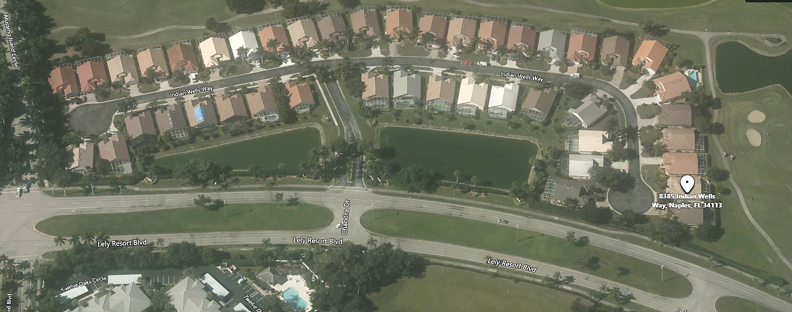
As you can see, the actual landscape barrier may or may not fall in the LBE in all cases

Slide 7
Florida Statute 177 Land Boundaries
Part I – Platting
In short, there is no real state guidance.
177.031 Definitions
  (7)(a) “Easement” means any strip of land created by a subdivider for public or private utilities, drainage, sanitation, or other specified uses having limitations, the title to which shall remain in the name of the property owner, subject to the right of use designated in the reservation of the servitude.
  No definition of “maintenance”
The only reference to “Landscape” or “Landscaping” in the whole statute is simply to include that word in a list of “Improvements”
The word “Maintenance” appears 4 times. Three are in reference to cable TV. The only time it seems relevant to us is as follows:
  177.081 (3) Dedication and approval …. “When a tract or parcel of land has been subdivided and a plat thereof bearing the dedication executed by the owners of record and mortgagees having a record interest in the lands subdivided, and when the approval of the governing body has been secured and recorded in compliance with this part, all streets, alleys, easements, rights-of-way, and public areas shown on such plat, unless otherwise stated, shall be deemed to have been dedicated to the public for the uses and purposes thereon stated. However, nothing herein shall be construed as creating an obligation upon any governing body to perform any act of construction or maintenance within such dedicated areas except when the obligation is voluntarily assumed by the governing body.”

Slide 8

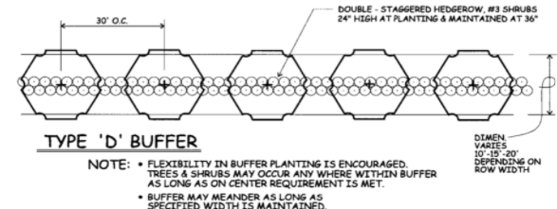
Collier County Land Development Code Chapter 4.06
“Landscape Code. The purpose and intent of the landscape code is to: …. by establishing minimum uniform standards for the installation and maintenance of landscaping”
All buffer tracts or easements shall be owned and maintained by a property owner's association or other similar entity and shall be so dedicated on the final subdivision plat.”
Shrubs and hedges. Shrubs and hedges shall be installed and maintained at a minimum height as specified in Section 4.06.02.C. …Shrubs and hedges shall screen the adjacent pavement surface or developed property required to be buffered and/or screened. Hedges, where required, shall be maintained so as to form a continuous, unbroken, solid visual screen within a minimum of one year after time of planting.
Type of buffer required for a PUD was not listed in the code but one the northside it appears to be a Type D Buffer: A landscape buffer shall be required adjacent to any road right-of-way external to the development project
  a. Trees shall be spaced no more than 30 feet on center in the landscape buffer abutting a right-of-way or primary access road internal to a commercial development.
  b . A continuous 3-gallon double row hedge spaced 3 feet on center of at least 24 inches in height at the time of planting and attaining a minimum of 30 inches in height in one year shall be required in the landscape buffer where vehicular areas are adjacent to the road right-of-way, pursuant to LDC section 4.06.05 D.4
For code-required trees, the trees at the time of installation shall be a minimum of 25 gallon, ten feet in height, have a 1¾-inch caliper (at 12 inches above the ground) and a four-foot spread.
36”
Seems to be a disconnect between the language and the diagram as it mentions a solid visible screen and yet only shows maintaining it to 36”

Slide 9
Our contract with Stalhman regarding hedges…
Per our Landscape Management Specifications document which is part of our contract in the section on Ornamentals and the paragraph regarding pruning….
“Hedges above 6 feet tall shall be performed at Owners request and expense.”

Slide 10
Conclusions based on the IW Plat, CC code, IWHOA Declarations, and Stahlman contract
IWHOA is responsible for maintenance of the LBE shown on the plat (ref: Plat & CC code)
CC Land Development code appears to require a LB next to a road to have two parallel hedges maintained to 36” high with trees planted no less that 30’ on center
The Owner is responsible for the cost of maintaining the plants on their property per our Declarations.
Hedges over 6’ high require an Owners request to trim and this will be an additional cost to the Owners.
  (The use of the word Owners in this case is unfortunate as it is unclear whether it is IWHOA or individual owners in IW given contract language and context. In any case, it may be cost beyond what the HOA budgets for and in the case of trees over 14’ on an individual owner’s property this has historically been paid by the Owner, not the HOA. What has been precedent for hedge’s above 6’ that make up our LB?)
Do you agree with the above conclusions?
Based on the following slides and discussion what does the BOD want to do going forward?

Slide 11
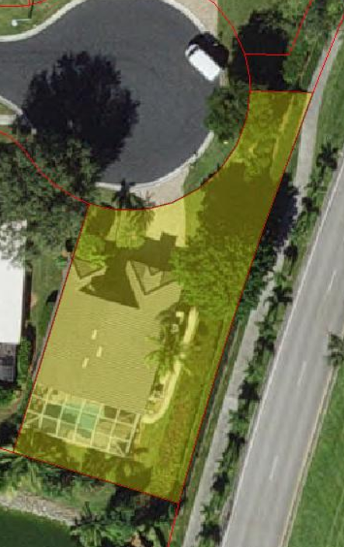
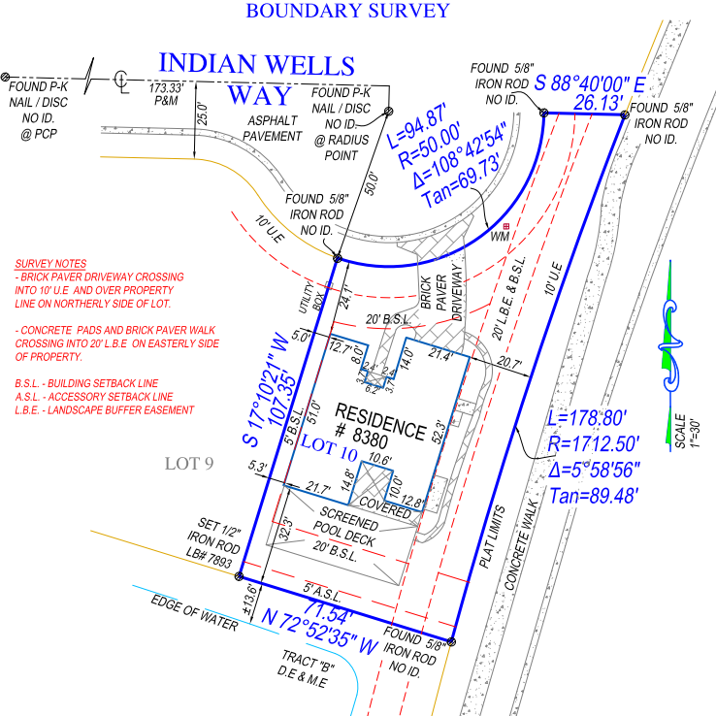
Looking at Owner 8380 (lot 10) specifically...
As you can see, the LBE goes right up to the east side of the house
The property line appears to go down the center of the outer row of hedges though the yellow area may be skewed ~4-5’ east given its position relative to the west side of the house.

Slide 12
Questions regarding 8380 (lot 10)
Is it fair to have 8380 pay for clean-up and replacement of parts of the LBE separating IW from Lely Blvd?
  IWHOA paid $1400 for the recent removal of a large tree in this LBE that fell across the Owners driveway
  There is presently a gap in the higher hedge due to the recent tornado. Miguel has suggested replacement that would cost $625.
  Past precedents:
    The previous owner made modifications to planting in this LBE (e.g. He changed some planting and added to plantings)
    The HOA paid to have the large tree on this property up righted and several association members helped replant it after Irma had toppled it.
What say does the owner of the land have with regards to how planting are done? (i.e. Does IWHOA have full say in what is done and the resulting cost to the owner of LBE maintenance on his land? Or vice versa? Or is there a good middle ground?)
Other questions?

Slide 13
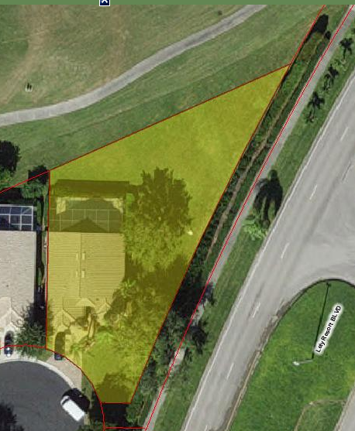
This owner would like see that the original high hedge maintained high due to noise, dust, privacy etc.
Past storms and plants near the end of their life are putting gaps in this barrier.
In this case, the actual landscape is on Tract C owned by Associated Real Estate SW Inc but is part of the Indian Wells community like the lakes and road.
The LBE on the Plat is to the west of the actual landscape and is on the owner’s land.
The Plat Dedication does not call out IWGVHOA Inc. to maintain the plants on Tract C because it “expects” the actual barrier on 8381 property. LCDD currently maintains the outer hedge. (Verify that Stahlman maintains the inner hedge or not. In any case, who will if not us?)
The owner has stated that he is willing to fund replacing plants and filling gaps. While this is a very generous offer, is it fair to the owner to pick up the entire tab and to what extent can he have say in what goes in and when on land that is not his?
Looking at Owner 8381 (lot 11) specifically…

Slide 14
Looking at Owner 8480 (lot 37) specifically….
This owner reached out to the HOA to have plants and trees in the LBE cutback last year due to the shading effect killing his lawn and not being able to re-establish it. He was told at the time that it was his property, not the HOA’s and needed to addressed by him. In retrospect, the correct answer should have been “based on the Plat Dedication and our Declarations is that the HOA will take care of it and bill you for the cost”.
Was the actual answer better for the owner because he had more control of scope and cost?
Miguel has suggested a one-time charge to reduce the height of the hedge to 5’ and then maintain it below 6’ as part of our current contract.
  Does the owner want the hedge that low?
  If so, should we do this?
  Should the owner be burdened with this cost per the Declarations or should the HOA subsidize?

Slide 15
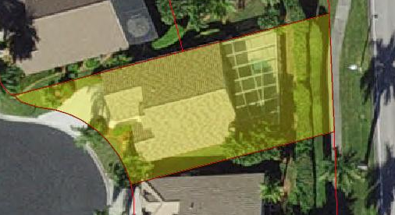
Looking at Owner 8476 (lot 38) specifically….
Hedge is ~7’ high

Slide 16
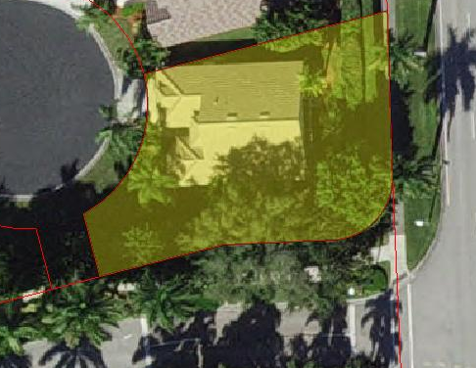
Looking at Owner 8480 (lot 37) specifically…
Hedge on Blvd side is ~7 high
Hedge on Musting Island side is ~12-15’ high

Slide 17
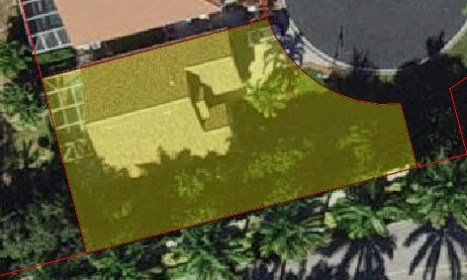
Looking at Owner 8481 (lot 36) specifically…
Hedge is ~12-15’ high
Miguel has suggested a one-time charge to reduce the height of the hedge to 5’ and then maintain it below 6’ as part of our current contract. Thoughts?

Slide 18
Discussion

Slide 19
Back up slides

Slide 20
