Slide 1

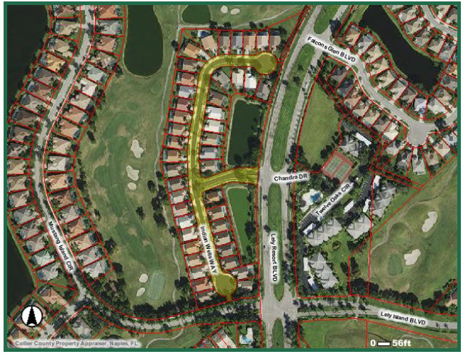
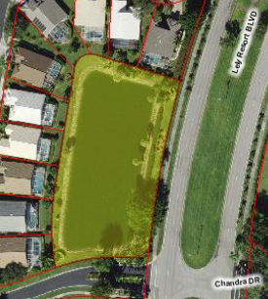
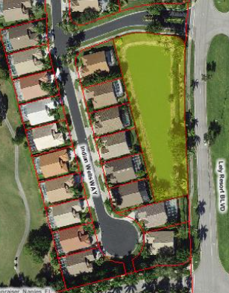
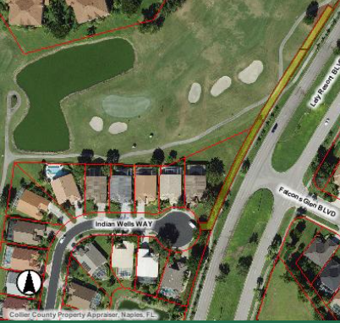
Collier County Property Appraiser (collierappraiser.com)
ASSOCIATED REAL EST SW INC
7995 MAHOGANY RUN LN
Naples, FL 34113-1625
51677512640
Legal: INDIAN WELLS GOLF VILLAS TRACT R
51677512585
TRACT B
51677512569
TRACT A
51677512608
TRACT C

