Slide 1
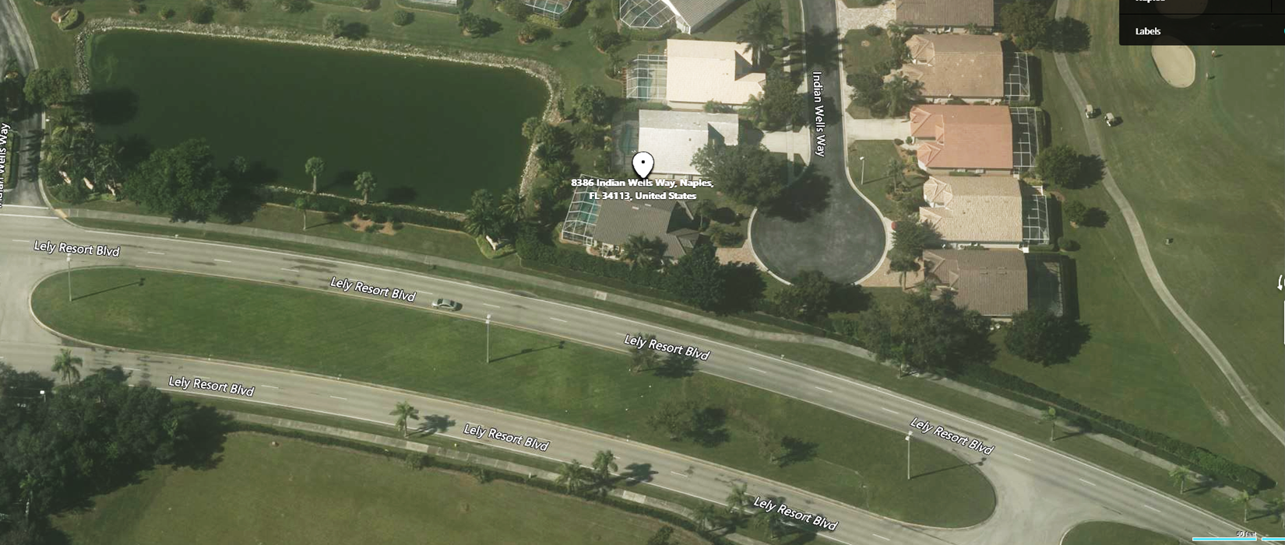
In general, the recommended approach by the ARC for the first phases of work on the north side is
fix bare spots and dying plants and replace random plantings of Clusia by planting 25 gal guava bushes that match existing guava hedges and maintain at a 6’ height (priorities 1a, 1b, 1c, 1d & 2)
trim what looks to be dying viburnum at far north end of hedge to 6’ and add two irrigation rotors (1c)
This should address all the holes in the hedge and provide a much more consistent look compared with the hodge podge of plants there now.
Priority 2
19 ft bare spot with some Clusia. Tornado damage. Remove Clusia. Replace with five 25 gal Guava. An maintain at 6’. Consider replacing tree taken out by tornado with a Shady Lady with dribble irrigation. All of this is on the LBE on 8380 property
Priority 1a. Remove 35’ ft of dying Viburnum hedge and Clusia. Replace with seven 25 gal Guava and maintain at 6’.
4. 20 ft total 2 areas sections north lake Sweet Viburnum
Priority 1c
See if 85 ft of what looks like dying Viburnum hedge can be salvaged by cutting to 5-6’ height and adding two pop-up sprinkler heads. Plant one 25 gal Guava bush adjacent to existing north most Guava hedge to fill gap
Priority 3. If 1b above is unsuccessful, plant ____ 25 gal Guava bushes and maintain at 6’. This is on trac C adjacent to 8381, but not on 8381 property,
Priority 1b. Remove Clusia. Replace with three 25 gal Guava and maintain at 6’.
Fill gap just north of manway with one 25 gal Guava
5. Remove ornamental grass by Bougainvillea and replace with sod
Priority 1d. Maintain this hedge at 6’
50’

Slide 2
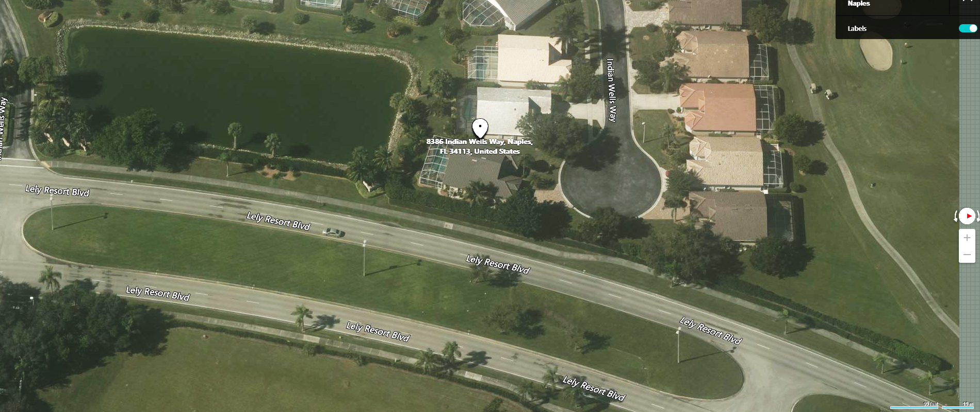
In general, the recommended approach by the ARC for the first phases of work on the north side is
fix bare spots and dying plants and replace random plantings of Clusia by planting 25 gal guava bushes that match existing guava hedges and maintain at a 6’ height (priorities 1a, 1b, 1c, 1d & 2)
trim what looks to be dying viburnum at far north end of hedge to 6’ and add two pop up sprinklers (1c)
This should address all the holes in the hedge and provide a much more consistent look compared with the hodge podge of plants there now.
Priority 2
19 ft bare spot with some Clusia. Tornado damage. Remove Clusia. Replace with five 25 gal Guava. An maintain at 6’. Consider replacing tree taken out by tornado with a Shady Lady with dribble irrigation. All of this is on the LBE on 8380 property
Priority 1a. Remove 35’ ft of dying Viburnaum hedge and Clusia. Replace with seven 25 gal Guava and maintain at 6’.
4. 20 ft total 2 areas sections north lake Sweet Viburnaum
Priority 1c
See if 85 ft of what looks like dying Viburnaum hedge can be salvaged by cutting to 5-6’ height and adding two pop-up sprinkler heads. Plant one 25 gal Guava bush adjacent to existing north most Guava hedge to fill gap
Priority 3. If 1b above is unsuccessful, plant ____ 25 gal Guava bushes and maintain at 6’. This is on trac C adjacent to 8381, but not on 8381 property,
Priority 1b. Remove Clusia. Replace with three 25 gal Guava and maintain at 6’.
Fill gap just north of manway with one 25 gal Guava
5. Remove ornamental grass by Bougainvilla and replace with sod
Priority 1d. Maintain this hedge at 6’
50’

