Slide 1
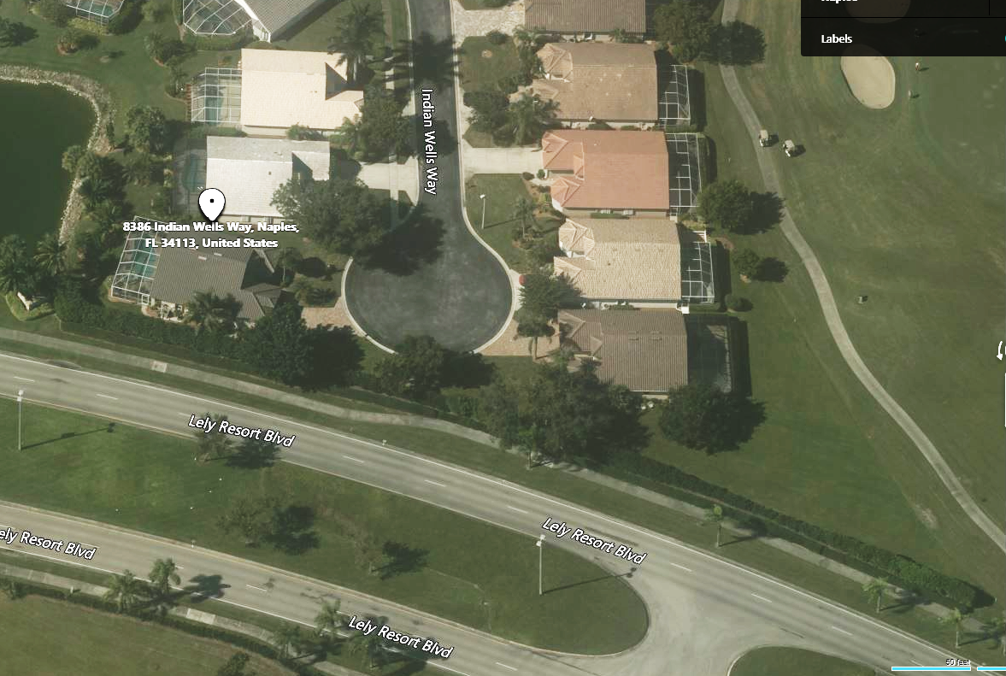
In general, the scope approved by the IW BOD on 20 April 2022 is to:
fix bare spots and dying plants and replace random plantings of Clusia by planting 25 gal guava bushes that match existing guava hedges and maintain at a 6’ height (priorities 1a, 1b, 1c, 1d & 2)
trim what looks to be dying viburnum at far north end of hedge to 6’ and add two pop up sprinklers (1c)
The goal is to fill all the gaps in the hedge and provide a much more consistent look by eliminating random plantings of clusia in these areas and maintain the hedge to the maximum height that is allowed under the Stahlman maintenance contract.
Priority 2
Remove Clusia and fill this area and bare spot with five 25 gal Guava. An maintain at 6’.
Priority 1a. Remove 35’ ft of dying Viburnaum hedge and any Clusia. Replace with seven 25 gal Guava and maintain at 6’.
Priority 1b. Remove Clusia. Replace with three 25 gal Guava and maintain at 6’.
Fill gap just north of manway with one 25 gal Guava
Priority 1c
Revive Viburnaum hedge by cutting to 5-6’ height and adding two pop-up sprinkler heads. Plant one 25 gal Guava bush adjacent to existing north most Guava hedge to fill gap
Priority 1d. Maintain this hedge at 6’

