Slide 1
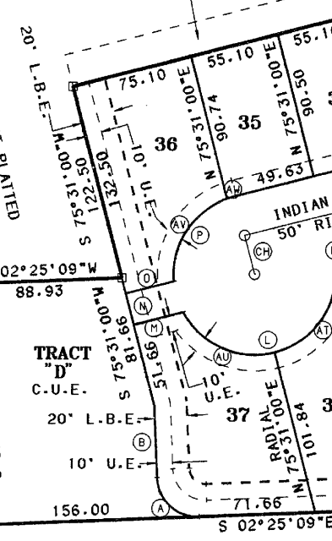
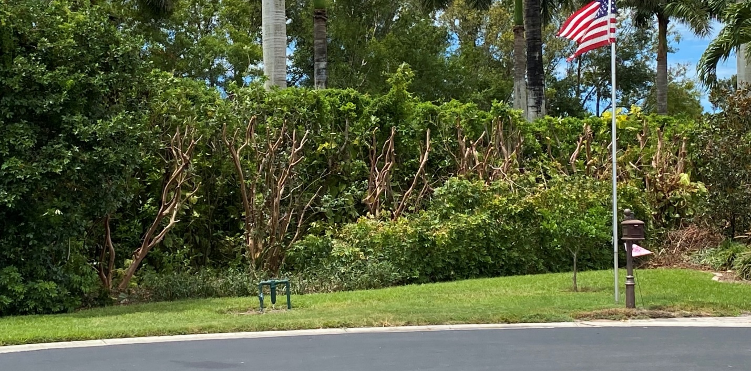
Work by Goodwin Landscaping and paid for by lot 36 (8481) owner
Scope of work budgeted for in 2023 by HOA
Looks like we are responsible for LBE up to 30’ deep from cul-de-sac (10’ UE + 20’ LBE)
Fox

