Slide 1
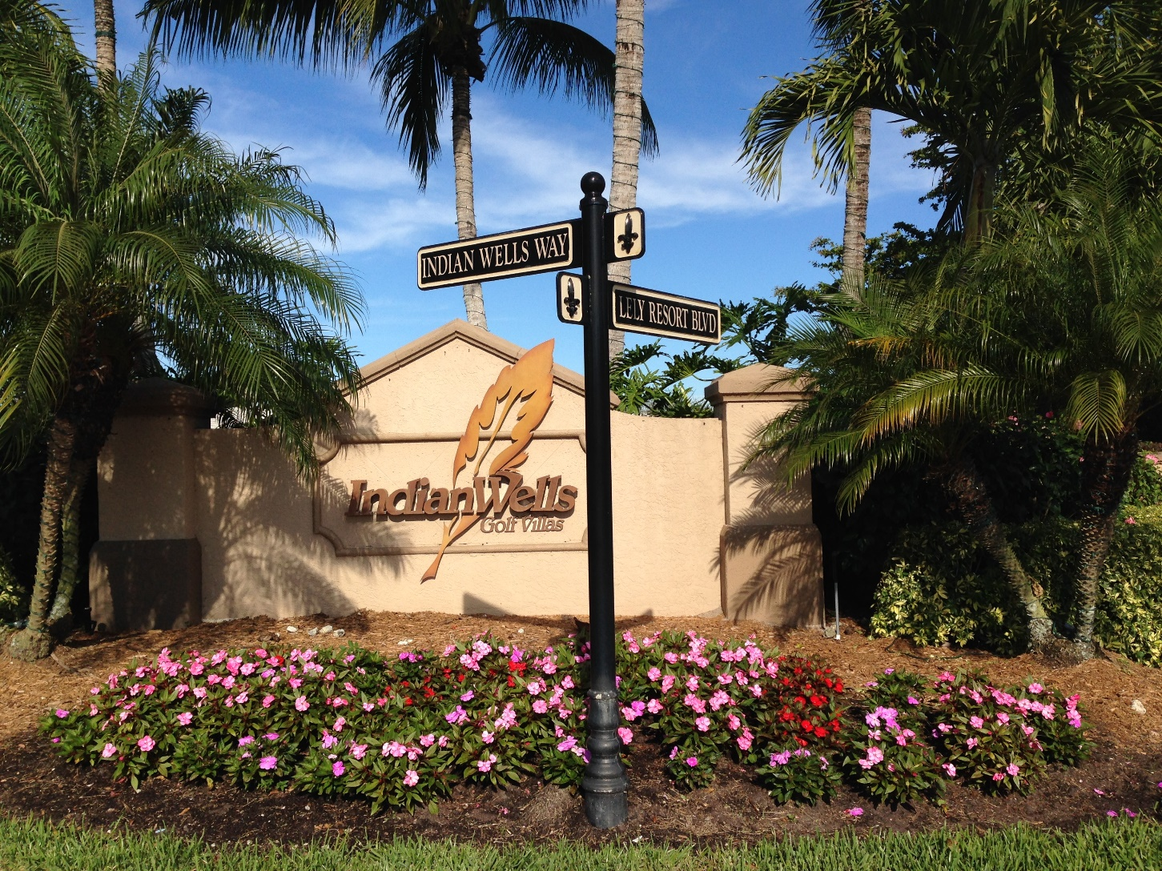
2025 Indian Wells HOA Annual Mtg.
IndianWellsHOA.com

Slide 2
Agenda
Call Meeting to Order
Certify Proxies and Establish a Quorum
Certification of Mailings
Approval of Meeting Minutes
  2024 Annual Meeting minutes
President’s Report
Financial Report
New Business
Adjournment

Slide 3
2024 Community Involvement
Board of Directors
Meagan Billings
Pat Buchenroth
Bill Fox
Tricia O’Hare
ARC
Kathy Fox
Mike Billings
Barb Wietzes
Community Manager: Michael Cohen, CAM
Anchor Associates, Inc

Slide 4
President’s Report
Pond update
  Based on benchmarking and recommendations, we installed an inexpensive aerator system in the south lake in 2021 to pilot lake water quality improvement via aeration. We saw no visual improvement. Since it appeared this led to no improvement, it has been shut off.
  Tricia O’Hare contacted several service providers for recommendations. After reviewing all their comments and suggestions, we chose to flocculant to eliminate suspended algae. This made a significant visual improvement in both lakes
  The Board will be making decisions regarding next steps to maintain or improve water quality further

Slide 5
President’s Report
Landscape maintenance update
In 2022 & 2023, we addressed…
  North landscape barrier (LB) damage from an EF-0 tornado, planting irregularities & inadequate watering, and plant end of life
  South cul-de-sac LB overgrowth and plant end of life
In 2024 we addressed similar issues with our LB and common areas between the two cul-de-sacs that were identified by our ARC
During budgeting for 2025, the Board discussed whether we should continue spreading this remediation out over several more years consistent with our past approach. A decision was made to put together full list of landscape maintenance issues and do it all at once funded by a special assessment.
Our ARC recently put together this list of issues

Slide 6
President’s Report
Landscape maintenance contract
Our current contract with Stahlman expires at the end of 2025
Nearly every Owner has had some issue(s) with their performance over the time they have served us.
They account for over 85% of the landscape maintenance in Lely
  The next biggest is Greenscape who we had before and chose to not renew their contact due to performance issues.
Kevin Carter, who manages LCDD maintenance, sees all the landscape maintenance providers and believes Stahlman is the best
The Board will submit a performance spec to obtain bids from several possible service providers for 2026

Slide 7
President’s Report
Mulch update
During the 2023-2024 winter season, we chose a different mulching contractor and a different mulch (dyed wood vs. cypress). Significant excess mulch was required because of the color change.
For the 2023-2024 we used the same contractor and their recommend amount of mulch
  There seemed to be more areas which didn’t receive mulch this time. Multiple issues – some associated with our understanding and some associated with their execution. They had a person come and survey our neighborhood post application, A key learning point for us is that while they use the number of houses to suggest how much mulch to buy for our neighborhood, it was not made clear that their work would be focused to Owners lots and much of our common area would be neglected.

Slide 8
Financial Report - 2024 in review
Income statement
Estimated expenses & budget | $111,584
Actual expenses | ($110,856)
Budget surplus | $728
Interest on our accounts and CDs | $1,186
Late fees and other income received | $983
Total surplus | $2,897

Slide 9
Financial Report - 2024 eoy
Account balances (31 Dec 24)
Operating account balance at Horizon | $40,541
Outstanding checks | ($10,551)
CD(s) | $20,204
Accounts receivable | $1,268
Balance coming into 2025 | $51,462
  This amounts to ~ 5.3 months of cashflow going into 2025 which falls between 3-6 months recommended by Anchor.
We had a Reserve account balance of $41,029
  This is still a concern given the cost to replace our road in the future along with other recapitalizations

Slide 10
Financial Report - 2025 Budget
Estimated expenses are $116,774
Quarterly Owner assessment is $663/quarter

Slide 11
Our operating assets expressed in months of expenses
Anchor recommends 3-6 months of coverage.
In 2017 we were down to a couple of weeks and had to have a special assessment to get back on good financial footing

Slide 12
Road sealing;
wall & gate repair
Gate call box replacement

Slide 13
Questions, issues & suggestions ?

