Slide 1
WE ARE ONLY STRONG TOGETHER
We work hard, we lean in,
make hard sacrifices of time and resources,
leverage social media, relationships, and networks,
cultivate commitment from others,
and we continue to do so no matter what. Everything we do, is done by volunteers, like you.
To do more, we need you.
Our strength is collective

Slide 2
We get more done with less, because we rely on volunteers
VOLUNTEERS ARE LEGITIMATE REPRESENTATIVES OF THE ORGANIZATION
Key Volunteers Board Members (also Volunteers)
Stacey Mosteller, Webmaster Ileana Perez, President & Family Mentor
Shoaib Mohammed, Technology Leader Amanda Leon, Secretary, Medical School Student
Mandy Huang, Technology design and production Celia Earle, Founder of Christmas in July
Sonia Shah, Content creator Liliana Gomez, Sanofi Pharmaceuticals & Family Mentor
Gladys Mendez, Project Manager Cliff McClenny, (Name of agency he works for)
Theresa Southern, Technology Consultant Kathryn Wilkens, Pearl-quest & Family Mentor
Subhashini Jain, Volunteer Coordinator and Lead Researcher Chet Taylor, Board member emeritus and grant writer
Cynthya Borges, Grant researcher
Laura Hansen, C.E.O.

Slide 3
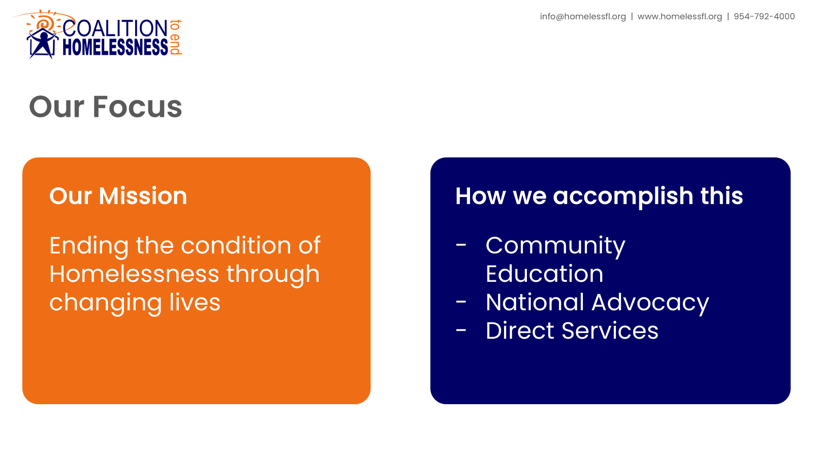

Slide 4
The Coalition is a volunteer-driven movement
United by one belief:
Homelessness must End
For Everyone
-We are different than an organization that only provides services such as food or shelter.
- We concern ourselves with the entire condition of homelessness, the increasing number of people living without adequate or any shelter.
- We focus on sharing solutions to the increasing number of people
without housing in the U.S.

