Slide 1


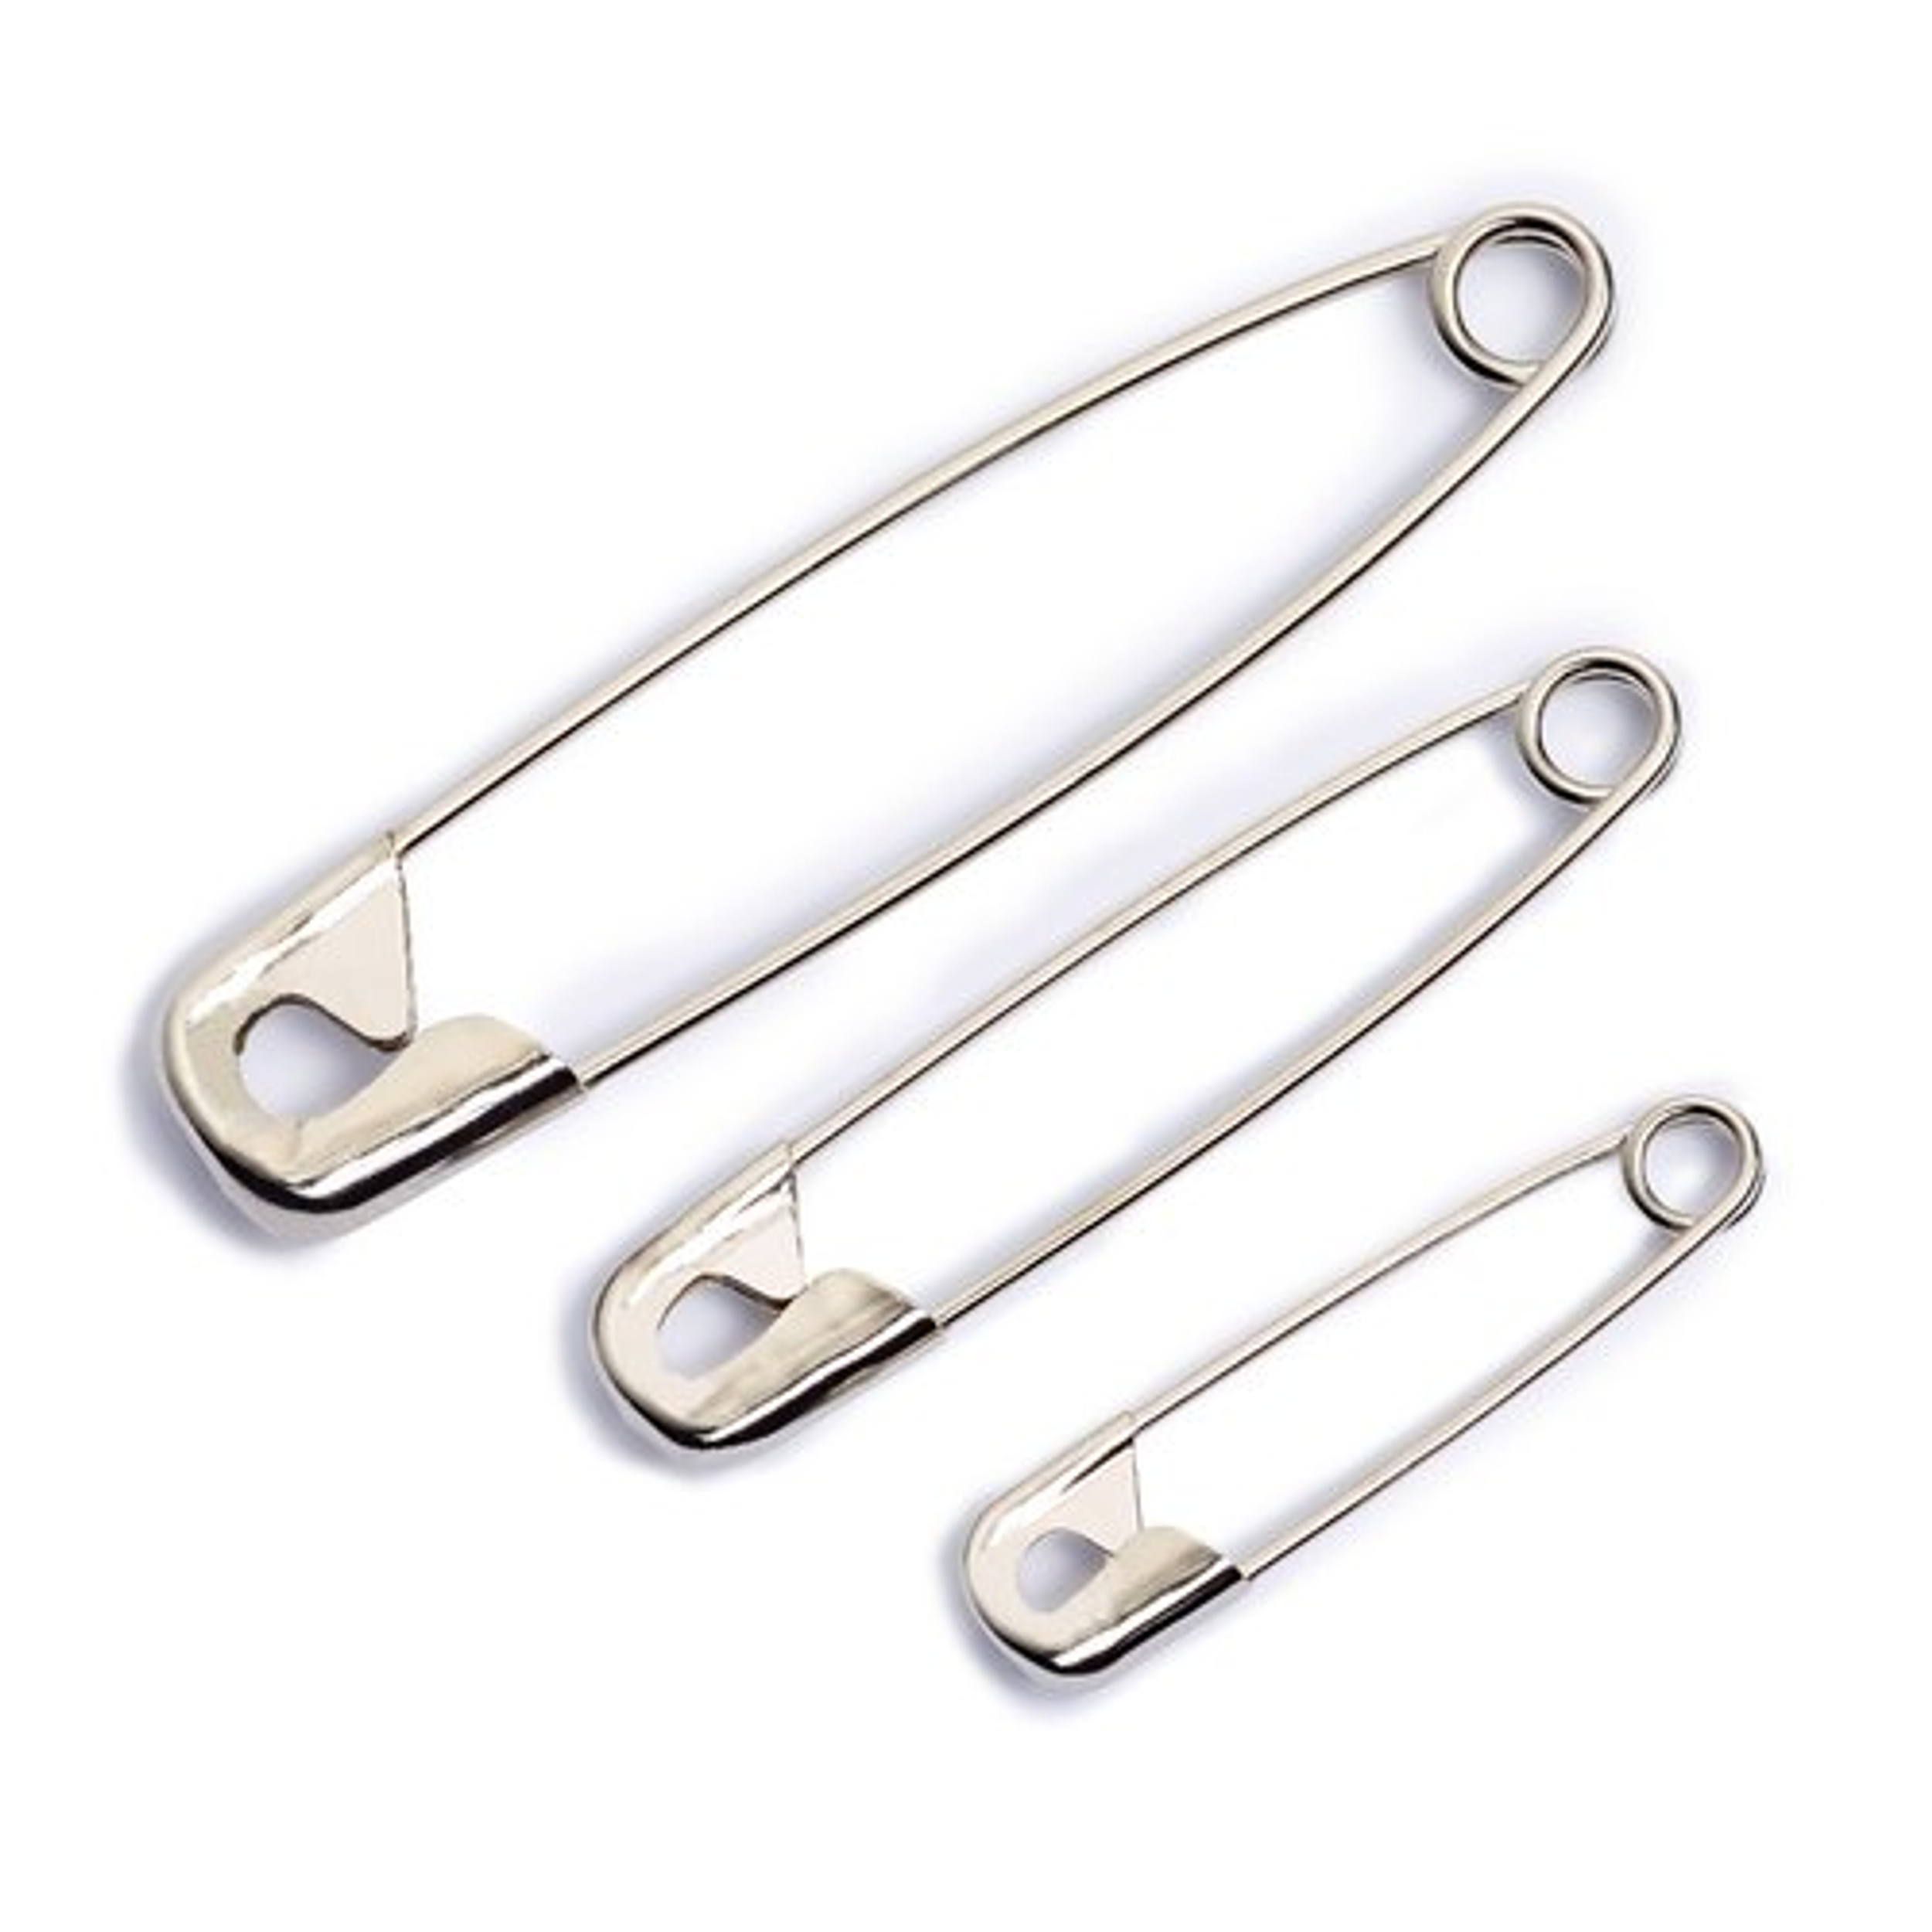

Activity 3:
Object 2
1.
2.
3.
4.
5.
Object 1
1.
2.
3.
4.
5.
Object 3
1.
2.
3.
4.
5.
Object 4
1.
2.
3.
4.
5.

Slide 2

Case Study
Activity 4:
Sudhir has recently completed 3 months with Jupiter Group; a hypermart chain of departmental stores in Mumbai.
Being new to the company he is just beginning to adjust to a new working style. His colleague Shanaya has reported sick because of Covid and won't be expected to be back at work for a week at least. In her absence, their Manager Mr. Vishwas Patil has asked Sudhir to create a presentation for the review with the CEO.
Vishwas has categorically informed Sudhir to create interactive dashboards for the review. Though Sudhir agrees to it, he is completely clueless how to initiate this.
He fears if he informs his inability to do the task, Vishwas won't trust him with any critical tasks going forward.
How can this ambiguity be done away with?
What will you advise Sudhir ?

Slide 3

WAYS TO BUILD A TOLERANCE OF AMBIGUITY
Master Mindfulness
Be Assertive
Focus on What Matters
Practice Agility
Cultivate Curiosity
Let go and move on
Notes:
Master Mindfulness
One of the key behaviours related to TOA is mindfulness. This relates to someone being able to regulate and control their emotions, to handle stress and be in the present moment. They also have a mental state of openness, awareness and focus. The ability to master mindfulness is particularly important for people who score low on the Comfort with Ambiguity Scale.
Be Assertive
Assertive behaviours including taking charge or control of situations and not waiting for others to lead, were found to be related to someone with high levels of TOA. These people seek to influence others and are prepared to present their opinions and have a say. Assertiveness should be a focus for those who score low on the Desire for Challenging Work Scale.
Focus on What Matters
To assist in developing levels of TOA, individuals should seek to minimise distractions and noise, and identify and focus their attention on important tasks. This could include setting objectives and strategies to achieve by breaking down problems and issues into more manageable pieces. It might also include identifying unimportant or irrelevant details that can be overwhelming in an ambiguous situation. Focusing on what matters is a habit that should be cultivated in people who score low on both the Comfort with Ambiguity Scale or the Coping with Uncertainty Scale.
Practice Agility
An important trait displayed by people with high levels of TOA is their ability to be flexible when change or uncertainty is present in the workplace. They have an ability to expect success however they have realistic expectations and do not let their desire for perfection impede their progress. In a practical sense, it is important to not get lost or bogged down in the details and to rewire mindsets to accept that perfection is not obtainable nor a worthy endeavour. Developing one’s flexibility and agility in the workplace is particularly important for people who score low on the Coping with Uncertainty Scale.
Cultivate Curiosity
Cultivating curiosity in the workplace was also found to be a trait that people could focus on to develop their TOA. These behaviours centre around interacting with others and include effectively communicating and listening to co-workers; when problems arise, asking questions that encourage curiosity and if confronted with resistance from others, asking questions that lead to identifying possible solutions rather than dwelling on the past. Collaboration is also important including behaviours such as encouraging participation from others, posing questions, creating strong professional relationships and networks for diversity of thought, sharing ideas and being open to connect the ideas of different people. Cultivating one’s curiosity is ideally important for people who have low scores on their Desire for Challenging Work Scale and the Coping with Uncertainty Scale.
Let go and Move on
It is important for employees to not dwell on mistakes but to learn from them. This was an important trait that was evident in people who had a high TOA. These people are able to “unhook” themselves from the past and not dwell on missed opportunities, hurts or mistakes. They are also able to not blame themselves for mistakes and are not people to have regrets or rethink too much. Once they make a decision they also don’t look back. The habit of letting go and moving on is particularly important for those who displayed low levels on the Comfort with Ambiguity Scale.
Act Courageously
The ability to have courage at work was found to be a trait of someone with high TOA. Courage is exhibited in people who are able to face their fears, step out of their comfort zone and back their own opinions and beliefs. They are able to stand up for others, tell the truth even when unpopular and speak their mind freely even if there might be negative consequences. Courageous people are able to face uncomfortable or awkward situations and are comfortable with not knowing all the answers. Developing courage in the workplace is particularly important for those who score low in their Desire for Challenging Work Scale.
Think Differently
TOA can also be cultivated by developing ones creativity at work. When problems arise, people with a high TOA were able to use their imagination to think outside the box as well as question existing ways of doing things. Their aptitude to challenge the status quo and draw on a range of ideas assisted them in navigating ambiguous situations. Results showed that developing creativity will particularly assist people if their overall TOA score is low.

