Slide 1







2026
Campus Command & Control Center Proposal
NSHM Knowledge Campus Durgapur
Campus Command &
Control Center

Slide 2

2026
Campus Command & Control Center Proposal
Agenda
01
AI-Based Surveillance Module
02
Deployment & Conclusion

Slide 3
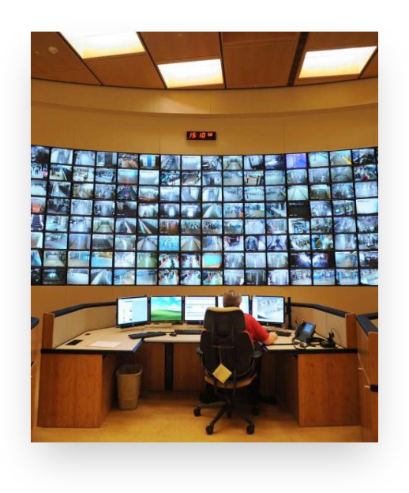



2026
Campus Command & Control Center Proposal
Executive Summary
Project Scope:
Current: 400 cameras across campus
Planned expansion: Up to 0075cameras
Existing infrastructure: 4 Hikvision NVR + 4 Matrix NVR
Objective:
Unified Command Center with Full Campus Visibility
Key Benefits:
Brand-independent integration
Highly scalable architecture
Professional command center
7-10 year lifecycle
WyreStorm AV over IP architecture is recommended as the most robust, scalable, and future-ready solution

Slide 4

2026
Campus Command & Control Center Proposal
Current Infrastructure Assessment
Current
Planned
400
750
NVR Infrastructure
4 × Hikvision NVR (64 & 32 Channel)
Cameras
Cameras
4 × Matrix NVR (64 Channel)
Mixed Brand Environment
Storage & Challenges
Monitoring Objective
Storage: Each NVR equipped with 4 × 8TB HDD
Centralized Command Center with Full Campus Visibility
Challenge: Unified monitoring across mixed brand ecosystem

Slide 5


2026
Campus Command & Control Center Proposal
AI-Based Surveillance Module
Introduction
Transforms CCTV from passive recording to active intelligent monitoring
Enables automated monitoring of 800-1000+ cameras without human dependency
Objectives
Continuously monitor all camera feeds without human dependency
Detect predefined abnormal or critical events in real time
Generate instant alerts for security personnel
Reduce manual monitoring effort and human error
Improve incident response time
System Concept: Monitor everything, alert only when necessary
AI Analytics Engine

Slide 6


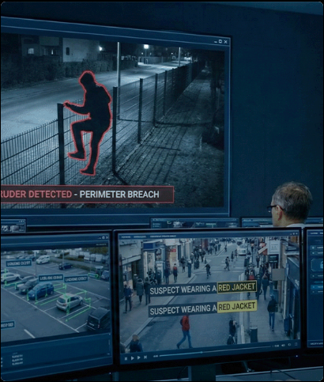





2026
Campus Command & Control Center Proposal
AI Detection Features & System Architecture
Aggressive Crowd Detection
Vandalism Detection
Detect sudden crowd formation and abnormal/aggressive movement patterns
Detect suspicious interaction with assets and identify damage or tampering
Live Analysis
Area Restriction Monitoring
Camera Tamper Detection
Define restricted zones, apply time-based access rules, alert on unauthorized access
Detect obstruction, covering, angle changes, or signal loss
System Architecture
IP Camera
AI Server
Processing
AI Detection
Rule Engine
Popup Alert
Alert Handling
Real-time alert generation
Minimal false positives via tuning
Clear actionable alerts for operators
Multi-camera event handling
Direct RTSP Access & Event Detection Interface

Slide 7











2026
Campus Command & Control Center Proposal
AI Deployment Strategy & Benefits
Hardware & Network Requirements
High-performance server with 64-128 GB RAM
GPU-enabled processing
Deployment Phases
SSD storage
Same LAN for cameras and AI server
Sub-stream enabled
VLAN segmentation recommended
01
Phase 1
AI deployment for 400 cameras, configuration and testing
Key Benefits
Limitations
02
Phase 2
Eliminates manual monitoring dependency
Depends on camera positioning and lighting
Scale to 800 cameras, add processing capacity
Real-time detection and faster response
Requires tuning for accuracy
Scalable architecture
Works with existing infrastructure
Initial calibration needed
03
Phase 3
Hospital deployment 600-800 cameras, zone-based architecture
24×7 operation without fatigue

Slide 8


2026
Campus Command & Control Center Proposal
Final Recommendation
AV over IP + AI-Based Surveillance = Future-Ready Campus Security
Summary
AV over IP provides scalable, brand-independent infrastructure for 550-1000 cameras
ROI: 3-4 years with 7-10 year infrastructure lifecycle
Eliminates brand compatibility issues and centralized bottlenecks
AI module transforms passive monitoring into intelligent, proactive surveillance
Combined solution delivers enterprise-grade command center with automated threat detection
Next Steps
01
02
03
04
Review technical specifications
Schedule site assessment
Finalize deployment timeline
Begin Phase 1 implementation

Slide 9



2026
Campus Command & Control Center Proposal
Thank You
Nexus Technologies

