Slide 1
New Avenue Mutual Water Company 2024 Annual Meeting
5/22/2024
7pm

Slide 2
Schedule of Events
1 Website Update with Joe Cardinalli
2 Financial Review with Jim Armstrong
3 Water Quality with Tony Bowden
4 Capital Projects (Well 3) with Alan Heinzen
5 Summary/ Rate Increases with Mike DiPietro
6 Q&A with the Board
7 Voting for Board Members
8 Adjourn Meeting

Slide 3
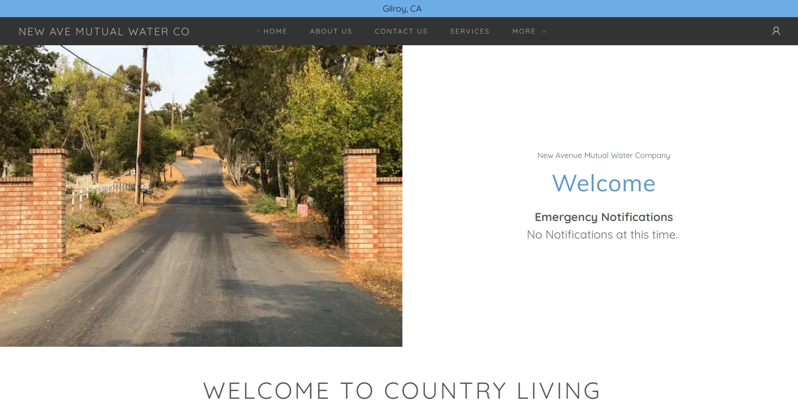
Website Update

Slide 4
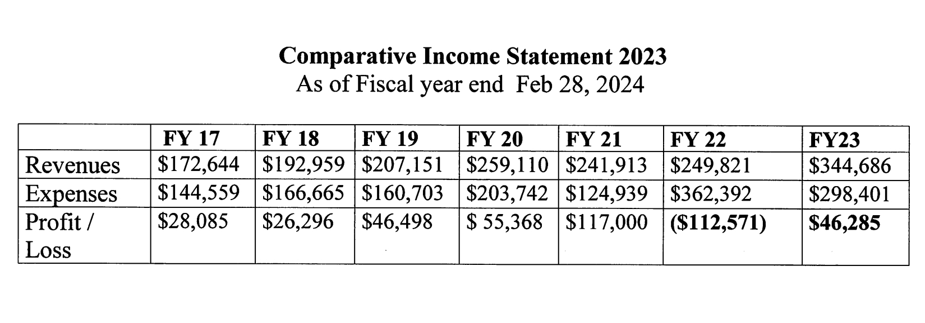

Slide 5
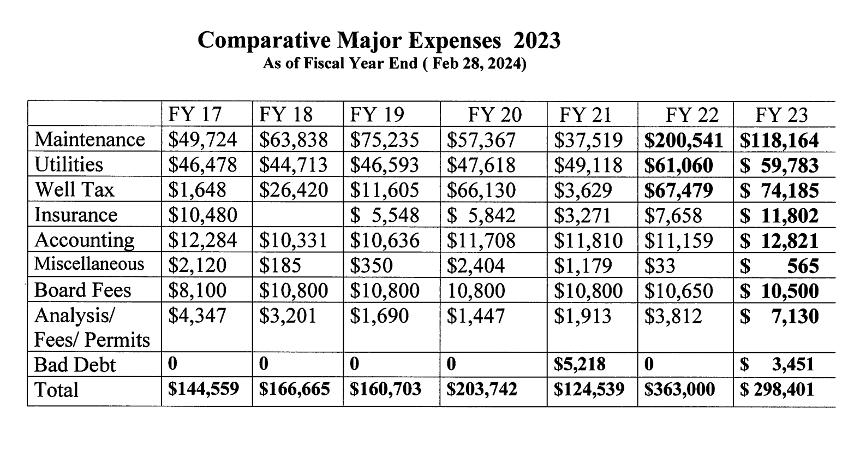

Slide 6
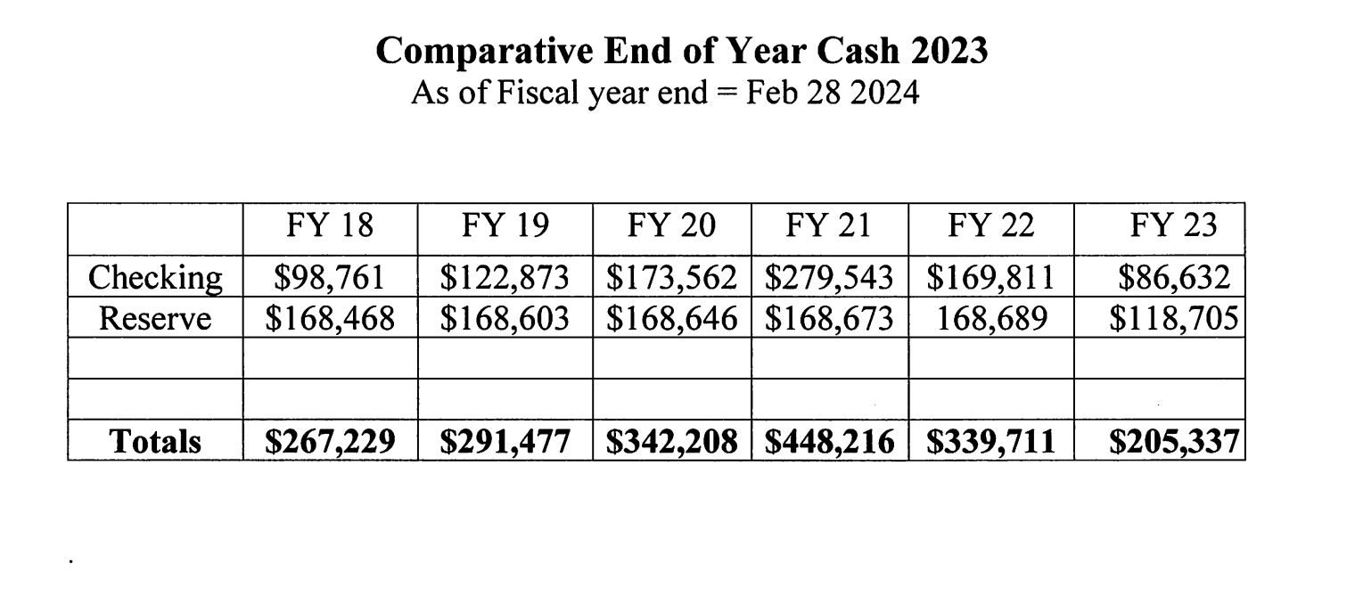

Slide 7
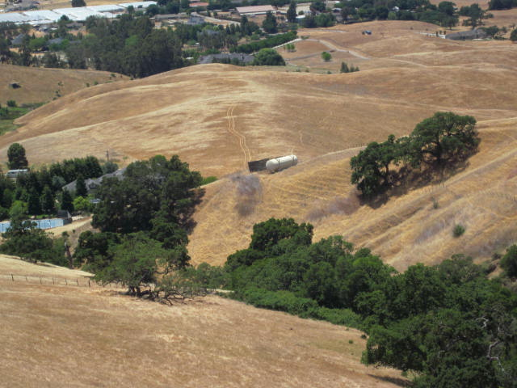
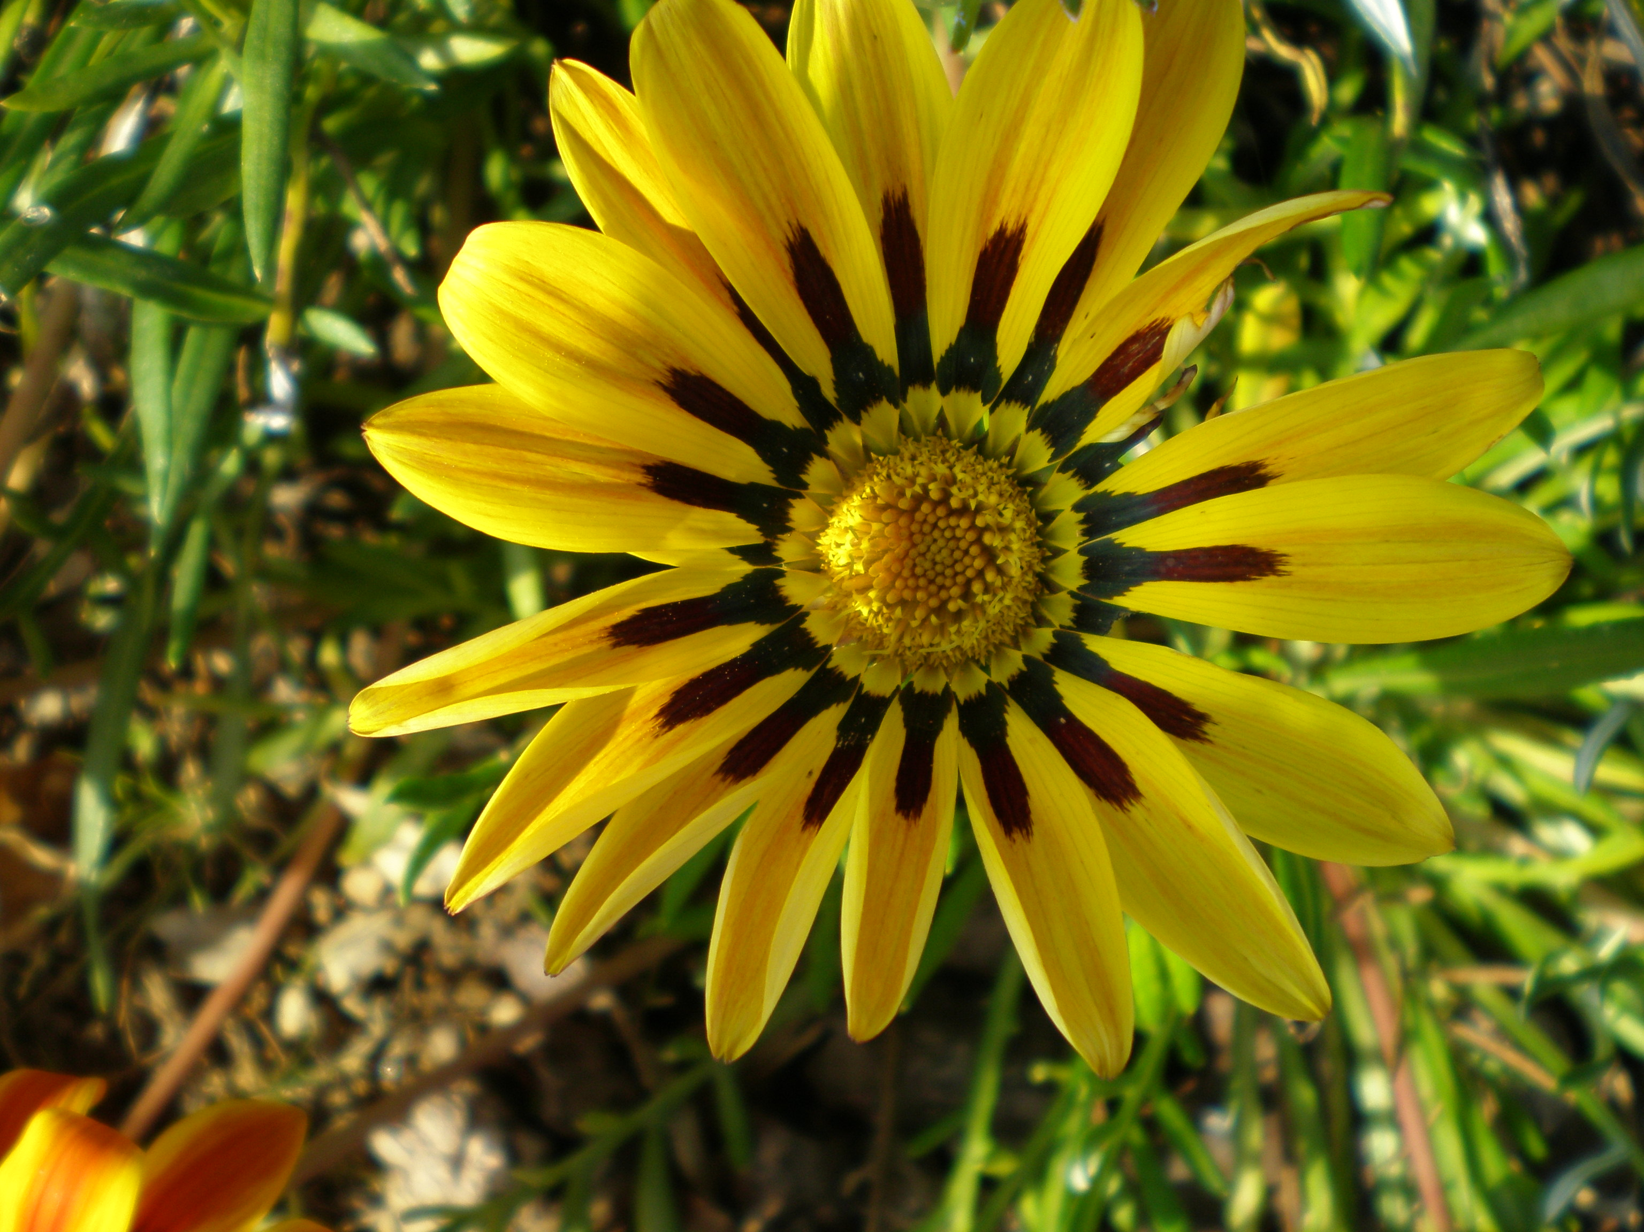
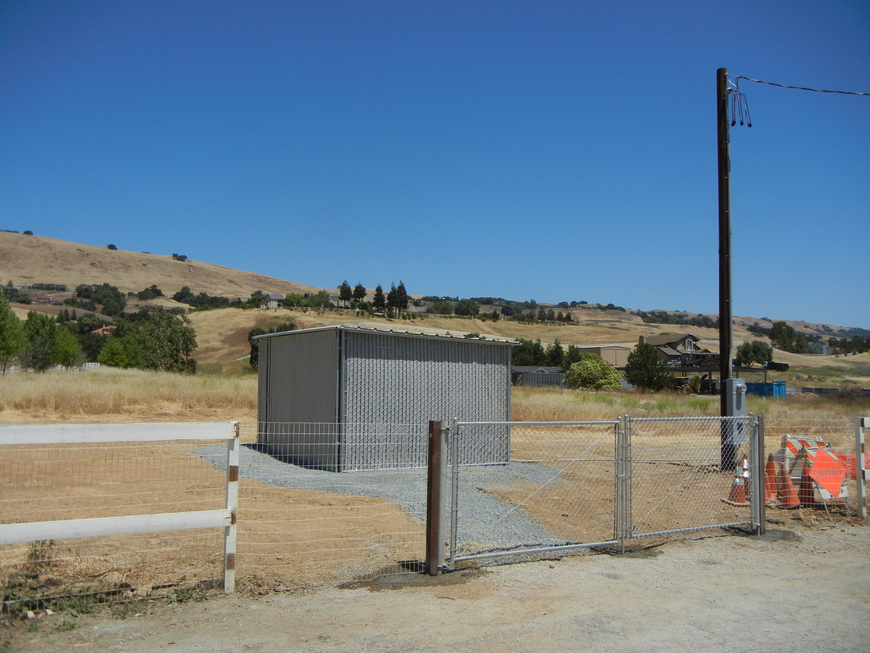
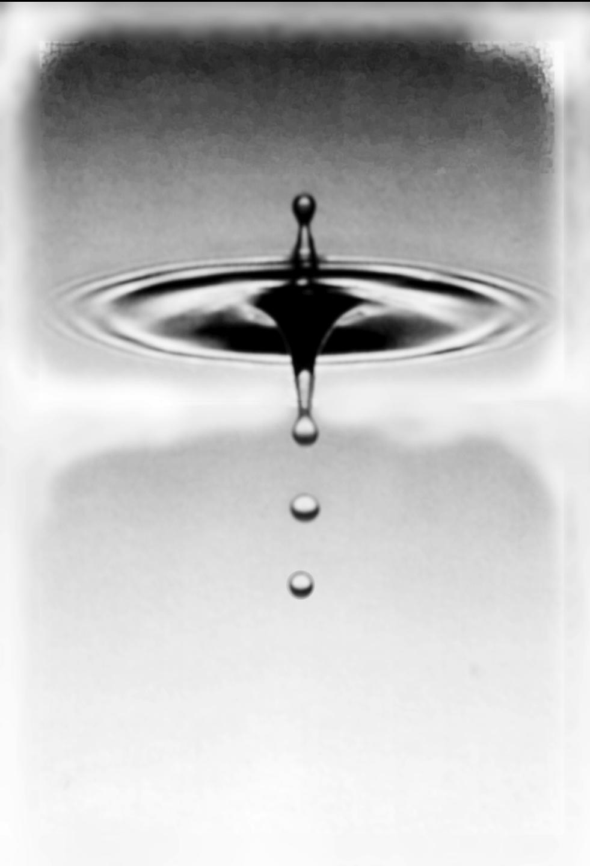
Water Quality – Jae Schwartz
2024 Shareholders Meeting

Slide 8
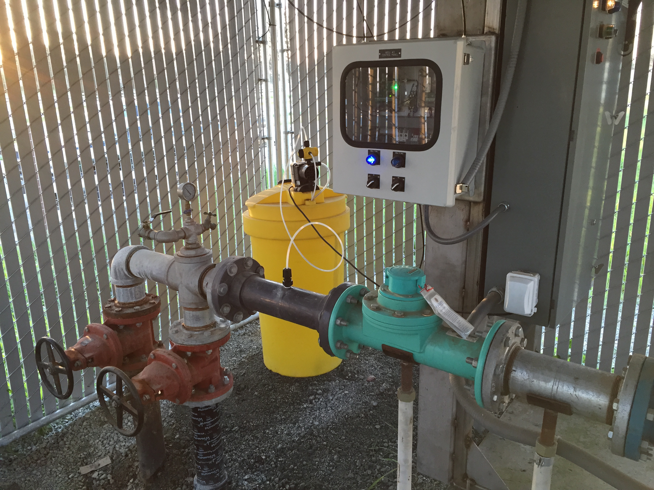
All Wells Include Chlorine Injection System for Disinfection
Example Chlorine Injection system (yellow) located at Well, inserts a small dose of chlorine into the water when the well turns on.
Each well has an injector.
Chlorine Levels are checked Monthly.

Slide 9
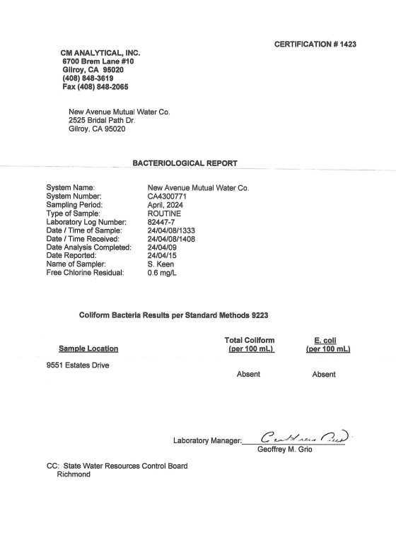
Latest Monthly Coliform Bacteria Test
(Including E. Coli)
By State Certified Lab – CM Analytical
ALL TESTS HAVE BEEN NEGATIVE FOR COLIFORM BACTERIA!

Slide 10
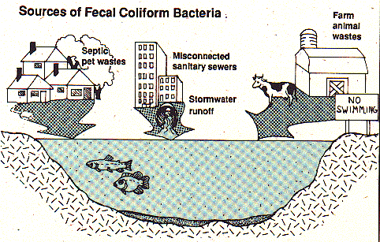
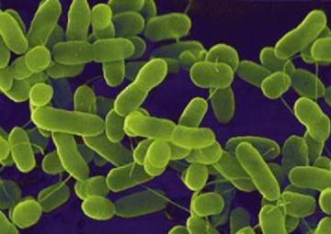
What Do We Test For, and When
All done By State Certified Lab – CM Analytical
Monthly (Location Rotates 3 locations):
Chlorine Level
Total Coliform (Bacteria)
E. Coli
Periodically (every 3 to 5 years) :
Copper and lead
Sodium, HARDNESS, Manganese
Asbestos
Radiation
Primary Standard
  Aluminum, Barium, Flouride, Radiation (Alpha Activity), Hexavalent Chromium
  NITRATEs, Perchlorate, Selenium, Turbidity, Total Trihalomethanes
  HaloCETIC ACIDS
SeCONDARY STANDARD
  Total Dissolved Solids, Specific Conductance
  Chloride, Sulfate
  62 Volatile Organic chemicals
  24 synthetic organic chemicals ( TRIChloroPropane, Arsenic, Cyanide (Inorganic)
Benzene, MTBE, toluene (regulated VOC)
Notes:
These tests correspond with specific incidents and acknowledgement that some materials are unhealthy.

Slide 11
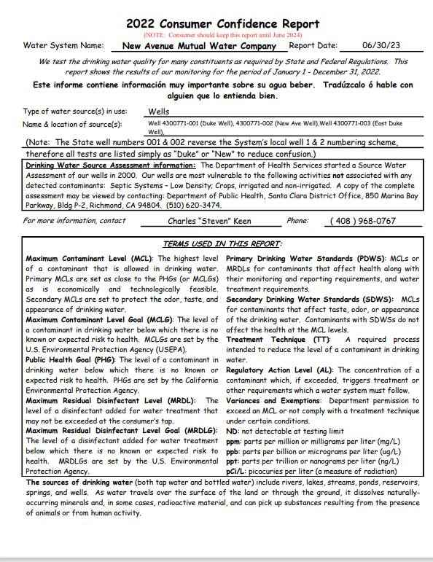
Consumer Confidence Report
2022 Report Posted On the Web Site (Reported in 2023)
The 2023 CCR must be completed and distributed to consumers by July 1 2024
Water samples taken from each well by Steve Keen, our certified treatment operator.
Samples are analyzed by a state certified lab.
Test results are also available online through the California Department of Public Health.

Slide 12
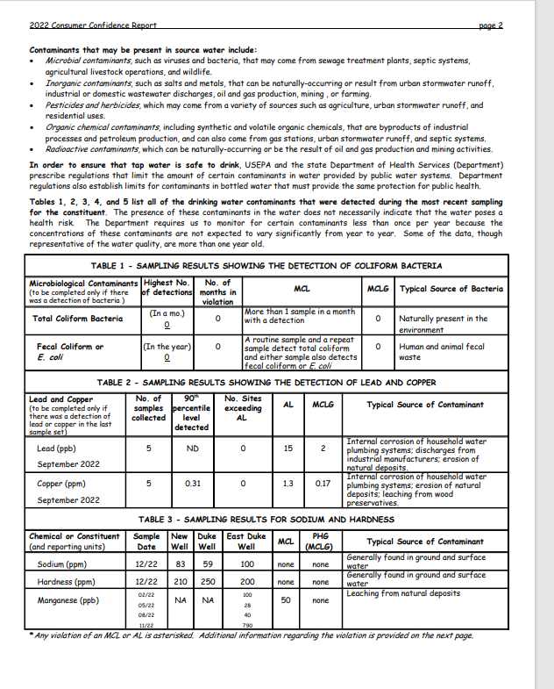
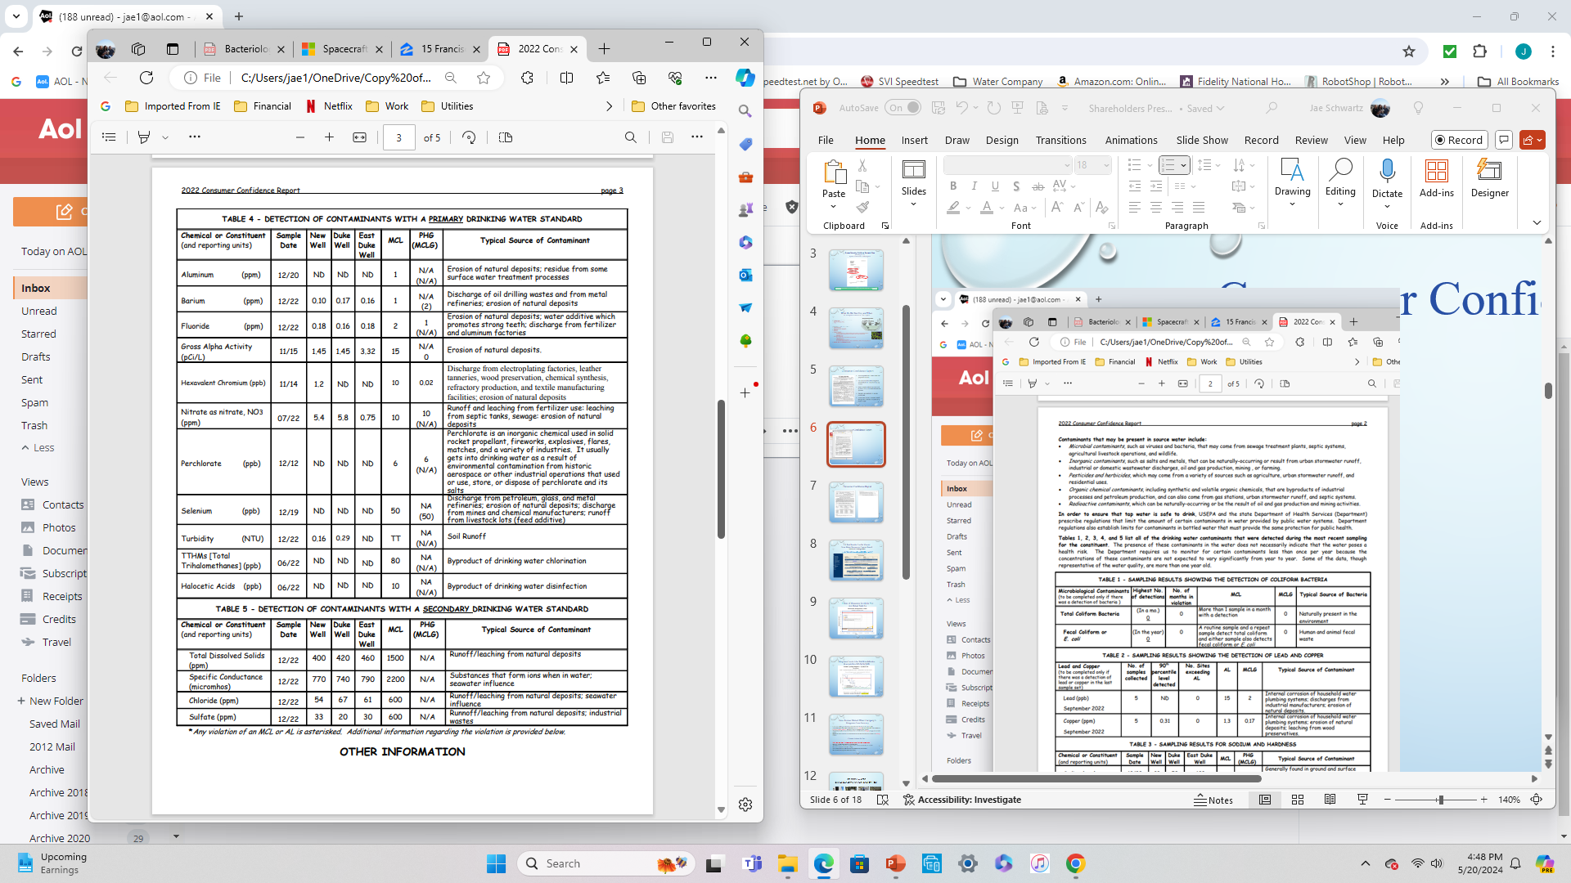
Consumer Confidence Report

Slide 13
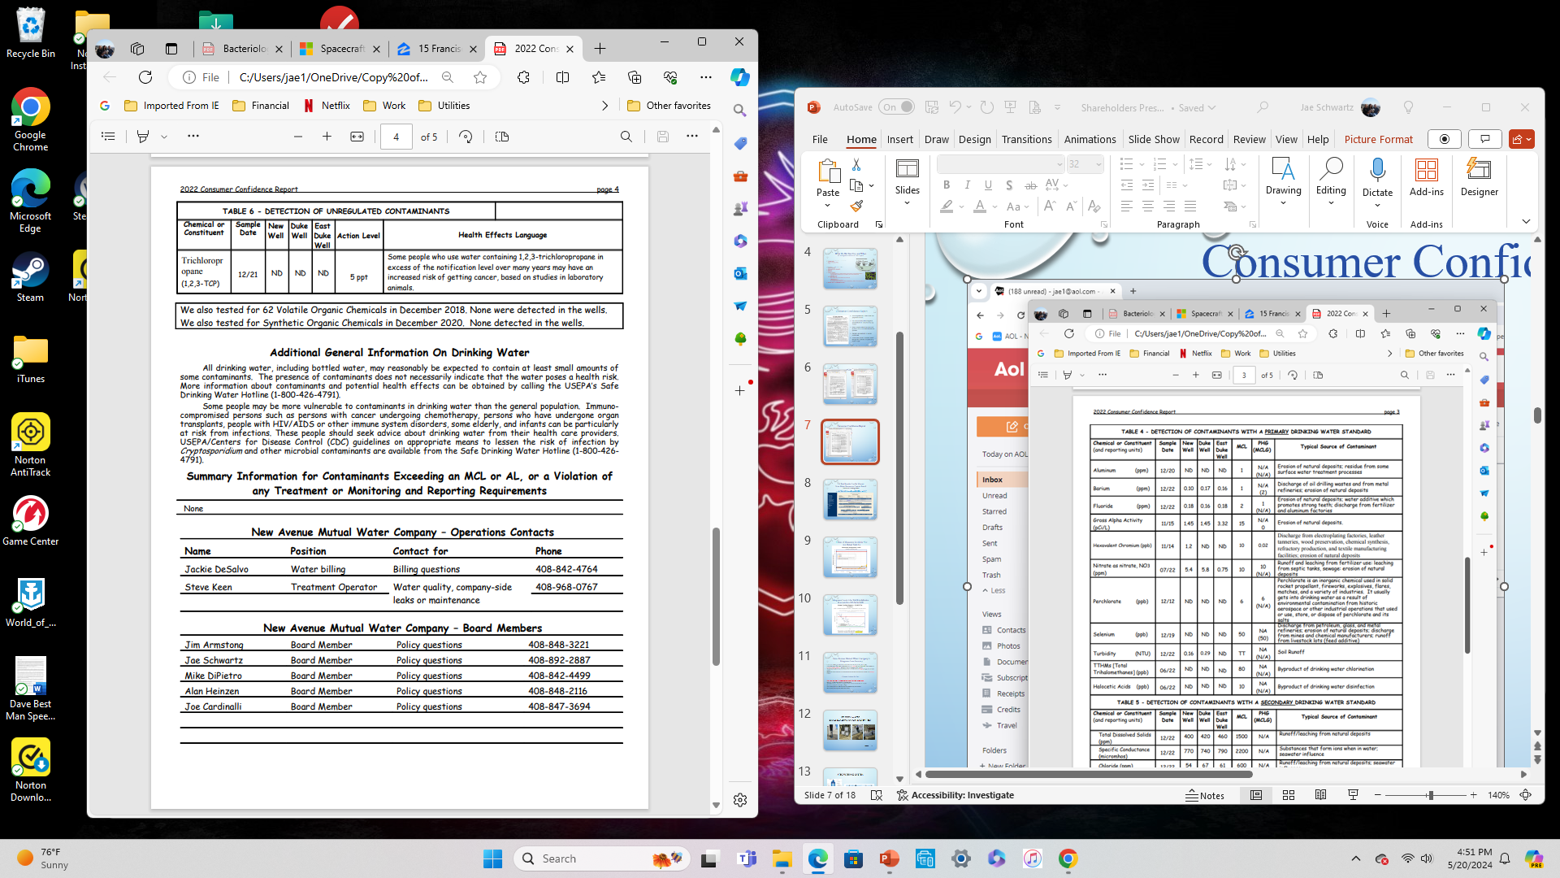
Consumer Confidence Report

Slide 15
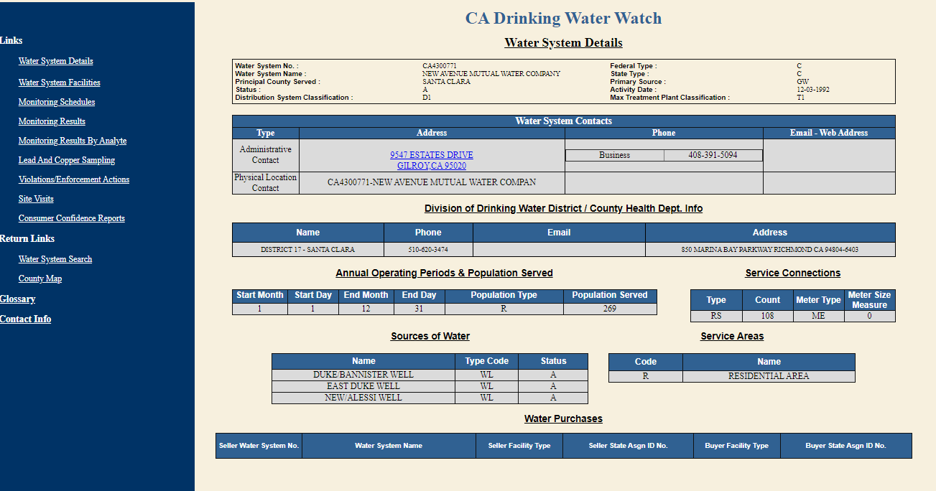
All Test Results Can Be Viewed
State Water Resources Control Board
Division of Drinking Water
https://sdwis.waterboards.ca.gov/PDWW/

Slide 16
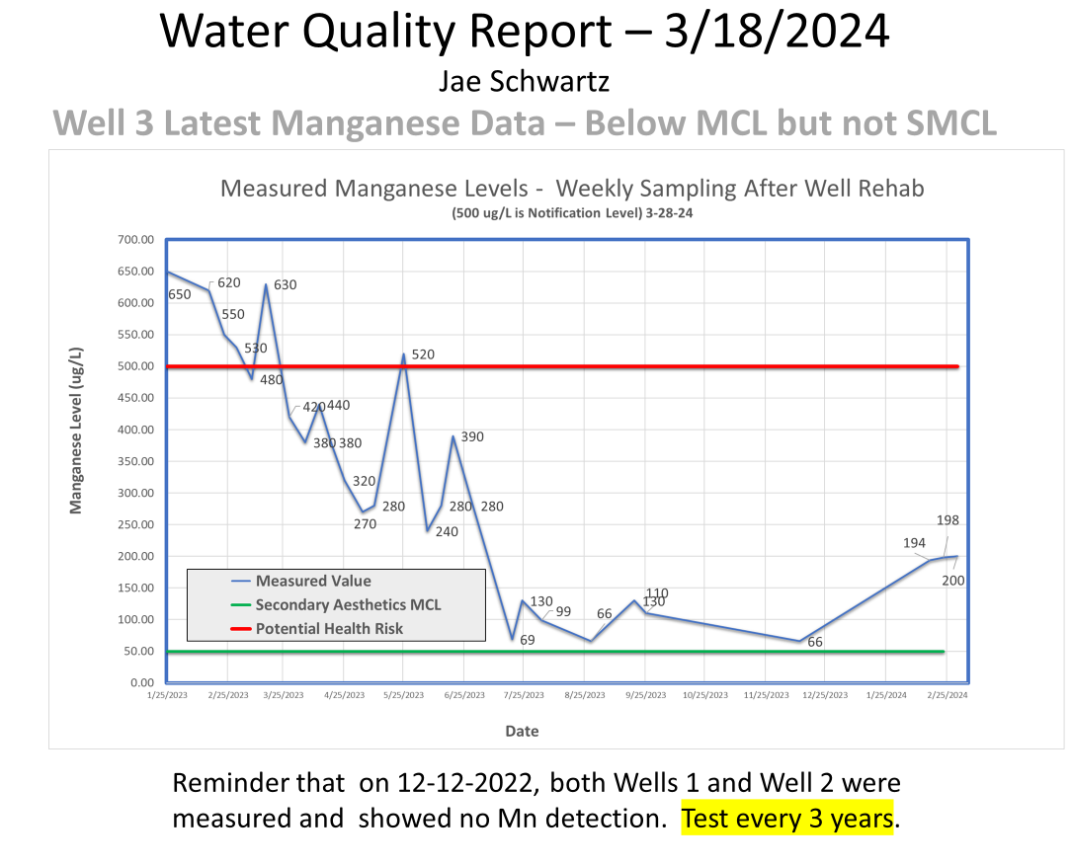
  Manganese Levels After Well Rehabilitation
  We are Again Below MCL (But Not SMCL)
>

Slide 17
  New Avenue Mutual Water Company’s
  Manganese Issue Summary
Low Levels of Manganese have been detected for Well #3 (Newest Well, See Graph)
A secondary MCL (maximum contaminant Level) of 50 ug/L has been established in the US and CA for purely aesthetic purposes, and applies only to community water systems.
The potential health risk based notification level is 10x this level at 500 ug/L and applies to all water systems
Magnesium Source removal is recommended at ten times the notification level which is at 5000 ug/L (5mg/L).
  Current Actions So Far….
Well 3 has been shut off from normal use (using Wells 1&2, but pay taxes)
Had Well 3 Rehabilitated based on Consultant Input
After Rehabilitation, Mn levels are higher and we continue to flush the well to waste
Mn Levels continue to recede (See Graph)
Now Pursuing Mn/Fe Filtration System as permanent long term solution.
Have Monthly Meetings with State Water Board

Slide 18
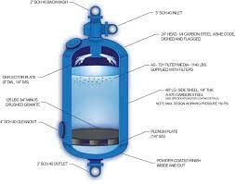
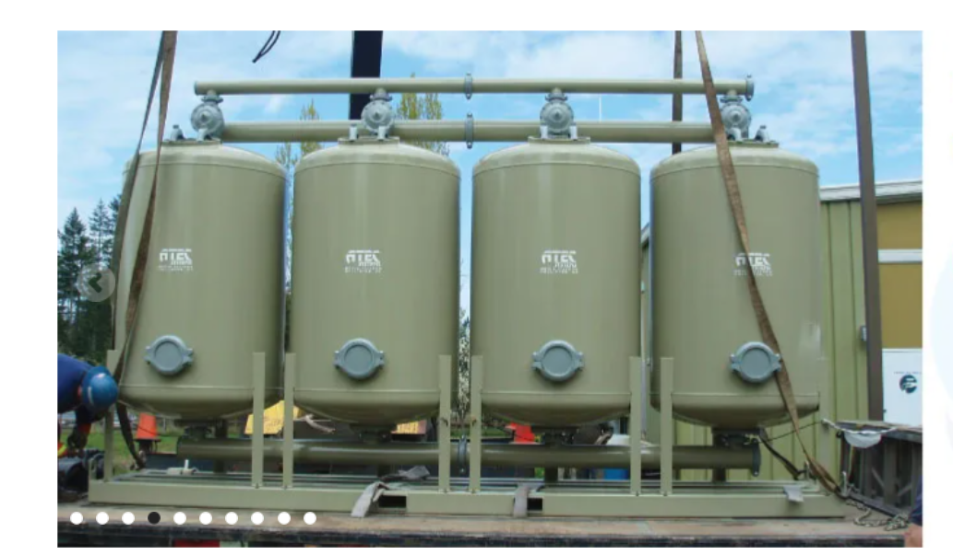
ATEC Filtering System

Slide 19
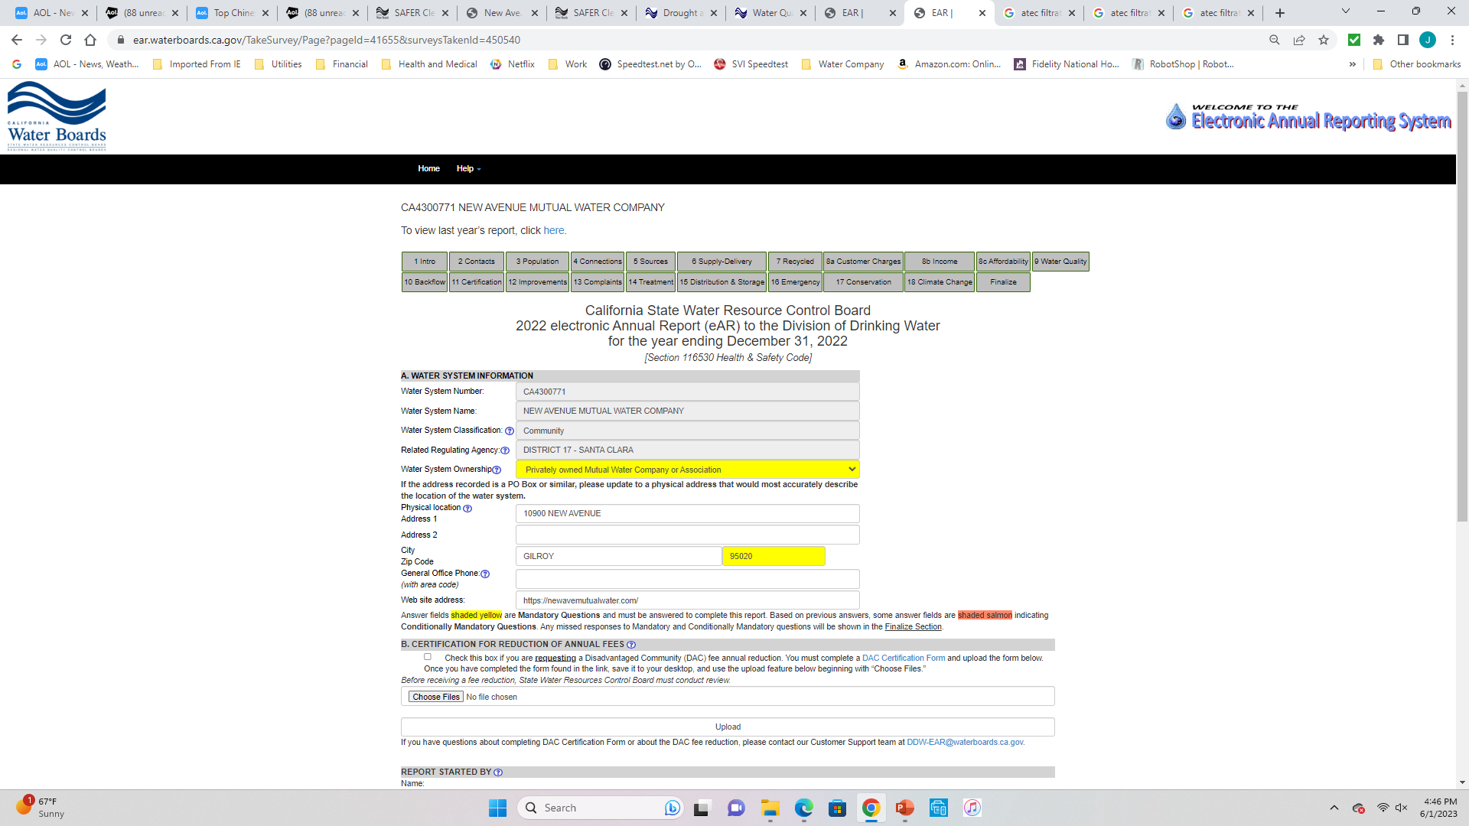
  2022 State Electronic Annual Report (EAR) Submitted
Contains All Information Regarding Our System

Slide 20
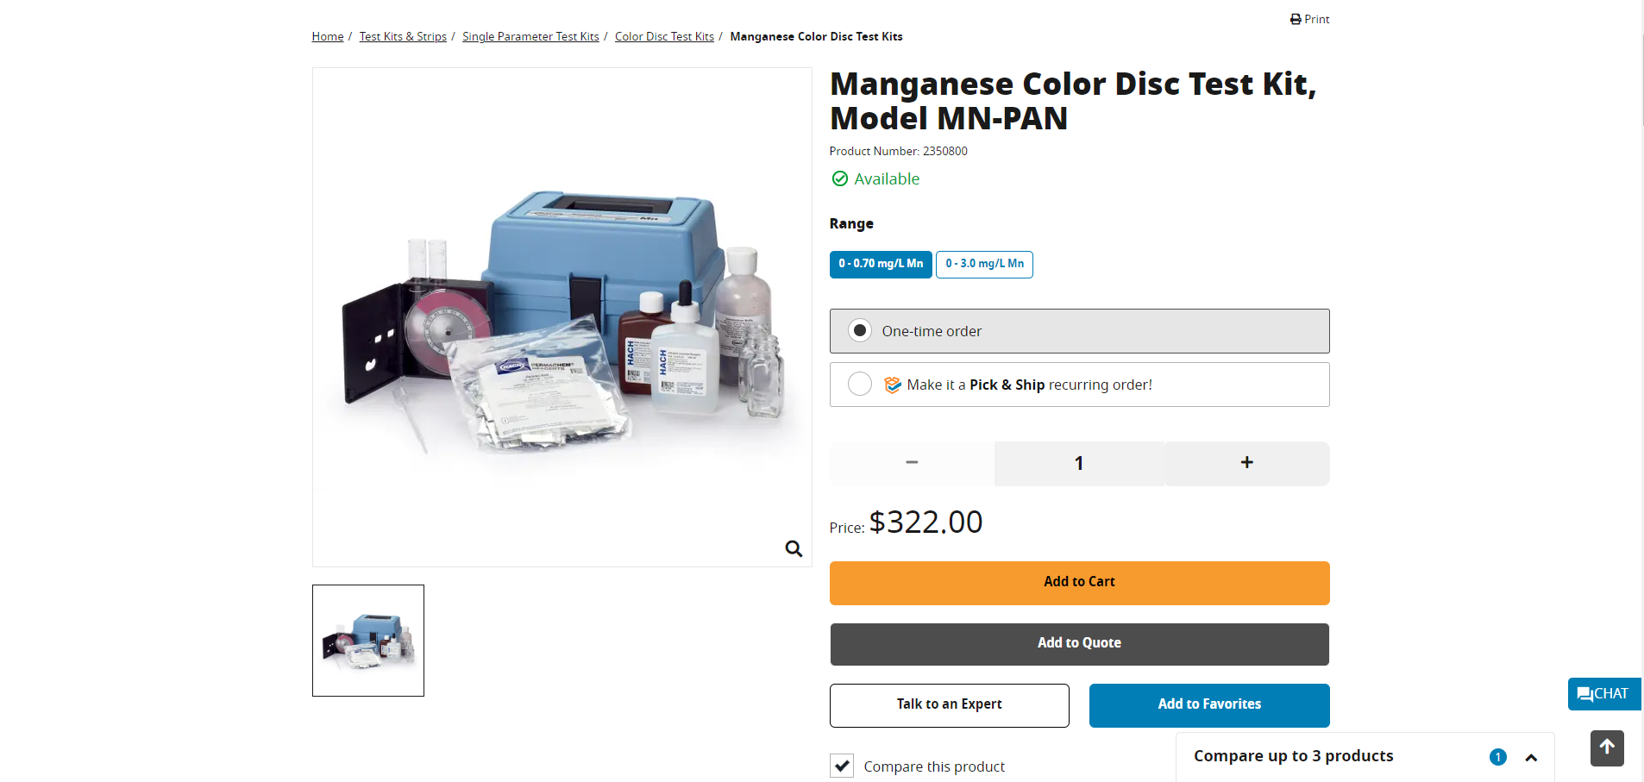
Manganese Test Kit On Site and Used Successfully
0-0.7 mg/L (700 ug/L)
Due Date 1/27/2024

Slide 21
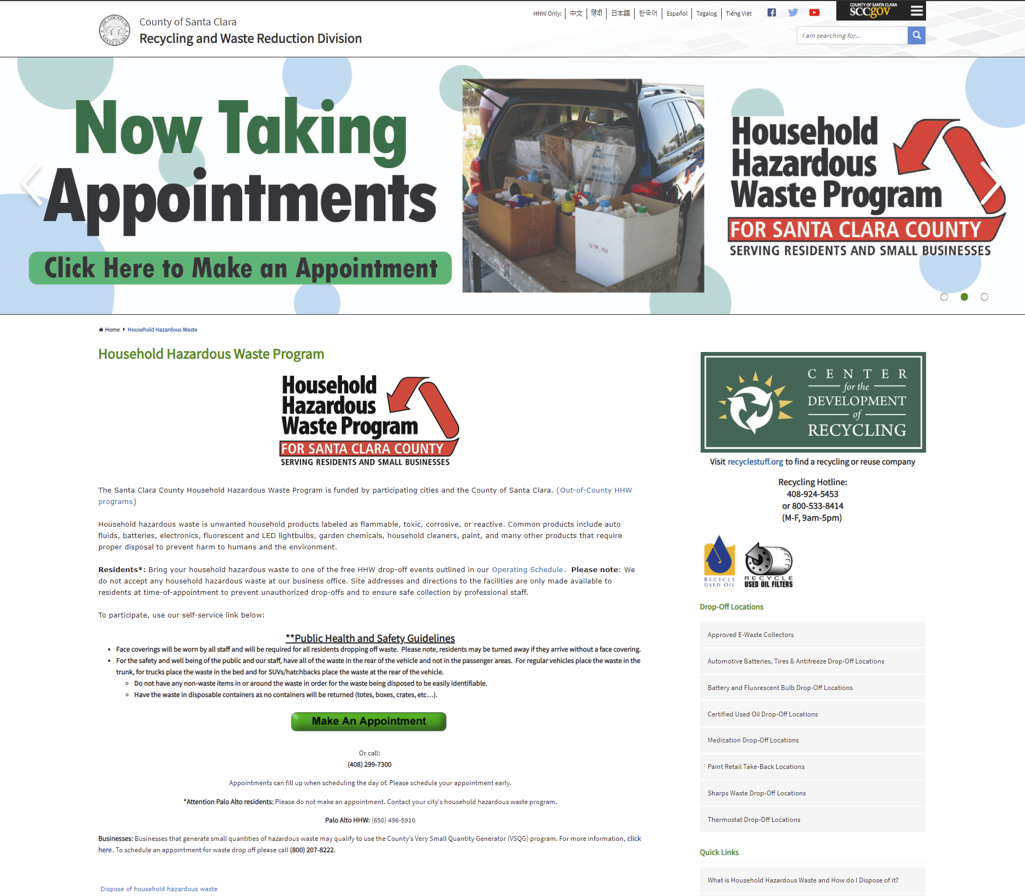
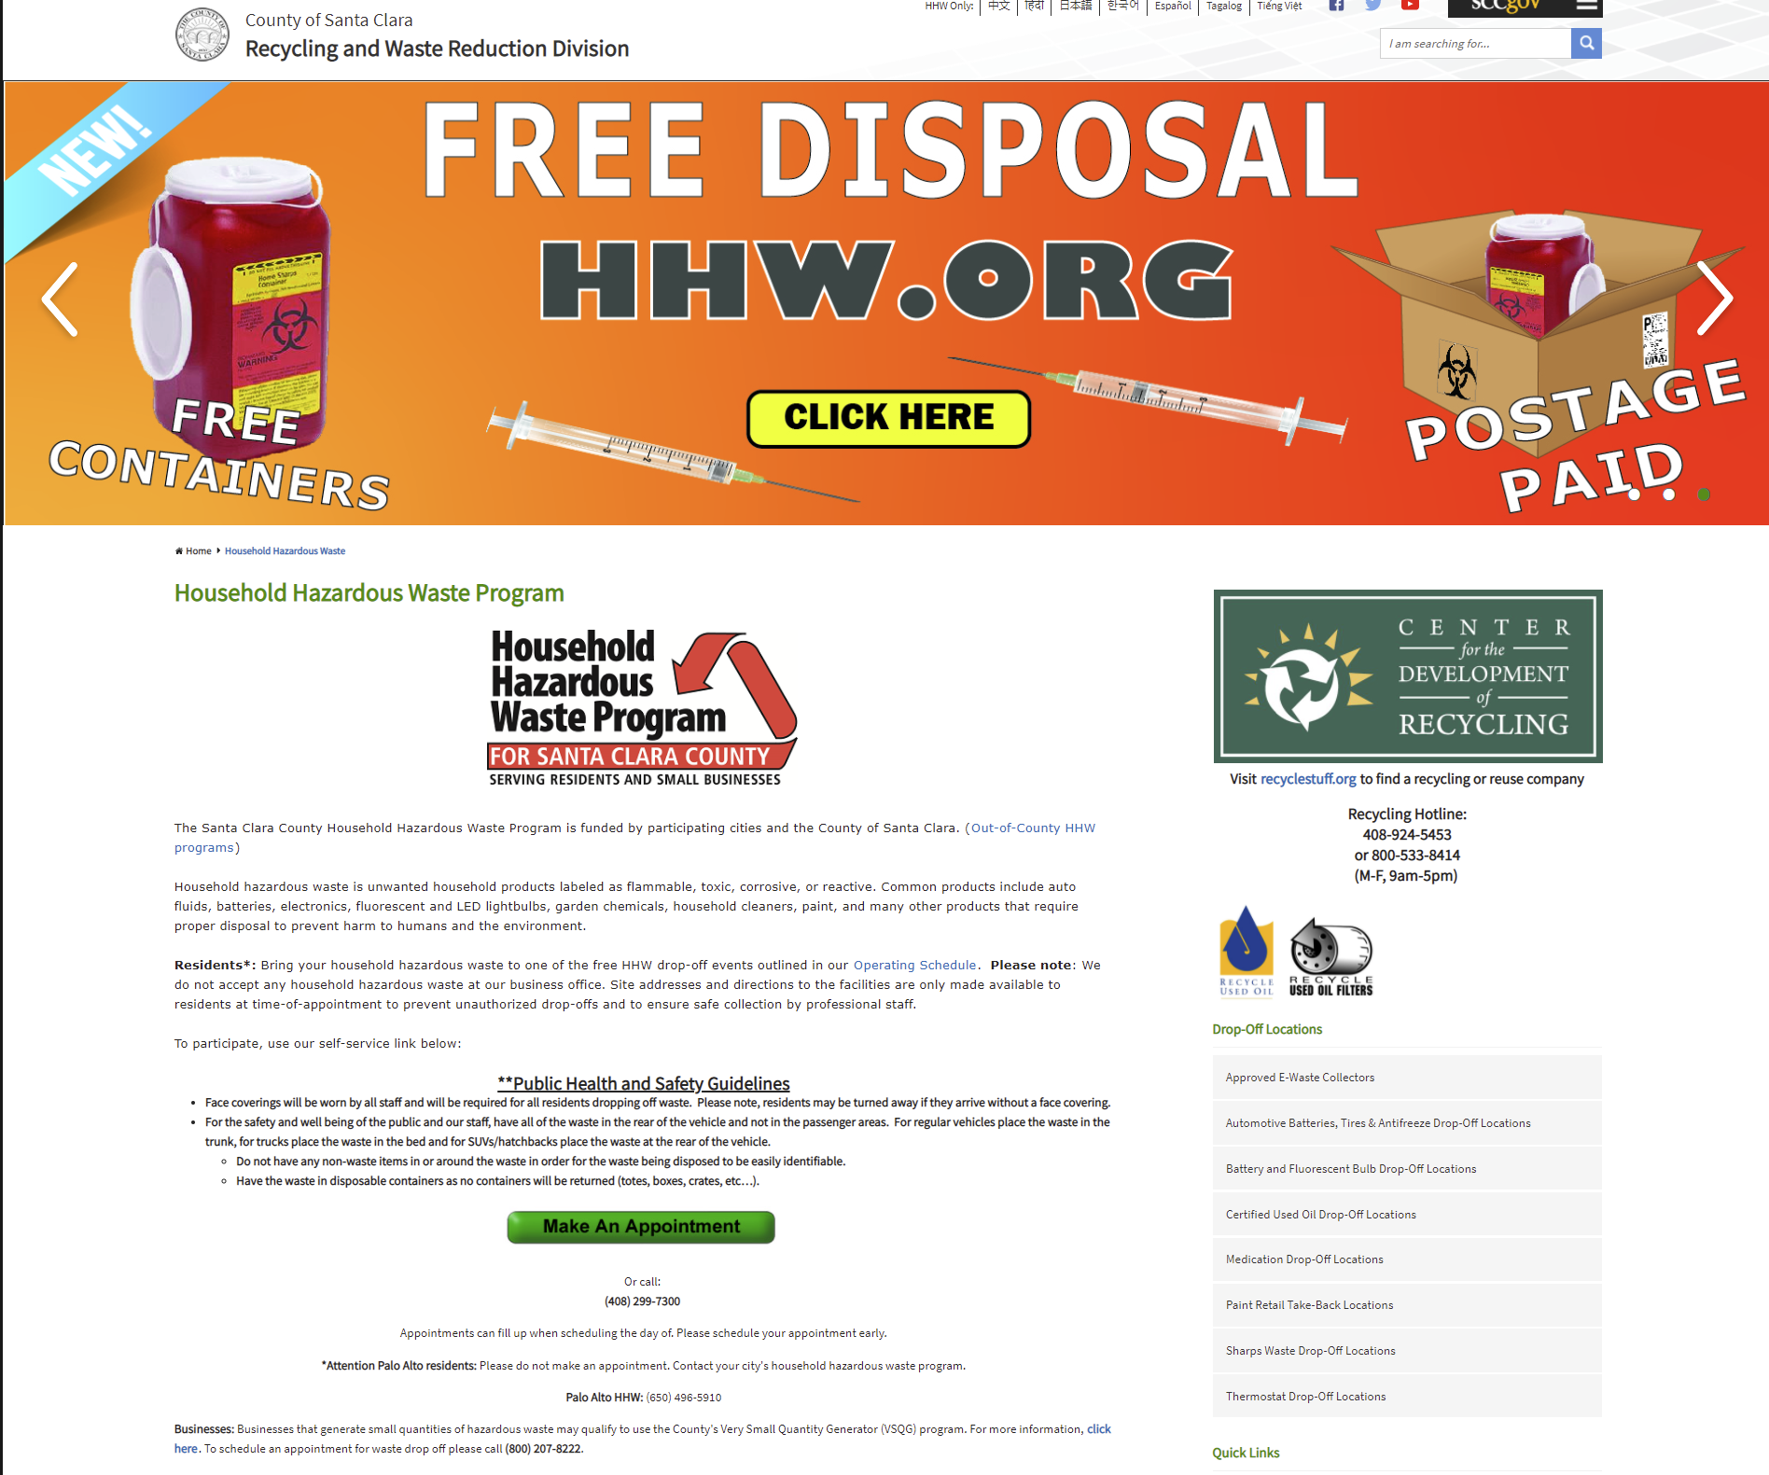
Remember!!!
our water is under our feet
What you throw on the ground can end up in our water supply
Recycle paints, drugs, chemicals, oils through the county hazardous waste program
Please Submit any questions or comments at our website or contact a Board Member

Slide 22
Other Items:
Thank you to Tony for Taking over Water Quality responsibilities and Completing Safer Clearinghouse and EAR!
Will Transfer All my Responsibilities as me and my family spend more time in Santa Barbara with daughter and grandkids. Can help when needed!

Slide 23
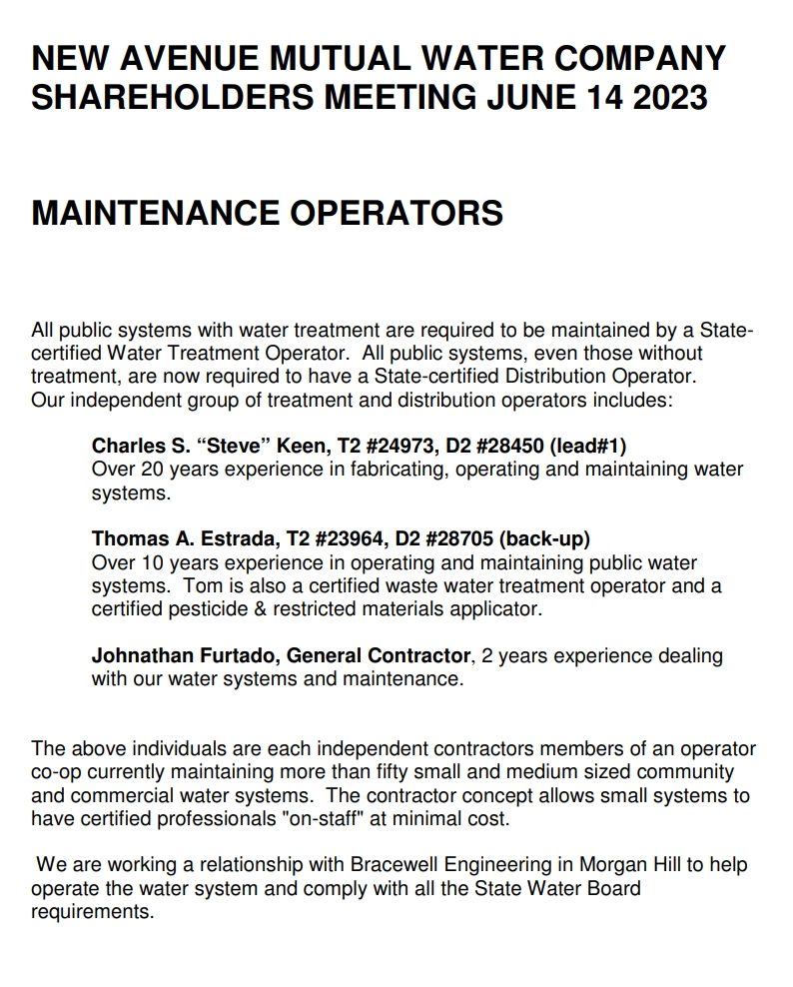

Slide 24
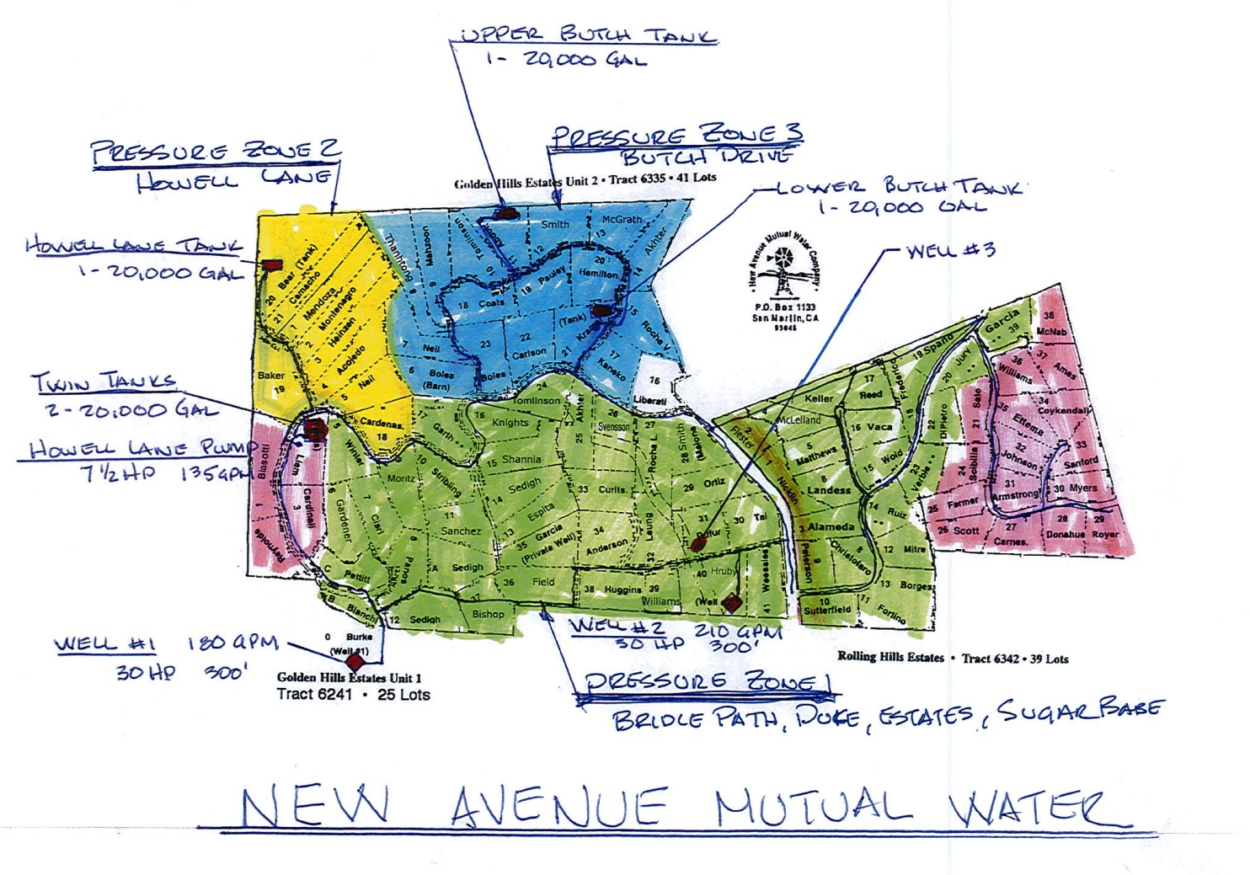

Slide 25
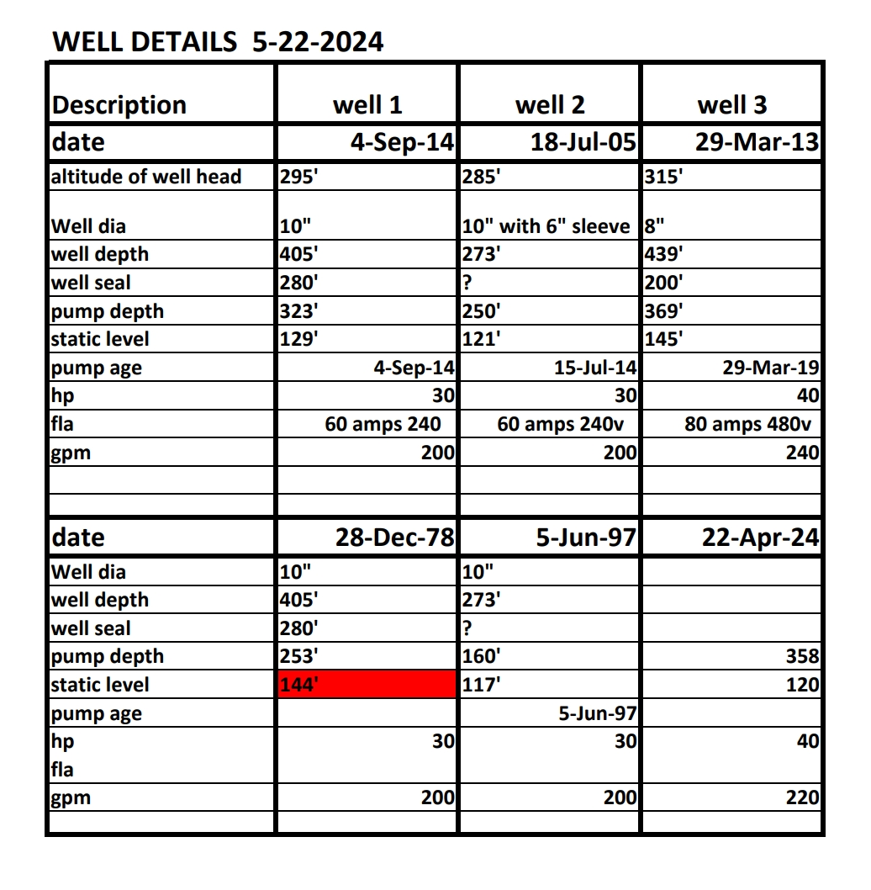

Slide 26
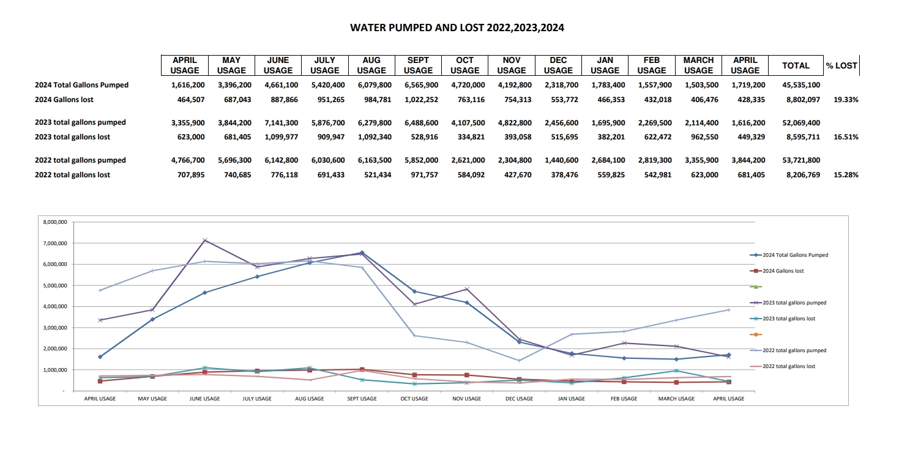

Slide 27
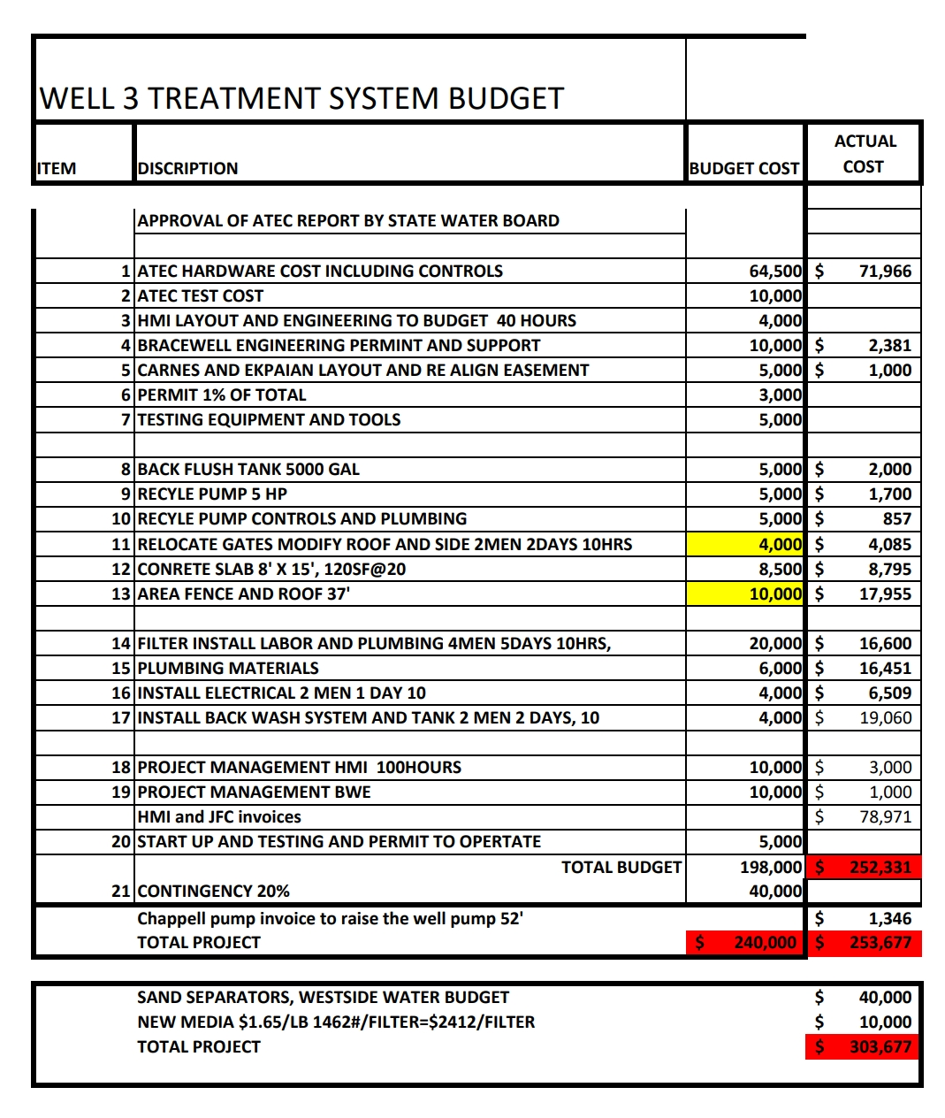

Slide 28

Questions for the Board?

