Slide 1
Water Quality - Manganese Contamination Issue Activities
1/25/2021
Compliance Order No. 02_17_21R_001) Violation of MCL for Manganese in East Duke Well
  State Required Documents/Actions
    Nov 30, 2021 – Corrective Action Plan - COMPLETE
    Dec 10, 2021 – Public Notification (Appendix 1) - COMPLETE
    Dec 20, 2021 – Certify Public Notification (Appendix 2) - COMPLETE
    Mar 10, 2022 – Report of Actions to comply with Corrective Action Plan – Report In progress
    Nov 1 2022 – Comply with CCR Title 22 (Reduce Mn below SMCL) – TBD, although have turned off Well 3
Actions Since Last Meeting
  Previous tests after chlorination due indicate reduced levels of Mn, but borderline results (one at 50 ug/L at MCL)
  Took down posted notifications
  Re-requested sample bottles from Tom Ballard
  Jan 2022 bacteriological report not received yet (check with Steve K)
Actions for Next Meeting
  Submit quarterly progress reports to state by end of 10th day of each quarter (Appendix 3) – March 10, 2022
  Schedule Well check with Southeast Hydrogeology – Alan?
  Consider/Perform “Rehab” of Well 3 (Based on previous conversation with Tom Ballard indicating biological activity most likely cause of Mn issue)
  Submit samples and Obtain water sample test results for Well Health investigation
  Get estimate for Oxidation-Filtration system as possible long term solution, and for budgeting purposes
Proposal – Add 2nd water operator, let Steve continue with meter readings,etc., including training
  Not sure if Steve submitted Bacteriological Sample Site Plan (BSSP) to SWR control board requested in Oct 2021

Slide 2
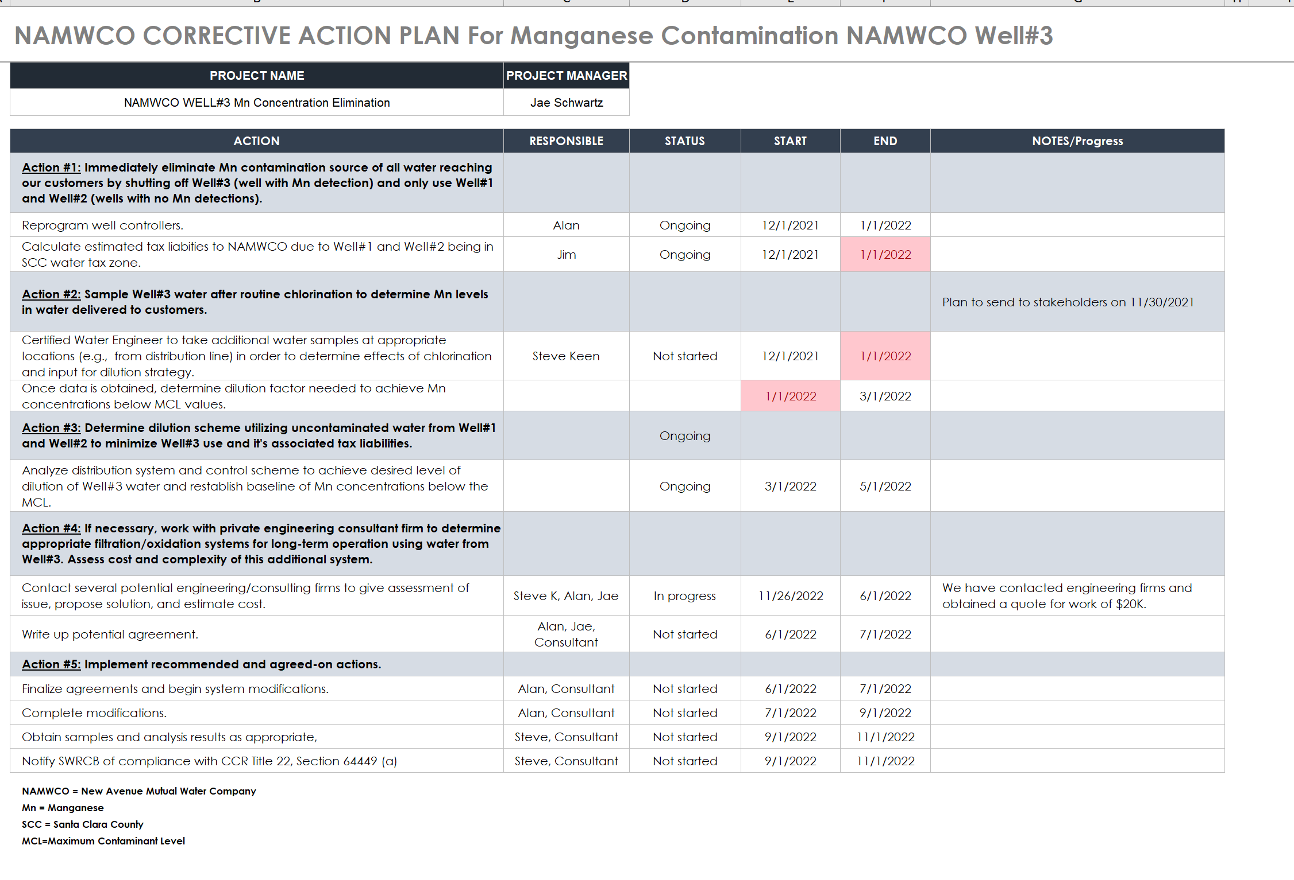
Current Submitted Corrective Action Plan - Status
Complete
Complete
State Denied
Can Discuss Furter
In Progress
In Progress

