Slide 1
RCS tranche 2 regulation changes
Noel Pinkerton COH
Principal Advisor – Occupational Hygiene

Slide 3
Session overview
All about silica
Controlled processing
Assessing the risk – is it high risk?
Air Monitoring and Health Monitoring
Case Studies

Slide 4

Types of silica - Crystalline Vs Amorphous
Same chemical formula
Different structure

Slide 5
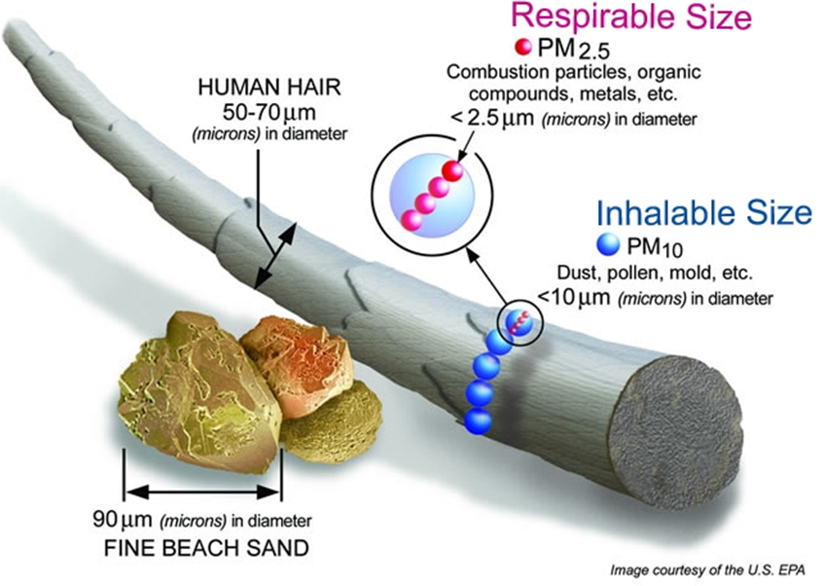
Definitions
Crystalline silica:
  polymoprhs of silica including quartz, cristobalite, tridymite and tripoli
Crystalline Silica Substance (CSS):
  materials that contain at least 1% crystalline silica (by weight)
Respirable Crystalline Silica (RCS):
  dust that contains particles of crystalline silica with particles less that 10µm in diameter

Slide 6

What is crystalline silica?
529A(2) Crystalline silica
means crystalline polymorphs of silica; and
includes the following substances—
  (i) cristobalite;
  (ii) quartz;
  (iii) tridymite;
  (iv) tripoli.

Slide 7
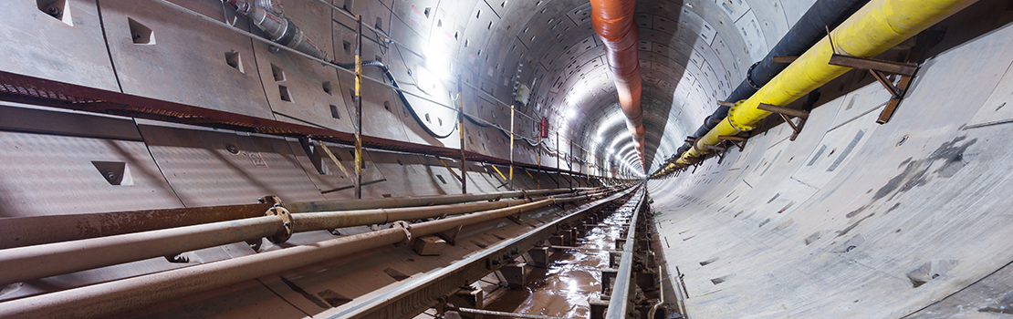
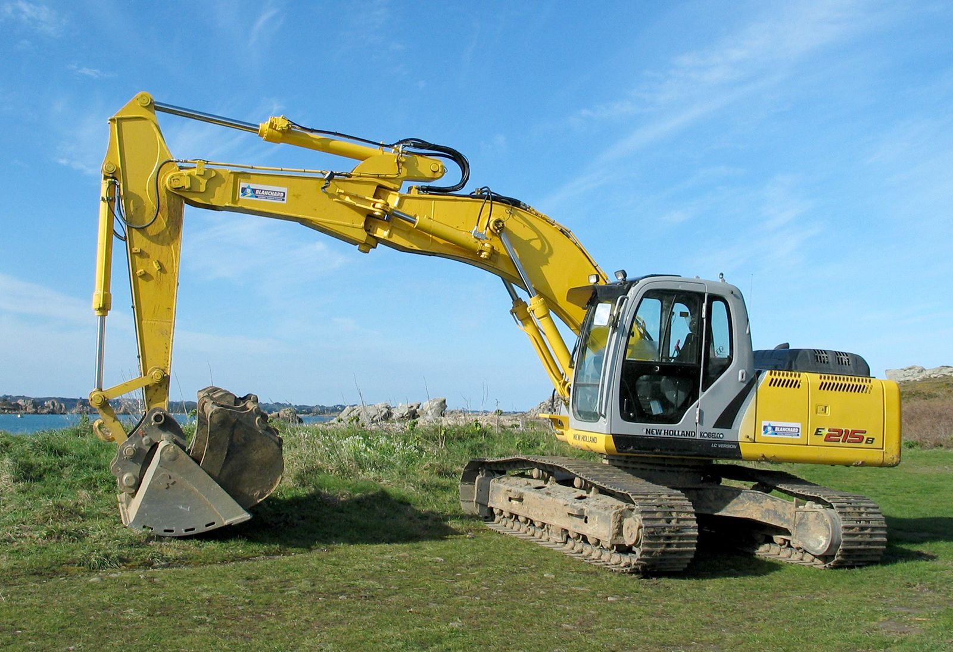
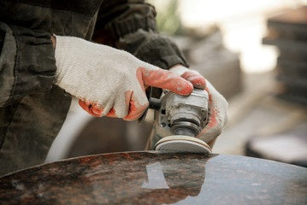
Definitions cont’d
‘Processing’ in relation to a CSS means:
the use of power tools or mechanical plant to carry out an activity involving the crushing, cutting, grinding, trimming, sanding, abrasive polishing or drilling of a CSS; or
the use of roadheaders to excavate material that is a CSS; or
the quarrying of a material that is a CSS; or
mechanical screening involving a material that is a CSS; or
tunnelling through a material that is a CSS; or
a process that exposes, or is reasonably likely to expose, a person to respirable crystalline silica during the manufacture or handling of a CSS.

Slide 8
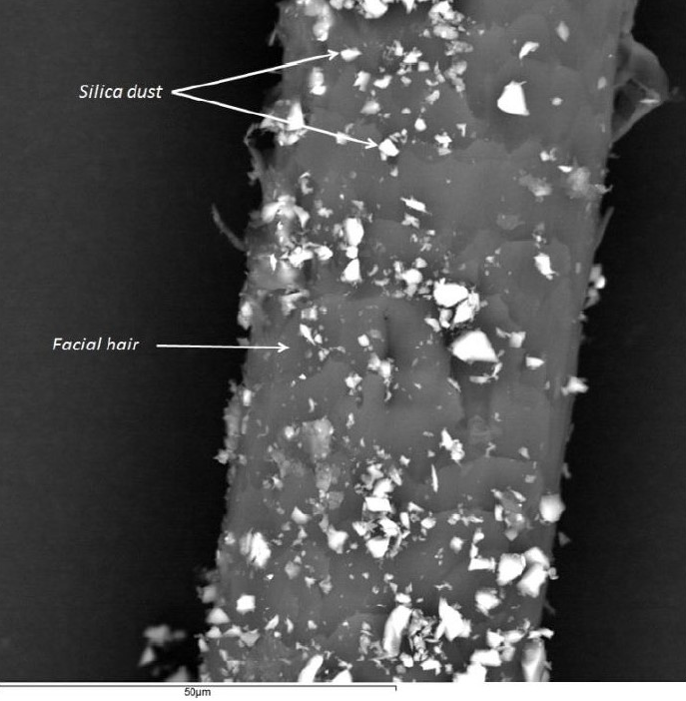
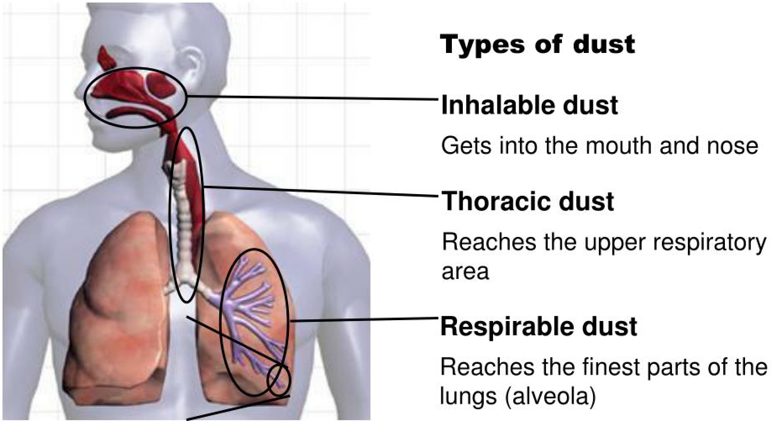
The problem with respirable dust
Comparison of the size of respirable-sized silica dust particles with facial hair
Notes:
Key points:
Respirable crystalline silica (RCS) is the portion of dust that is too small to be seen under normal lighting, its size allows it to stay airborne for long periods of time, and it is easily inhaled deep into the lungs.
Respirable dust is able to reach the deepest parts of the lungs can bypass the normal lung defences
RCS has been found to be toxic to the lung macrophages
RCS causes scarring of the lungs, which is permanent (silicosis)
Exposure over time (years), even at low levels increases risk.
Very high levels can increase risk greatly i.e. engineered stone benchtop examples.
Important – silica is NOT the new asbestos. This is because single on-off significant exposures to RCS do not present the same health risks as asbestos (e.g. risk of mesothelioma).

Slide 9
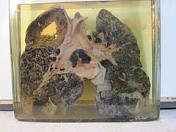
Health effects
When airborne, workers can breathe RCS particles deep into their lungs where they can lead to a range of respiratory diseases, including:
silicosis
progressive massive fibrosis
chronic obstructive pulmonary disease
chronic bronchitis, and
lung cancer.

Slide 10


Control
Under regulation 529B(1) of the WHS Regulations, the processing of a CSS is controlled if:
control measures to eliminate or minimise risks arising from the processing are implemented so far as is reasonably practicable; and
at least 1 of the following measures are used during the processing:
    the isolation of a person from dust exposure;
    a fully enclosed operator cabin fitted with a high efficiency air filtration system;
    an effective wet dust suppression method;
    an effective on-tool extraction system;
    an effective local exhaust ventilation system; and
a person still at risk of being exposed to respirable crystalline silica after 1 or more of the measures in paragraph (b) are used:
    is provided with respiratory protective equipment (respiratory protective equipment); and
    wears the respiratory protective equipment while the work is carried out.

Slide 11
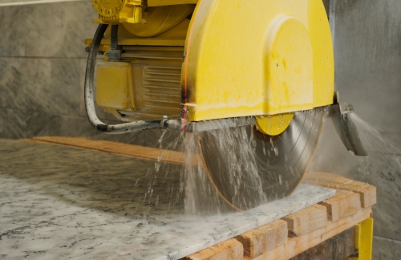
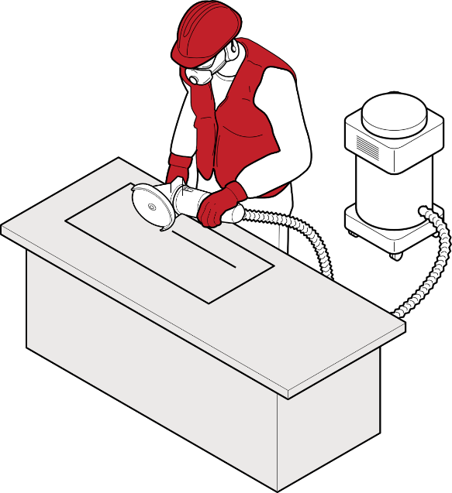

Controlled processing

Slide 12
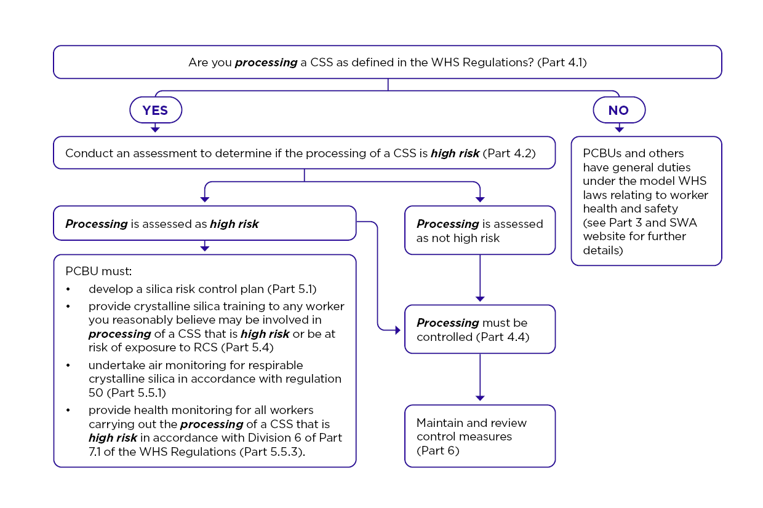
Assessing the risk

Slide 13
Assessing the risk
When determining whether the processing of a CSS is high risk, and therefore reasonably likely to result in a risk to the health of a person at the workplace, a PCBU must have regard to the following:
the specific processing that will be undertaken
the form or forms of crystalline silica present in the CSS
the proportion of crystalline silica contained in the CSS, determined as a weight/weight (w/w) concentration
the hazards associated with the work, including the likely frequency and duration that a person will be exposed to RCS
whether the airborne concentration of RCS that is present at the workplace is reasonably likely to exceed half the workplace exposure standard (WES)
any relevant air and health monitoring previously undertaken at the workplace
any previous incidents, illnesses or diseases associated with exposure to respirable crystalline silica at the workplace.

Slide 14
Assessing the risk - Outcomes
Unable to determine if the processing of a CSS is high risk?
If, after completing the assessment, you are unable to determine if your processing of a CSS is high risk, then you must assume that it is high risk. All requirements for processing of a CSS that is high risk apply, until you can determine the processing is not high risk (for example by implementing additional engineering controls, undertaking further testing or additional air monitoring and performing a new assessment).
Processing of a CSS determined as high risk:
If you determine the processing of a CSS is high risk, then you must:
  ensure that processing is controlled
  meet the additional requirements for processing of a CSS that is high risk
Processing of a CSS determined as not high risk:
If you determine the processing of a CSS is not high risk, then you must:
  ensure all processing is controlled, and
  meet all other duties and requirements under the WHS laws, including the general duties

Slide 15

Additional requirements for high risk
If you have assessed the processing of a CSS, or a combination of processing of a CSS, as being high risk, you must:
develop a silica risk control plan covering those processing tasks
Develop it in consultation with workers involved in carrying out processing of a CSS that is high risk and if any, their elected health and safety representatives (HSR)
provide it to all workers before they commence the processing of a CSS
make it available to all workers
ensure any processing of a CSS that is high risk is carried out in accordance with the plan.

Slide 16

Construction Work
Processing of a CSS may be considered high-risk construction work if RCS may contaminate the work atmosphere.
If a Safe Work Method Statement (SWMS) has been prepared for high-risk construction work that involves processing of a CSS that is high risk, a silica risk control plan is not needed, provided the SWMS includes all the information required for a silica risk control plan.

Slide 17
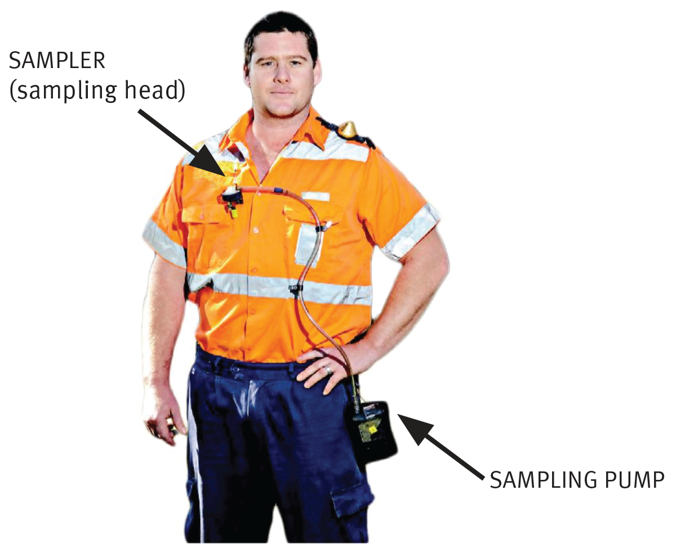
Air monitoring
For each processing of a CSS that is high risk at the workplace, a PCBU must:
undertake air monitoring for respirable crystalline silica in accordance with regulation 50.
Regulation 50 of the WHS Regulations requires a PCBU to undertake air monitoring to determine the airborne concentration of a substance or mixture which has a WES if:
  you are uncertain on reasonable grounds whether or not the airborne concentration of RCS at the workplace exceeds the WES for RCS, or
  monitoring is necessary to determine whether there is a risk to health from RCS at the workplace.
This means that, in addition to any air monitoring necessary to identify whether the processing of a CSS is high risk, the PCBU may also need to undertake additional air monitoring to meet the obligations of regulation 50

Slide 18


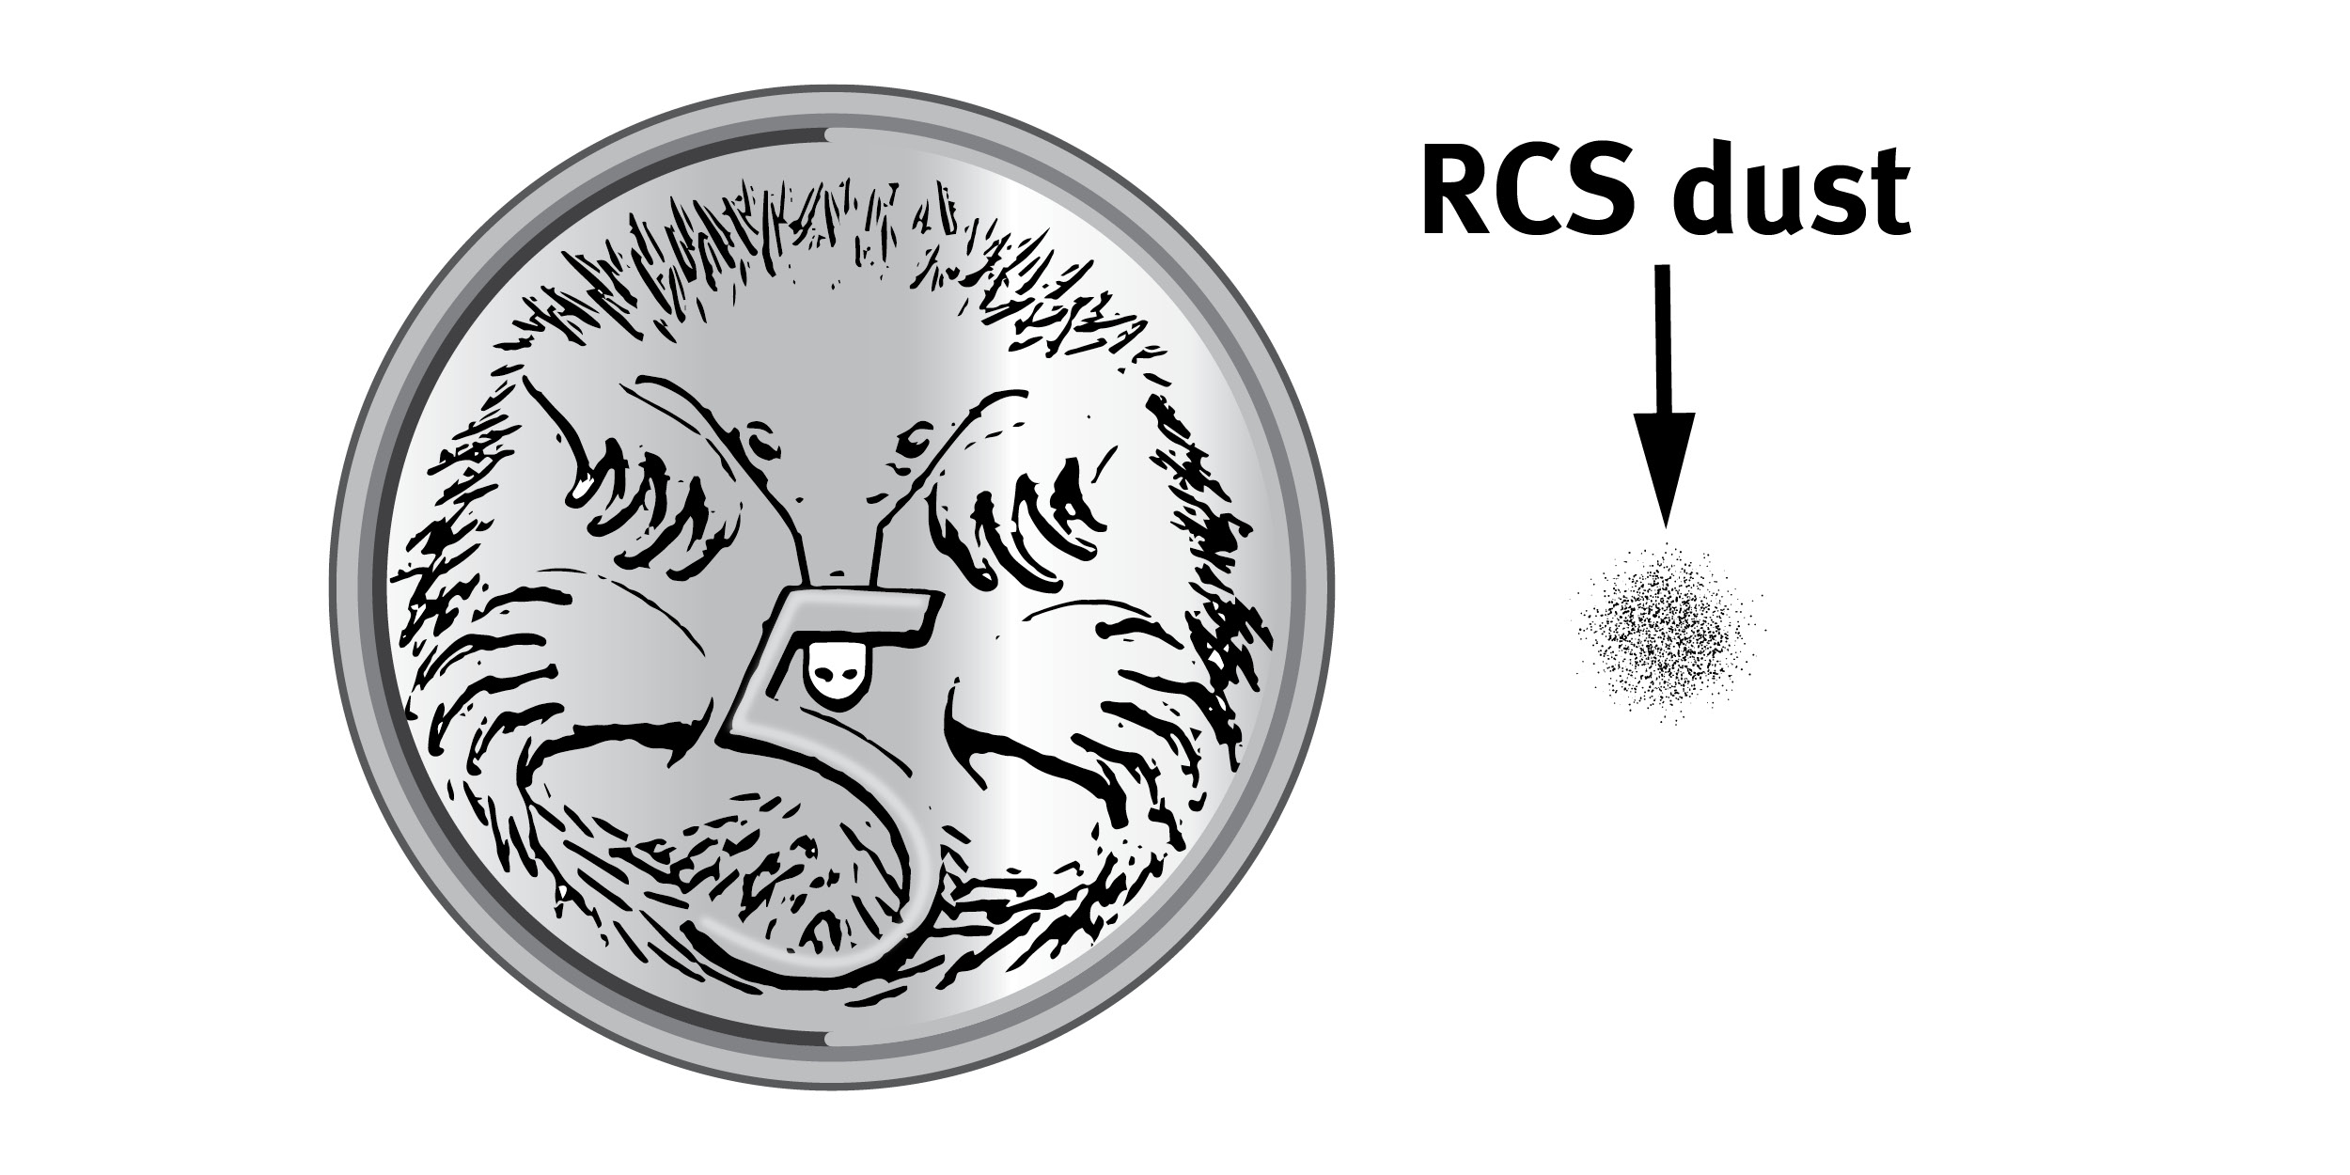

Air monitoring
In addition, you must provide air monitoring results to the regulator if the airborne concentration of RCS has exceeded the WES for RCS.
You must report the result to the WHS regulator as soon as reasonably practicable and no more than 14 days from the date the result was reported to you.
The workplace exposure standard for RCS in Australia is 0.05 mg/m³ (8 hour time weighted average).

Slide 19

Air monitoring cont’d
Air monitoring records must be:
retained for 30 years
readily accessible to people at your workplace who may be exposed to RCS.

Slide 20


Training
You must provide training on crystalline silica to any worker you reasonably believe may be involved in processing of a CSS that is high risk or be at risk of exposure to RCS because of processing of a CSS that is high risk at your workplace.
Crystalline silica training must be nationally accredited training, or another form of training approved by the WHS regulator, and must cover:
  the health risks associated with exposure to RCS, and
  the need for, and proper use of, any risk control measures required by WHS laws.
You must ensure a record of crystalline silica training undertaken by workers is
  kept while the worker is carrying out the processing of a CSS that is high risk,
  kept for 5 years after the day the worker ceases working for your business.
  available for inspection.
This record of training can be documented in the silica risk control plan.
If the processing of a CSS is not high risk, you must still ensure you are providing information, instruction, training or supervision to workers who may be exposed to RCS.

Slide 21
Health monitoring
Workers must be provided with health monitoring:
  when there is ‘significant risk’ to a worker's health arising from ongoing exposure to RCS
  whilst undertaking processing of a CSS that is high risk
Depending on the circumstances, health monitoring may be needed for workers who may regularly be in the vicinity of RCS or in contact with RCS in other ways such as through cleaning work areas or equipment.
It is your responsibility to determine if there is a ‘significant risk’.
For RCS generated from processing of a CSS that is high risk, the level of risk depends on the frequency, duration and amount of exposure (also known as dose, or how much your worker might be exposed).
You should consider a health monitoring program for all workers undertaking ongoing tasks involving processing of a CSS that is high risk frequently at your workplace or where you regularly use administrative controls or personal protective equipment to control risks.

Slide 22
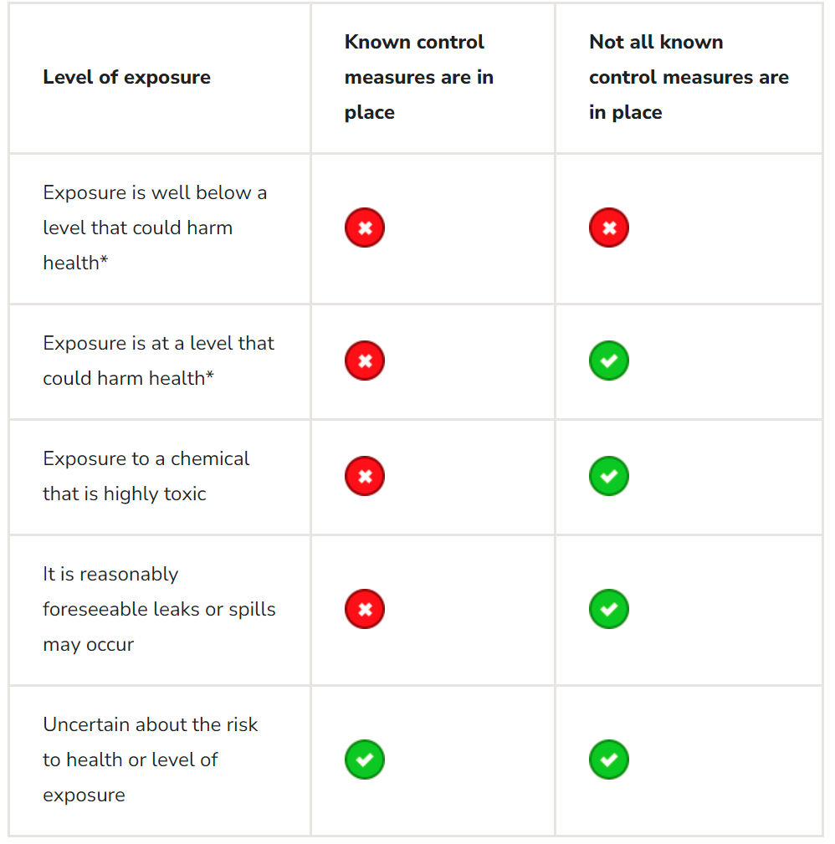

Where a workplace exposure standard (WES) for an airborne contaminant has been established, exposure over 50 per cent of the WES indicates controls may not be adequate

Slide 23

Health monitoring records
The medical practitioner doing your workers’ health monitoring will provide you with a health monitoring report relating to each worker. The report must be kept for at least 30 years and the worker must receive a copy of the report.
You must provide the health monitoring report to your WHS regulator if the medical practitioner doing your monitoring:
informs you that a worker may have contracted a disease, injury, or illness as a result of carrying out work using, handling, generating, or storing silica
recommends that you take remedial measures (such as stopping a worker from continuing to perform particular work or implementing additional exposure controls).

Slide 24

Case study 1
Julia’s Electrical
Julia is a PCBU who undertakes processing of a CSS when installing power points in kitchens and bathrooms that contain tile backsplashes. The task requires Julia to drill holes into the tiles to facilitate the installation. In conducting an assessment, Julia considers the likely crystalline silica content of the tiles to be 30% w/w.
Due to the variety of electrical work performed Julia estimates the processing of a CSS is undertaken infrequently (up to 10 times per week) and that each processing of a CSS is for short duration (less than 5 minutes per installation). She uses an on-tool dust extraction on the drill as an engineering control to control the release of dust.
When taking into account all of the considerations outlined in regulation 529CA, Julia determines that the processing is not high risk. Julia then documents the risk assessment in accordance with regulation 529CA and ensures that the cutting is controlled in accordance with regulation 529B.

Slide 25
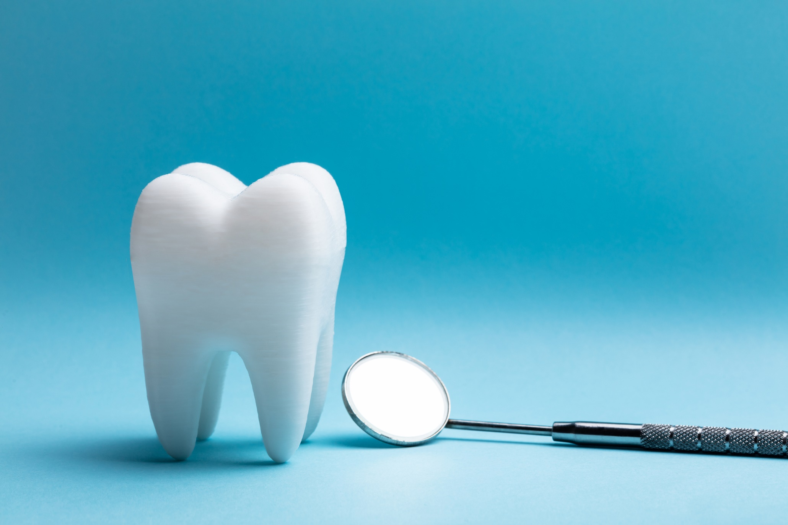
Case study 2
Tony’s Teeth
Tony is a dental prosthetist who owns and runs a denture clinic. Whilst some of Tony’s dentures are made from acrylic resins, he primarily makes porcelain dentures as they last longer.
The denture manufacturing process requires Tony to carry out casting, sandblasting, and grinding of the porcelain dentures, sometimes for a full 8-hour workday.
Tony conducts an assessment to determine if the processing is high risk or not. When considering all matters outlined in regulation 529CA, Tony reaches the view that the processing is high risk. Tony then:
documents the assessment in accordance with regulation 529CA
completes a silica risk control plan in accordance with regulation 529CB
implements control measures outlined in Part 4.3 of this guide in accordance with regulation 529B
undertakes training in accordance with regulation 529CD, and establishes an air monitoring program to ensure the control measures are working in accordance with regulation 50 and undertakes health monitoring in accordance with regulation 368.

Slide 26
