Slide 1
Kansas Amateur Quarter Horse Association
Year End Awards 2020

Slide 2
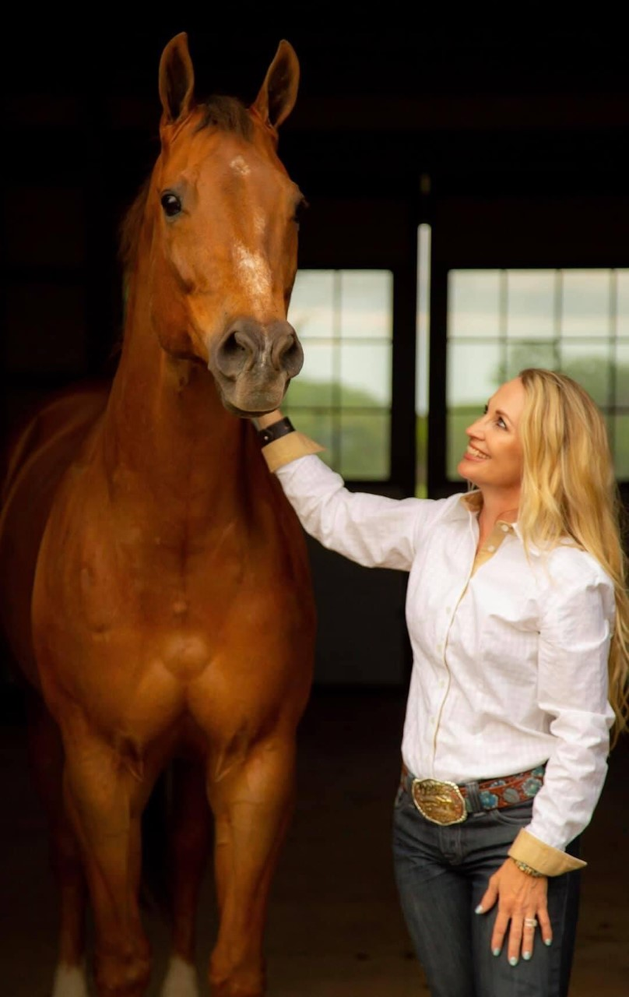
Abbey Janssen exquisite romeo
3rd aged geldings

Slide 3
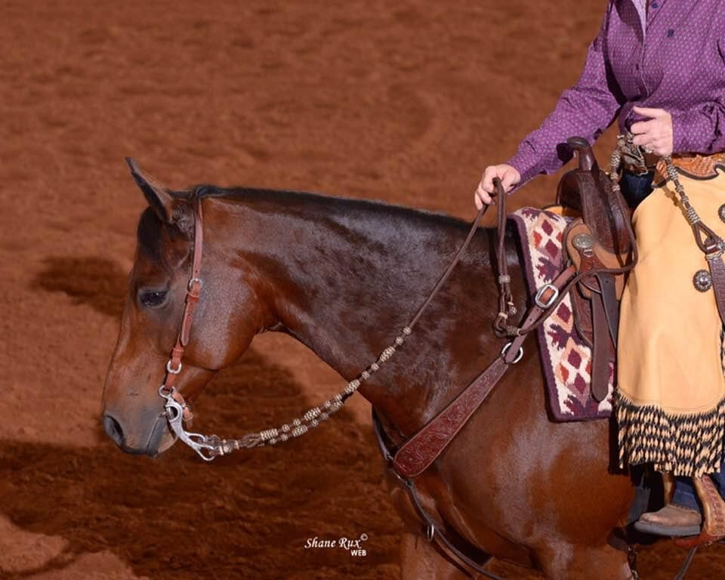
Angela De Graeve Brinleys Rooster
2nd ranch horse riding Level 1
5th vrh Amateur ranch reining

Slide 4
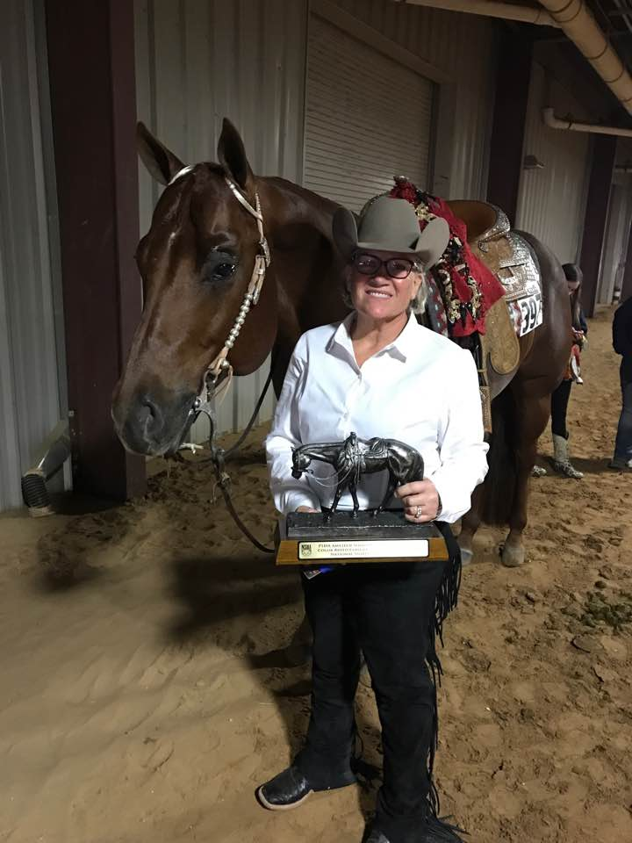
Ann Nordquist certainly shy
3rd showmanship select
3rd showmanship level 1

Slide 5
Annette Cline Stealing the moment
1st level 1 hunter under saddle
1st hunter under saddle select
2nd level 1 hunt seat equitation

Slide 6
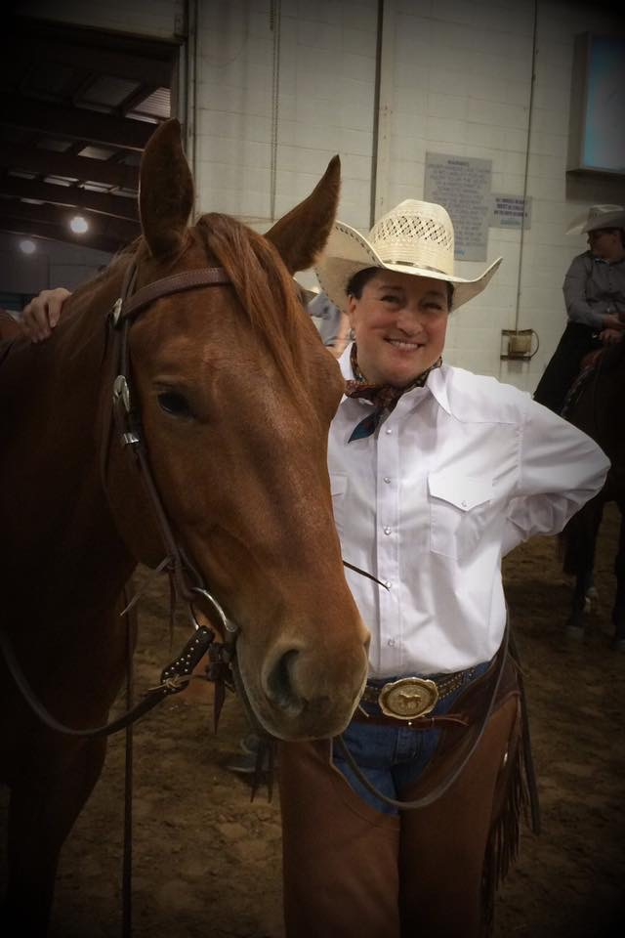
Annette Thornburg Just plain reddy
1st ranch horse riding
1st ranch horse riding select
1st ranch horse riding level 1
2nd VRH ranch riding
4th vrh ranch trail
3rd amateur select all around

Slide 7
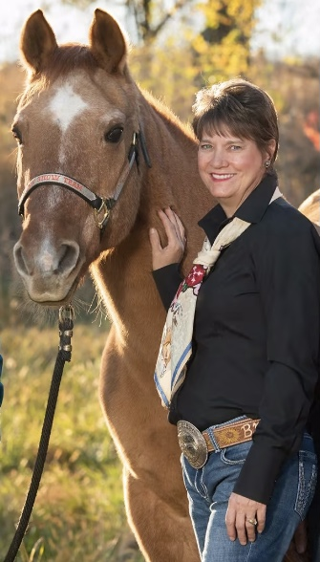
bobbie Hinds AH Drifting Faith
3rd ranch horse riding level 1
4th showmanship at halter select

Slide 8
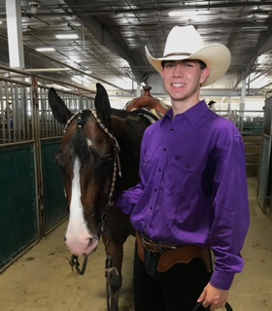
Collin champagne Zippos one and only
1st showmanship at halter level 1
2nd showmanship at halter
2nd western horsemanship
6th all around
6th all around level 1

Slide 9
Debbie priest hot kay cee
1st select trail
1st select western pleasure
1st select horsemanship
1st select trail intermediate
1st performance halter geldings
2nd western pleasure level 1
2nd aged geldings
Amateur Select All Around champion
High point amateur halter horse reserve champion
High point amateur performance halter champion

Slide 10
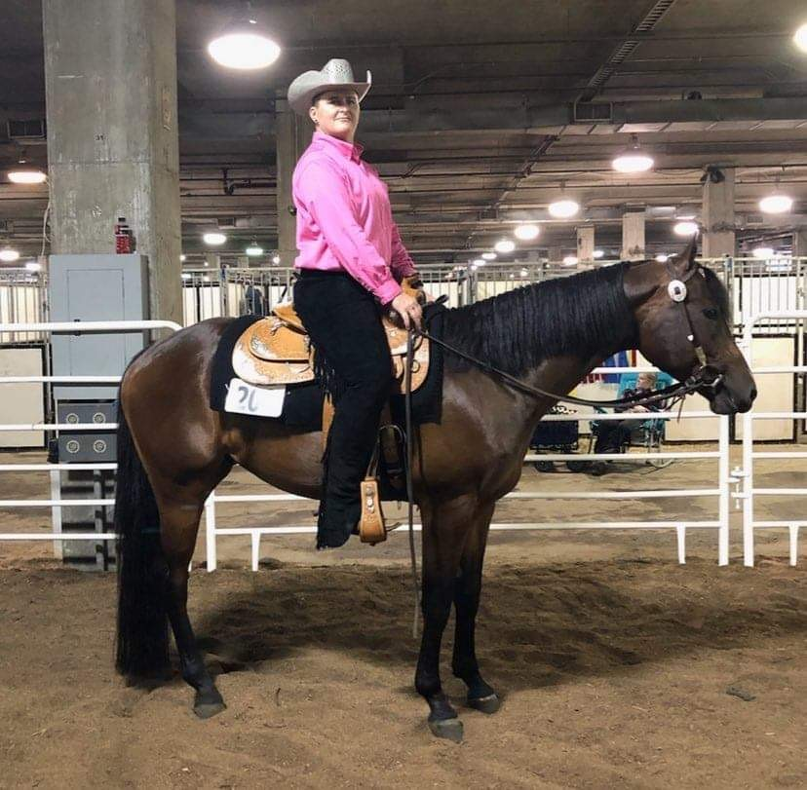
Diana brown lazy zippotamus
1st level 1 trail

Slide 11
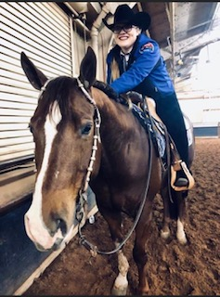
Haley Waddell An Obvious Selection
2nd trail
2nd level 1 western pleasure
2nd level 1 trail
3rd performance halter geldings
4th western pleasure
6th level 1 horsemanship
6th horsemanship
3rd amateur all around level 1
4th high point amateur performance halter horse

Slide 12
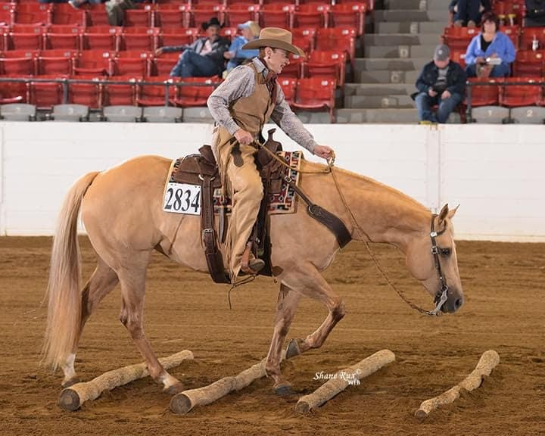
Harva leigh lambert hs docs lil barbie colonel smartpeppy
3rd & 5th vrh ranch riding
4th & 5th ranch horse riding
4th working cow horse boxing
4th vrh amateur ranch riding
6th vrh ranch horse confirmation
5th & 6th all around amateur select

Slide 13
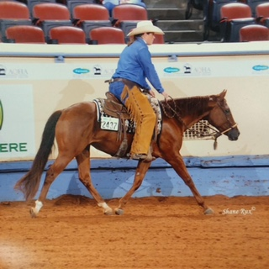
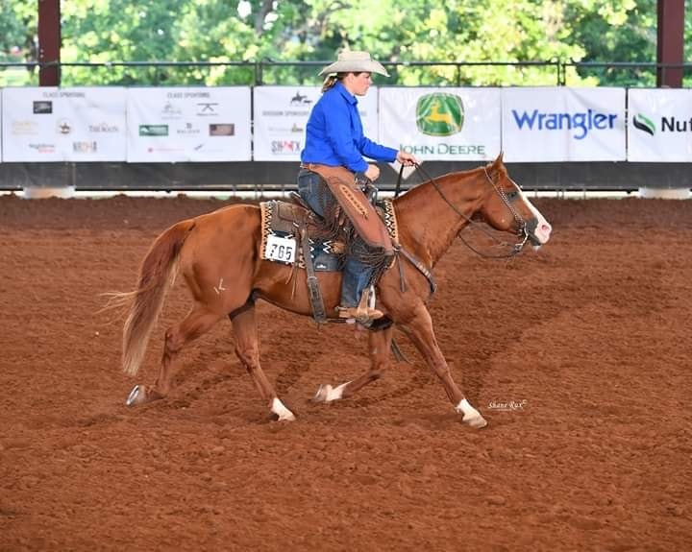
Heidi Lange sheza stella olena
5th vrh ranch cutting
5th vrh amateur limited ranch cow work

Slide 14
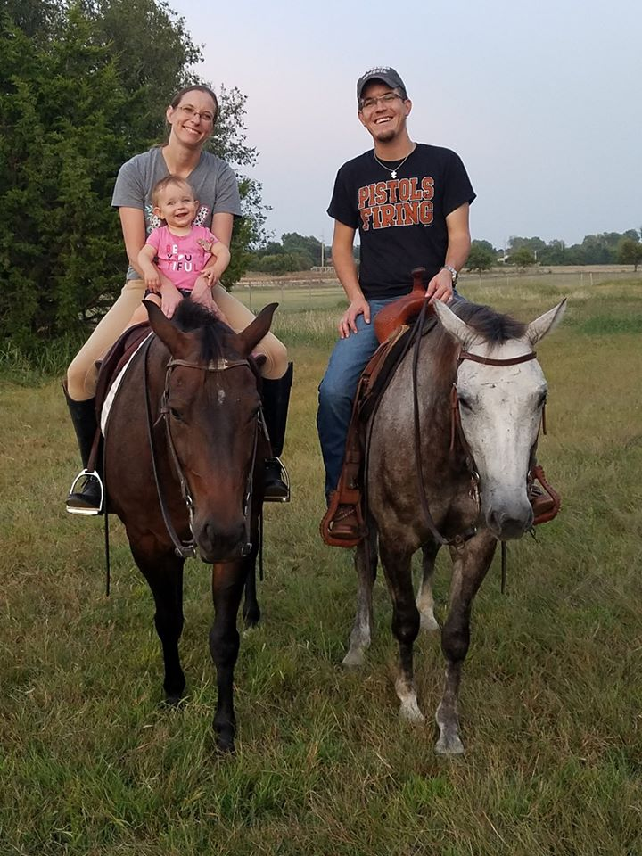
Janislynn dorris cp president cahill
1st trail
1st trail intermediate
1st horsemanship intermediate
1st hunt seat equitation level 1
2nd western pleasure
2nd hunt seat equitation
2nd horsemanship level 1
3rd horsemanship
Amateur All around champion
Level 1 All around champion

Slide 15
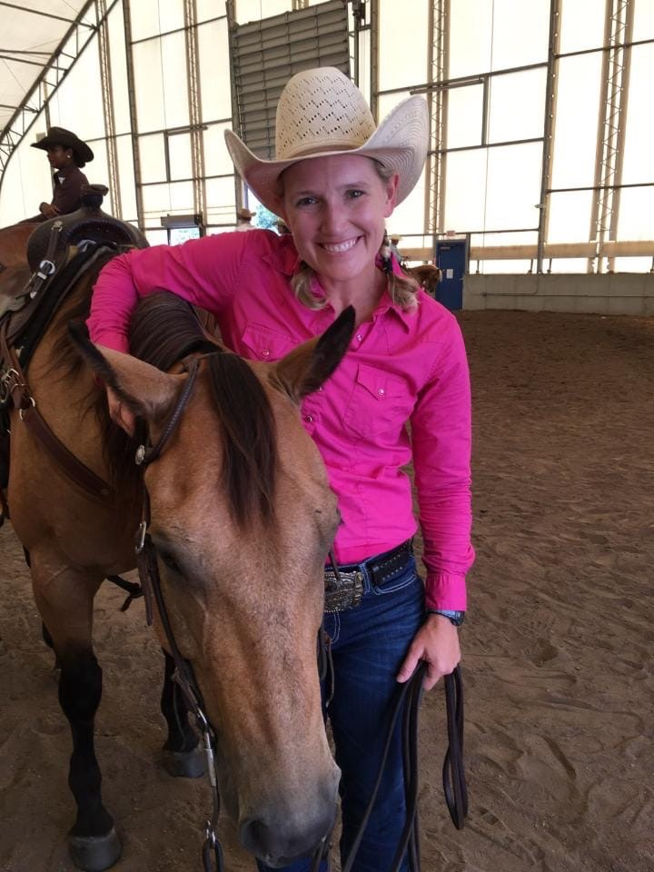
Jo gadberry just plain spooky
1st vrh amateur ranch reining
1st working cow horse boxing
3rd vrh amateur limited ranch cow work
4th vrh ranch cutting
5th vrh ranch trail
4th vrh ranch conformation
6th vrh ranch riding
4th amateur vrh limited all around

Slide 16
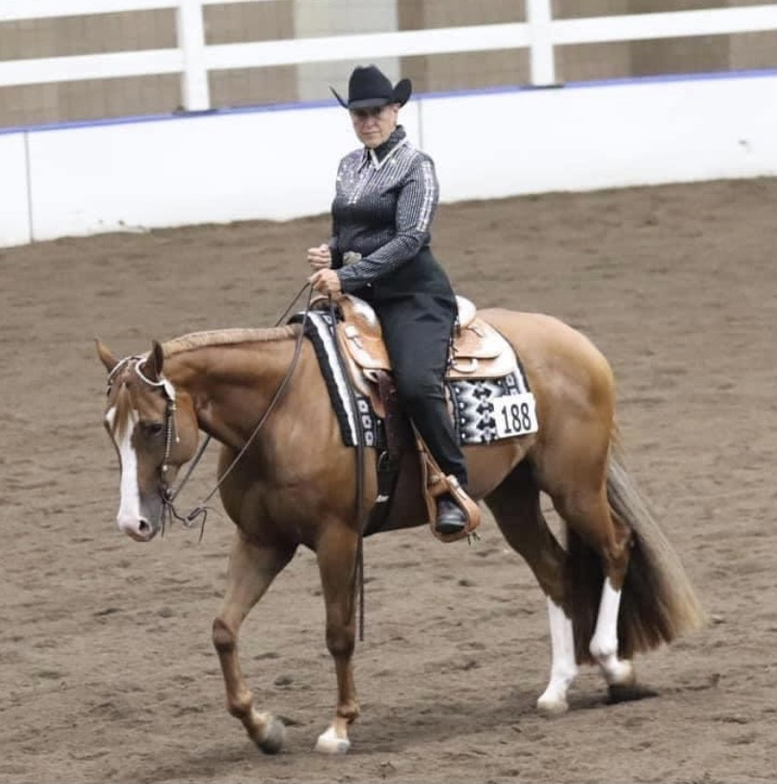
Kathy hood hot Texas nites
1st aged mares
1st western pleasure level 1
5th horsemanship level 1
Amateur all around level 1 reserve champion
3rd high point amateur halter horse

Slide 17
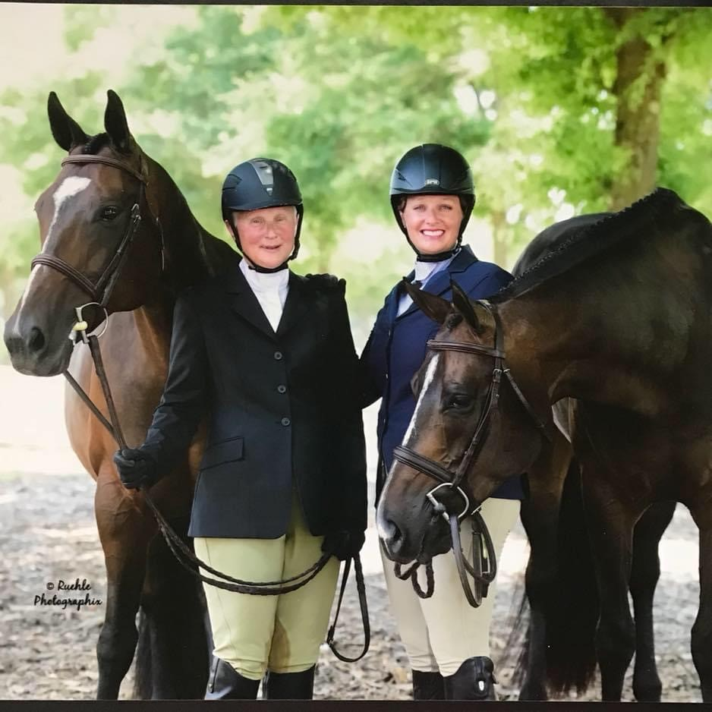
Kellee Hartman thrift shop
1st working hunter
1st hunter hack
1st equitation over fences
6th amateur all around

Slide 18
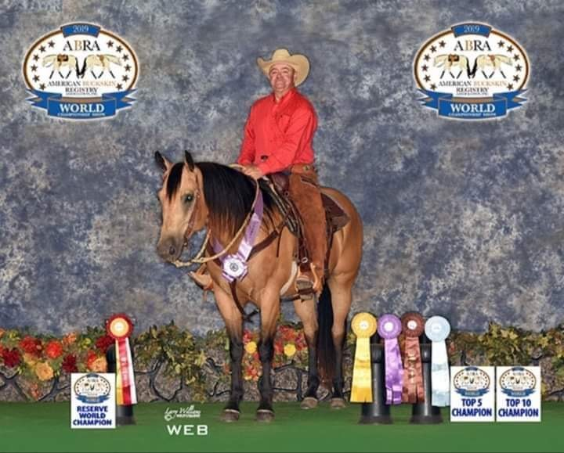
Kevin smith cat diggity smokin cattilac
1st VRh ranch riding
1st vrh limited ranch cow work
1st vrh ranch conformation
1st vrh ranch cutting
2nd working cow horse boxing
2nd ranch horse riding
2nd vrh ranch reining
4th vrh ranch cutting
6th vrh ranch trail
4th amateur select all around
5th amateur vrh limited all around

Slide 19
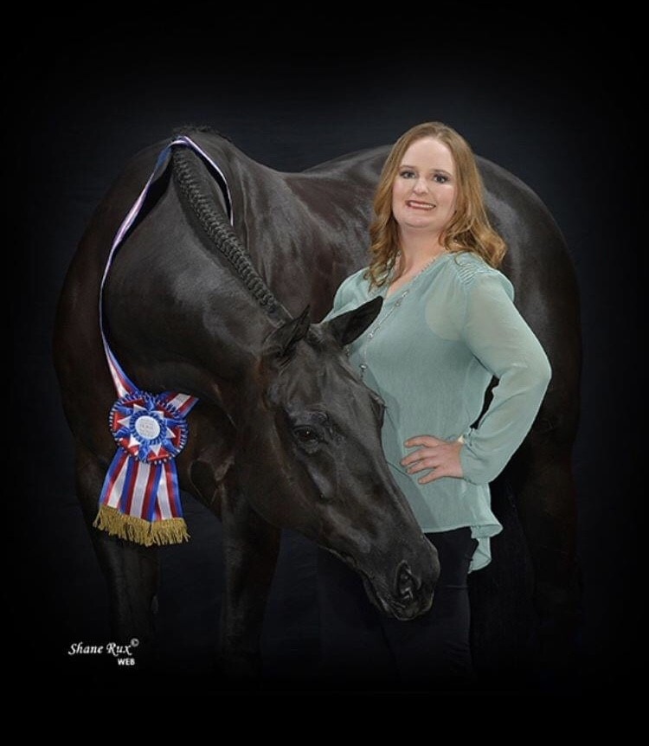
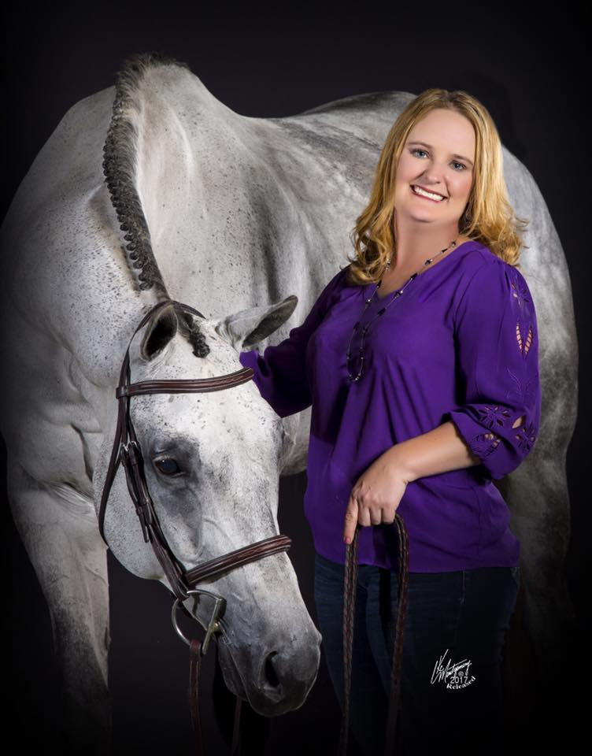
Kimberly roark Al ways Coature zip up my blumers
1st hunter hack level 1
1st working hunter level 1
3rd hunter under saddle
3rd hunt seat equitation

Slide 20
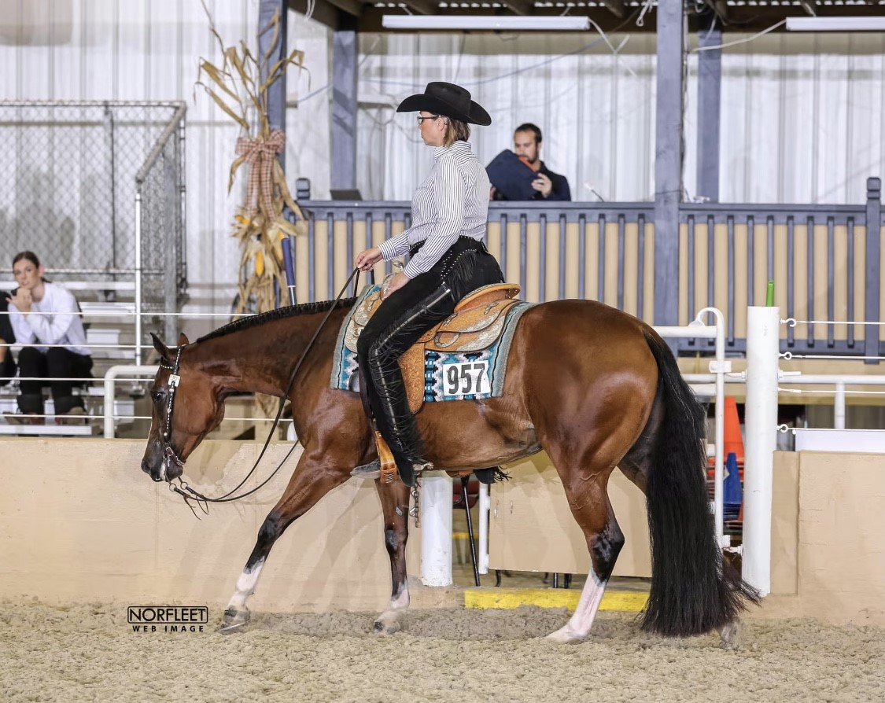
Kris Theiler reinvest in revo
3rd western pleasure level 1

Slide 21
Jenny bormann Maidjalook
1st performance halter mares
2nd showmanship level 1
3rd showmanship
4th horsemanship
4th horsemanship level 1
4th amateur all around
4th amateur all around level 1
Reserve high point performance halter horse

Slide 22
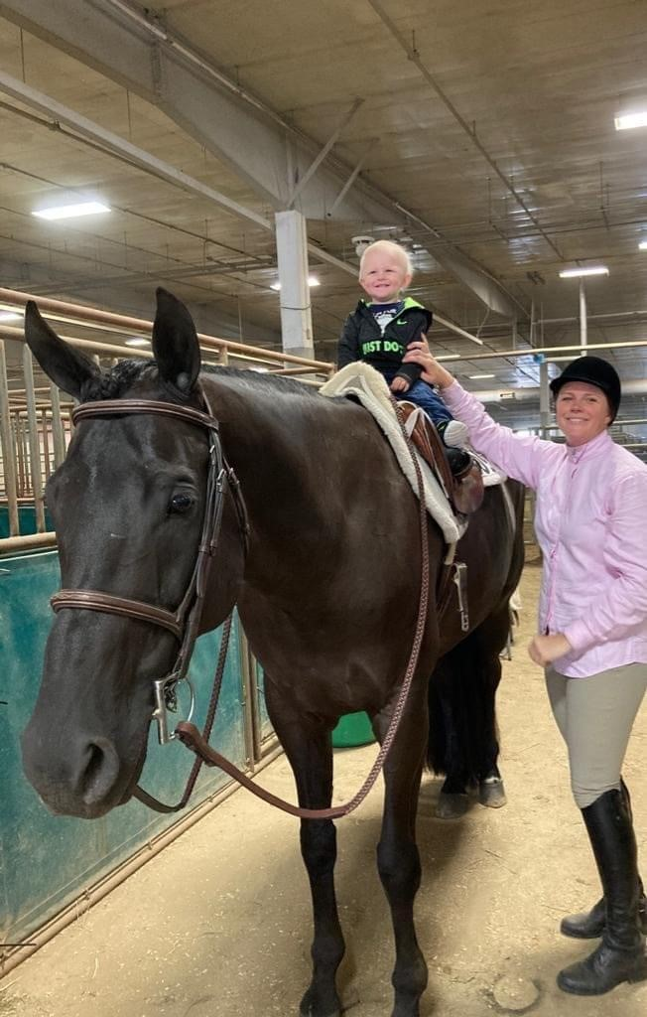
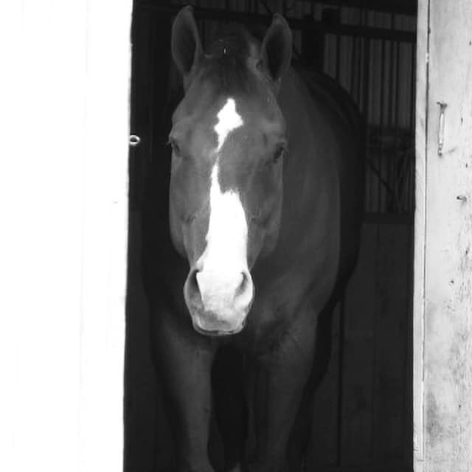
Jessica martin tell a good tail
1st hunt seat equitation
2nd hunter under saddle

Slide 23
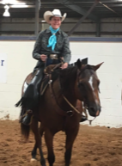
Lisa Anderson Peppy San Chance
3rd vrh ranch trail
4th vrh ranch riding
4th vrh limited ranch cow work

Slide 24
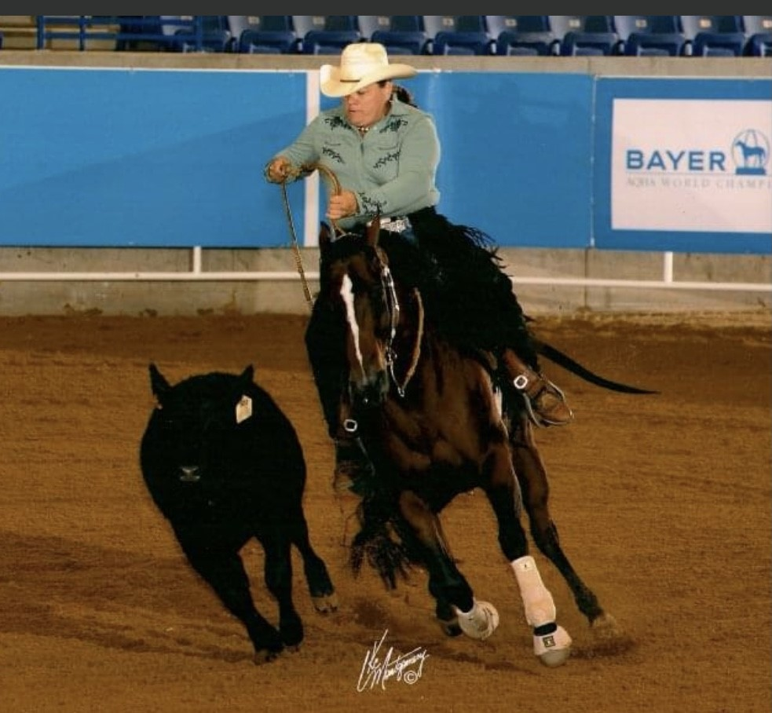
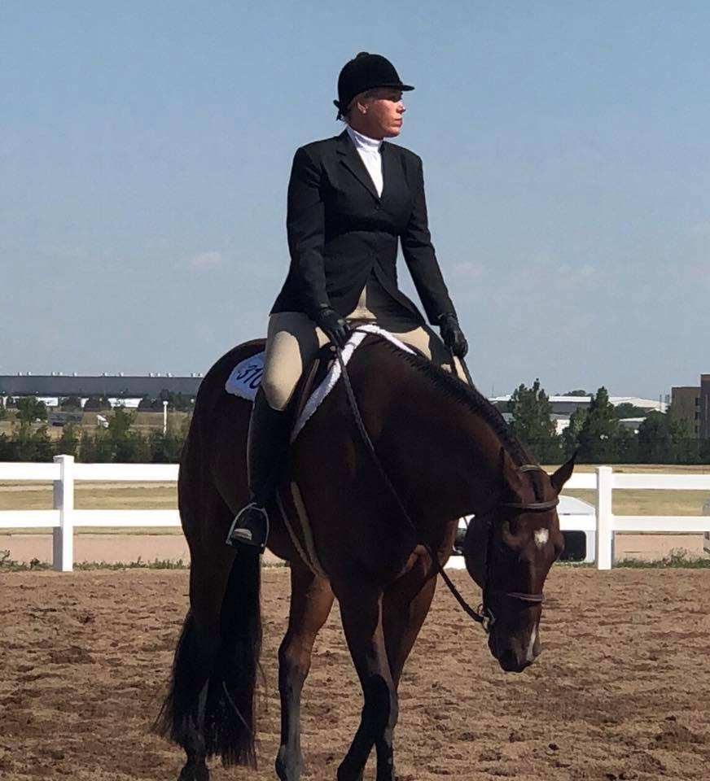
Lisa bray gotta travel to play
3rd vrh ranch cutting
3rd vrh ranch reining
5th ranch conformatiom
5th vrh amateur limited ranch cow work
3rd amateur limited all around

Slide 25
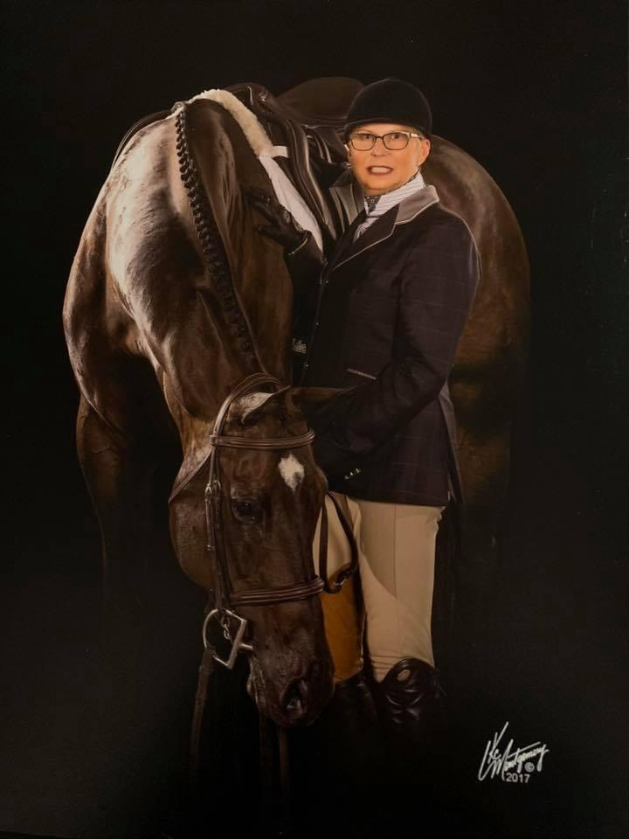
Marcia meloy vital signs are back
1st walk/trot western horsemanship
3rd hunt seat equitation level 1

Slide 26
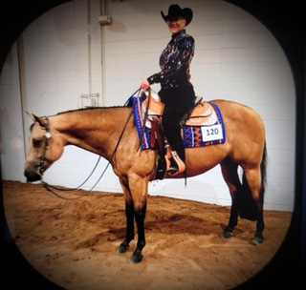
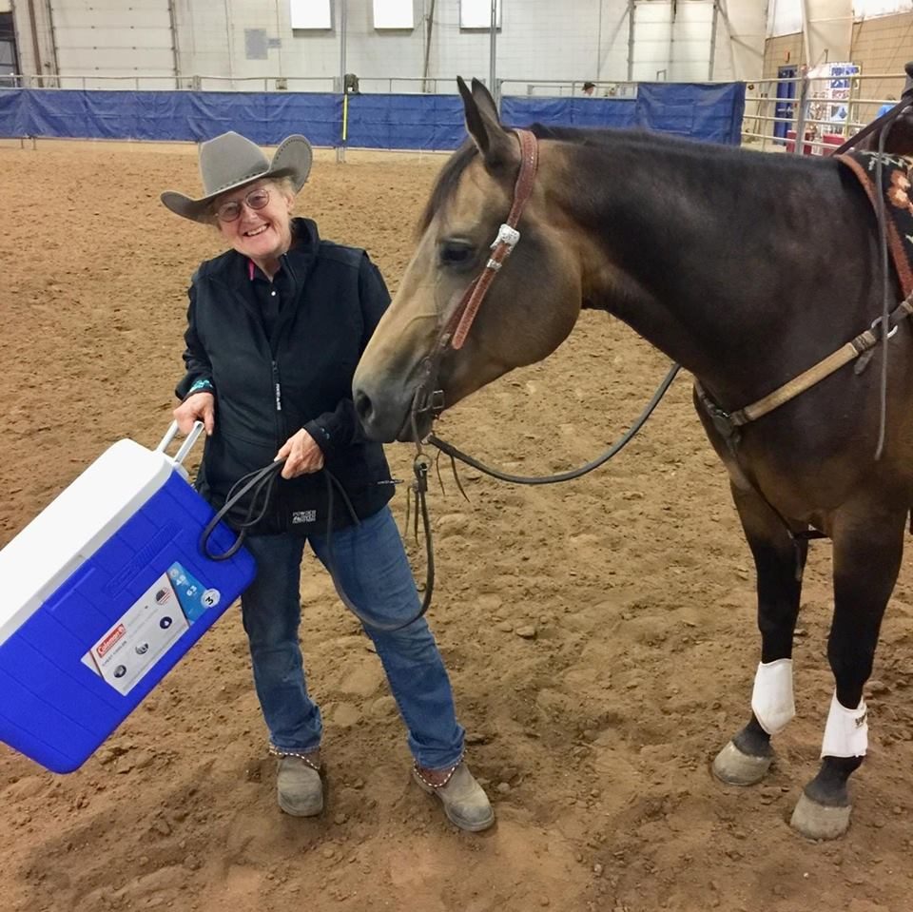
Marty oltjen too kool tobe krymsun
1st showmanship at halter select
2nd aged geldings
2nd horsemanship select
Reserve High point amateur halter horse

Slide 27
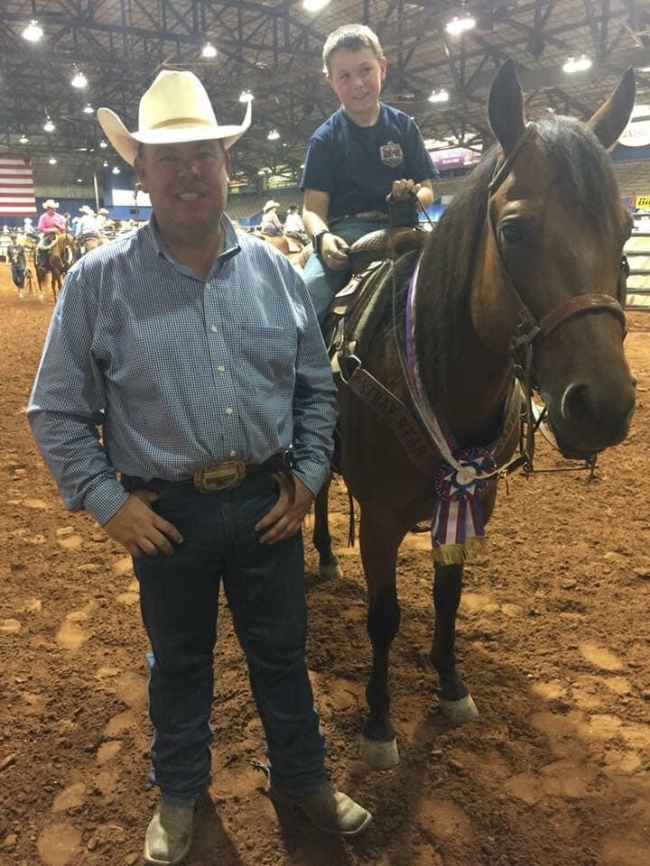
Mark hickey royal cattilion
5th vrh ranch reining
1st vrh ranch trail
2nd vrh ranch cutting
2nd vrh ranch conformation
4th ranch horse riding
5th amateur all around
Vrh amateur all around champion
Vrh amateur limited all around champion

Slide 28
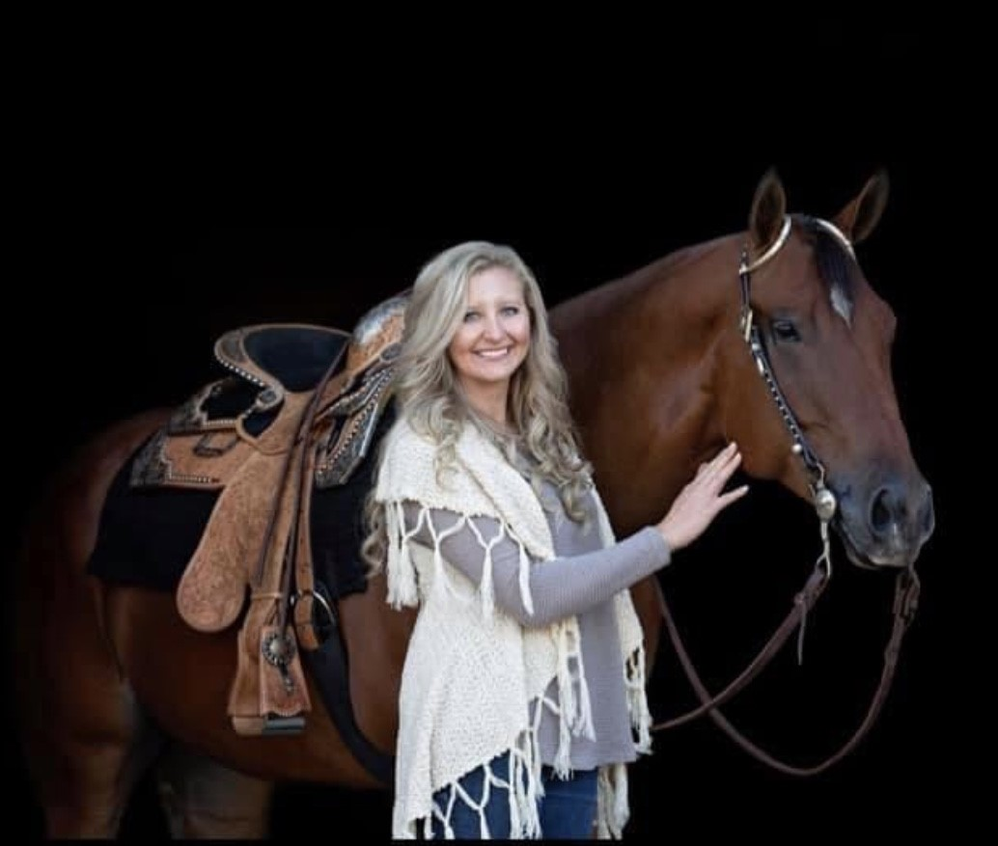
Mikaela Sundgren red amblin Man stranger danger huntin for unicorns
1st aged halter geldings
1st & 5th horsemanship
1st & 4th showmanship
3rd level 1 showmanship
3rd Western pleasure
3rd Hunt seat equitation
4th hunter under saddle
Reserve champion amateur all around
High point amateur halter horse champion

Slide 29
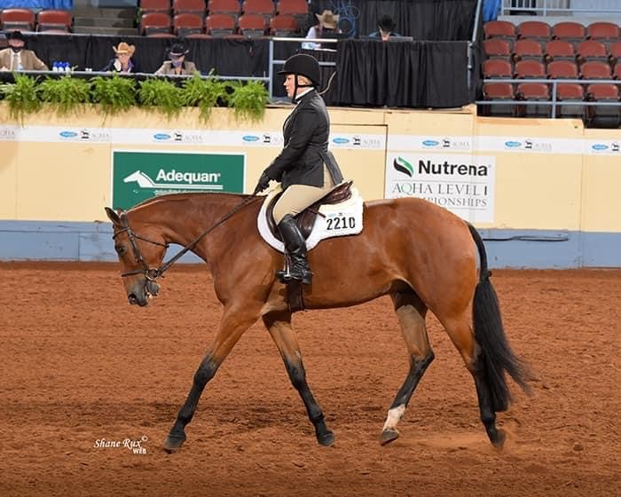
Stephanie Manhart Al walk the line
1st amateur hunter under saddle
4th amateur hunt seat equitation
5th level 1 showmanship

Slide 30
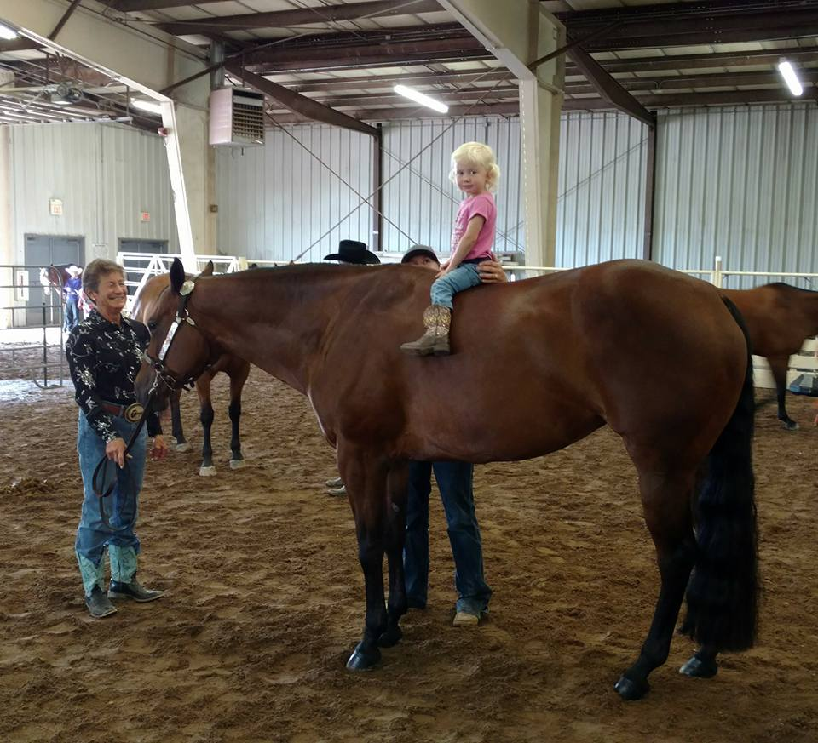
Sue weller twilight is innocent
2nd select showmanship
3rd level 1 horsemanship
4th level 1 showmanship

Slide 31
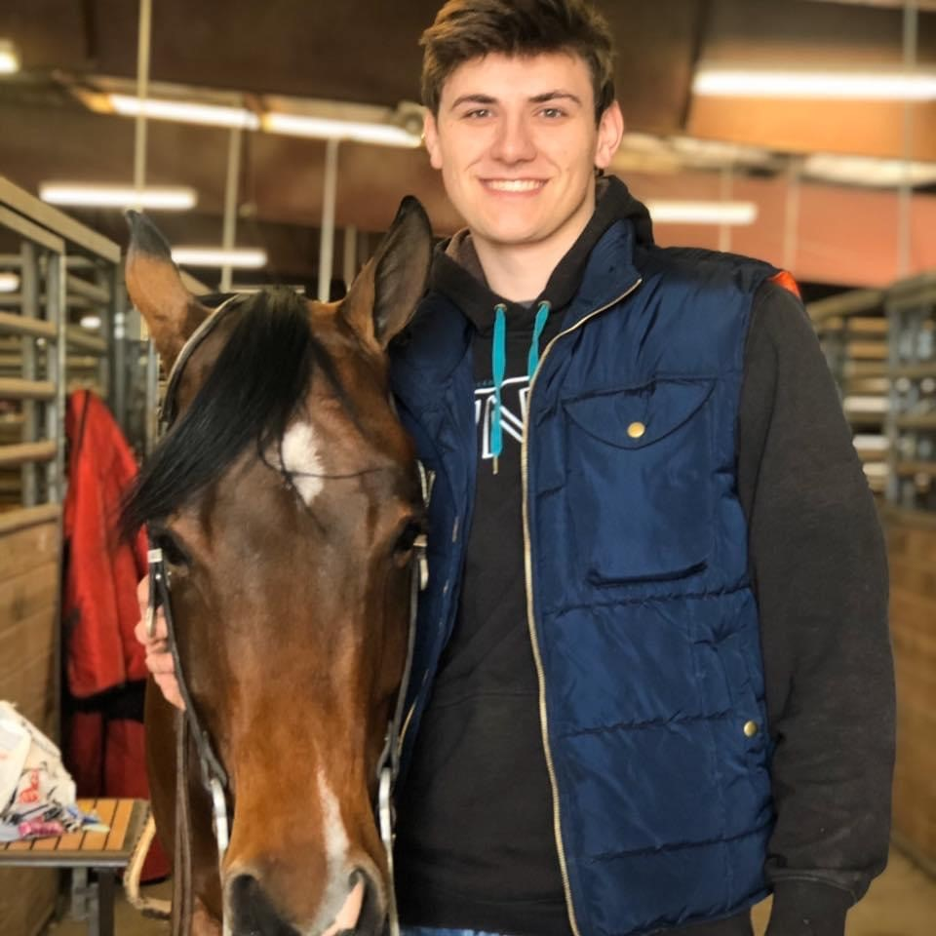
Tate Thompson hot enough for gq
1st western pleasure
2nd performance halter geldings
3rd high point amateur performance halter horse

Slide 32
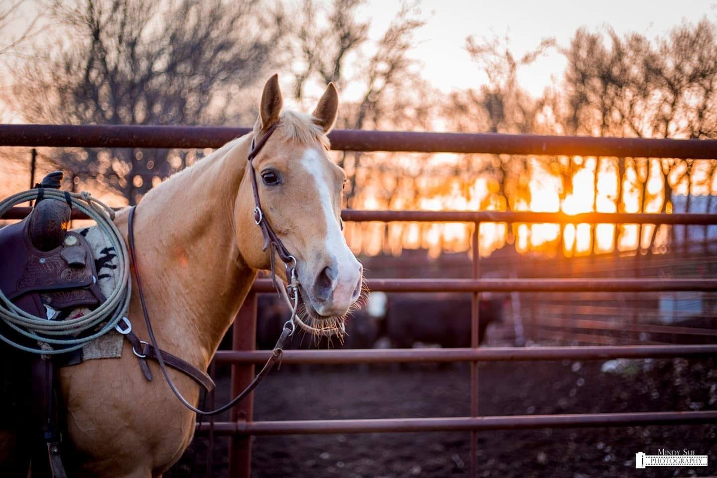
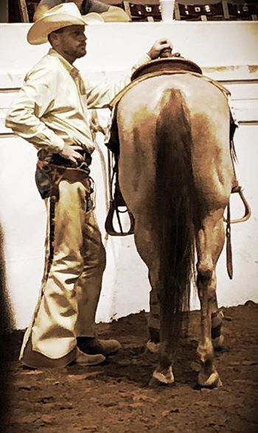
Tomi hitt wimpy smart rosey
2nd vrh ranch trail
2nd vrh limited ranch cow work
3rd working cow horse boxing
3rd ranch horse riding
3rd vrh ranch conformation
3rd amateur all around
Amateur vrh limited all around reserve champion

Slide 33
all around winners
2020

Slide 34
All Around amateur
Champion
Janislynn dorris
Cp president cahill
Reserve Champion
Mikaela sundgren
red amblin man

Slide 35
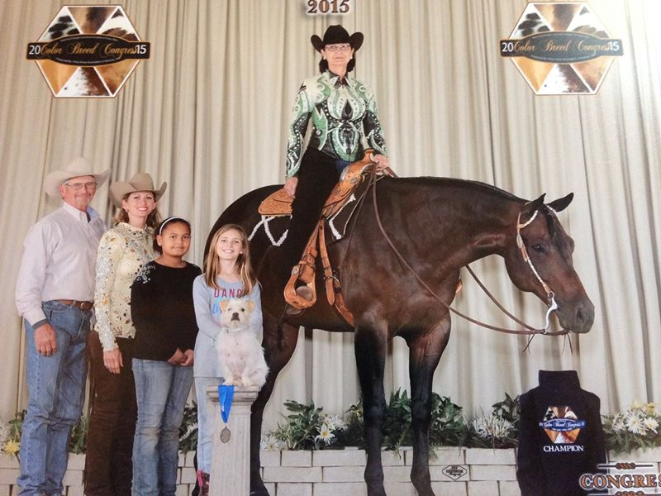
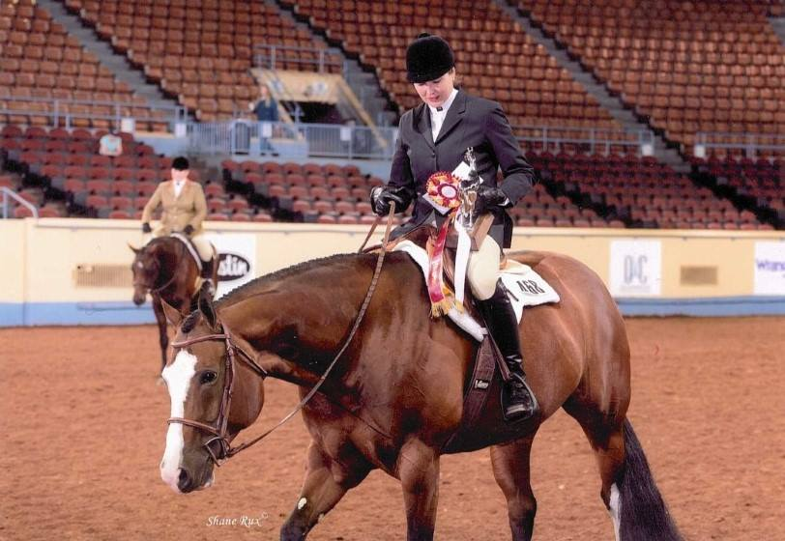
All around amateur select
Champion
Debbie priest
hot Kay cee
Reserve Champion
Annette thornburgh
just plain reddy

Slide 36
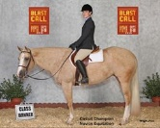
All around level 1 amateur
Champion
Janislynn dorris
Cp President cahilln
Reserve champion
Kathy hood
hot Texas nites

Slide 37
All around vrh amateur
Champion
Mark Hickey
royal cattilion

Slide 38
All around vrh Limited amateur
Champion
Mark hickey
royal cattilion
Reserve champion
Tomi hitt
wimpy smart rosey

Slide 39
High point amateur halter horse
Champion
Mikaela sundgren
red amblin man

Slide 40
Am high point performance halter horse
Debbie priest
one hot kay cee

Slide 41
Congratulations kaqha exhibitors! Looking forward to the 2021 show season!
Good luck!

