Slide 1

Old Bennington Village Plan
Community Engagement Plan
September 8, 2025
Past Strategies and Future Plans

Slide 2
Project Goals
Outline strategies to protect and maintain historic character of the Village
Address updated state laws regarding housing and density requirements
Prioritize pedestrian-scaled, climate resilient developments to protect natural and historical resources
Shift from fossil fuel-based energy sources to renewable energy sources

Slide 3
Engagement Tells Us…
What are Old Bennington’s strengths and challenges? What do people want for the future of Old Bennington?
How do we create a plan that is reflective of the entire community?
Who lives, works, and plays in Old Bennington? What issues are on their minds?

Slide 4
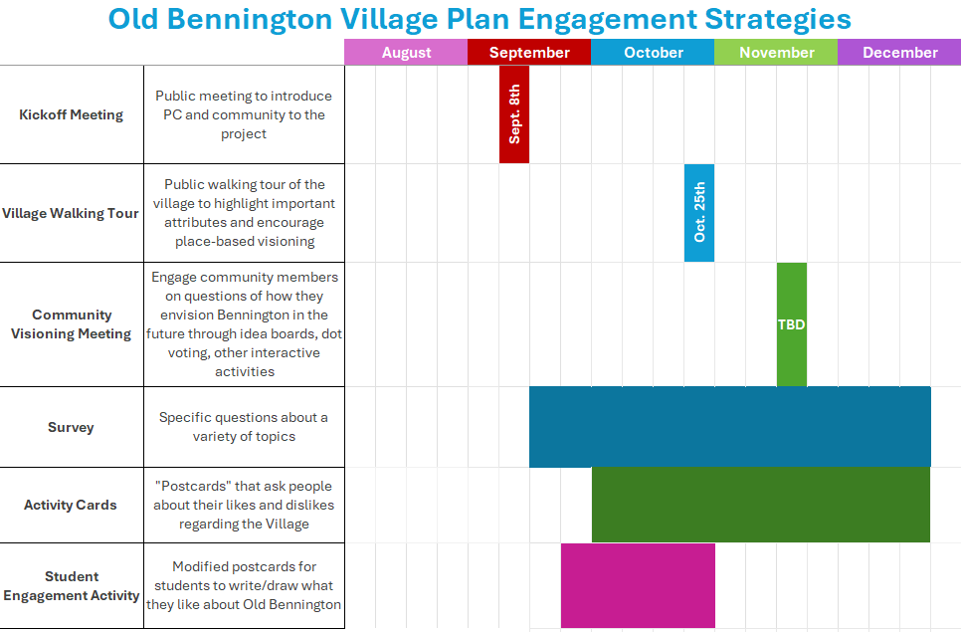
Community Engagement Strategies & Important Dates to Note

Slide 5


Old Bennington Walking Tour
(most likely) Saturday, October 25th, morning/midday, Monument Ave
BCRC will be partnering with the Bennington Historical Society to provide a walking tour throughout Old Bennington this upcoming fall
Give people a sense of the character of the Village, and how land uses have changed over time; highlight place-based assets such as historic and scenic features; and engage people in identifying areas of pride and concern

Slide 6
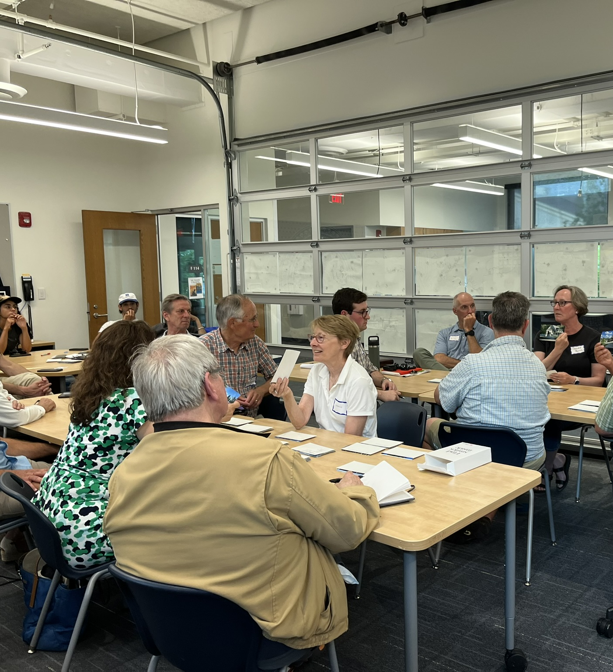


Community Visioning Meeting
Late October/early November, Weeknight evening, Location TBD (Monument Elementary or The Barn)
Include entrance card, dynamic visioning and discussion-based activity, and exit card to facilitate community conversation, imagine the village’s future, and determine top priorities
“Spectrum” Activity, Dot Voting
Example: Manchester Village Community Visioning Meeting, June 2024
Notes:
What key information do you hope to gather at this meeting?
What feedback have you received from past Old Bennington meetings that may be helpful to BCRC?

Slide 7
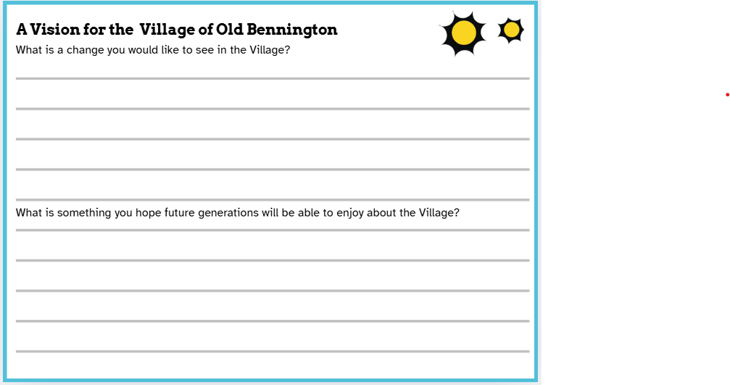
Postcard Activity
Distribute postcards to various locations and organizations around Old Bennington
Use postcards as feedback cards at other community engagement events
Postcards as a form of both active and passive community engagement
Where would you like to see postcards distributed?

Slide 8
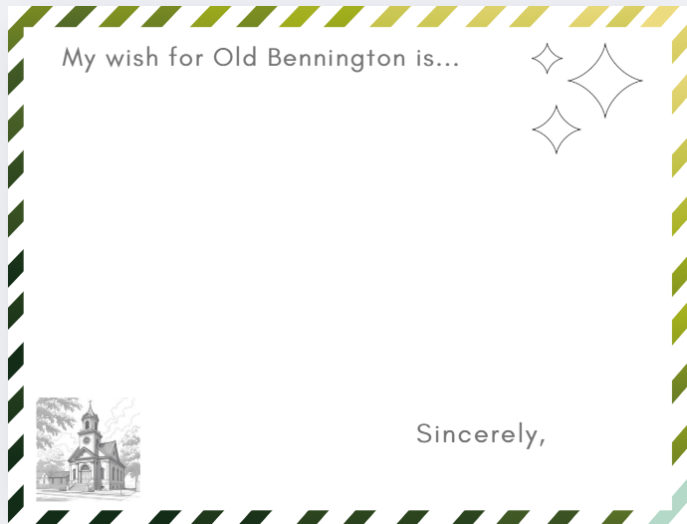
Student Engagement Activity
Monument Elementary to engage their students
This partnership will act as an educational tool to emphasize the importance of civic engagement
Better understand student hopes and wishes for the future of their community

Slide 9
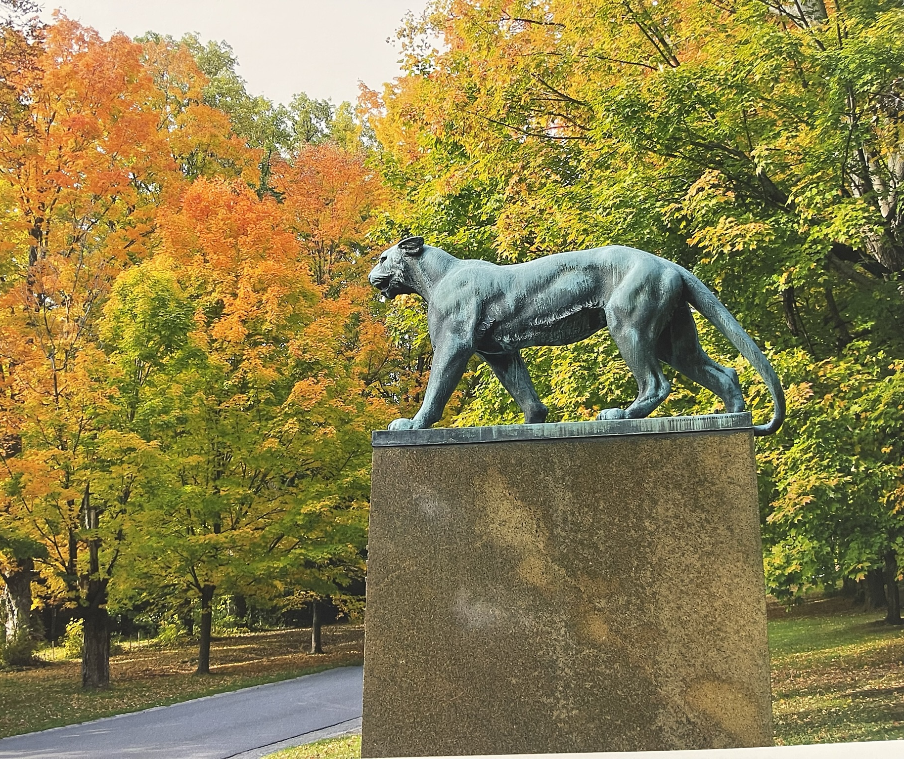
Old Bennington Survey
Online and in hard copies throughout town
Hopes and concerns for the future of those who live, work, and play in Old Bennington
Topics include: General information, Community, Size and Scale, Arts, Culture, and History, Environment, Demographics
How would you like to see surveys distributed?

Slide 10
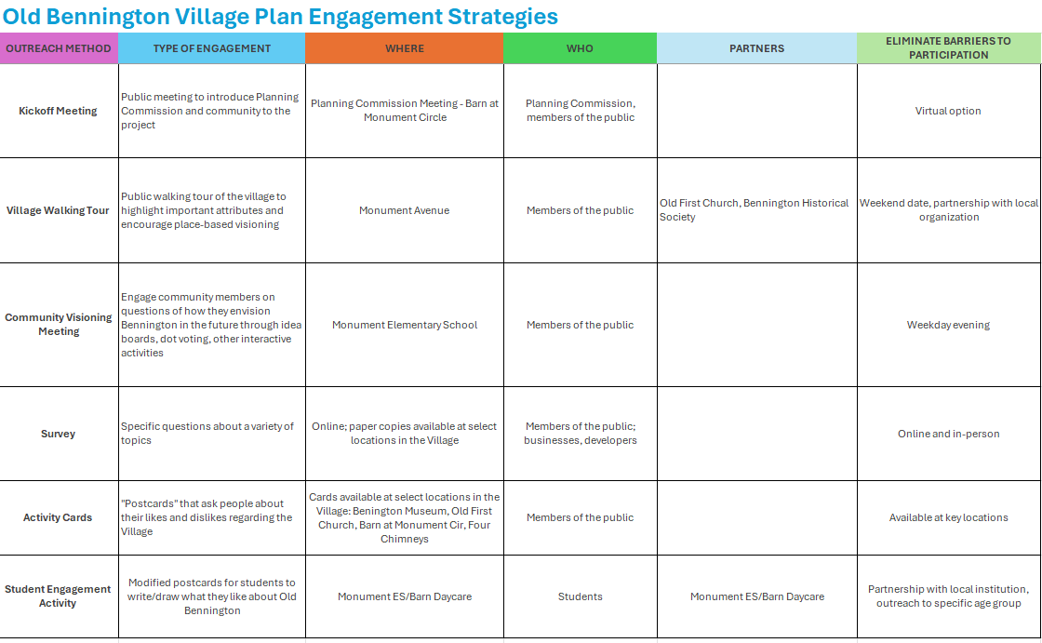

Slide 11
Community Engagement Strategies & Important Dates to Note

Slide 12
We’ve Engaged, Now What?
Timeline
January–March: Prepare and present our findings
March–June: Draft and present the plan
Incorporation of Engagement
Synthesize survey responses, activity cards, community visioning feedback and student engagement cards to propose themes and structure for the plan
Circle back to Monument Elementary to present student findings

Slide 13
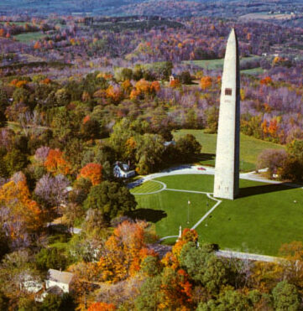
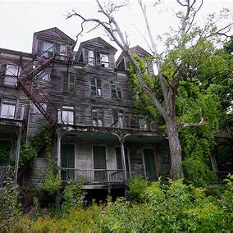

Thank you!

