Slide 1
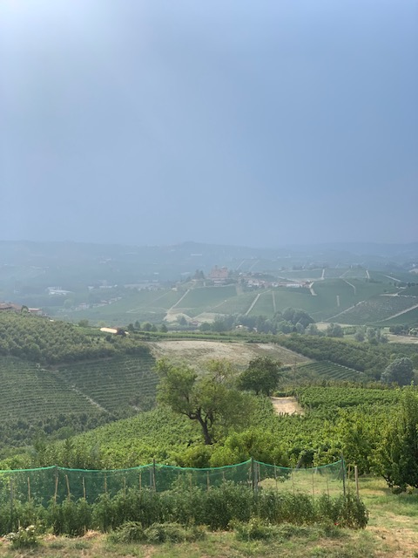
Vine Nirvana Luxury Wine & Culture Tours in Piemonte, Italy
Discover the Wine & History
of Langhe & Monferrato
Group tours September 2026
& Upon Your Group Request
Presented by Vine Nirvana

Slide 2
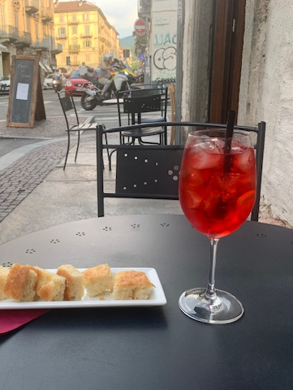

Tour Overview
5 nights/ 6 days curated experience in Piedmonte, Italy’s Langhe region (longer upon your group’s request)
Explore UNESCO World Heritage landscapes
Taste world-class wines like Barolo & Barbaresco
Enjoy authentic cuisine and cultural heritage
Small group travel with expert guides

Slide 3
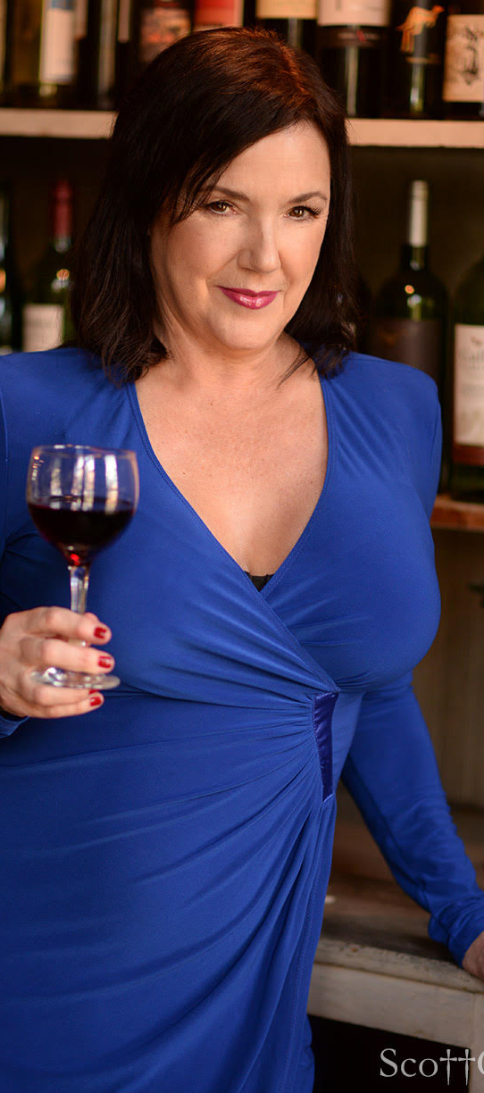
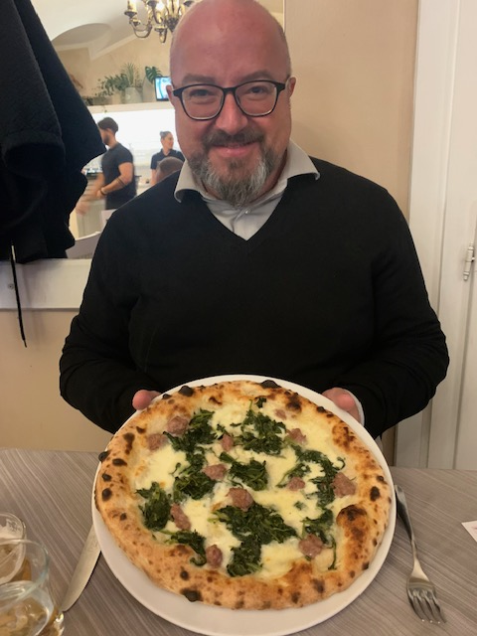
Meet Your Expert Wine Hosts
Gwendolyne Willis Owner, Vine Nirvana
UNLV Sommelier Academy; WSET Advanced with Merit; Spanish Wine Scholar; Italian Wine Scholar candidate
Sandro Minella
Certified Sommelier and 20 years tour guide; Barolo & Barbaresco Academy Instructor; Host of Alba White Truffle Fair cooking events; Deep knowledge of Langhe wines & traditions

Slide 4
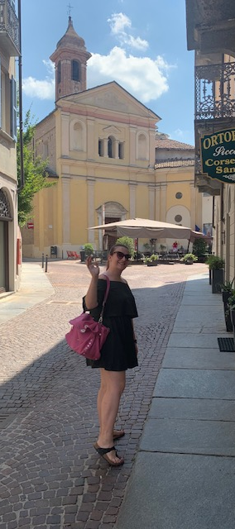
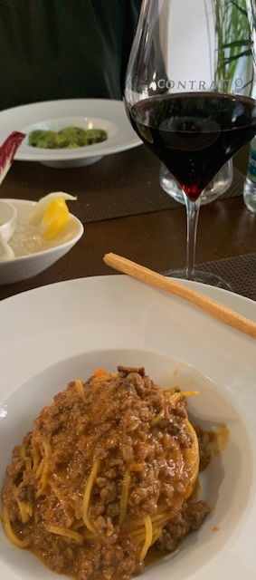
Itinerary Highlights – Day 1
Day 1: Welcome to Piedmonte!
Meet in Turin at 9:30 am, transfer to Alba
Guided walking tour and lunch in a local osteria
Check-in to Alba hotel or Private Villa
Private dinner by Michelin-starred Chef Alessandro Boglione

Slide 5
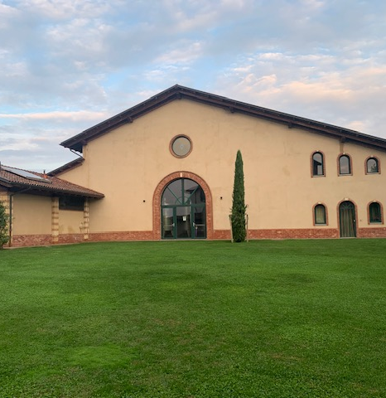
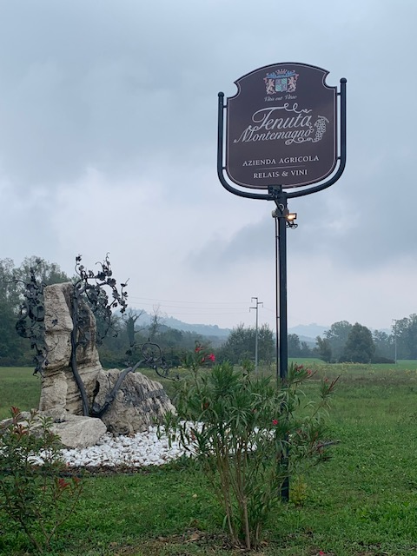
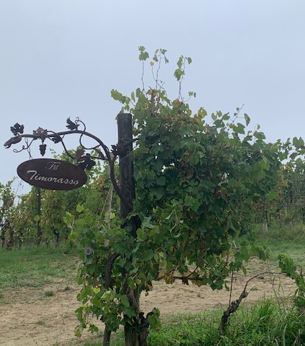
Itinerary Highlights – Day 2
Flavors of Langhe & Monferrato
- Visit Cascina Pistone sheep & cheese farm
- Truffle hunting with expert guide and dogs
- Wine tasting and dinner at Tenuta Montemagno winery

Slide 6
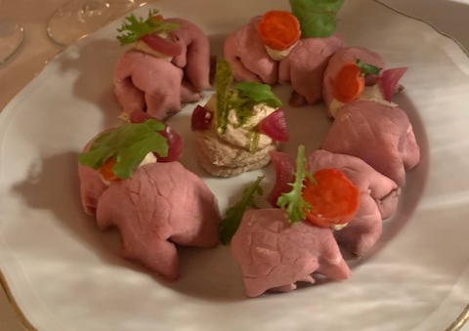
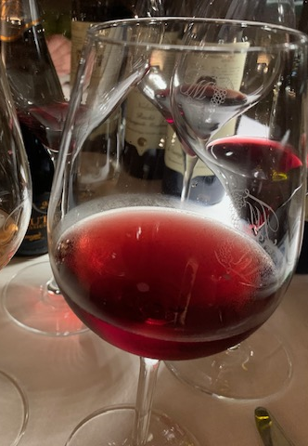
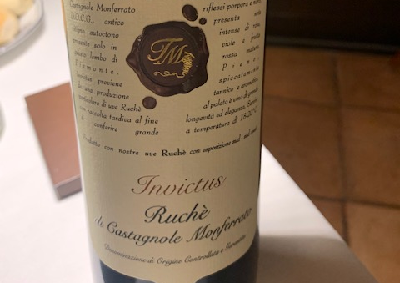
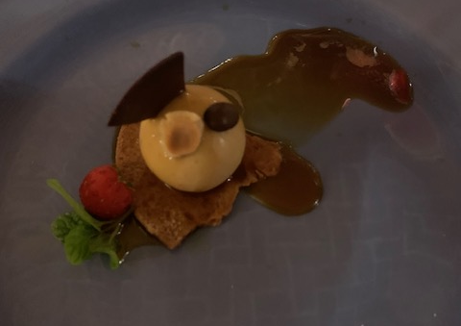
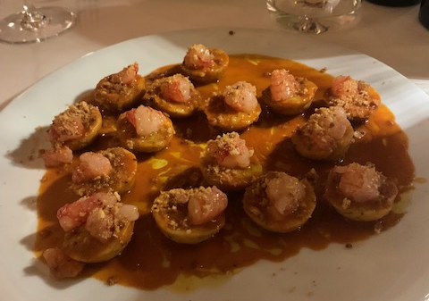
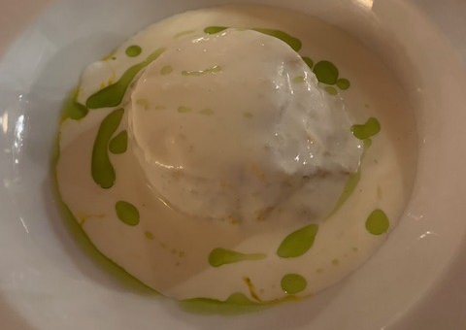
Welcome to the Exclusive Chef’s Table: La Civetta sul Comò at Tenuta Montemagno Winery

Slide 7
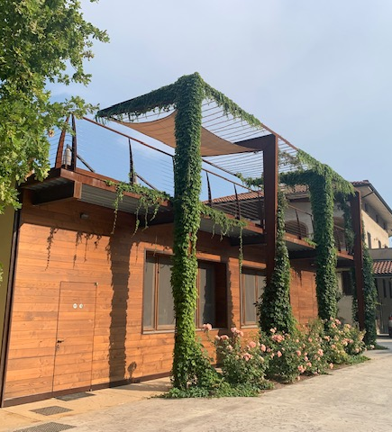
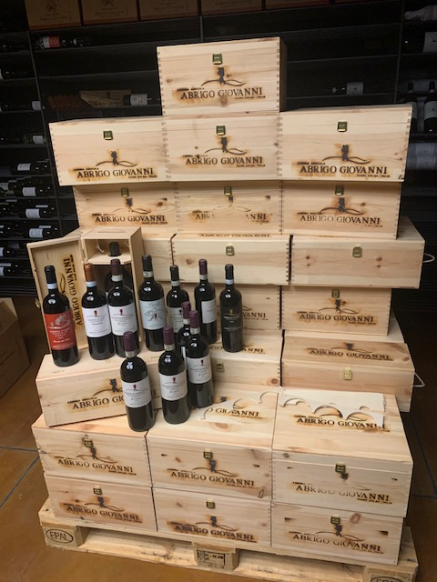
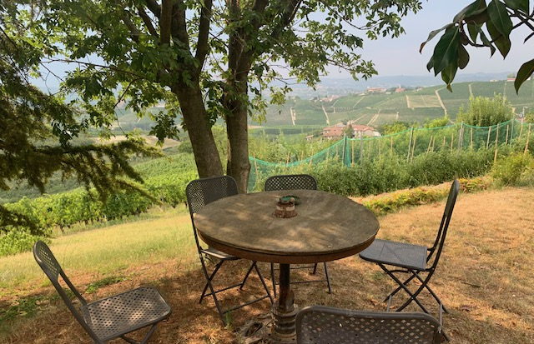
Itinerary Highlights – Day 3
Barolo Unveiled
Cooking class at Roddi Castle
Visit Abrigo Giovanni winery in Diano d’Alba
Dinner in La Morra village

Slide 8
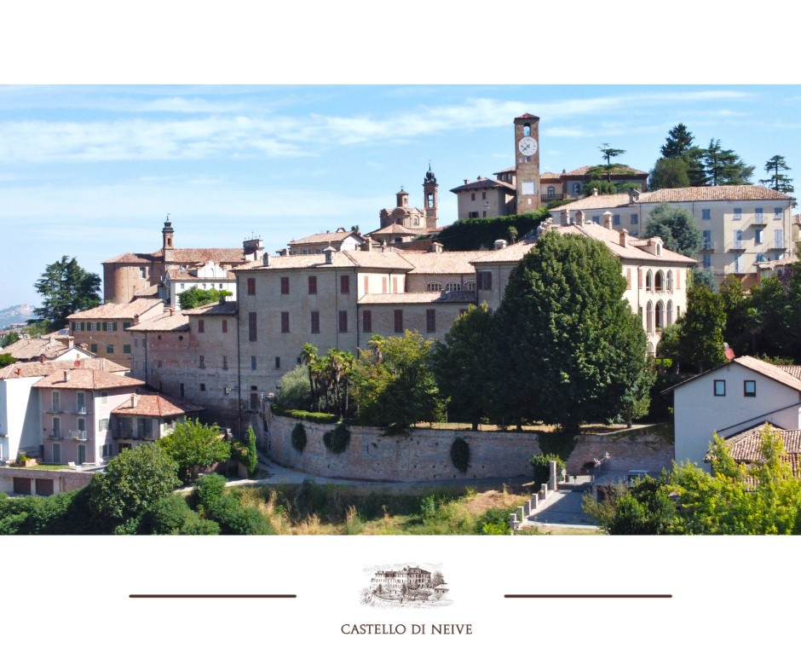
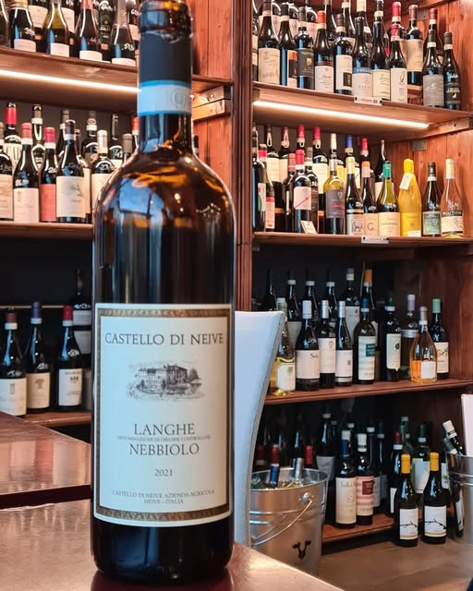
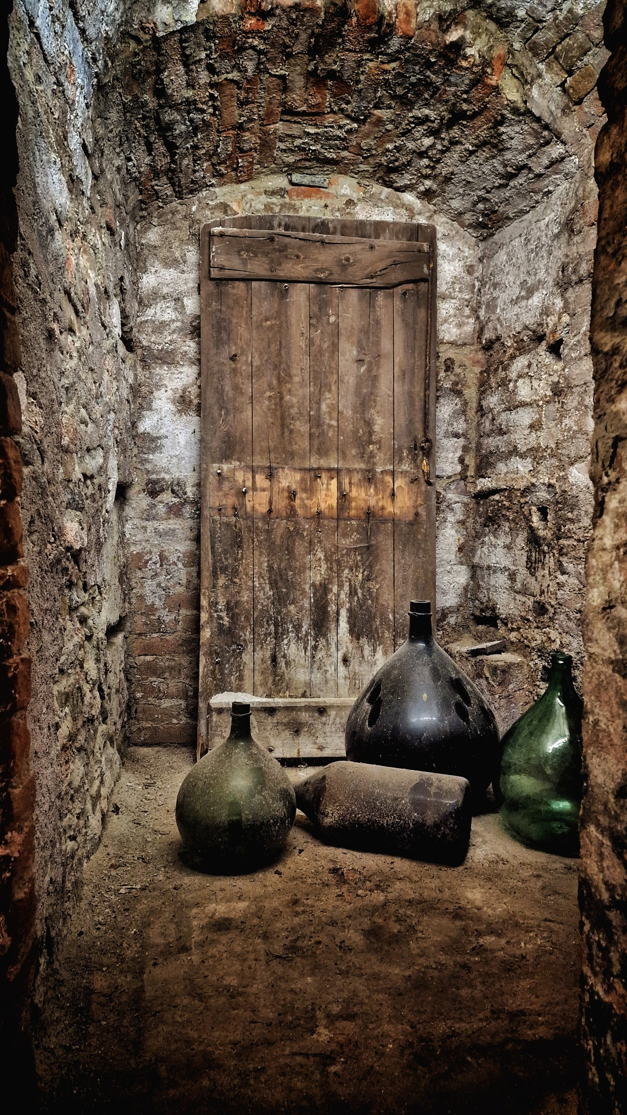
Itinerary Highlights – Day 4
Visit Barbaresco & Neive Villages
- Tour Castello di Neive with lunch & wine tasting
- Explore Neive village
- Afternoon Free Optional activities: yoga, massage, e-bike tour, shopping in Abla
- Themed dinner with a private Chef

Slide 9
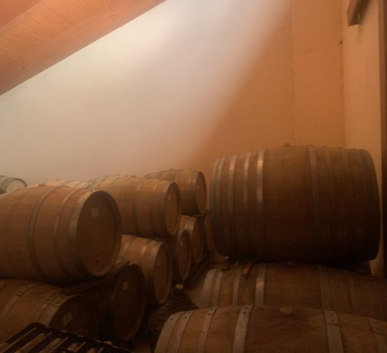
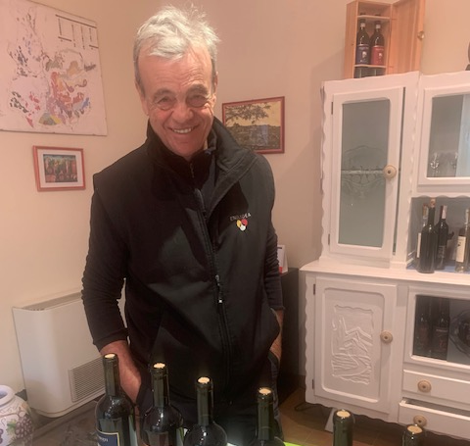
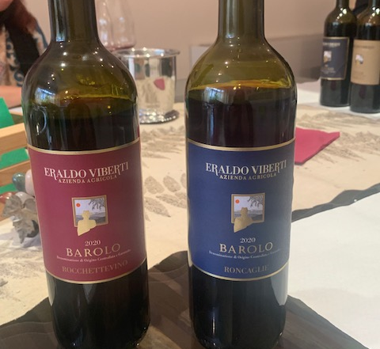
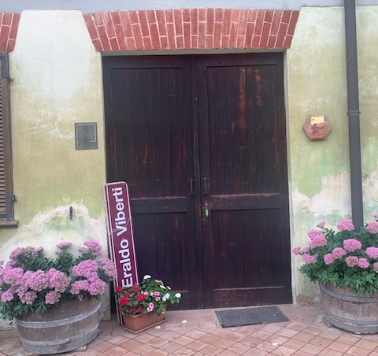
Itinerary Highlights – Day 5
Grand Finale:
Scenic tour of Barolo & La Morra
- Visit Castello di Grinzane Cavour
- Wine tasting at Eraldo Viberti Winery
- Farewell dinner at Locanda in Cannubi

Slide 10
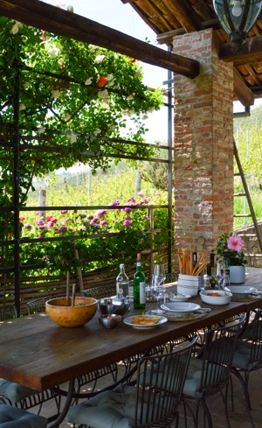
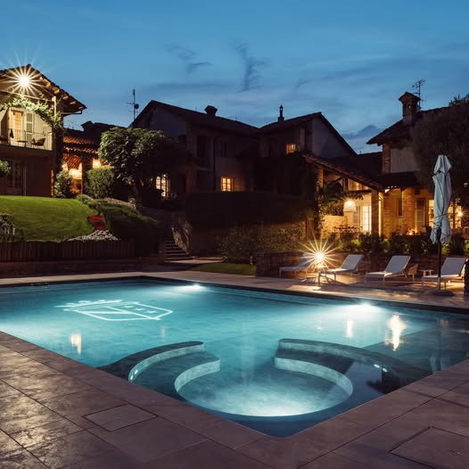
Your Luxury Accommodations
Hotel in Alba or a Private Villa with Vineyard Views
Your group choice:
An upscale hotel in Alba
Elegant private villas with vineyard views
Spacious living areas and full kitchens
Private gardens and pools
Ideal blend of comfort and luxury

Slide 11
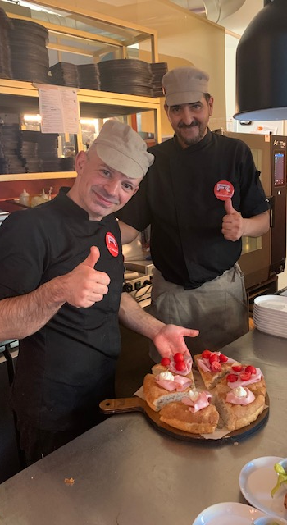
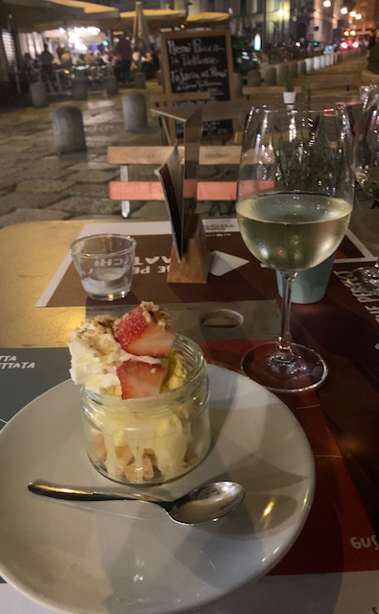
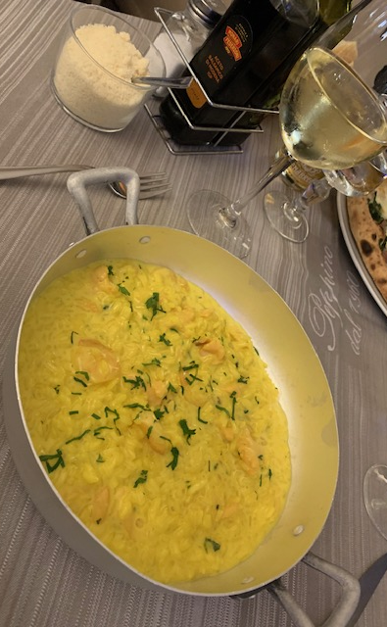
Culinary Experiences
Michelin-starred dinners by Chef Boglione
Hands-on cooking class in a medieval castle
Regional specialties: truffles, cheeses, fresh pasta
Themed culinary evenings with seasonal menus
Wine pairings from top Piedmonte producers

Slide 12
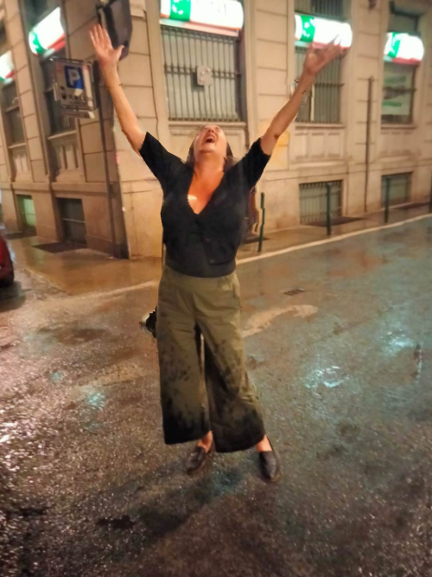

Booking & Contact
Tour Price Includes:
All accommodations, meals, tastings, and transfers between pick up and drop off in Turin, Italy
Expert guides and curated experiences
Contact Gwendolyne to Reserve Your Spot for September
2026, or for a Private Tour for Your Group on Another Date

