Slide 1


Management of facial injuries

Slide 2





Priority
Safe patient life
Delay fracture treatment
Focus on patient general condition

Slide 3










ATLAS protocol for management of trauma
A: airway
B: breathing
C: circulation with control of bleeding D: disability
E: exposure

Slide 4












Airway
Loss of the airway is the most likely cause of death in injury to the face
Immediately clear the lumen of the airway
Maintain airway patency

Slide 5

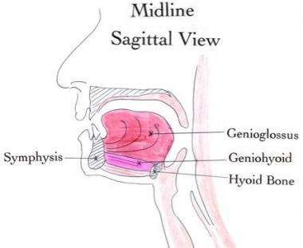
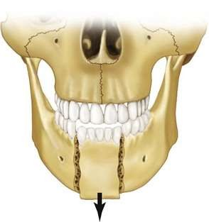

Slide 6

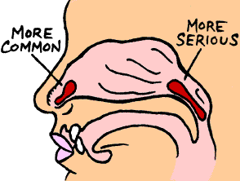
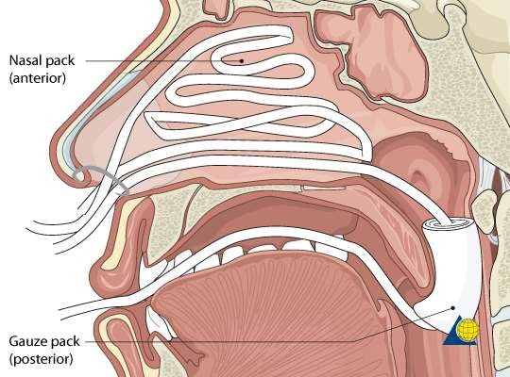

Slide 7

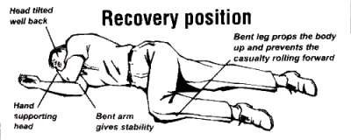

Slide 8

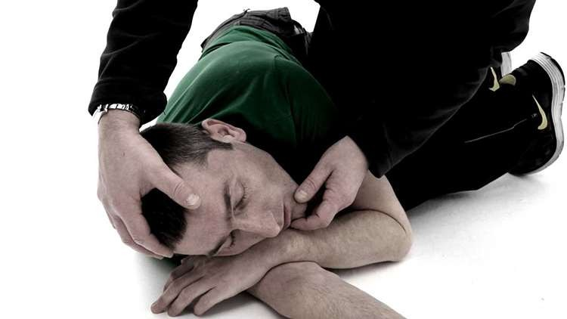

Slide 9



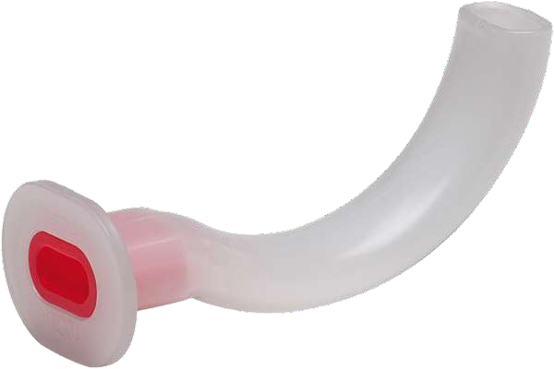
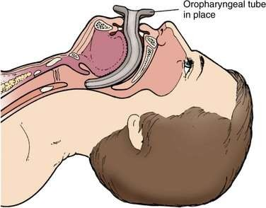
oropharyngeal airway

Slide 10

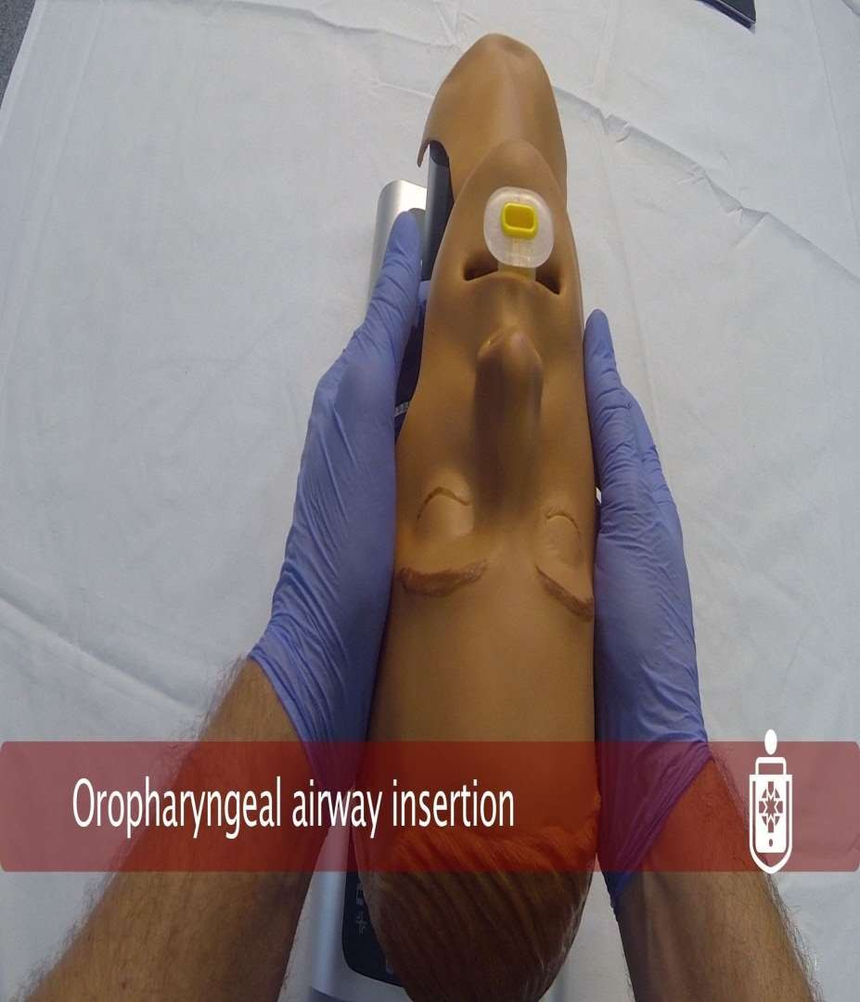

Slide 11

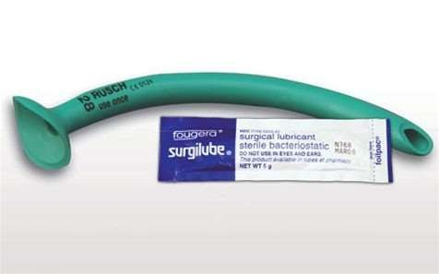
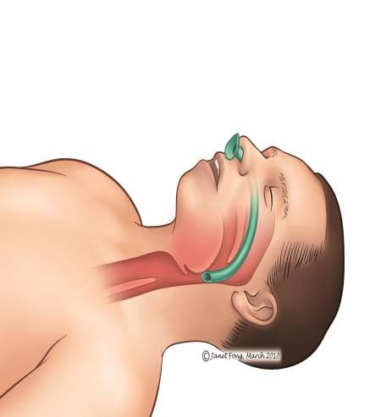
Nasopharyngeal airway

Slide 12






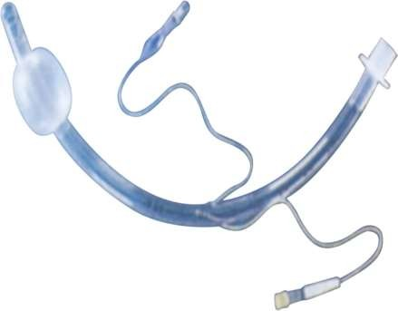
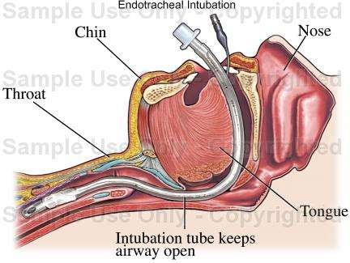
Endotracheal intubation
cuff tube inserted either by oral or nasal route
It is difficult to be placed in conscious patient ,highly distressed and hypoxic , not tolerate it

Slide 13
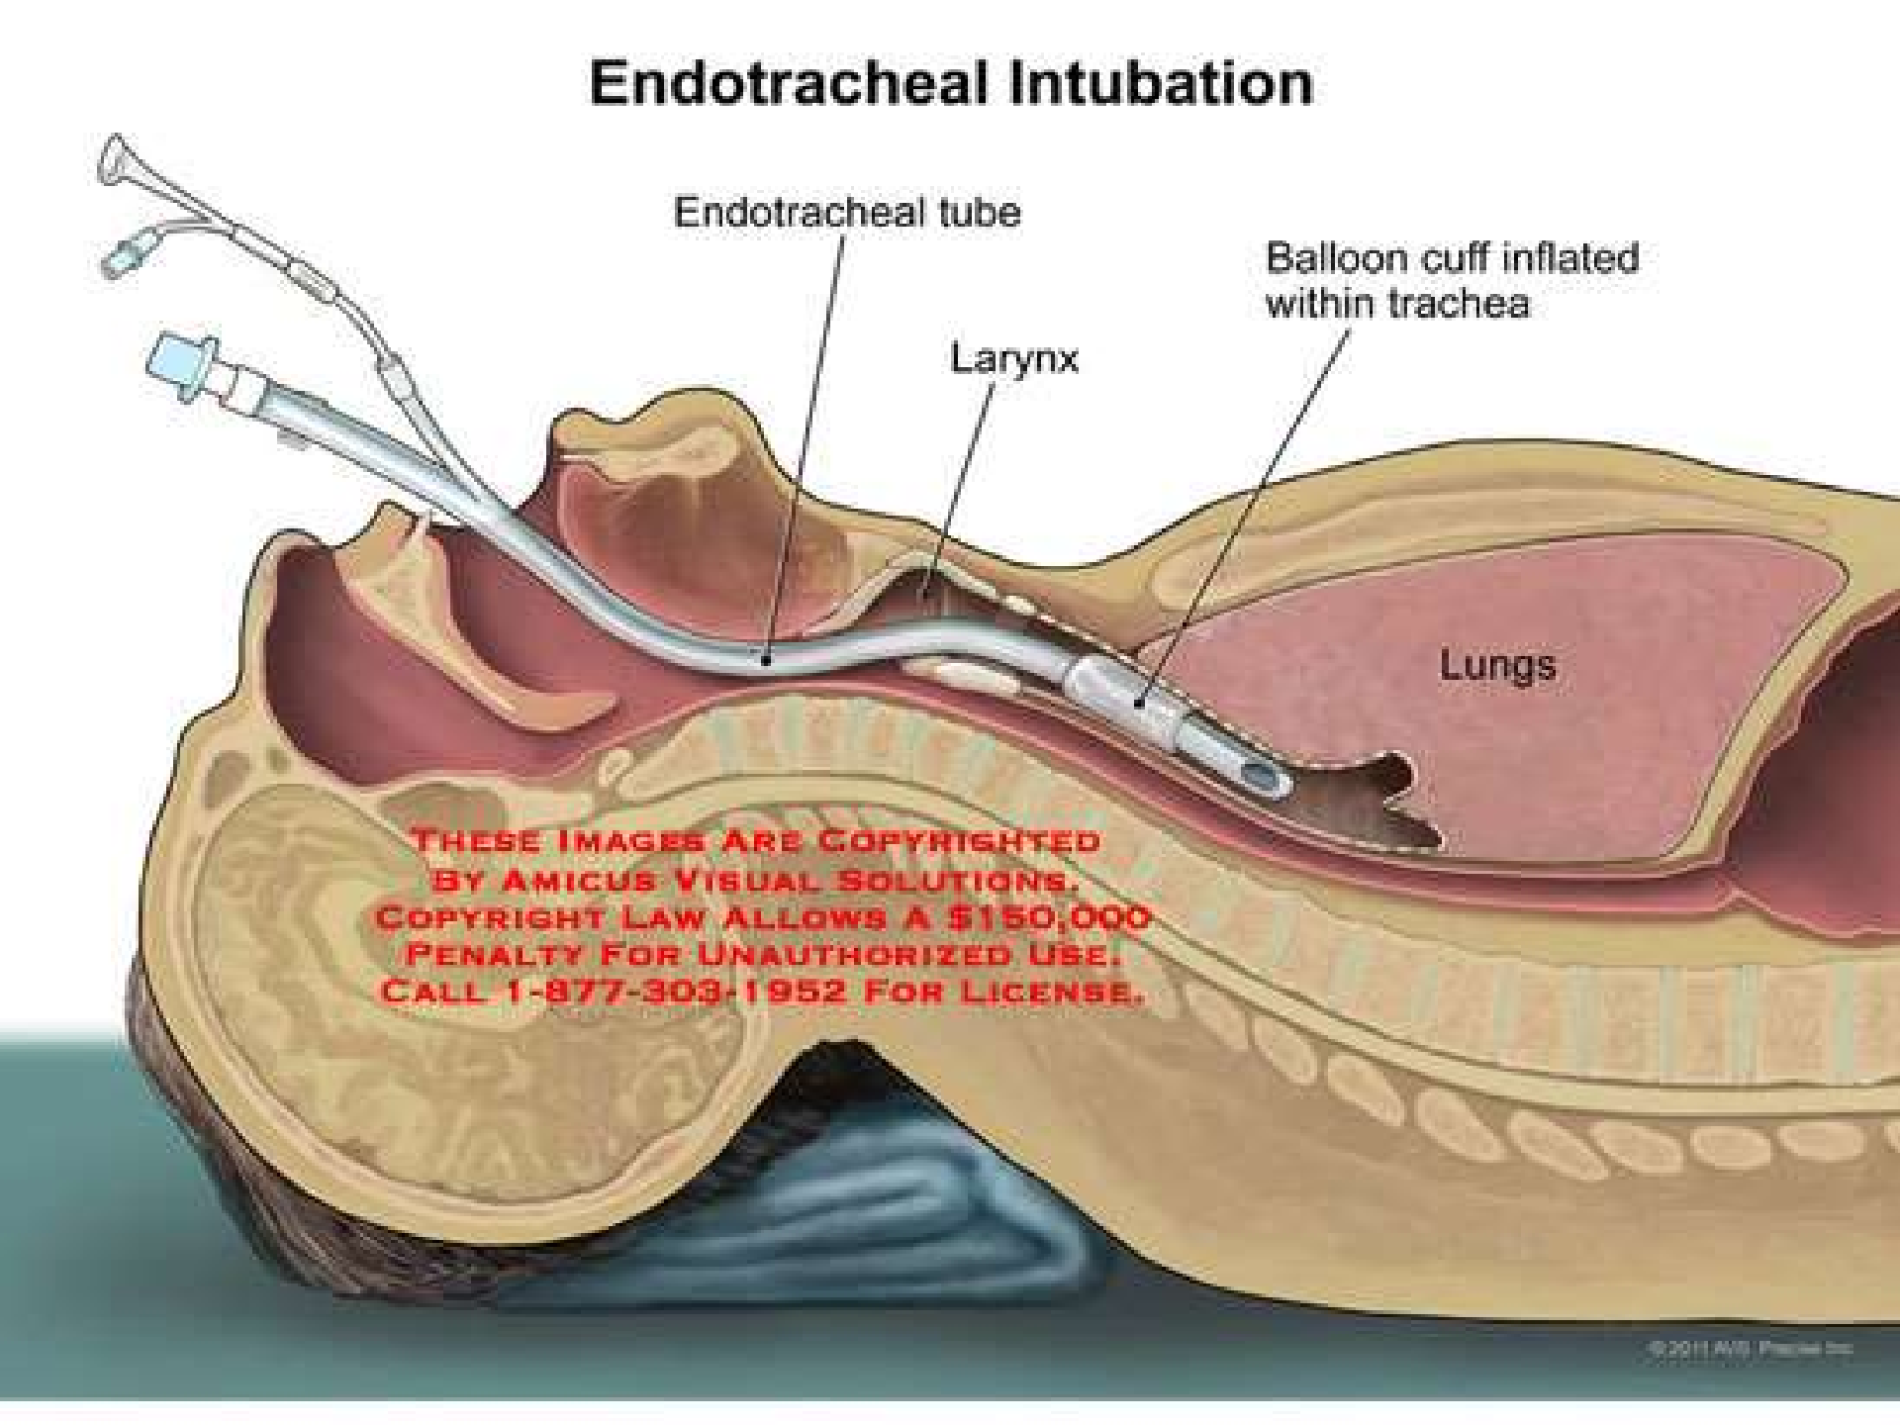

Slide 14
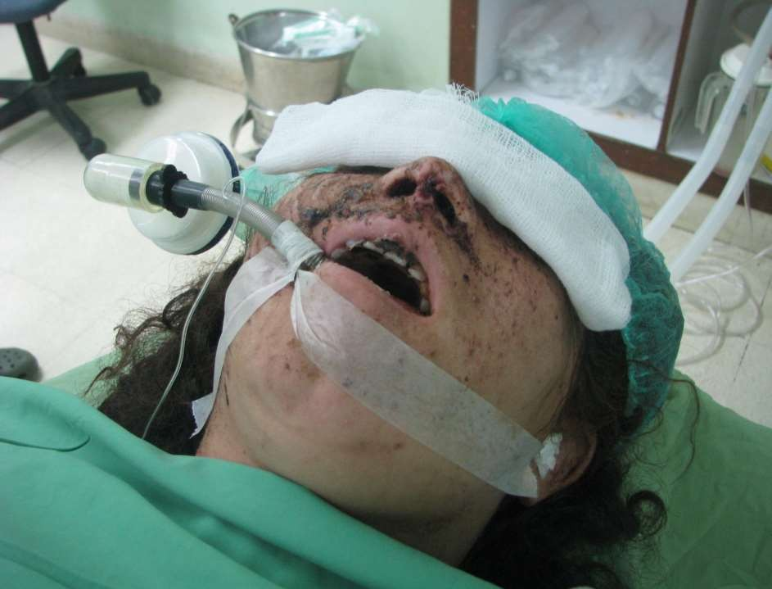

Slide 15

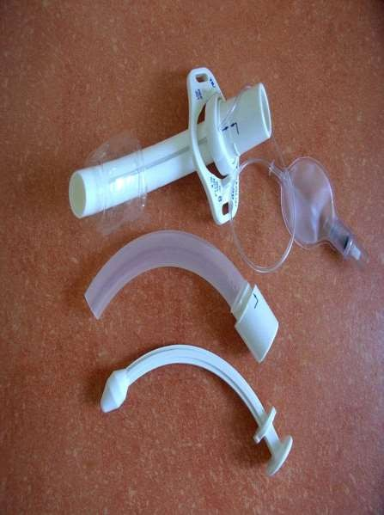
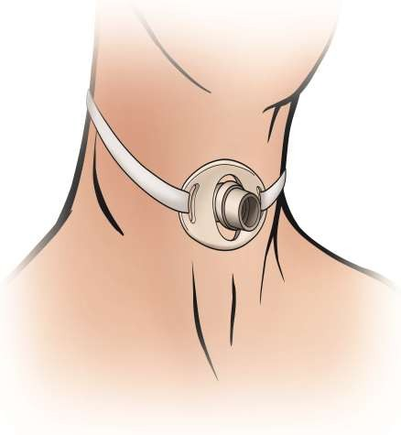
Tracheostomy

Slide 16











Indications of tracheostomy
When prolonged artifacial ventilation is necessary
Facilitate anasthesia in major injuries
Facilitate postoperative recovery
Laryngeal odema
Hemorrhage to the airway

Slide 17









Preliminary examination
Priority in examination
ABC
Head injury
Eyes
Spine
Limbs
Abdomen and chest
Soft tissue lacerations

Slide 18






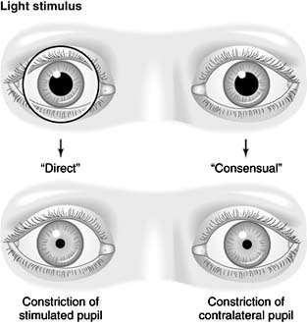
Eye examination
1. visual acuity 2.pupil size
3. pupil reaction

Slide 19









Soft tissue lacerations
In the face its best to sutured early within 1-8 hours (golden hours) before odema
Patient should be stable (priority to general health)

Slide 20

























History and local examination
History can taken from patient if consciouse or from eye witnesses ambulance men if patient unconsciouse
Amnesia indictive of cerebral injury
Retrograde amnesia; failure to remember up to the time of accident
Anterograde amnesia ; loss of memory following the accident
Asking the patient if there is difficulty in breathining ,swallowing or pain else where in the body.
Medications history : insuline ,steroid , anticoagulants
Detailed history taken when the patient can talk comfortably

Slide 21





















Local examination of facial injury
washing the wound with normal saline or gauze, to removed the crasted blood (H2O2) can be used but should be avoided in compound fractures to avoiod emphysema
inspection externally : odema,ecchymosis,lacerations,bony deformity, hemorrhage, CSF leak
palpation : to determine fractures,foreign bodies (tenderness,step deformity ,mobility are signs of fracture)
Examination include skull ,facial bone ,nose ,mandible ,paresthesia
, eye should examine for ecchymosis,lacerations,visual acuity,diplopia…

Slide 22
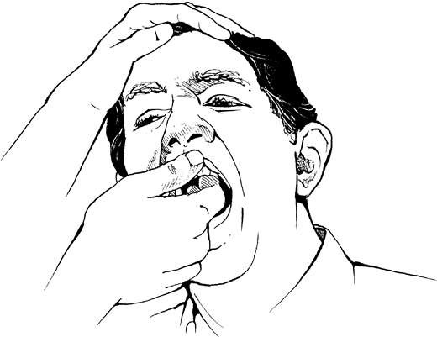

Slide 23
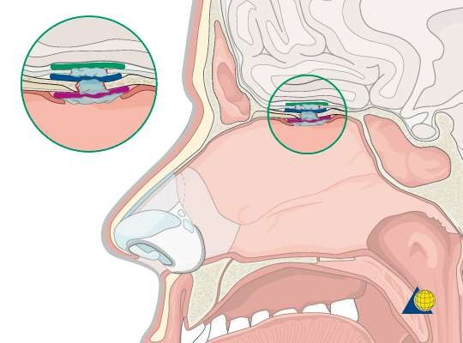

Slide 24

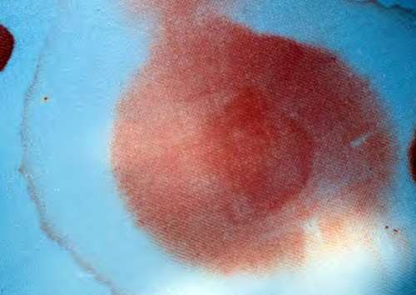
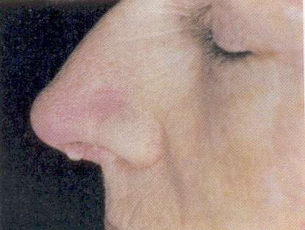

Slide 25
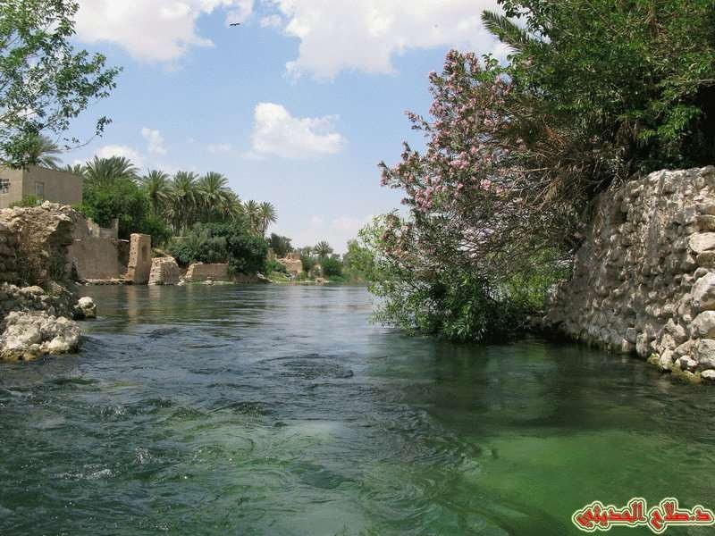



THANK YOU

