Slide 1
Marlow’s Mighty Math
Curtis Marlow Elmore

Slide 2
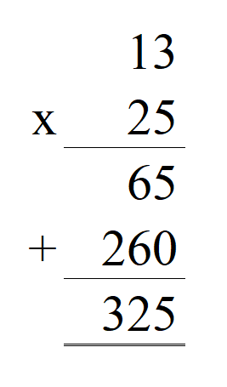
Old Method

Slide 3
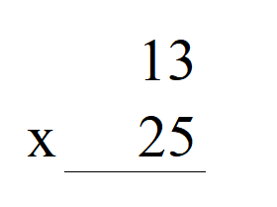
New Method
Stack the numbers

Slide 4
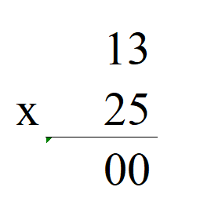
New Method
Write zeros in

Slide 5
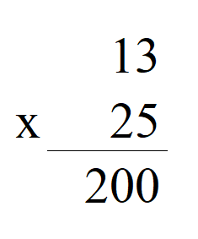
New Method
Write in the product

Slide 6
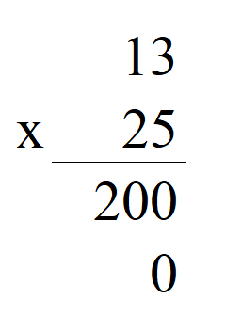
New Method
Write in zero

Slide 7
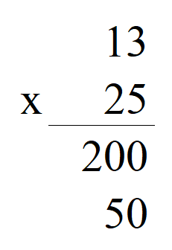
New Method
Write in product

Slide 8
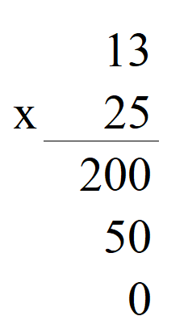
New Method
Write in zero

Slide 9
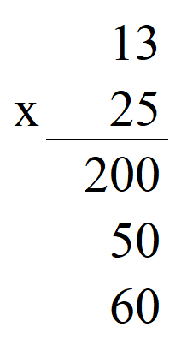
New Method
Write in product

Slide 10
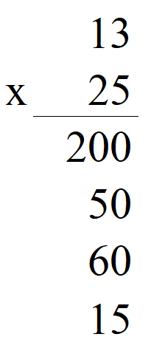
New Method
Write in product

Slide 11
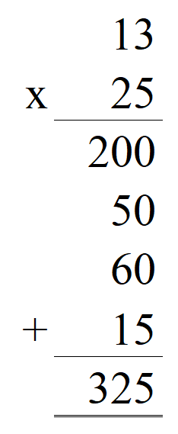
New Method
add

Slide 12
Questions?

Slide 13
Stack the numbers

Slide 14
Write in zeros

Slide 15
Write in product

Slide 16
Write in zeros

Slide 17
Write in product

Slide 18
Write in zeros

Slide 19
Write in product

Slide 20
Write in product

Slide 21
add

Slide 22
Key differences:
Provides a place for every step of the calculation, eliminating transcription errors, and removing the need to hold any numbers in your head, thereby making the calculation easier and more accurate.
Separates the multiplication from the addition, thereby keeping the practitioner focused on one type of operation at a time.
Clarifies the middle product repeatedly showing the times-table numbers to student and teacher.

Slide 23
Benefits:
More accurate
Easier
Faster
times-table numbers
Approximations
Significant digits
Checks at a glance

Slide 24
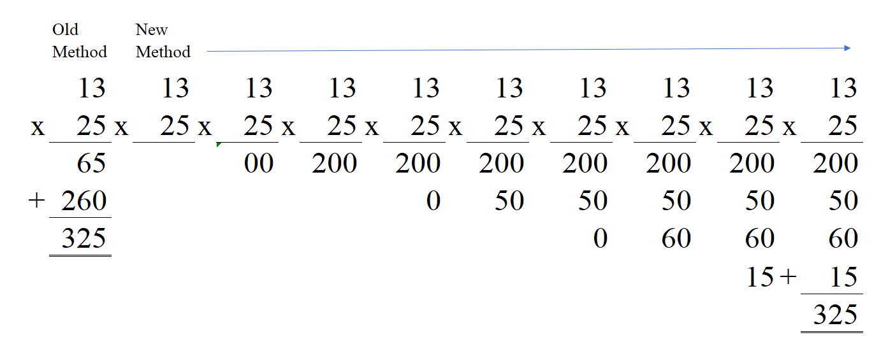
MethodS Compared

Slide 25
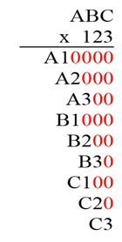
Extended generic form

Slide 26
The 36 times-table numbers
There are only 36 times-table numbers. These are the most important numbers in your life.
1 2 3 4 5 6 7 8 9
1 1 2 3 4 5 6 7 8 9
2 2 4 6 8 10 12 14 16 18
3 3 6 9 12 15 18 21 24 27
4 4 8 12 16 20 24 28 32 36
5 5 10 15 20 25 30 35 40 45
6 6 12 18 24 30 36 42 48 54
7 7 14 21 28 35 42 49 56 63
8 8 16 24 32 40 48 56 64 72
9 9 18 27 36 45 54 63 72 81

Slide 27
The 36 times-table numbers
1 2 3 4 5 6 7 8 9
10 12 14 15 16 18 .
20 21 24 25 27 28 ,
30 32 35 36 1
40 42 45 48 49,
54 56 ,
63 64 , 1
72 1
81 .

Slide 28
Questions?

