Slide 1
Stay Safe
Self-Defense
Level 1

Slide 2
Goal orientated
Movement Based
Civilian Centered

Slide 3
Empowering Individuals in taking personal action

Slide 4
Surviving active shootings
&
Mass shootings

Slide 5
AGENDA
How to Move Quickly
How to Escape Danger
How to Evade Danger
How to Engage Danger
How to Save a Life

Slide 6
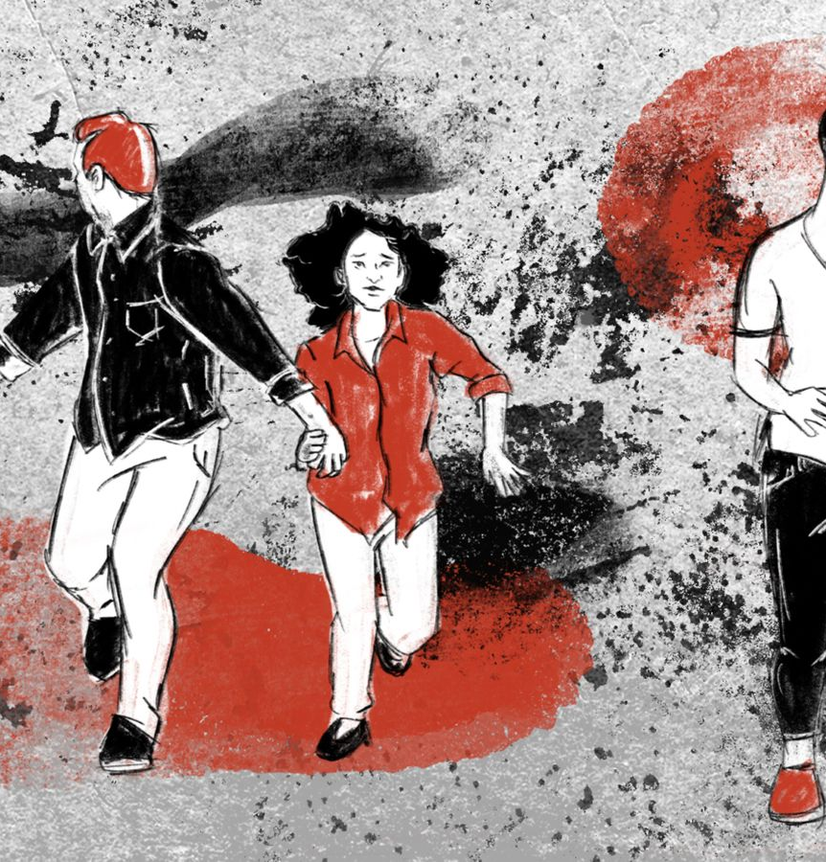
Movement is essential to survival

Slide 7

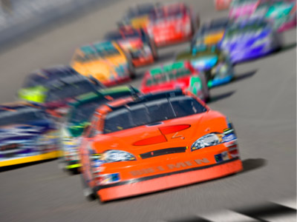
Quick movement vs Fast movement

Slide 8
Relaxation as a tool of movement

Slide 9
Protocol for responding to an Active Violence Event (AVE)
Escape
Evade
Engage

Slide 10
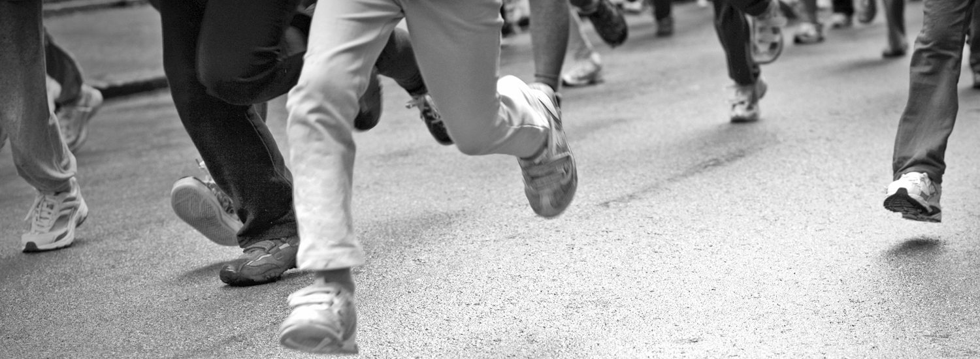
Escape
MOVE TO SAFETY
Know your Exits
Use Buddy System
Move in bursts from safe place to safe place
Check your corners
Use Visual Aids

Slide 11

Escape MOVEMENT DETAILS
Options:
High or Low
Straight or Zig-Zag
Go with the flow but be aware of danger
Go to “Safe Family Location” (Family Responsibility)

Slide 12
Buddy System
Details:
Move with the people around you
2-4 people in group
Hand on Back
Vocal and visual Cues – Examples:
  Go, Go, Go Stop, Stop, Stop
  Hand signals to stop and direction

Slide 13
EVADE
MOVE TO SAFETY
Cover vs. Concealment
Get Low
Disappear
Move from safe place to safe place if you have to go

Slide 14
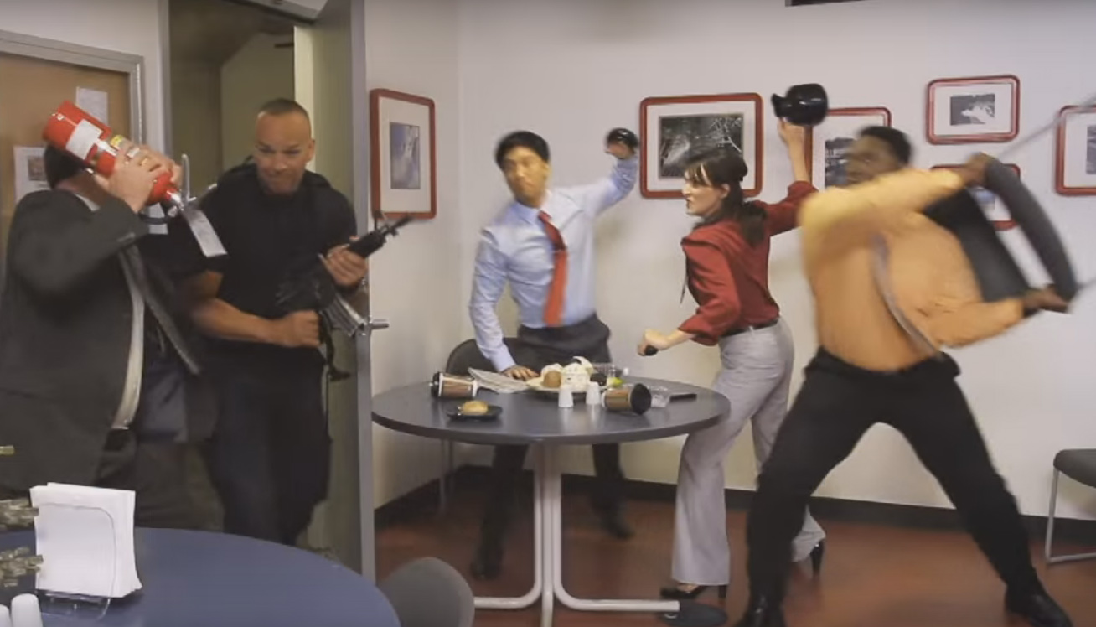
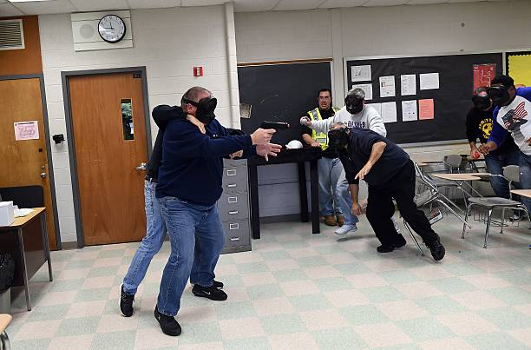
engage
Move off the Line of Attack QUICKLY
Throw and Go
  Anything and Everything
Wrap the Arms above the Elbows
  Pin against your Body
High & Low
  Pressure and Gravity
Attack CNS
  Eyes & Neck
DETAILS
Location, Location, Location
Teamwork
Evade to Engage
Change their Focus
Do Not Focus on the Weapon

Slide 15
Aftermath
FOLLOW ALL POLICE COMMANDS WHEN THEY ARRIVE
DO NOT have any weapon in your possession
Hands up at head
Communicate who is the attacker
PROVIDE TRAUMA CARE
Tourniquets
Pack Gauze
Take Injured with you

Slide 16
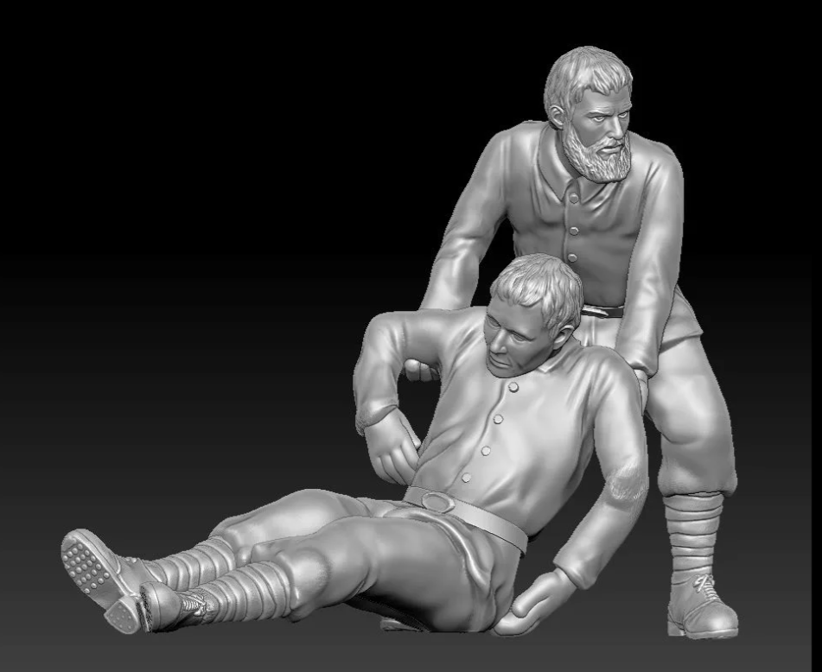
SAVE A LIFE
Stop the Bleed
Tourniquets for Limbs
Cover for Torso Injuries
Gauze Packing
Take the Injured on Evacuation

Slide 17
THANK YOU
Greg McGillen
Stay Safe Self Defense
406-533-8487
www.staysaveselfdefense.com
procountry4@gmail.com

