Slide 1
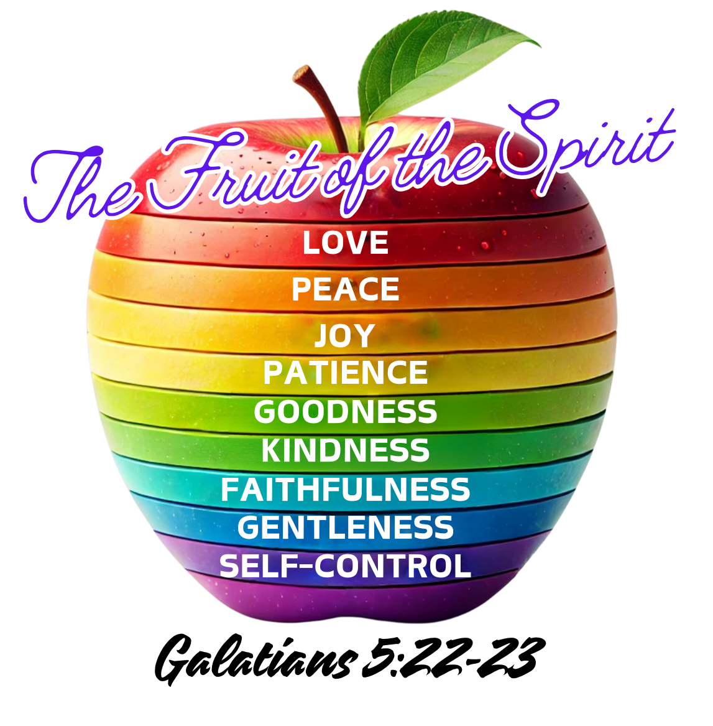
House of David Worship Center Vacation Bible School
Day 3:
Cultivating the Fruit of the Spirit
Galatians 5:22-23
July 2024

Slide 2
Agenda
Worship & Prayer
Fruit of the Spirit Quiz
Fruit of Spirit – Faithfulness, Gentleness, Self-Control
Putting it into Play!
Wrap Up & Take-aways & Prayer

Slide 3
Fruit of the Spirit Quiz - #2

Slide 4
Fruit of the Spirit Quiz - 2
c) Humility
b) The Holy Spirit
b) It reflects the character of God.
b) Peace
False
c) Galatians 5:22-23
b) Helping a neighbor in need without expecting anything in return
b) Stick to a budget & avoid overspending
b) Faithfulness
False
b) By speaking with empathy and care
b) Remaining hopeful and supportive, trusting in God’s timing
c) Pursuing selfish ambitions
False
b) The Holy Spirit empowers believers to live according to God’s will.

Slide 5
Fruit of the Spirit
Galatians 5:22-23
²² But the Holy Spirit produces this kind of fruit in our lives: love, joy, peace, patience, kindness, goodness, faithfulness, ²³ gentleness,
and self-control. There is no law against these things!
Notes:
Not about performance – character

Slide 6
Fruit of the Spirit: Faithfulness
What is Faithfulness?
Notes:
What

Slide 7
FAITHFULNESS: HEBREW WORD - EMET
EMET - translated as Faithfulness or Truth
EMET – has to do with stability & reliability
EMET – Reliable and stable character or trustworthiness
MOSES –when the rock was placed under him to hold up his arms – stability
MOSES – appoints leaders, they are to be people of EMET
Jesus was faithful (EMET) unto the CROSS!
Notes:
Not about performance – character

Slide 8
Fruit of the Spirit: Faithfulness
Faithfulness involves being loyal, reliable, and trustworthy. It reflects a steadfast adherence to promises, commitments, and the truth. Faithfulness means being consistent in your relationship with God and others, maintaining integrity and trustworthiness in all aspects of life.
Notes:
What

Slide 9
FAITHFULNESS: FAITHFULNESS
God is Faithful
His character

Slide 10
FAITHFULNESS: FAITHFULNESS
Lamentations 3:22-23
²² The faithful love of the Lord never ends! His mercies never cease. ²³ Great is his faithfulness; his mercies begin afresh each morning.
Notes:
Abraham considers God trustworthy - 4generation they form the nation of Israel – just as God was trustworthy and faithful to Abraham he will be faithful to your generation.

Slide 11
FAITHFULNESS: FAITHFULNESS
God can be trusted to be consistent to his character!
Notes:
Abraham considers God trustworthy - 4generation they form the nation of Israel – just as God was trustworthy and faithful to Abraham he will be faithful to your generation.

Slide 12
FAITHFULNESS: FAITHFULNESS
FAITHFUL VS. FICKLE
FICKLE means changing frequently, especially as regards one's loyalties, interests, or affection.
Notes:
FICKLE MEANS changing frequently, especially as regards one's loyalties, interests, or affection.

Slide 13
FAITHFULNESS: FAITHFULNESS
Deuteronomy 7:9 NLT
Understand, therefore, that the Lord your God is indeed God. He is the faithful God who keeps his covenant for a thousand generations and lavishes his unfailing love on those who love him and obey his commands.
1 JOHN 1:9 AMP (Memory Verse)
But if we freely admit our sins when his light uncovers them, he will be faithful to forgive us every time. God is just to forgive us our sins because of Christ, and he will continue to cleanse us from all unrighteousness.
Notes:
Abraham considers God trustworthy - 4generation they form the nation of Israel – just as God was trustworthy and faithful to Abraham he will be faithful to your generation.

Slide 14
Fruit of the Spirit: Faithfulness
Reflective Questions:
1. How do you demonstrate faithfulness in your daily life and relationships?
2. Can you recall a time when your faithfulness was tested? How did you respond?
3. How does your faithfulness to God influence your actions and decisions?
4. In what areas of your life might you need to improve your faithfulness?
Notes:
What

Slide 15
Fruit of the Spirit: Gentleness
Description: Gentleness is characterized by a humble, tender, and compassionate demeanor. It involves being kind, respectful, and considerate in interactions with others. Gentleness is not about weakness but rather strength under control, showing care and concern in how we treat people and address conflicts.
Biblical Reference: Philippians 4:5 (NLT) - “Let everyone see that you are considerate in all you do. Remember, the Lord is coming soon.”
Practical Example: Responding to criticism with grace, offering comfort to someone in distress, and handling disagreements with empathy and understanding.
Notes:
What

Slide 16
Fruit of the Spirit: Gentleness
Reflective Questions:
How do you practice gentleness in your interactions with others?
Reflect on a recent situation where gentleness could have been applied. How might it have changed the outcome?
What are some ways you can cultivate a more gentle attitude in your daily life?
How does gentleness reflect the character of Christ in you?
Notes:
What

Slide 17
Fruit of the Spirit: Self-Control
Description: Self-control is the ability to regulate one’s emotions, desires, and behaviors, especially in difficult situations. It involves resisting temptation, exercising discipline, and making choices that align with God’s will rather than giving in to impulses or desires.
Biblical Reference: 1 Corinthians 9:25 (NLT) - “All athletes are disciplined in their training. They do it to win a prize that will fade away, but we do it for an eternal prize.”
Notes:
What

Slide 18
Fruit of the Spirit: Self-Control
Reflective Questions:
In what areas of your life do you struggle with self-control?
Reflect on a recent situation where self-control was required. How did you handle it?
How can practicing self-control impact your relationships and personal growth?
What practical steps can you take to strengthen your self-control in specific areas of your life?
Notes:
What

Slide 19
Fruit of the Spirit Bingo

Slide 20
Questions/Remarks

