Slide 1
Troop 278 – Ahwatukee Parent Information
Troop278.net

Slide 2
Scoutmaster and Assistants Does your Scout need a Scoutmaster Conference? Here is who you need your son to contact:
Randy Derr - Scoutmaster
randerr77@gmail.com ph 480-310-7967
Fraser Elliott – ASM
Mail.fraser.elliott@gmail.com ph 816-309-0322
Chee Lee – ASM
cklee6177@gmail.com ph 480-785-6683
Erik Vijums – ASM
evijums@yahoo.com ph 602-510-3945
Chris Lohman – ASM
chris@southmountaintractor.com ph 602-363-2396
Justin Turner – ASM
archnemysis@gmail.com ph 602-317-2727
ASM’s approve advancement for 1st Class and below

Slide 3
Scout Leadership Positions
SPL, Senior Patrol Leader
ASPL, Assistant Senior Patrol Leader
Historian
Librarian
Quartermaster
Scribe
Patrol Leaders
Troop Guide (bring new scouts to PLC)
Together these positions comprise the Patrol Leader’s Council (PLC)

Slide 4
Troop Committee Committee meetings are once per month and are usually held the 3rd Wednesday of each month with the exception of July due to summer camp.
Alan Tavassoli – Committee Chair
(appoint committee, assure representation at Roundtable, preside over monthly meetings)
Lisa Derr – Chartered Org Representative
(member of district committee, approves adult apps, liaison with Corpus Christi, appoints the committee chair, completes the annual recharter process)
David Diggs – Treasurer
(annual troop budget review, keep financial records, train scribe in record keeping, coordinate FOS, collect and make camp payments)
Guy Brown – Outdoor Coordinator
(promote National Camping Award, work with secretary to assemble medical and insurance binder for scoutmaster to take on outings, works with leadership on camping reservations and yearly calendar)
Allen Hartzell – Advancement Coordinator
(maintains scout records, oversees boards of review, coordinate advancement day attendance, stimulate advancement program, reports unit advancement to Council, gets badges, maintains MBC list, work with scribe to get patrol info, work with librarian, coordinate quarterly courts of honor, meet with District Committee Advancement chair and Council Committee Advancement Chair)
Dana Vijums – Secretary
(take and publish committee meeting minutes, send meeting notices, prepare family newsletter, conduct annual troop resource survey, work with outdoor coord. to assemble medical binder)

Slide 5
Troop Committee cont.
( ) – Membership Coordinator
(smooth transition for new scouts, orientation for new parents, ensure crossover ceremony attendance, plan troop open house and Cub Scout recruitment)
Lisa Derr – Training Coordinator
(encourage youth leadership training, keep troop leadership compliant, introduce training opportunities)
Erika Gronek – Marketing and Website Communication
(keep troop calendar up to date, promote Troop activities online and in newspapers)
Suzie Davis – Fundraising
(coordinate annual fundraisers including Class B shirts, Christmas tree pick-up, popcorn or other BSA-approved sales)
( ) Equipment Coordinator
(work with quartermaster on inventory, proper storage, and maintenance; make periodic safety checks on all troop camping gear, supervise and help the troop procure camping equipment, maintain troop storage locker)
Lisa Derr - JTE Coordinator
(plan and keep track of troop service projects and record hours in JTE database; includes Scouting for Food)
( ) Chaplain
(give guidance to chaplain aide, encourage earning religious emblems, promote participation in/ activity in religious org of choice)

Slide 6
Communications
Website www.troop278.net
Calendar
Photo link – see what you are missing on outings
Forms – permission slips, packing checklists, camp physical
Monthly newsletter - Committee meeting news and upcoming activities
Facebook: Ahwatukee BSA Troop 278
Committee meeting news and upcoming activities
E-blast updates to the Troop – leadership only
(no personal use i.e. your son’s school fundraiser, etc.)

Slide 7
Scouting & Troop Overview
To help build values in young people and in other ways to prepare them to make ethical choices during their lifetime.
The values we strive to instill are based on the Scout Oath and Law. The aim of Scouting is to build character, foster citizenship, develop fitness and confidence, and most importantly have fun!
Troop 278 features an outdoor-oriented program that follows closely the BSA model of a youth-led troop. We plan an outing each month that may include hiking, backpacking, canoeing, skiing, boating, fishing, and of course summer camp.

Slide 8
Leadership & Advancement
Boy-led Troop
SPL & Adult Leadership run an annual planning session
SPL & PLC define weekly meeting details
SPL runs Troop meetings
Many other leadership positions are available to Scouts
Rank Advancement
Happens at a Scout’s own pace – by acquiring skills, demonstrating leadership and service, he moves through a series of ranks all leading to the highest rank of Eagle Scout.
Scout > Tenderfoot > Second Class > First Class
These ranks focus on learning specific Scouting skills
Star Scout > Life Scout > Eagle Scout
These ranks focus on leadership, service, merit badges & elective skills
Once skills are mastered & requirements met, Scouts request a Scoutmaster Conference and then a Board of Review.

Slide 9
Leadership and Advancement cont.
Service projects are non-fundraising service activities for the local community. Hours of service are required for advancement at certain rank levels.
While a Life Scout your Scout must plan and lead others in an approved service project of their choice for their Eagle Scout service project.

Slide 10
Scoutbook
www.scoutbook.com
Scoutbook is an online tool for tracking advancement of scouts in the troop. Leaders can approve completion of requirements, and parents can track progress.
Create a link on your cell phone for easy access
Automatically generates a cc: for parents to ensure no one-on-one contact with scouts.
Parents invite their scout to create a profile

Slide 11
Troop Meetings
Monday Meetings (7 – 8 p.m.)
Flag Ceremony, SPL opening the meeting, announcements
Theme activity for the meeting
Skills
Scoutmaster Minute
SPL closing ceremony retiring the colors
Third Monday of each month is a PLC (Patrol leaders Council)
Youth leadership meets to plan the next month’s activities
No meetings on holidays
Meetings range from skill training, game nights, patrol challenges, boards of review, elections, and courts of honor.
Youth Elections twice per year for troop leadership positions

Slide 12
Outings
At least one troop-specific monthly outdoor/physical activity
Put the OUTING in Scouting
Camping / backpacking / hiking / boating / fishing etc.
Additionally there may be district or other events
Scout O Rama, Advancement Days, Camporees, Service Projects
At least 10 nights of camping per year (BSA goal) following Youth Protection guidelines
Camping Merit Badge requires 20 camping nights
Order of the Arrow membership requires __ camping nights
Every outing for which we travel requires a permission slip (available on our website)
Establishing a purpose, reinforce character development, personal fitness, and skills
Opportunity to use the Patrol Method
Taking care of physical arrangements, equipment, forms binder
Selecting a site. Building a program of activities
Building a program of activities
Nature and advancement skills star hikes
Exploration conservation good turns
Tracking and compass challenges cooking specialties
Environmental awareness

Slide 13
Summer Camp
Camp Geronimo
7 day scout camp north of Payson
Amazing camp experience including merit badge opportunities with camping, hiking, swimming, canoeing, climbing, archery, rifle shooting
Camp Emerald Bay
Catalina Island, every other year
Boundary Waters
Planned by Order of the Arrow
Out-of-state BSA camps (Florida Sea Base, Connecticut June Norcross Scout Reservation)

Slide 14
Merit Badges (see Guide for Merit Badge Counseling)
Merit Badges
Badges are required for advancement (Star, Life, Eagle ranks)
There are over 134 merit badges to choose from
You can find the requirements online at www.meritbadge.org or a link to it on our website
www.scouting.org/merit-badges
The Troop has a library of merit badge booklets. Current copies can be purchased at the Scout Shop for $5 or viewed online
Thirteen Merit Badges specifically required for Eagle Rank, 21 total required to complete

Slide 15
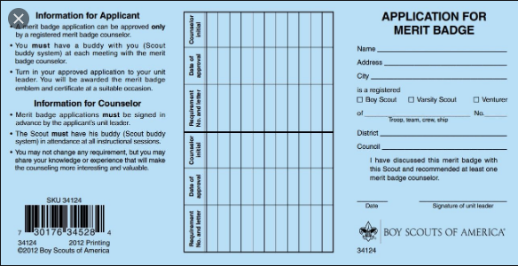
Merit Badge Process
Application for Merit Badge = Blue Card
Not like Cub Scout Belt Loops
Must meet with the Scoutmaster before starting the merit badge
Pick a subject and get a blue card
Then work to complete Badge
Pick a buddy
Call a counselor
Learn
Show your stuff
Get the badge
Return blue card to Scoutmaster when complete for final signature
List of MB Counselors on file with Troop
Council website calendar has merit badge clinics and Merit Badge University sign ups
See www.scouting.org/programs/boy-scouts/advancement-and-awards/ for more details on Advancement Resources and educational presentations
Advancement Days- offered by Gila River District and other districts in the Grand Canyon Council. Check the GCC website calendar for events.

Slide 16
Merit Badge Counselor
Great Adult Volunteer opportunity to….
Share your hobby or work experience
Help our scouts learn about various topics
Register (for free) with the Grand Canyon Council
Complete YPT training and MBC orientation at my.scouting.org (Menu _ my dashboard _ training center _ Boy Scouts and Venturing)
Complete Merit Badge Counselor Information Form
Give app and Information form to training coordinator for submission to Council

Slide 17
Fundraising – Troop Dues
The Troop runs on Scouts paying their weekly/monthly dues
$5 per month
These funds pay for patches, pins, advancements and troop expenses (trailer insurance and storage, equipment storage)
Fundraising is vital to the troop and our only source of income
Ideally hold 1-2 troop-wide fundraisers per year with parent support
Friends of Scouting, Popcorn sales, Christmas Tree Pick-up, Wreaths

Slide 18
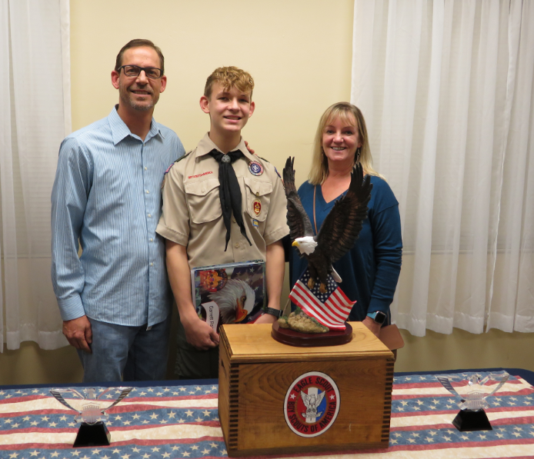
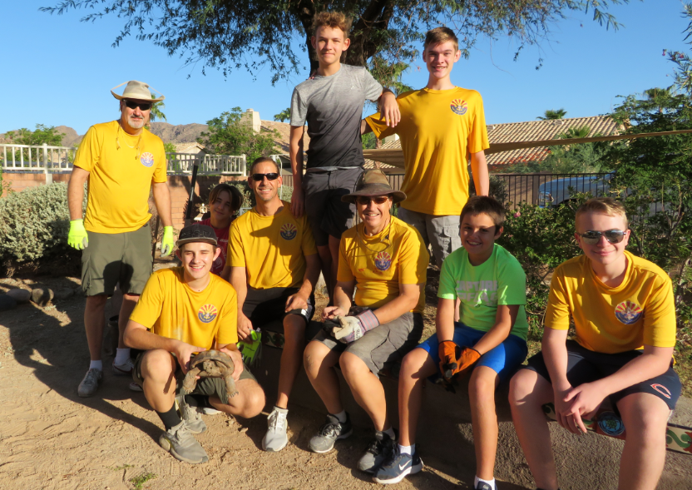
Expectations and Volunteer Support
Garrett in Class A Field Uniform
Expectations for Scouts
Attend the majority of regular troop meetings
Attends at least 4-5 troop activities/events
Support fundraising activities
Have a Class A Uniform and Class B, yellow t-shirt
If you need help acquiring one, please discuss with the Scoutmaster or an ASM
Participate in Patrol Events
Have fun!
Ian in Class B Shirt

Slide 19
Expectations and Volunteer Support
Expectations for Parents
Troop 278 runs entirely on volunteer efforts…we need you!
Parents share car pooling to troop events
Parents volunteer on the committee or other support:
Merit badge counselor
Trip leader or co-leader
Transportation
Trained leadership positions
Camp coordinator
Many more…..

Slide 20
Parent Note Page

Slide 21
Contact Information
Troop 278 is part of the Grand Canyon Council, Gila River District
Grand Canyon Council Service Center
2969 N. Greenfield Rd
Phoenix, AZ 85016
602-955-7747
www.grandcanyonbsa.org
DISTRICT CONTACT INFORMATION
www.gilariverdistrict.org
Tony Clark – Gila River District Executive
602-955-7747 ex. 241
Tony.clark@scouting.org
UNIT COMMISSIONER, DISTRICT COMMITTEE ADVANCEMENT CHAIR, COUNCIL COMMITTEE ADVANCEMENT CHAIR,
NATIONAL WEBSITE
www.scouting.org
Registration database - www.My.scouting.org

