Slide 1
A Complete Game
Improvement System
Improve Distance. Increase Accuracy.
Lower Score.

Slide 2
Where is Your Game?
Tired of “Quick Fix” Solutions That Never Last?
Find Yourself Still Asking:
How Do I Get More Distance On My Drives?
How Do I Get Rid Of This Slice?
Why Is My Buddy’s Game More Consistent Than Mine?
Why Does my Back Hurt After the Round?
Want To Start Practicing Like The PGA Pros?

Slide 3
Some Quick Facts
Fact #1
“Quick Fix” Swing Improvement Products Don’t Produce Lasting Results
Fact #2
Everyone’s Body is Different, and so is Their “Best Possible Swing”
Fact #3
To Truly Develop The Most Efficient Swing YOUR Body can Produce, Schedule a K-VEST Assessment Today

Slide 4
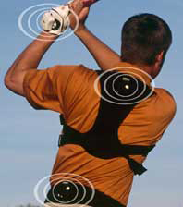
How Can K-VEST Help Me?
K-VEST Uses 3 wireless sensors to Capture Your Golf Swing with the Use of Three Body Sensors
The Program Incorporates Biofeedback
K-VEST Diagnoses Accuracy & Distance Issues
Specifically Designed Improvement Programs will Get Your Body to its Maximum Potential

Slide 5
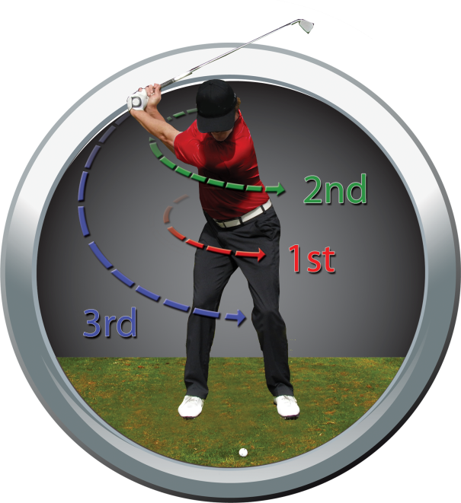
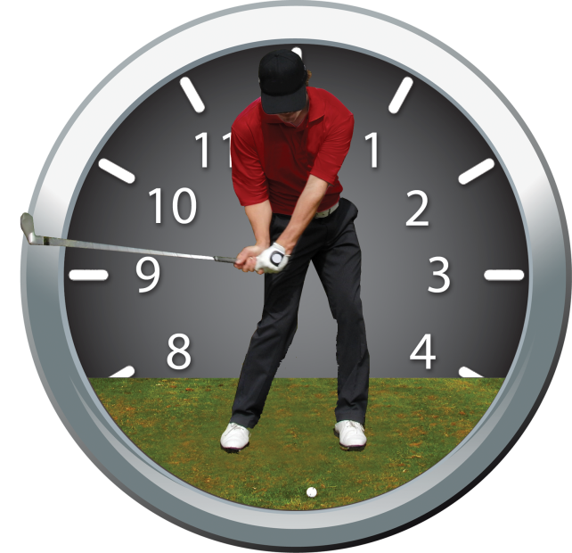
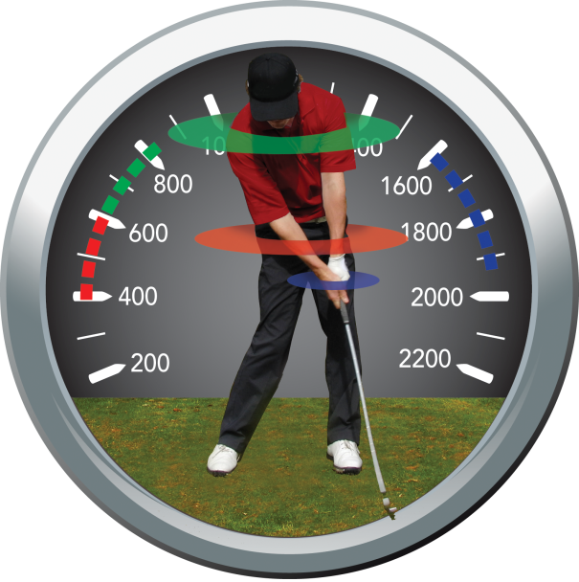
What Does K-VEST Measure?
Swing Efficiency
Swing Sequence Swing Timing Swing Speed
(Accuracy) (Consistency) (Distance)

Slide 6
How It Works
Initial Swing Capture
Wear the vest, line up to a ball, and swing normally
Program captures motion
Your local K-VEST Professional will show you how to swing more efficiently based on the data
Body Posture
Swing Sequence
Swing Timing
Swing Speed

Slide 7
How It Works (continued)
Practice Sessions
A K-VEST Professional sets you in a position tailored to your physical capability
Program synchronizes and lets you repeat exercise on your own
When you get into the correct position- music sounds and animation turns green
Move out of the correct position- music stops and animation turns red
Watch your body move on-screen for instant feedback
Develop an Efficient, Repeatable Swing
to Lower Scores Quickly!

Slide 8
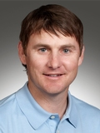
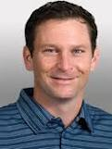
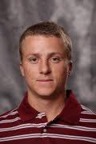
What Tour Pro’s Are Saying…
“I Can’t Image Training Without K-VEST.”
- Heath Slocum, PGA Tour Professional
“This Is The New Trend On Tour.”
- Mark Wilson, PGA Tour Professional
“K-VEST Helped Get Me To The
European Tour.”
- Scott Pinckney, European Tour Player

Slide 9
Schedule Your K-VEST Evaluation Today!
Rob Krieger, PGA
K-VEST Professional
440-339-1183 – cell
rob@sgugolf.com

