Slide 1
Whilst you wait for us to start…
Do you know what a noun is?
Do you know what an adjective is?
Can you recall the numbers 1-50 in Spanish?
What questions and answers did we practise last week?

Slide 2
español @ The Frostery Living, Delph Beginners 1 Introductory Conversation Lesson 3
miércoles 20 de marzo
Sam Doodson
Saddleworth Language School
www.saddleworthlanguagschool.com

Slide 3
Los objectivos….
To recap greetings and introductions
To recap numbers 1-50
To practise numbers 50-100
To learn colours and how they work in Spanish

Slide 4
Empezamos con (Let’s start with)…
Spanish Q&A
Ask your question to someone in the room
Support them with answering (if they need it) using the red sentence starter
Answer their question
Swap cards
Move to someone different

Slide 5
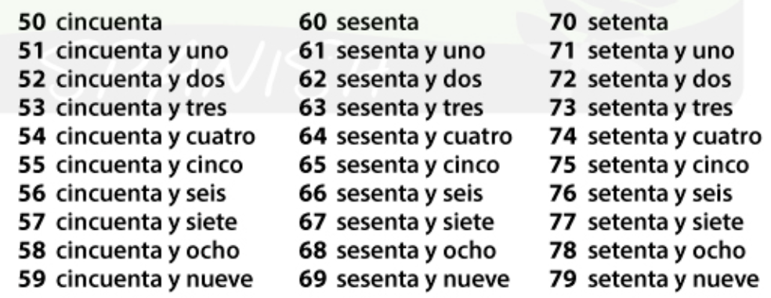

Slide 6
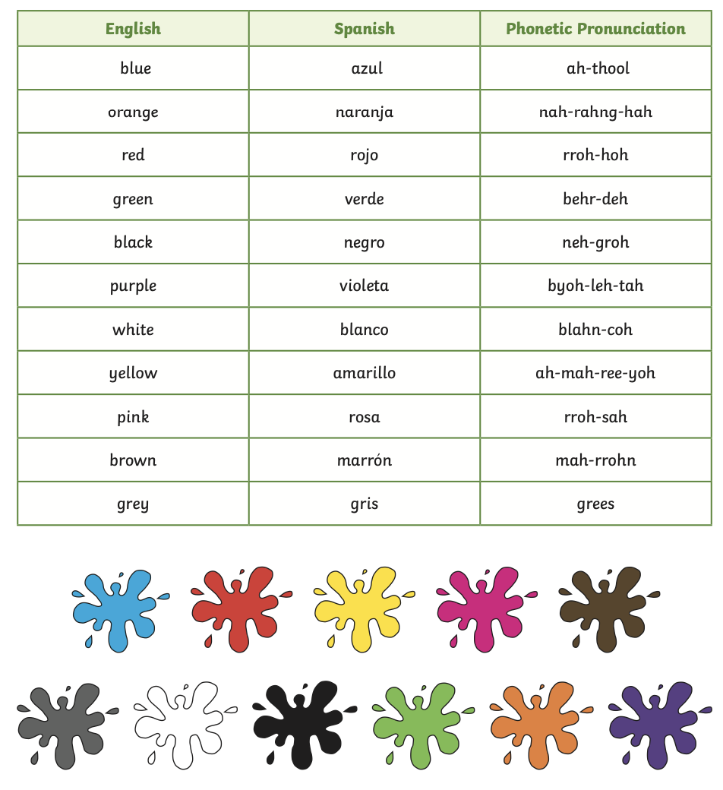
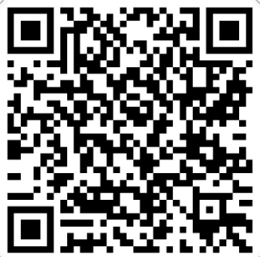
morado – purple
rosado – pink
café – brown
anaranjado – orange
https://open.spotify.com/track/3Xh4kaQAumTW993ETAdACB?si=3e514b426fa5491b

Slide 7
Adjectives and Nouns
Colours are adjectives
In Spanish adjectives work differently to adjectives in English
Firstly they usually come after the noun e.g. una casa blanca (a white house)
Secondly they have a masculine, feminine and plural version
This is because the adjective must match the gender and number of the noun they describe and Spanish nouns have a gender and number!
This is initially hard to get your head around since we do not do this in English. It takes some practise!

Slide 8
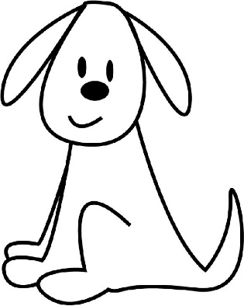
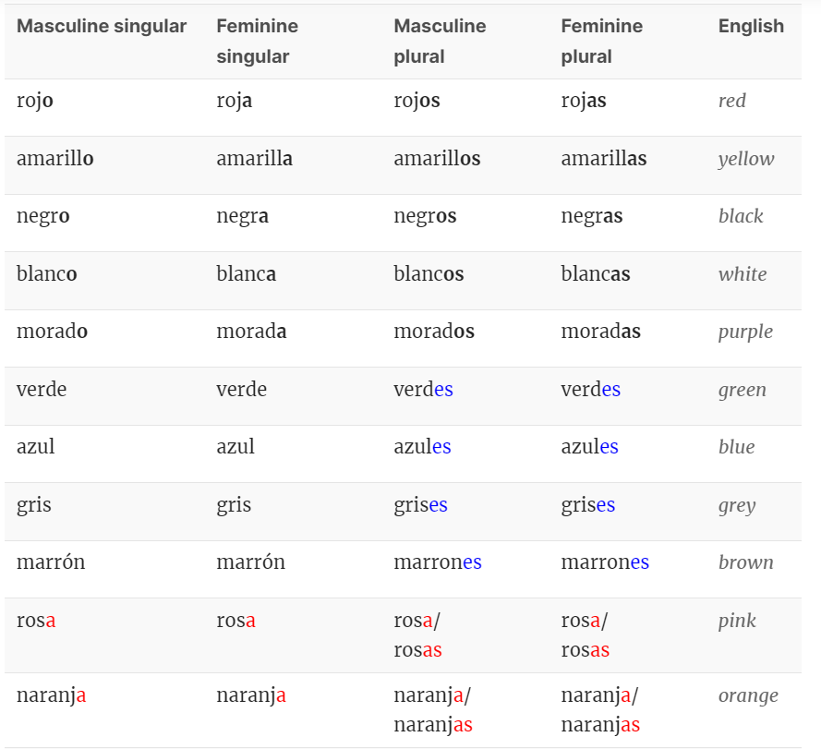
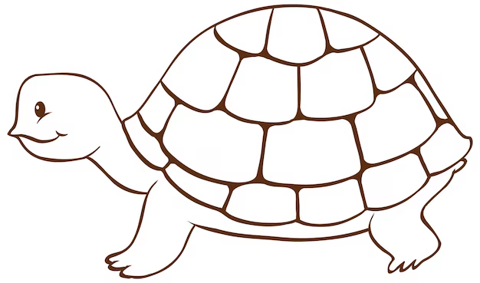
De qué color es el perro?
El perro es blanco.
Es un perro blanco.
De qué color son los perros?
Los perros son blancos.
Son perros blancos.
Las perras son blancas.
De qué color es la tortuga?
La tortuga es morada.
Es una tortuga morada.
De qué color son las tortugas?
Las tortugas son moradas
Son tortugas moradas.

Slide 9
How can we tell if the noun is masculine, feminine or plural?
Look for a clue in the ‘article’ that proceeds it
Many masculine nouns end in ‘o’ and many feminine in ‘a’
Most plurals end in ‘s’
However, there are many exceptions
 | a | the
masculine masc. plural | un unos (some) | el los
feminine fem. plural | una unas (some) | la las

Slide 10
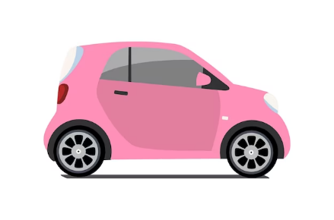
De qué color es el coche?
El coche es
-------------
 | a | the
masculine masc. plural | un unos (some) | el los
feminine fem. plural | una unas (some) | la las

Slide 11
De qué color es la silla?
La silla es
-------------
 | a | the
masculine masc. plural | un unos (some) | el los
feminine fem. plural | una unas (some) | la las

Slide 12
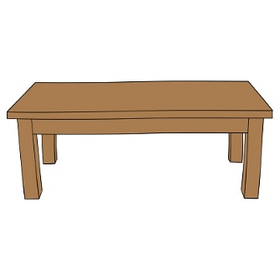
De qué color es la mesa?
La mesa es
-------------
 | a | the
masculine masc. plural | un unos (some) | el los
feminine fem. plural | una unas (some) | la las

Slide 13
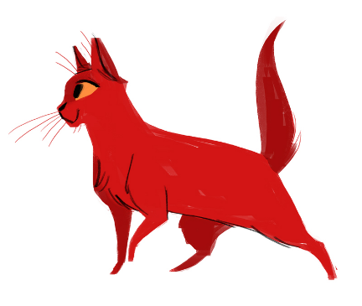
De qué color es el gato?
El gato es
-------------
 | a | the
masculine masc. plural | un unos (some) | el los
feminine fem. plural | una unas (some) | la las

Slide 14
De qué color es la casa?
La casa es
-------------
 | a | the
masculine masc. plural | un unos (some) | el los
feminine fem. plural | una unas (some) | la las

Slide 15
De qué color son las casas?
Las casas son
-------------
 | a | the
masculine masc. plural | un unos (some) | el los
feminine fem. plural | una unas (some) | la las

Slide 16
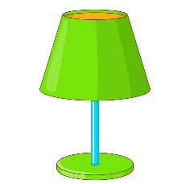
De qué color son las lámparas?
Las lámparas son
-------------
 | a | the
masculine masc. plural | un unos (some) | el los
feminine fem. plural | una unas (some) | la las

Slide 17
To summarise
Numbers sixty and seventy in Spanish are __________ and _________
One hundred in Spanish is _______________
Five colours I remember in Spanish are ________________________________________________________________________________________________________________________________
Colours are adjectives. An adjective describes a ______________
In Spanish nouns and adjectives have a ___________________
Spanish adjective endings change to reflect the gender and number of the noun they describe e.g. blanc_, blanc_, blanc_ _ and blanc _ _

