Slide 1
español @ The Frostery Living, Delph Beginners 1 Introductory Conversation Lesson 1
miércoles 6 de marzo
Sam Doodson
Saddleworth Language School
www.saddleworthlanguagschool.com

Slide 2
Sam Doodson
German and French Studies – The University of Lancaster, PGCE Sheffield Hallam, PGEd Expert Teaching
15 years UK Secondary and primary schools
Saddleworth Language School – making languages accessible to everyone

Slide 3
Adult’s Beginners Spanish
How will you be taught?
A focus on spoken communication with lots of talking, repetition, paired and group talk
Vocabulary memorisation
Grammar explanations and exercises to embed concepts
Suggested (optional) activities & work to do between lessons to make further progress

Slide 4
Adult’s Beginners Spanish
What will you learn?
The aim of the course is to enable you to function in Spanish at a basic level, understand and communicate in Spanish on a number of practical everyday matters.
The course will include;
Greetings, farewells and introductions
Numbers, colours, days and months
Alphabet and Spanish pronunciation rules
Asking for and giving personal information
Jobs and places of work
Nationalities

Slide 5
How many words?
250 words: the essential core of a language. Without these words, you cannot construct sentences. 750 words: those that are used every single day by every person who speaks the language. 2,500 words: those that should enable you to express everything you could possibly want to say, although some creativity might be required. 5,000 words: the active vocabulary of native speakers without higher education. You will understand about 90% of all written text. 10,000 words: the active vocabulary of native speakers with higher education. 20,000 words: the amount you need to recognize passively in order to read, understand, and enjoy a work of literature such as a novel by a notable author.

Slide 6
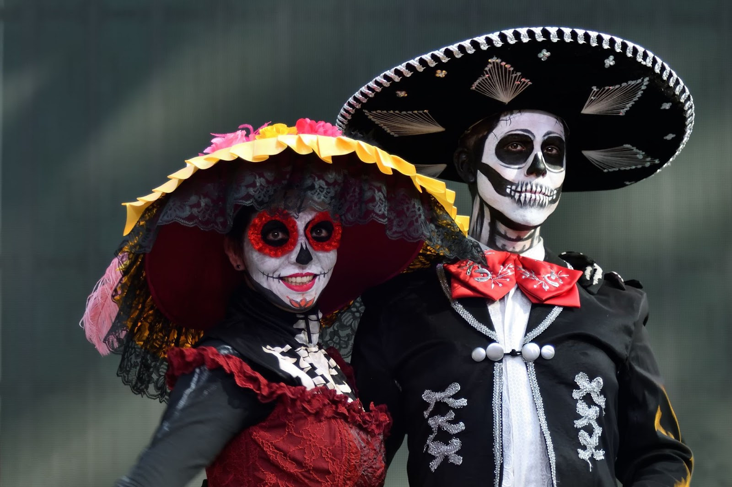
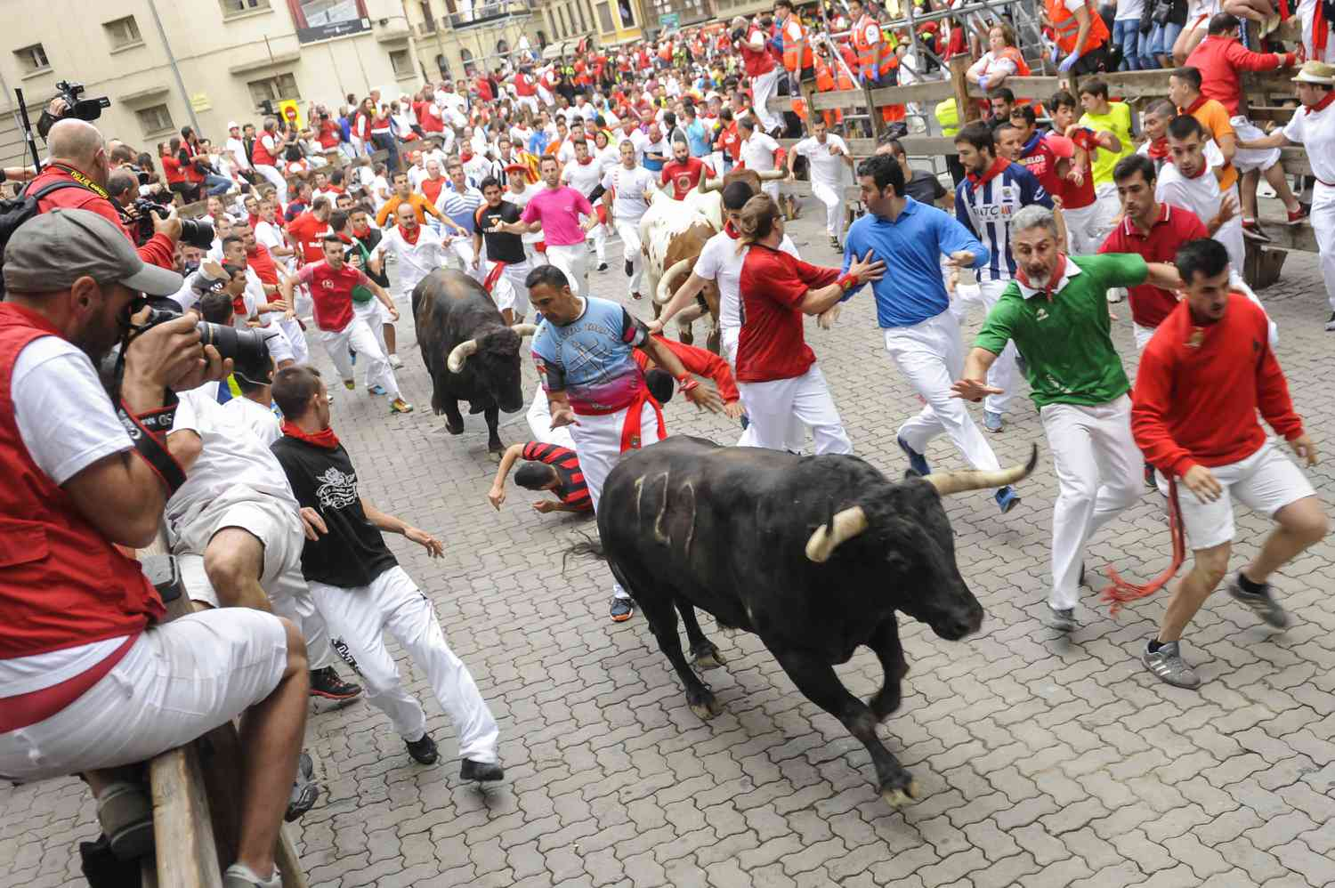
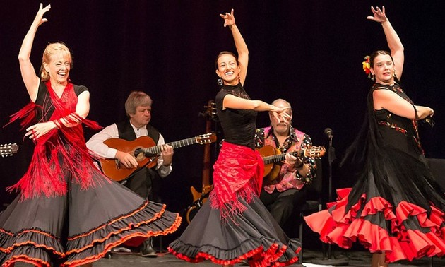
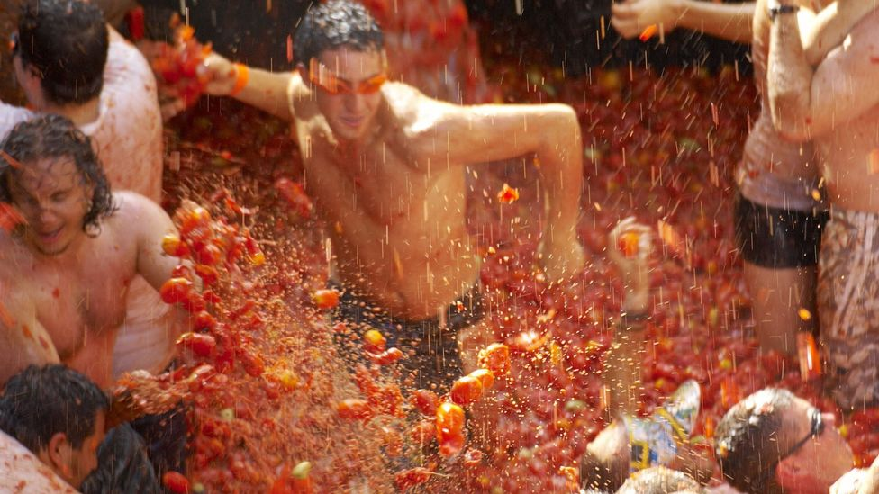
¿Por qué español?

Slide 7
Listening task 1
 | 1 | 2 | 3 | 4 | 5 | 6 | 7 | 8 | 9
Español
Otra lengua
1.Hola, ¿qué tal? !Muy bien, ¿y tú?
2. Bok, kako si? !Jako dobro, i ti?
3. Salut, ça va? !Oui, ça va bien, et toi?
4.Muchas gracias. !De nada.
5. Mila esker. !Ez horregatik.
6. Danke schön! !Bitte, gern geschehen!
7. ¡Hasta luego! !Adiós.
8. Ciao! A presto! !Ciao!
9. Até logo! !Tchau.

Slide 8
Listening task 1
 | 1 | 2 | 3 | 4 | 5 | 6 | 7 | 8 | 9
Español | Yes |  |  | Yes |  |  | Yes
Otra lengua |  | Croatian | French |  | Basque | German |  | Italian | Portuguese
1.Hola, ¿qué tal? !Muy bien, ¿y tú?
2. Bok, kako si? !Jako dobro, i ti?
3. Salut, ça va? !Oui, ça va bien, et toi?
4.Muchas gracias. !De nada.
5. Mila esker. !Ez horregatik.
6. Danke schön! !Bitte, gern geschehen!
7. ¡Hasta luego! !Adiós.
8. Ciao! A presto! !Ciao!
9. Até logo! !Tchau.

Slide 9
Saludos | Despedidas
Hola Buenos días Buenos tardes Buenas noches ¿Cómo estás? ¿Qué tal? | ¡Hasta pronto! ¡Hasta luego! ¡Adiós! Chau

Slide 10
Hola, me llamo Sam.
¿Y tú? ¿Cómo te llamas?
Vivo en Delph.
¿Y tú? ¿Dónde vives?
Bien – good/ well
Así así – okay
Malo - bad

Slide 11
Ana
Victoria
Juan
Valencia
Barcelona
Sevilla

Slide 12
