Slide 1

GSA/Mid-Sized Companies
Quarterly Meeting
July 28, 2025

Slide 2

The Mid-Size Company Challenge
The federal industrial base is shaped much like a martini glass
The BASE represents Small Business
The THIN STEM represents the Mid-size firms
And the LARGE portion of the glass represents Giant Corporations

Slide 3

Background Summary & Problem Statement

Slide 4
BACKGROUND & SUMMARY
Small and mid-sized firms face tremendous difficulties when they transition from small to “other-than-small” and that very few successfully make the transition
Small businesses under the current structure are incentivized to remain small to benefit from government set-asides
There is a lack of empirical data examining the failure or success rate of small businesses exceeding their sizes. Because there is no federally recognized definition of “mid-size”, it is inherently difficult to quantitatively measure the success or failure of transitioning firms.

Slide 5
Defense Industrial Initiatives Current Issues:
Small Businesses
The Defense-Industrial Initiatives Group at CSIS has been looking at these issues from the service-contracting side for the last four years. 2 Some results of our research relate to the Post article, both specific problems with the Federal Procurement Data System (FPDS) and broader policy issues of government contracting to small businesses.
On FPDS, two issues are worth noting:
FPDS Data Integrity Issues
Dynamic Nature of the Data
Set-asides going to the wrong companies
Not only have contracts to large companies been misidentified as ones made to small companies, but small business set-asides were actually entered as having been awarded to large companies. In 2007, $635 million in small business set-asides were classified as awarded to large corporations, up from $486 million in 2005.
Mismatched oversight and enforcement
We cannot tell how much of the problem is data entry error and how much is a real procurement problem. Stricter enforcement of existing regulations is needed requiring agencies to ensure that the data they enter into FPDS is correct and that require companies to report acquisition of small businesses and discontinue all set-aside contracts awarded to them. There is an opportunity for GSA to lead on this issue.
~ Guy Ben-Ari and Greg Sanders
Center for Strategic & International Studies
2 Chao et. al. (2007) Structure and Dynamics of the U.S. Federal Services Industrial Base, 1995-2005, CSIS: Washington, DC, http://www.csis.org/media/csis/pubs/070501_psc.pdf

Slide 6
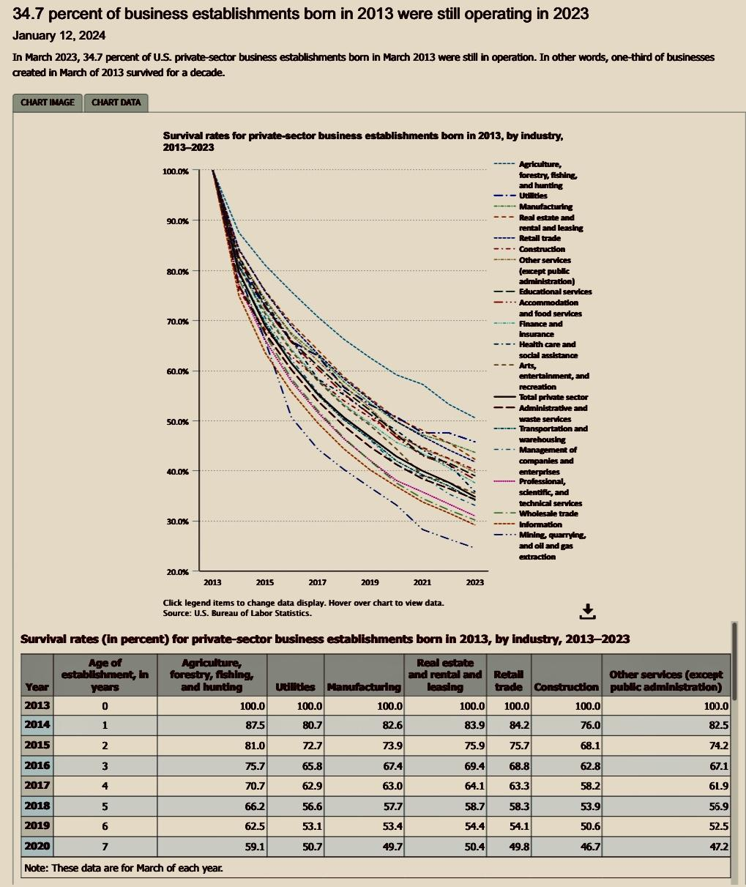
U.S. BUREAU OF LABOR STATISTICS
34.7 percent of business establishments born in 2013 were still operating in 2023
January 12, 2024
In March 2023, 34.7 percent of U.S. private-sector business establishments born in March 2013 were still in operation. In other words, one-third of businesses created in March of 2013 survived for a decade.
Federal contracting data is not included.
Bureau of Labor Statistics, U.S. Department of Labor, The Economics Daily, 34.7 percent of business establishments born in 2013 were still operating in 2023 at https://www.bls.gov/opub/ted/2024/34-7-percent-of-business-establishments-born-in-2013-were-still-operating-in-2023.htm (visited January 27, 2025).

Slide 7
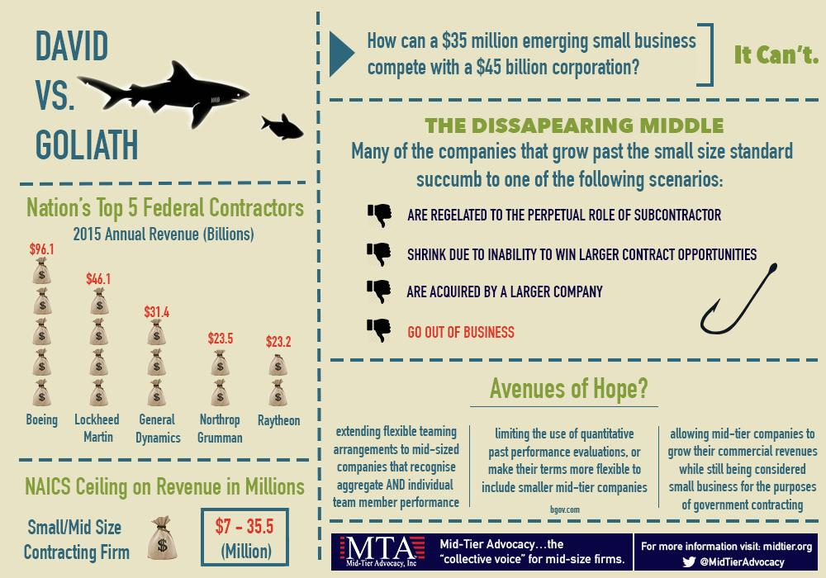
PROBLEM STATEMENT
Concerns of businesses transitioning from the small business designation to “other than small” have been voiced for more than a decade. (Mid-Tier Advocacy was founded in 2010).
As small businesses graduate they are forced to compete with larger enterprises with vastly more established connections, past performance, and resources.
The landscape of government contracting is dominated by consolidation-hungry large corporations on one end of the spectrum and small companies relying on SBA programs on the other. (MTA graphic 2015)

Slide 8
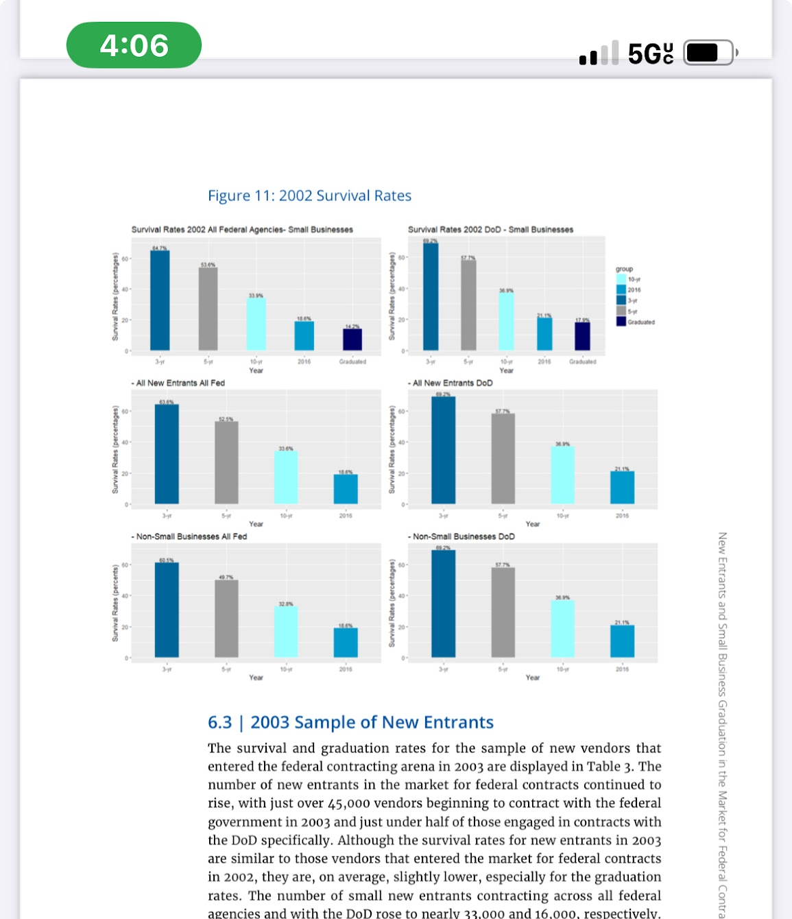
Figure 11: 2002 Survival Rates
While around 60 percent of the 2003 new entrants survive after 3 years, only 30 percent make it to the 10-year mark, and less than 20 percent exist in the market for federal contracts in 2016.
The graduation rates for the 2003 sample of new entrants decreases from previous years where around 12 percent of the small new entrants working with both all federal agencies and the DoD in 2003 graduated from small business status. In other words, less than half of the small new entrants that survived 10 years graduated from small business status.
(Source: FPDS)
The Disappearing Small Business: The survival rates of these two groups are significantly different for 3-year and 5-year; however, there is no statistical support for a difference in survival rates between the two groups for the 10-year or 2016 survival rates. While around 60 percent of the 2003 new entrants survive after 3 years, only 30 percent make it to the 10-year mark, and less than 20 percent exist in the market for federal contracts in 2016.

Slide 9
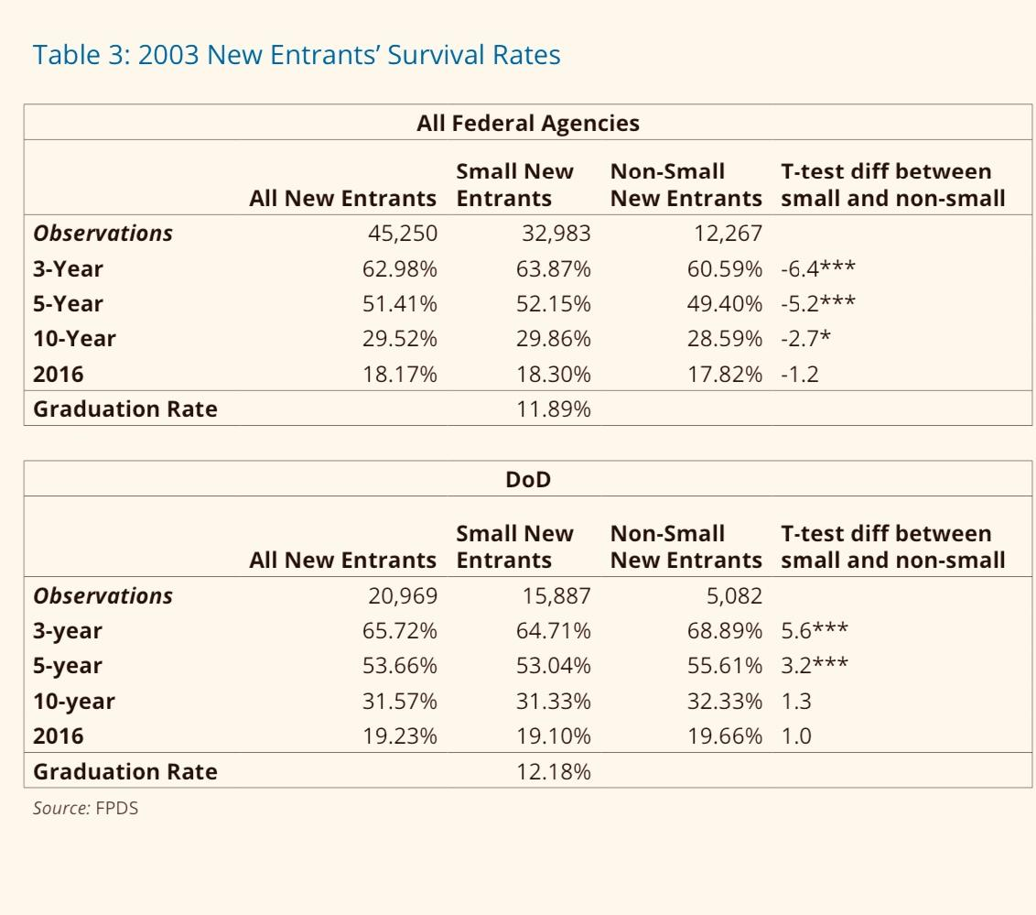

Slide 10
Challenges for Mid-size Companies & Government Agencies
Overall, businesses that grow beyond their SBA size standards are not rewarded for their growth as evidenced by the majority who fail to become large sustainable federal contractors. While it is difficult to precisely study the fates of businesses that no longer win federal awards, it is safe to assume that the majority either left the federal market, terminated operations completely, cut back on operations to intentionally stay small, or implemented some other succession strategy.
Certain procurement strategies also present a challenge. The increase in the use of government-wide contract vehicles and indefinite-delivery, indefinite-quantity (IDIQ) contracts, such as unrestricted IDIQ contracts that have extensive past performance requirements pose the greatest barriers for small and mid-sized firms.
The use of strict past performance qualifications on these contracting vehicles limits the government’s opportunity to realize a return on its investment in emergent small firms and mid- sized businesses.

Slide 11
Opportunities to Collaborate Together
‘Creating Data & Tracking Mid-Size Firms’
Operational Metrics and KPIs for small & mid-size business – as they evolve.
It is a program that earns a participation acknowledgment.
The participants are grouped in evolution tiers.
Purpose: Tracking of these OPM and KPIs could provide insight into goals valued by both (organizations & Agency). Companies can be anonymized through a third-party service. A suggestion: could be different ways of grouping (analytics). For instance: 0-3,4-6,7-10,10+ for smalls, revenue tiers for mid-sized firms.

Slide 12
Back Up Slides

Slide 13

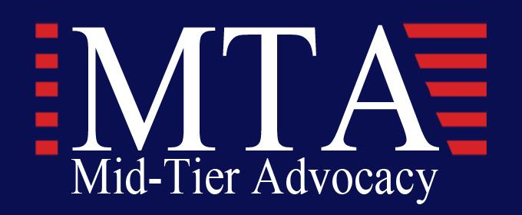
WELCOME
This interchange between GSA and mid-sized companies is intended to be ‘a continuing dialogue.” We welcome everyone to the first in the series of quarterly meetings on topics important to industry, agencies and thought leaders who are gathered here.
About Mid-Tier Advocacy, Inc. (MISSION) Mid Tier Advocacy (MTA) is a 501(c)3 nonprofit leading advocacy organization that has been on the forefront of leveling the playing field for advanced small and mid-tier companies in the federal contracting space since 2010. By briefing Congress and reaching out to federal agencies MTA firms engage in policy discussions that impact business.
About GSA: (MISSION) To deliver the best customer experience and value in real estate, acquisition, and technology services to the government and the American people.
Vision: Effective and efficient government for the American people.
Values: Service, accountability, and innovation.

Slide 14
FAR Rewrite: Key Questions & Mid-Tier Implications
General Impact on Mid-Tier Firms
🔹How will the FAR rewrite address challenges faced by mid-sized firms that have outgrown small business programs but struggle to compete with large primes?
🔹 Will the revised FAR include acquisition policies that explicitly support mid-tier participation in full and open competitions?
🔹 How will GSA ensure that FAR reforms don’t unintentionally exclude mid-sized firms from participation?

Slide 15
Acquisition Strategy & Contract Consolidation
🔹 How will the FAR rewrite affect contract bundling and consolidation practices that reduce opportunities for mid-sized firms?
🔹 Will agencies be required to assess the impact of acquisition strategies on mid-tier businesses during market research and planning?
🔹 Is there support within GSA for a “mid-tier set-aside” or transitional category to help former small businesses remain competitive?
🔹 Will the FAR include guidance to support firms just beyond the small business threshold?
🔹 Are there planned changes to strengthen protections for mid-tier firms in mentor-protégé or joint venture agreements?

Slide 16
: Evaluation Criteria & Best Value
🔹 How will past performance and pricing criteria be addressed to avoid favoring large incumbents?
🔹 Will the FAR encourage best value determinations that account for innovation, agility, and performance—not just size?

Slide 17
Questions for Consideration & Discussion
Starting the Dialogue
In looking at the accounting for small business spending within GSA programs where a designated small business is not the prime, what percentage of the spend credited to going to small businesses is directed through a non-small business prime contractor?
  What aggregate dollar amount does this represent?
  To what degree does GSA rely upon these non-small business primes (emerging companies) to conform to terms of a transparent and accountable small business program with guidelines and oversight?
Looking at the general challenges around teaming
Shouldn’t a prime contractor be required and held accountable to honor the terms of teaming agreements when prior performance of the proposed subcontractor was used to secure a successful award outcome? This addresses workshare and equitable pricing adjustments during the lifecycle of a contract.
  In an effort to provide these small and emerging businesses with deserved recognition around contract performance, should there not be a threshold above which any GSA contract holder is required to provide the qualifying small business subcontractors (mid-tiers) with CPARs, or other recognition acceptable to government, so that it is available for prior performance use, when necessary and required?

Slide 18
Mid-Tier Advocacy Encourages Open Dialogue & Engagement
Your insights and answers help shape a stronger federal contracting ecosystem.

Slide 19
References
13 C.F.R. § 121 (2020)
H.R. Rep. No. 115-939 (2018)
Tonya Saunders cited, The mid-tier paradox: too small to compete, too large to survive, Bloomberg Gov. (May 13, 2016), https://about.bgov.com/blog/the-mid-tier-paradox-too-small-to-compete-toolarge-to-survive/.
See also No Man’s Land: Middle-Market Challenges for Small Business Graduates: Hearing Before the Subcomm. on Contracting and Workforce of the H. Comm. on Small Bus., 115th Cong. (2018), as cited in Meng, F. L. (2021). Challenges Facing Transitioning Federal Small Businesses: A Proposed Framework and Solution, i–47.) (SAME.ORG)

