Slide 1
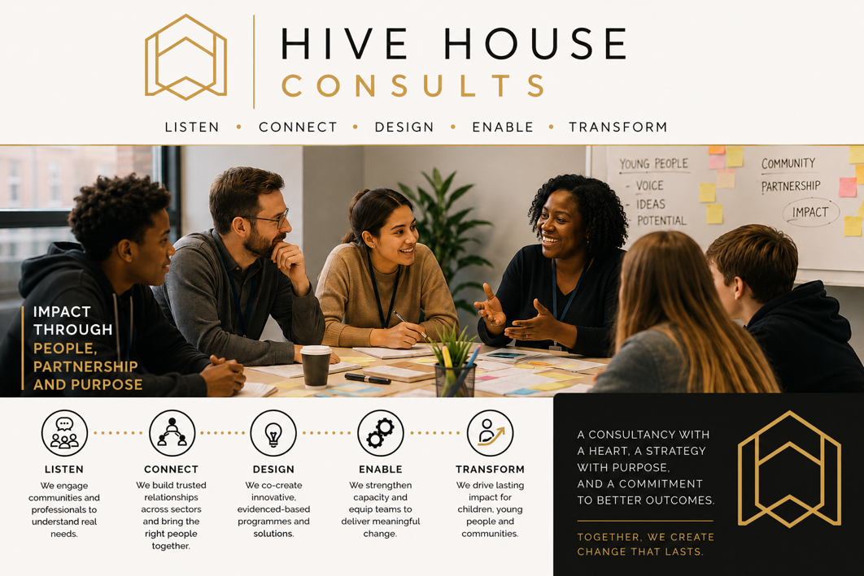

Slide 2
WHO WE ARE
HIVE HOUSE
Hive House Consults
The consultancy and programme development division of the Hive House family. Grounded in our values of compassion, innovation, collaboration and excellence, we bring frontline experience together with strategic thinking to improve outcomes for children, young people, vulnerable adults and families.
OUR EXPERTISE
Rooted in the realities of delivery
WHO WE WORK WITH
Partners across the system
OUR APPROACH
Collaborative and evidence-informed
Residential childcare, trauma-informed practice, family justice and children's social care, SEN, therapeutic interventions, safeguarding, youth development, early intervention and criminal justice.
Local authorities, schools and colleges, alternative provision, charities, health services, criminal justice partners, housing and supported-living providers and community organisations.
We listen first, bringing together professionals, communities and the people who use services to build practical, solutions-focused change.
Listen • Connect • Design • Enable • Transform
Impact through people, partnership and purpose.

Slide 3
WHO WE SUPPORT
HIVE HOUSE
The people behind the programmes
Vulnerability arises at different stages of life and through many circumstances. Our programmes and consultancy support a diverse range of groups, with a focus on prevention, early intervention and lasting change.
Children and young people in care
Care-experienced young people and care leavers
Vulnerable adults and young people moving to independence
Children and young people with SEND
Young people excluded from or at risk of leaving education
Young people and adults who are NEET or at risk of becoming NEET
People at risk of offending, reoffending or antisocial behaviour
Children and young adults vulnerable to criminal or sexual exploitation
Individuals affected by trauma, abuse or adverse childhood experiences
Young parents and families requiring additional support
People experiencing social isolation or barriers to participation
Support with life skills and progression
Communities experiencing inequality or deprivation
Every programme is tailored to the organisation, individuals and community it serves.

Slide 4
WHY IT MATTERS
HIVE HOUSE
Vulnerability does not fit neat boundaries
Vulnerability does not end at a particular age, nor does it sit within the boundaries of a single service. Challenges overlap, and they intensify at moments of transition.
OVERLAPPING NEED
Challenges rarely arrive alone
MOMENTS OF TRANSITION
Gaps open when support matters most
RISING COMPLEXITY
Services need a confident workforce
— Trauma and care experience
— SEND and educational exclusion
— Exploitation and offending
— Unemployment and housing instability
— Care to independence
— Education into employment
— Children to adult services
— Support often lost in the move
— Recognising emerging need
— Understanding behaviour
— Managing risk and safeguarding
— Building trusted relationships
Hive House Consults helps bridge these gaps.

Slide 5
HOW WE HELP
HIVE HOUSE
Bridging the gaps
We work with organisations to develop both the services people need and the workforce that delivers them — through consultancy, programme design, training and workforce development.
01
02
03
Respond earlier
Identifying emerging needs and opportunities for prevention and early intervention
Understand complexity
Recognising how trauma, SEND, exploitation and disadvantage intersect
Strengthen the workforce
Developing confident, skilled and resilient professionals
04
05
06
Connect services
Effective partnership and multi-agency working around the individual
Build sustainable capability
Embedding knowledge and practice rather than one-off interventions
Improve outcomes
Pathways to safety, wellbeing, education, employment and independence
Better equipped people. Stronger services. Lasting impact.
Creating the conditions, services and skilled workforce that enable people to thrive.

Slide 6
WHAT WE DO
HIVE HOUSE
Programme design and innovation
Bespoke programmes built on evidence-informed practice, therapeutic principles and measurable impact.
01
02
03
04
SEN and SEMH
Programme design for special educational and mental health needs
Trauma-informed
Interventions grounded in trauma-informed practice
Therapeutic and creative
Engagement through creative and therapeutic methods
Community music
Music and creative arts initiatives rooted in community
05
06
07
Youth diversion
Crime prevention and diversion programmes for young people
Employability
Life skills and independent living pathways
Social inclusion
Community engagement and social inclusion projects

Slide 7
HOW WE SUPPORT TEAMS
HIVE HOUSE
Workforce development
Training, coaching and consultancy that strengthen the knowledge and practice of those working with vulnerable children, young people and adults.
Trauma-informed practice
Embedding understanding of trauma across everyday practice
Reflective practice and supervision
Professional supervision that sustains good practice
Safeguarding and child protection
Confident recognition, recording and referral
Leadership and service development
Building capability and direction across services
Working with complex behaviours
Responding to distress and challenge with skill
Multi-agency collaboration
Working effectively across organisational boundaries
Exploitation and county lines
Contextual safeguarding and extra-familial harm
Strong services are built on confident, skilled professionals.

Slide 8
EARLY INTERVENTION
HIVE HOUSE
Supporting at-risk groups
Early intervention and prevention for children and young people at risk of exploitation, offending, exclusion or poor life outcomes.
RISK
Where young people are at risk
OUR APPROACH
Positive alternatives we provide
OUTCOMES
What young people build
— Exploitation and county lines
— Offending and antisocial behaviour
— Exclusion from education
— Poor long-term life outcomes
— Creative and music-based engagement
— Therapeutic, trauma-informed support
— Educational and skills pathways
— Trusted relationships with adults
— Resilience in the face of pressure
— Confidence and self-belief
— Aspiration and clear next steps
— Sustained positive choices

Slide 9
OUR COMMITMENT
HIVE HOUSE
People at the centre of everything we do
As part of the Hive House family, our commitment remains the same: to place children, young people and vulnerable adults at the centre of everything we do.
IN PARTNERSHIP
Residential homes, local authorities, schools, colleges, justice and community partners
SERVICES THAT LAST
Preventative, compassionate and sustainable
We work alongside partners rather than apart from them, shaping services around the people they serve.
Early intervention and practice that holds up in the real world, delivering long after a project ends.
Hive House Consults is more than a consultancy — it is an extension of our mission to improve lives, strengthen communities, and create opportunities for every child, young person and vulnerable adult we support to reach their full potential.

