Slide 1
CAC Meeting 1/9
Futures Explored
January 9
2026

Slide 2
Content
1
Rally and Legislative Breakfast
2
History of Developmental Disabilities
Futures Explored
January 9
2026

Slide 3
Icebreaker
How was your New Years?
Futures Explored
January 9
2026

Slide 4
Rally at the Capitol
West Steps Capitol, Sacramento
9:30-3:30
Wednesday, January 14
Futures Explored
January 9
2026

Slide 5
Focused on the impacts of the Big Beautiful BIll and how this could affect services
There will be a rally and some speeches in the morning
Afterwards, there will be time where groups will meet with legislators and talk about the importance of regional center services
Register Here!
Futures Explored
January 9
2026

Slide 6
Legislative Breakfast
January 30
10-12
UC Berkeley
Ed Roberts Campus
3075 Adeline Street
Futures Explored
January 9
2026

Slide 7

Will feature I/DD panelists who will talk about the services provided and their importance and impact
Meet representatives of elected officials
Some drinks will be provided
Register Here
Futures Explored
January 9
2026

Slide 8
Would anyone be interested in either of these events?
Futures Explored
2026
January 9

Slide 9
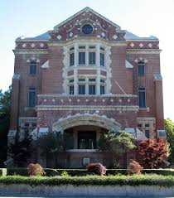
Consumer Action Committee
History of Developmental Disabilities System
Many people with disabilities were originally placed in institutions (state hospitals) because disability was seen as an illness
In 1955, 8500 people were in institutions

Slide 10
President John F. Kennedy, who had a sister with intellectual disabilities, called for more to be done by the government about disability

Slide 11
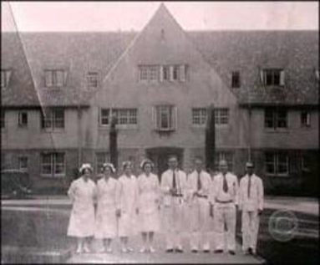
In 1963, a social worker visited one of the California hospitals and stated that the conditions were the worst they had seen
An expert from Denmark who saw Sonoma State hospital said they would not treat cattle the way that people were treated

Slide 12
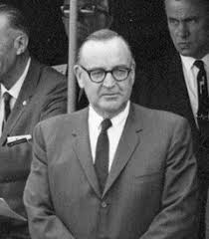
There are more than 12,000 people in the state hospitals
In California, Governor Pat Brown asked the Department of Mental Hygiene what was needed and they said more institutions
But parents said that they wanted life of value for their children, not more institutions

Slide 13
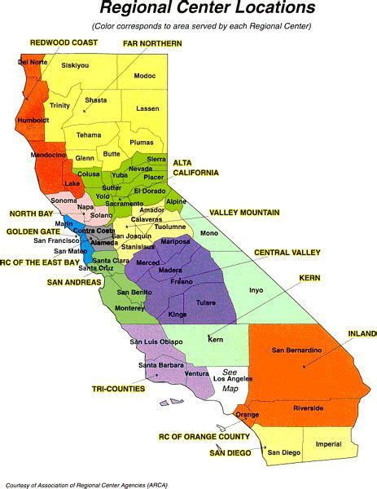
Origins of Lanterman Act
In 1966, two pilot programs for the Regional Centers were created in Los Angeles and San Francisco
In 1969, Frank Lanterman was cornered in an elevator by parents who convinced him of the importance of reforms

Slide 14
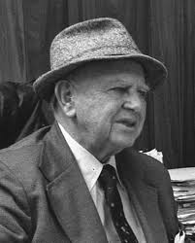
In 1969, the Lanterman Act became law in California
This created the Regional Center system and services for people with disabilities
At this point, the Act only applied to intellectual disabilities

Slide 15
In 1973, the Act was expanded to cover other disabilities
Home and Community Based Services began to be developed in the 1960s before becoming the law in 1981

Slide 16
In 1982, California had a recession
The Governor suggested making massive budget cuts and reducing services for people with disabilities to bare minimum
Services were limited to:
Place to live
Day program
Basic health and welfare

Slide 17

Consumer Action Committee
Led to ARC filing lawsuit which led California Supreme Court to state that the Lanterman Act was an entitlement

Slide 18
Next meeting: January 23

Slide 19
Thank you
Futures Explored
January 9
2026

