Slide 1
CAC Meeting 10/23
Futures Explored
October 23rd, 2025
Futures Explored
October 23rd
2025

Slide 2
Content
1
Opener
2
Gerrymandering Review
3
Statewide Special Election
4
Voter Process & Accommodations
5
Closing / Questions
Futures Explored
October 23rd
2025

Slide 3



Have you heard about California’s Special Election?
Futures Explored
October 23rd
2025

Slide 4
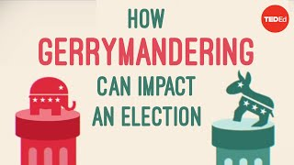
What is gerrymandering?
Futures Explored
October 23rd
2025

Slide 5

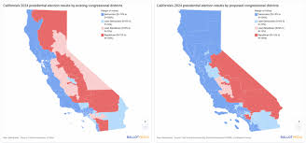
On November 4th, California will have a special election where voters will decide whether to redraw California’s maps for the next few elections to give Democrats more seats
Futures Explored
October 23rd
2025

Slide 6
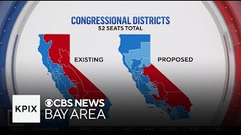
Current California system
Futures Explored
October 23rd
2025

Slide 7
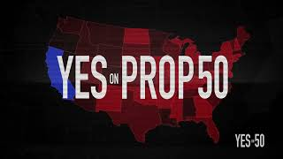

Who supports and opposes this?
This measure is supported by Democratic politicians who say it is necessary to counter the Republican states’ gerrymandering
It is opposed by Republicans who call it a power grab, They claim it reverses progress and lessens transparency by allowing politicians to draw districts
A NO vote means you want to keep the current maps
A YES vote means that you support the new maps
Futures Explored
October 23rd
2025

Slide 8
Statewide Special Election - November 4, 2025
1
2
3
4
County Elections Office have begun mailing ballots. Ballot drop-off locations are currently open
Early In-Person Voting begins in all Voter’s Choice Act counties
Election Day
Last day to receive ballots.
All mail-in ballots must be postmarked on or before November 4th.
November 12th
October 25th
November 4th
Futures Explored
October 3rd
2025

Slide 9
Voting locations Sacramento
Citrus Heights Event Center-6300 Fountain Square Dr
Galt-Littleton Community Center-410 Civic Dr
North Highlands-Murph-Emmanuel A M E Church-4151 Don Julio Blvd
Rancho Cordova-Koreana Plaza-10947 Olson Dr Ste 401
California Museum
Oak Park Community Center
The East Jay Building-
Lutheran Church of Our Redeemer
Department of Human Assistance
Richard T. Conzelmann Community Center
Christ Temple Apostolic Church
Florin Rebekah Hall-8360 Florin Rd
Sacramento Elks Lodge No. 6
Asian Pacific Islander American Public Affairs
Greater Sacramento Urban League
South Natomas Library
Futures Explored
October 23rd
2025

Slide 10
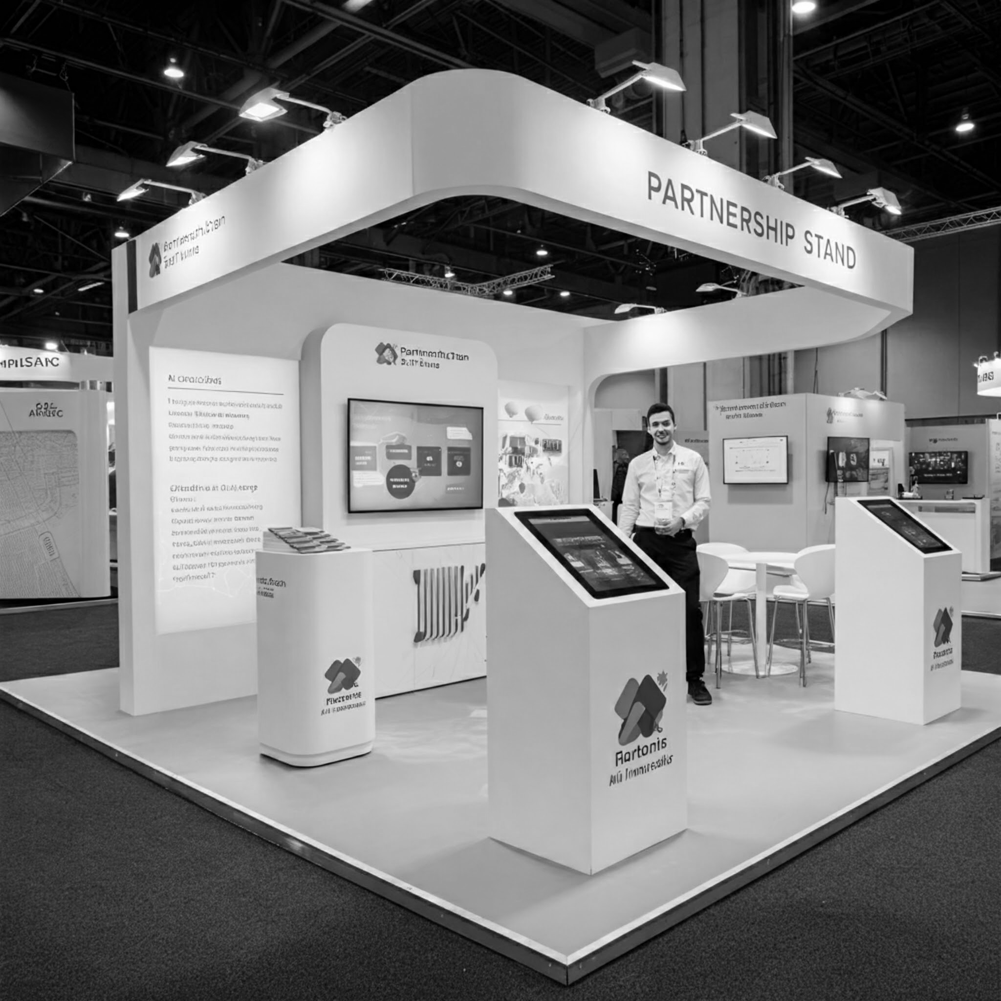


If you need help with your ballot, you may choose up to two people to help you. This person cannot be:
Your employer or anyone who works for your employer
Your labor union leader or anyone who works for your labor union
Futures Explored
October 23rd
2025

Slide 11
Curbside voting allows you to park as close as possible to the voting area. Elections officials will bring you a roster to sign, a ballot, and any other voting materials you may need, whether you are actually at a curb or in a car.
All polling places and vote centers are required to be accessible to voters with disabilities and will have accessible voting machines.
Futures Explored
October 23rd
2025

Slide 12
Accommodations Available
Voting at Home
Remote accessible vote-by-mail (RAVBM) systems provide an accessible option for voters with disabilities to receive their ballots at home and mark them independently and privately before sending them back to their elections official. Contact your county elections official for more information.
Futures Explored
October 23rd
2025

Slide 13
Audio and Large Print Voter Information Guides
This guide is available in audio and large print versions as well as in English, Chinese, Hindi, Japanese, Khmer, Korean, Spanish, Tagalog, Thai, and Vietnamese at no cost.
Futures Explored
October 23rd
2025

Slide 14
Join us next time!
Next virtual meeting:
October 31st @ 10 AM
Futures Explored
Year
October 23rd
2025

Slide 15
Thank you
Any questions?
Ready for what’s next?
Let’s talk
Kyle Choate
kylechoate@futures-explored.org
Futures Explored
October 23rd
2025

