Slide 1
CAC Meeting 10/31
Futures Explored
October
31
2025

Slide 2
Agenda
01
Opener
Slide 3
02
Government Shutdown: Why is it happening?
Slide 4
03
Government Shutdown: What does it mean for me?
Slide 6
04
Government Shutdown: What can I do?
Slide 10
05
Special Election
Slide 13
06
Closing & Final Questions
Slide 14
Futures Explored

Slide 3
What have you heard about the government shutdown?
Futures Explored

Slide 4
The government shutdown is over. Democrats and Republicans have m=agreed to a budget, Democrats want to reverse the cuts to Medicaid that were made by the Big Beautiful Bill
Futures Explored

Slide 5
Big Beautiful Bill cut Medicaid by over $700 billion over 10 years

Slide 6
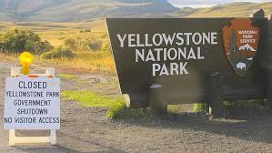
Expected Changes to Happen due to the Government Shutdown
Food stamps will likely be delayed and could run out of federal money
Social Security offices have less staff members, less air traffic controllers as they are not being paid, some national parks are closed
May be issues with unemployment if shutdown continues into January, many Centers for Independent Living may not be able to help as many people
Futures Explored

Slide 7
Some state parks like Muir Woods are temporarily reopened due to private donations.
Futures Explored

Slide 8
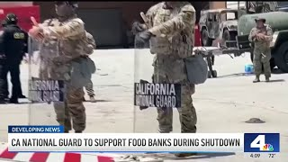
California is sending members of the National Guard to help at food banks
Futures Explored

Slide 9
SNAP
Many Democrats are suing the Trump Administration saying that they should use emergency funding instead of cutting SNAP payments but Republicans are rejecting this
Futures Explored

Slide 10

What you can do
Write to your federal representatives and let them know how the shutdown affects you or your family
Send a message to Congress encouraging them to restore benefits: The Arc
Help out at food banks
Futures Explored

Slide 11
Food Banks
Food Bank of Contra Costa and Solano
Find Food in Your City
Stockton Food Bank
Sacramento Food Bank
Call 211 if you need immediate help
Futures Explored

Slide 12
The Government Shutdown in a nutshell
Budget Disagreements
The Democrats want to reverse the cuts made to Medicaid by the Big Beautiful Bill.
A Reduction to Public Services
Food stamps are likely to run out, there are less air traffic controllers, less Social Security office workers, and more.
Get Involved
Call, email, or write your local representatives. Register to vote in future elections. Help your community by volunteering or supporting local businesses.
WE’RE HERE
Why is it happening?
What does a shutdown mean?
When is it expected to end?
What can I do?
No End In Sight
Currently, there is not an expected resolution date.
Futures Explored

Slide 13
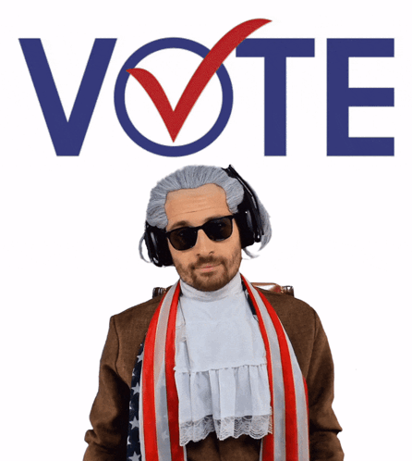
Special Election: Prop 50
A YES vote means that you support the new maps
This measure is supported by Democratic politicians who say it is necessary to counter the Republican states’ gerrymandering
A NO vote means you want to keep the current maps
It is opposed by Republicans who call it a power grab, They claim it reverses progress and lessens transparency by allowing politicians to draw districts
Futures Explored

Slide 14

Any Questions?
Thanks for joining us!
Futures Explored

Slide 15
Upcoming Meetings
November 14th
Join us for a virtual meeting.
November 28th
Futures Explored closed. No CAC Meeting. Happy Holidays!
December 9th
Join us for a virtual meeting.
Futures Explored

Slide 16
Thank you!
kylechoate@futures-explored.org
Futures Explored

