Slide 1
Practice Inquiry Colleague Groups…
INQUIRY!
Evidence? Experience?
Patient Context? Clinician Context?
Patient/Clinician Relationship?
SYNTHESIS >> reflection, shift, change
The UNCERTAINTY &
The STORY
Patient Follow-up
Clinician learning needs
System changes
The Colleague Group

Slide 2
Practice Inquiry Colleague Groups
for Family Medicine Clinicians

Slide 3
Faculty’s Name Here
Faculty Credentials
The CAFP Committee on Continuing Professional Development is responsible for management and resolution of conflict for any individual who may have influence on content, who have served as faculty, or who may produce CME/CPD content for the CAFP.
It is the policy of CAFP to ensure independence, balance, objectivity, scientific rigor, and integrity in all of their continuing education activities.
Drs. Sommers and Forrest declare that neither either of them or any members of their immediate family have a financial interest/arrangement or affiliation with one or more organizations that could be perceived as a real or apparent conflict of interest in the context of the subject of this presentation.
Drs. Forrest and Sommers do not intend to discuss off-label uses of drugs, mechanical devices, biologics, or diagnostics approved OR investigational drugs, mechanical devices, biologics, or diagnostics not approved by the FDA for use in the United States.

Slide 4
Learning Objectives
At the end of this session, you should be able to:
Describe the purpose of Practice Inquiry (PI) Colleague Groups
Explain how PI Colleague Groups differ from QI/QA and most CME programs
List three benefits of participation in PI Colleague Groups

Slide 5
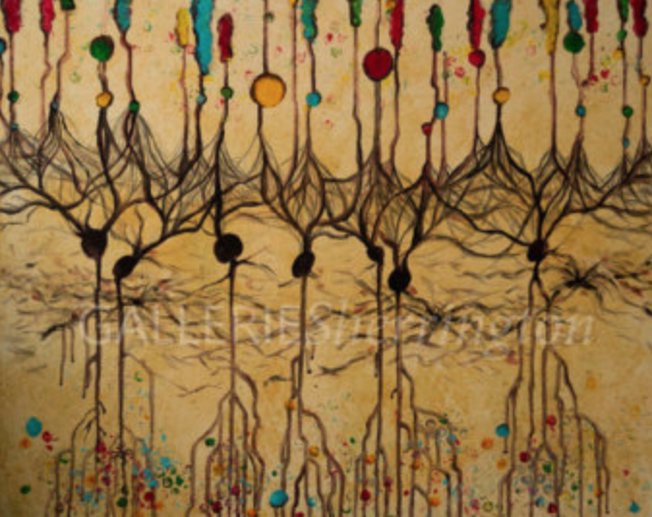
What would happen if….
Once out of training, in their workplace settings, primary care physicians had set-aside, paid time to meet with their peers in small groups led by a facilitator of their choosing?

Slide 6
Time to:
Share case-based dilemmas and clinical uncertainty
Probe colleagues’ clinical experience
Search/appraise ‘evidence’ to BLEND with experience & context
Re-imagine patient management
Hear case follow-up

Slide 7
And, over time…
Create a “community of learners” who use their practices to surface quality problems flying under QI radar AND
most importantly, improve clinical judgment - the cornerstone of care quality.

Slide 8
Practice Inquiry Colleague Groups…
INQUIRY!
Evidence? Experience?
Patient Context? Clinician Context?
Patient/Clinician Relationship?
SYNTHESIS >> reflection, shift, change
The UNCERTAINTY &
The STORY
Patient Follow-up
Clinician learning needs
System changes
The Colleague Group

Slide 9
Take-Homes from the Last 17 Years
The PERIL and PROMISE of clinical uncertainty
Creating a community of learners who
Take pride in engaging clinical uncertainty at the front lines
Develop metacognitive skills to prevent medical error
Create solidarity through collegial support to reduce isolation
The fishes’ question: “What the hell is water?”

Slide 10
Why discuss uncertainty: THE PERIL
Clinical Uncertainty
Misuse
Overuse
Error
Stress
Underuse
High Cost
Lack of Control*
Variation in practice
Isolation

Slide 11
Why discuss uncertainty: THE PROMISE
Clinical Uncertainty
Learning
Stimulation
Opportunity
Growth
New Perspective
Creativity
Redesign
Surprise
☺

Slide 12
Create sustainability…
Identify a champion
Carve out 1 hour (weekly or monthly)
Identify interested participants
Providers (MD, PA, NP,
other clinicians with panels)
Facilitator (internal or external)
Guests (case mgr, etc.)
Someone responsible for:
sharing info/update attendees
Tracking cases for log

Slide 13
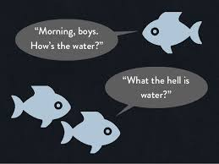
Now let’s dive in!

Slide 14
References
1. Sommers, L. S., Morgan, L., Johnson, L., et al. (2007). Practice inquiry: Clinical uncertainty as a focus for small-group learning and practice improvement. Journal of General Internal Medicine, 22(2), 246–252.
2. Sommers, L., Launer, J. (2013). Clinical Uncertainty in Primary Care, The Challenge of Collaborative Engagement. New York: Springer Science+Business Media.

Slide 15
Practice Inquiry Colleague Groups…
INQUIRY!
Evidence? Experience?
Patient Context? Clinician Context?
Patient/Clinician Relationship?
SYNTHESIS >> reflection, shift, change
The UNCERTAINTY &
The STORY
Patient Follow-up
Clinician learning needs
System changes
The Colleague Group

