Slide 1
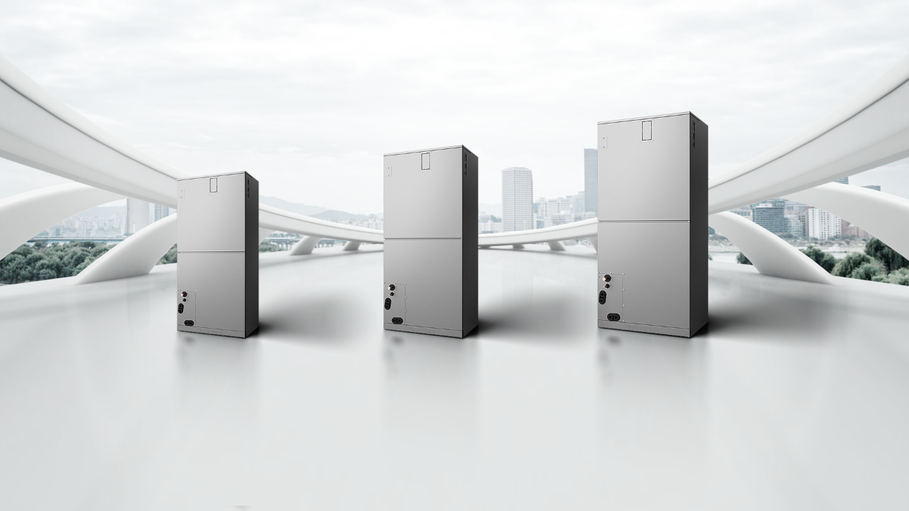
Unit Dimensions
1.5ton /18K
2ton/24K
2.5ton/30K
3ton/36K
4ton/48K
5ton/60K
（45*17-½*21）
（49*21*21）
（58*24-½*21）

Slide 2

Complete Product Line, High universality
Replace Market ACS with Bi Comm System | Product | 18K | 24K | 30K | 36K | 48K | 60K | Remark
 | AHU | Y | Y | Y | Y | Y | Y | Acoil Available
 | Regular SEER19 ODU | Y | Y | Y | Y | Y | Y
 | Hyper Heat ODU | Y | Y | Y | Y | Y | Coming Soon
“Y” mean new SKU
Notes:
2021.2.6：优化

Slide 3
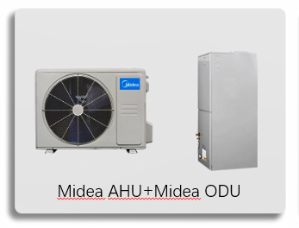
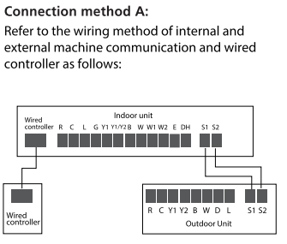
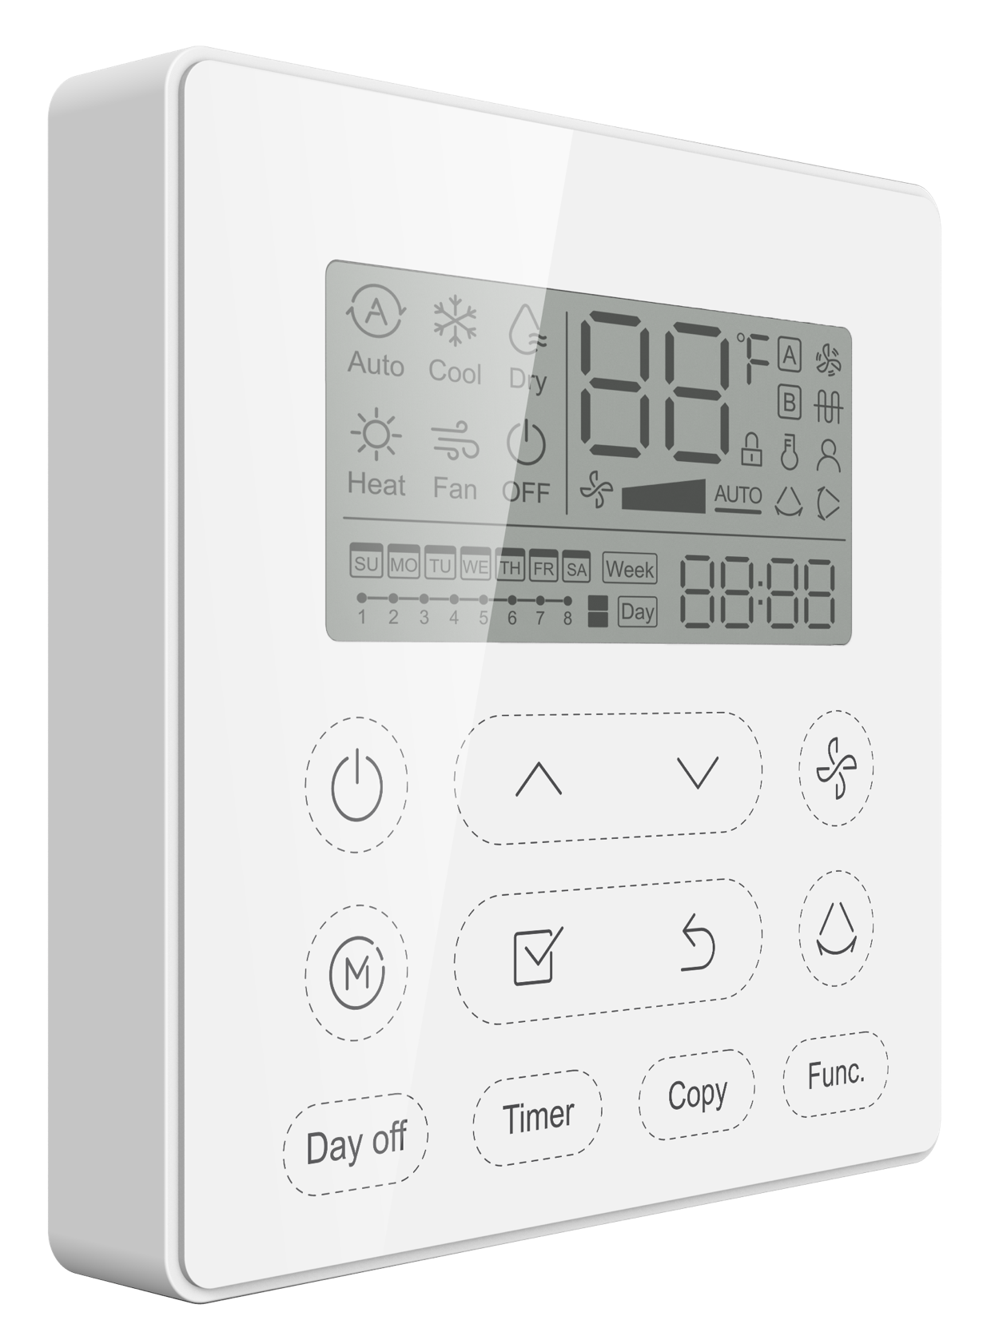
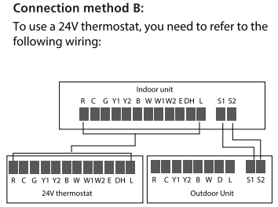

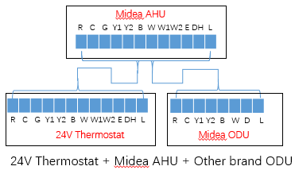
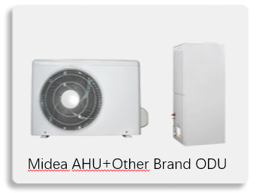
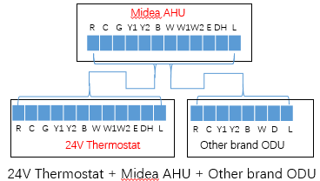
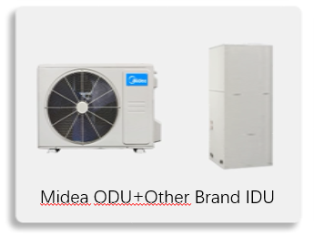
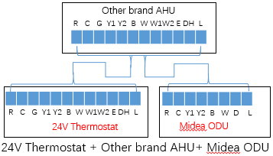
Dip Switch Setting
AHU SW1
ODU SW
ON
ON
Factory
Default Setting
1 2 3 4
1 2 3 4
Communication
ON
ON
1 2 3 4
1 2 3 4
ON
ON
1 2 3 4
1 2 3 4
ON
Other Brand
ODU
Traditional
1 2 3 4
ON
Other Brand
AHU
1 2 3 4
Notes:
2021.2.6：优化

Slide 4
Replace Market Product line
*When Y1 the system default demand coil temp
should be 9C and when Y2 the demand is 5C,
Suction sensor and pressure sensor will calculate
the coil temp CT,then CT-9 or 5=▲T,when the gap
▲T is bigger the compressor will running faster or
will slowly,the heat pump mode with same logic(49C
and 53C）
*different model have different parameter
IDU
ODU
T1,T2
T3,T4,T5
AHU
Replace
24V+485
Suction Sensor
EXV,T2A,T2B
Ref.Temp Sensor
Pressure Sensor
Remark:
T1--room temp. T2---evaporator temp.
T2B--evaporator out temp. Ts--setting temp.
T3--condenser temp. T4--outdoor temp.
T5– compressor discharge temp.
T2A and T2B –evaporator temp,control the EEV open(coil sensor)
Suction Sensor—detect the suction Sensor(Calculate the indoor demand
Pressure Sensor—Calculate the indoor demand
Ref.Temp Sensor—avoid the refrigerant heat sink have sweat issue
When Call Y1(stage one)
CT--Coil Temp
CTT--Coil Target Temp
▲T=CTT-CT
Fz
Y2
▲t+Y2
Y1
When Call Y2(stage two)
CT--Coil Temp
CTT--Coil Target Temp
▲t-- enhance factor
▲T=CTT-CT-▲t
▲T
Notes:
2021.2.6：优化

Slide 5
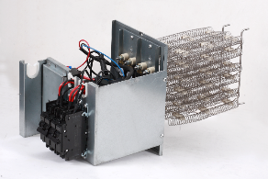
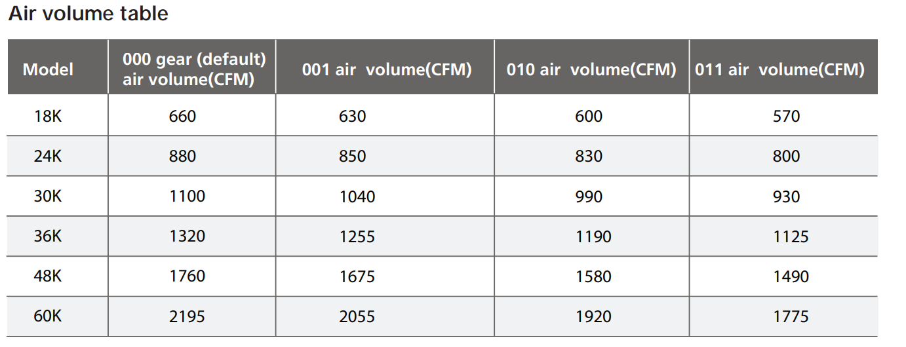
Complete Product Line, High universality
Electric Heater | Power of Electric Heater | 1.5ton /18K | 2ton/24K | 2.5ton/30K | 3ton/36K | 4ton/48K | 5ton/60K
 | 3KW | Y
 | 5KW | Y | Y | Y | Y
 | 8KW | Y | Y | Y | Y | Y
 | 10KW | Y | Y | Y | Y | Y | Y
 | 15KW |  | Y | Y | Y | Y | Y
 | 20KW |  |  |  | Y | Y | Y
 | 25KW |  |  |  |  |  | Y
SW4 is combination DIP Switch,just available with 1~3,the setting just available with 000/001/010/011
The relative air flow identification is below
Top Priority:When auxiliary is energize,the AHU will running with Turbo fan speed
Notes:
2021.2.6：优化

Slide 6

This Could be The Most
Compatible AHU system
Comprehensive Business Solution
Multi Position (up\down\left\right)
High Efficient up to SEER 20
Universal Product Connection.
Aluminium Coil
Constantly Air Flow system up to 0.80 In.W.G
Adaptive Control System
Easy Maintenance
Optional Auxiliary heat kit up to 25kW

Slide 7
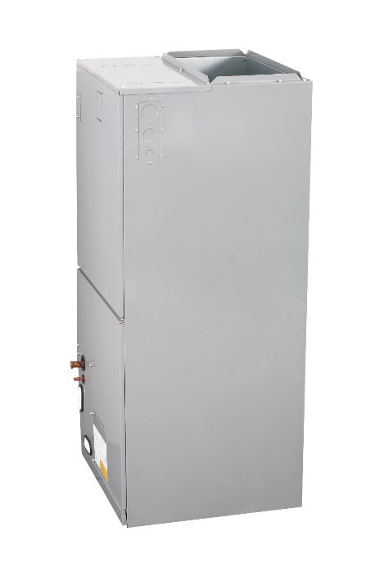
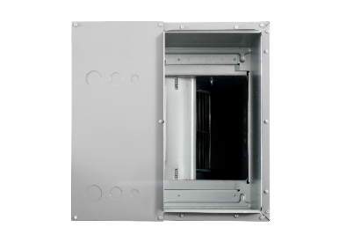
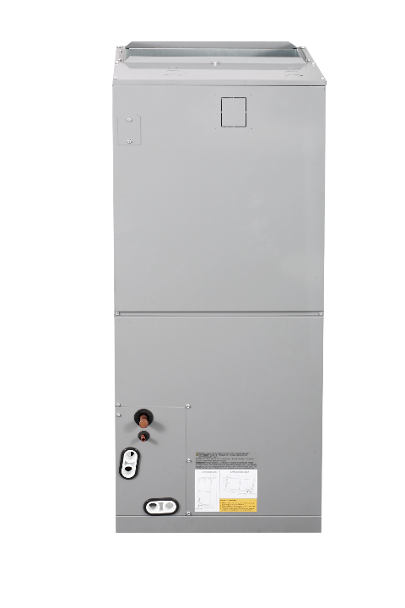





Disconnect or Circuit Breaker Location
Quick Check and Engineer setting Window
Controller and Blower&Heater Access Panel
Coil Access Panel
Fitting Panel
Filter Access Panel

Slide 8
This Could be The Most
Compatible AHU system
Comprehensive Business Solution
Multi Position (up\down\left\right)
High Efficient up to SEER 20
Constantly Air Flow system up to 0.80 In.W.G
Universal Product Connection.
Aluminium Coil
Easy Maintenance
Optional Auxiliary heat kit up to 25kW

Slide 9
24V Thermostat running identify（Set system or single IDU with Other ODU
Mode | Priority | G | Y1 | Y/Y2 | B | W | W1 | W2 | E/AUX | DH/DS/BK | Fan speed | Display
OFF | / | 0 | 0 | 0 | 0 | 0 | 0 | 0 | 0 | * | OFF | 00
FAN | 7 | 1 | 0 | 0 | 0 | 0 | 0 | 0 | 0 | 1 | AUTO | 01
FAN |  | 1 | 0 | 0 | 0 | 0 | 0 | 0 | 0 | 0 | LOW
Cool Y1 | 6 | * | 1 | 0 | 0 | 0 | 0 | 0 | 0 | 1 | Medium | 02
Cool Y2 |  | * | * | 1 | 0 | 0 | 0 | 0 | 0 | 1 | High | 03
Dehumidify 1 |  | * | 1 | 0 | 0 | 0 | 0 | 0 | 0 | 0 | LOW | 04
Dehumidify 2 |  | * | * | 1 | 0 | 0 | 0 | 0 | 0 | 0 | LOW | 05
Heat Pump 1 | 5 | * | 1 | 0 | 1 | 0 | 0 | 0 | 0 | 1 | Medium | 06
Heat Pump 2 |  | * | * | 1 | 1 | 0 | 0 | 0 | 0 | 1 | High | 07
Heat W |  | * | * | * | * | 1 | 0 | 0 | 0 | 1 | High
Heater W1 | 3 | * | 0 | 0 | 0 | 0 | 1 | 0 | 0 | * | Turbo | 08
Heater W2 |  | * | 0 | 0 | 0 | 0 | 0 | 1 | 0 | * | Turbo
Heater W1+W2 |  | * | 0 | 0 | 0 | 0 | 1 | 1 | 0 | * | Turbo | 09
Heat Pump1 +W1 | 4 | * | 1 | 0 | 1 | 0 | 1 | 0 | 0 | 1 | Turbo | 10
Heat Pump1+W2 |  | * | 1 | 0 | 1 | 0 | 0 | 1 | 0 | 1 | Turbo
Heat Pump2 +W1 |  | * | * | 1 | 1 | 0 | 1 | 0 | 0 | 1 | Turbo
Heat Pump W +W1 |  | * | * | * | * | 1 | 1 | 0 | 0 | 1 | Turbo
Heat Pump2 +W2 |  | * | * | 1 | 1 | 0 | 0 | 1 | 0 | 1 | Turbo
Heat Pump W +W2 |  | * | * | * | * | 1 | 0 | 1 | 0 | 1 | Turbo
Heat Pump 1 +W1+W2 |  | * | 1 | 0 | 1 | 0 | 1 | 1 | 0 | 1 | Turbo | 11
Heat Pump 2 +W1+W2 |  | * | * | 1 | 1 | 0 | 1 | 1 | 0 | 1 | Turbo
Heat Pump W +W1+W2 |  | * | * | * | * | 1 | 1 | 1 | 0 | 1 | Turbo
AUX | 1 | * | * | * | * | * | * | * | 1 | * | Turbo | 12
Heating Zone Control | 2 | * | 1 | 0 | 1 | 0 | * | * | 0 | 0 | Low | 13
Heating Zone Control |  | * | * | 1 | 1 | 0 | * | * | 0 | 0 | Low
Heating Zone Control |  | * | * | * | * | 1 | * | * | 0 | 0 | low

Slide 10
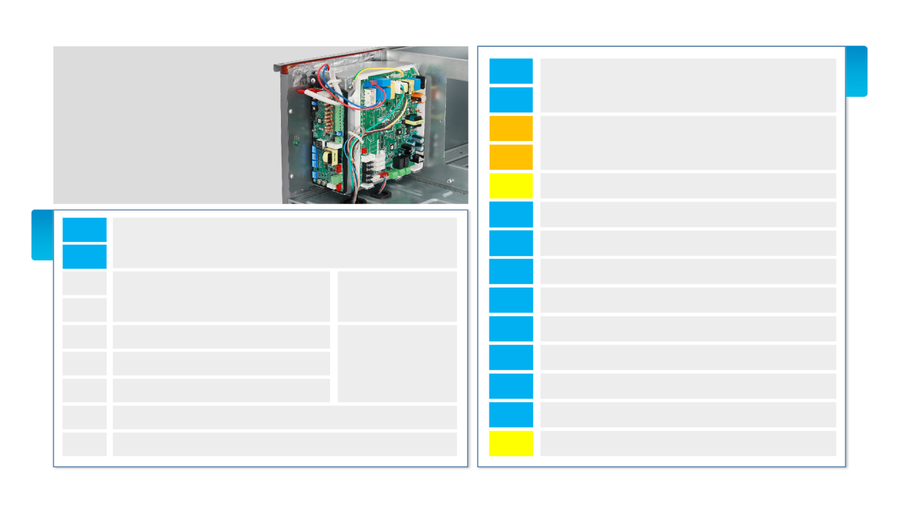
Universal Product Connection
L1
24V
Power
L2
AHU 485 +24V Connect Guide
R
24 V HOT
24 V COMM
C
L
ODU Malfunction Indicator
(out put to Thermostat or identification )
G
Fan
485
L1
Power
Y1
HEAT/COOL STAGE 1
L2
Y/Y2
HEAT/COOL STAGE 2(High Demand)
S1
To Midea Unit IDU 18K~60K AHU
To Midea’s ODU
B
Change 4 ways valve energized in heating
S2
CN7
W
Heat pump
No polarity 2 wires of Wire controller
CN13
WiFi port(connect smart port)
Midea supply
W1
Heater Group 1
CN14
reserve with 4 wires wire controller
W2
Heater Group 2
X.Y.E
Central Control/BACnet(controller from third party)
E/AUX
Auxiliary heater
CN2
Remote Control(default with jumper shorten)—output
DH
Dehumidify(Low Frequency and Low Fan)

Slide 11
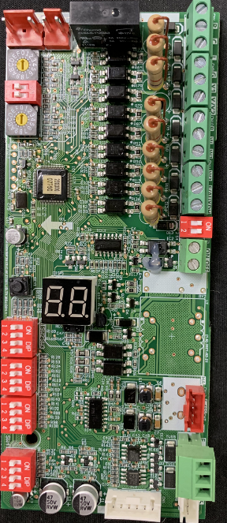
Universal Product Connection
Funcational Board Guide
Infrared
Receiver
S4
Group Control Port
24V thermostat
Connection
Remote
Control
485/Not Polarity
Wire Controller
WiFi Port
IDU+ODU
Connect Port
24V
Power
S1,S2 Group ENC1
Control Address
Check
Button
SW1
SW2
SW3
SW4
S3 operate
Limit temp.ENC2
Display
Tube

Slide 12
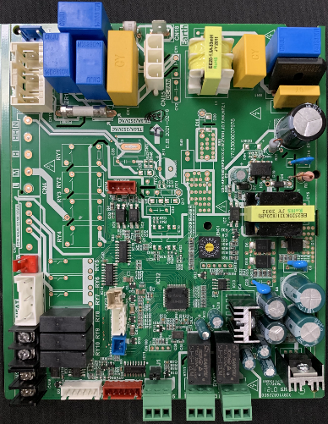
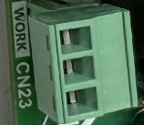
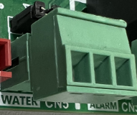
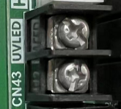
Universal Product Connection
Main Board Guide
CN6 T2B
ENC1
Grounded
CN29 T2
CN46 T1
WORK(dry contactor)—when unit is work the 2 pins energize,when unit have error or protection,2 pins disconnect
CN23
WORK
ALARM(dry contactor) )—when unit is work the 2 pins disconnect,when unit have error or protection,2 pins energize
CN33
ALARM
CN15
Water (input)when need use this,take off the
J1 (jumper) ,then connect to water switch,the 2 pins not connect the units will stop running
Fan
Motor
CN5
Water (input)
jumper
CN34
CN21
EXV
CN10
To IDU
24VAC for UVLED,when fan is running,will
Output 24V signal
Power to
Transformer
CN 20
S1&S2
to ODU
CN9 To
Functional
Board
To terminal
block
CN 34
UV LED(Output)
CN12
Heater

Slide 13
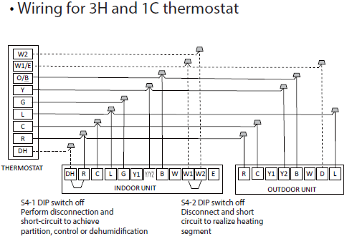
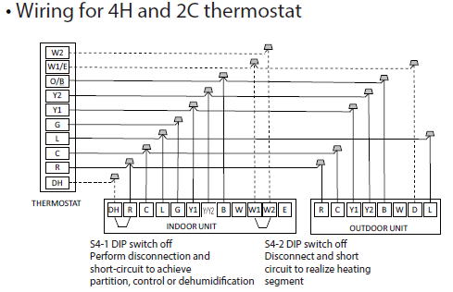
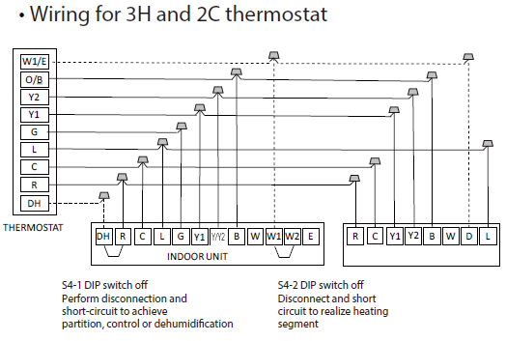
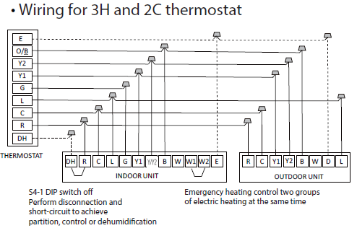
Universal Product Connection
AHU Heat Function Guide
Heat Control Solution 1#
Heat
Pump
Only
Heat
Pump +
Heater
Heater
Only
24V Thermostat
HP n/a
HP n/a
AUX
W or
Y1+B or Y/Y2+B
Based on HP
W1-Heater Stage 1st
W2-Heater Stage 2nd
Thermostat control the AHU just running with Auto fan speed(based on the setting temp and the ambient temp to adjust fan speed)

Slide 14
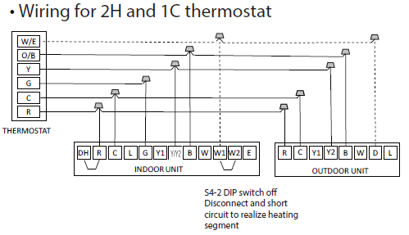
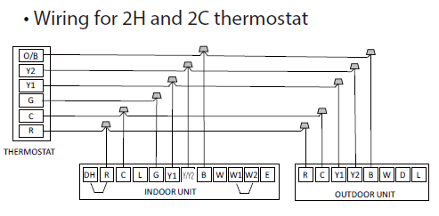
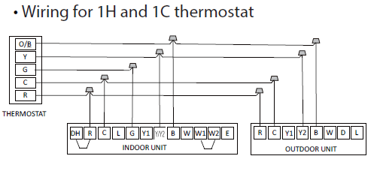
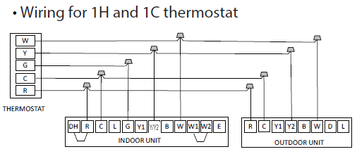
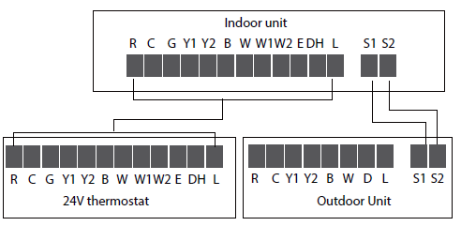
Universal Product Connection
AHU Heat Function Guide
Heat Control Solution 1#
Heat
Pump
Only
Heat
Pump +
Heater
Heater
Only
24V Thermostat
HP n/a
HP n/a
AUX
W or
Y1+B or Y/Y2+B
Based on HP
W1-Heater Stage 1st
W2-Heater Stage 2nd
When use the thermostat all of action based on the thermostat output directly,not delay (expect for W1 and W2 have 30 second different when have signal together)

Slide 15
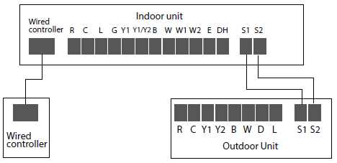



Universal Product Connection
AHU Heat Function Guide
Heat Control Solution 2#
Heat
Pump
Only
Heat
Pump +
Heater
Heater
Only
Midea’s Wire Controller
HP n/a
HP n/a
AUX
When Coil temp reach to 54℃ the electrical heater will shut off immediately in Heat model (Heat Pump +Heater) and just running with heat pump
Midea Wired Controller available set
Auto\Turbo\Medium\Low Fan speed
SW2-1:off is 2℃ gap; on is 1 ℃
SW2-2:off is 2.5℃ gap; on is not delay
SW2-3:off is delay 15’; on is 30’

Slide 16
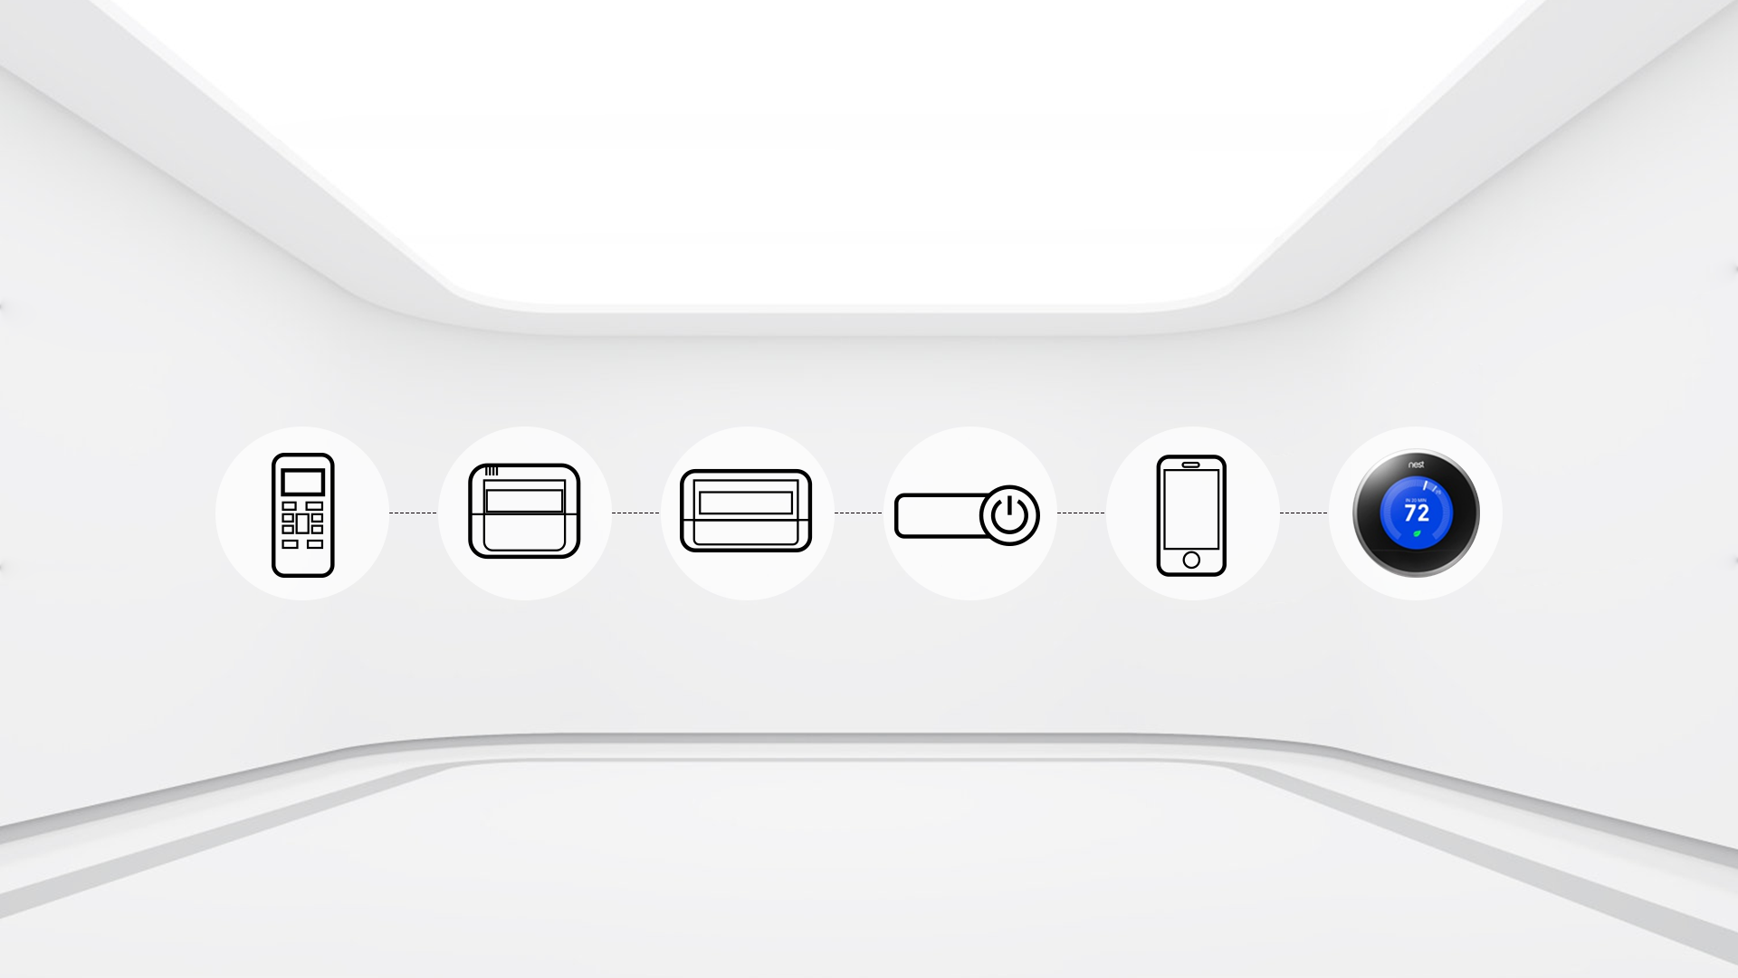

Multi Control Ways
Compatible with Midea wireless remote controller, programmable wired controller, central controller,
Wi-Fi controller, Remote On/Off.
Remote Control
Wired Control
Avoid mislaying
Central Control
Professional for commercial user
Remote On/Off
Easy for commercial users
Wi-Fi Control
Operates your AC wherever you are
24V Thermostat Control
Compatible for common 24V thermostat controller

Slide 17
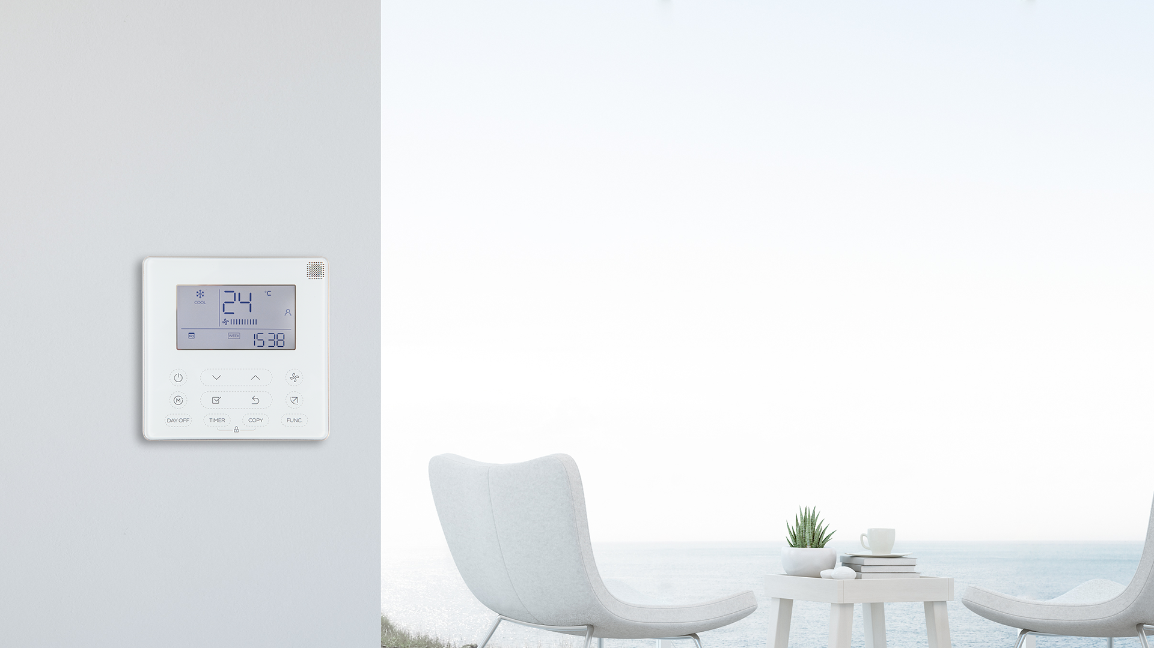
Midea Wired Controller
Benefit with Midea wire controller
Available to adjust fan speed(Low,Med,High,Turbo,Auto)
2 wire controller control one system(First floor and second Floor)
Remote control the wire controller
Display the ERROR code on screen
Comfort and Energy saving adjust
Wire controller with WiFi dongle(coming soon)
Two options :
Current 120G 485 control wired controller：
New 2-wired non-polarity control 120X wired controller
 | 485 control | 2-wired non-polarity
Weekly Timer | Yes | Yes
Follow-Me | Yes | Yes
Remote Control Compatible | No | Yes
Dual Control | No | Yes
Group Control | No | Yes
Rotation & Back-up | No | Yes
Ducted/Cassette/Ceiling floor compatible | Yes | No
Midea Wired Controller available set Auto\Turbo\Medium\Low Fan speed

Slide 18
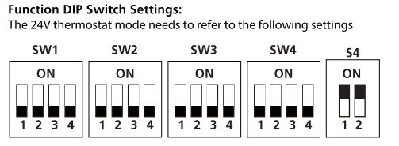
AHU DIP SWITCH Guide
Function setting
All DIP SWITCH default setting is OFF(except for S4)
SW1-1 | Communication solution （IDU controller select）
 | OFF not for 24V(it is 485)
 | ON for 24V comm.
SW1-2 | Anti cold setting(T2 to control fan start running) （BI controller work）
 | OFF for anti cold(Fan stop)
 | ON for not anti cold(fan not stop)
SW1-3 | Function setting（Set system and single IDU work）
 | OFF for HP
 | ON for Cooling Only
SW1-4 | Installation Request
 | OFF for Midea set system
 | ON for pair with third party ODU
SW1-1 setting mean we just available choose one communication even IDU and ODU from Midea,
If IDU or ODU not come from Midea have to use the 24V control
485 just available control with Midea’s wire controller /WiFi/Remote
24V just available control with 24V thermostat(not communication solution)

Slide 19
AHU DIP SWITCH Guide
All DIP SWITCH default setting is OFF
Here just for 485 communication(with
Midea’s wire controller)
Heater Mode Setting
SW2-1 | For W1 turn on condition(W1 and W2 have 30” delay even set not temp.delay)
 | OFF is 2℃ gap(setting temp and ambient temp)
 | ON is 1 ℃
SW2-2 | For W1 turn on condition(SW2-2 with ON then will delay with 2.5℃ and SW2-1 not available, SW3-3 decide 15’ or 30’, SW2-2 with OFF then will SW2-1 avaiable and SW3-3 not available）
 | OFF is not delay （when SW2-2 is OFF,the SW2-1 will be available or will use 2.5 ℃)
 | ON is 2.5℃ gap(setting temp and ambient temp)
SW2-3 | For energy saving(operate with heat pump priority,even have request with W1,when temp.not reach set point,the heater delay energize
 | OFF is delay 15’
 | ON is 30’
Note: When E/AUX controls electric heating, there is no temperature difference, and it starts directly
Heat Source Limit Select(just for heater or compressor)
S3 | It is 16 digitals for Temp.protection -20 to 8 ℃,1 digital 2 ℃,work with SW2-4, Select 0 mean not temp limit for heater or compressor,1-F mean the temp from -20 to 8℃
SW2-4 | For energy saving or some code request OFF is for heater energize highest limit Temp.(need to set ENC2) ON is for the compressor energize lowest limit Temp.(need to set ENC2)

Slide 20
AHU DIP SWITCH Guide
All DIP SWITCH default setting is OFF
Here just for 485 communication(with
Midea’s wire controller)
SW3-1 | Increase or decrease 1 ℃ for temp.not satisfy when Heat or Cool （Just for 24V thermostat,when indoor unit and outdoor unit from Midea）
 | OFF for 1.5 hours
 | ON for 0.5 hour
SW3-2 | Adjust the set Y/Y2 Temp
 | OFF for 2 ℃
 | ON for 1 ℃
SW3-3 | Adjust the set W2 Temp
 | OFF for 3 ℃
 | ON for 2 ℃
S4-1 | Default ON
 | OFF for 2 ℃
 | ON for 1 ℃
S4-2 | Default ON
 | OFF for DH is off by default
 | ON for DH on

Slide 21
AHU DIP SWITCH Guide
All DIP SWITCH default setting is OFF
Here just for 485 communication(with
Midea’s wire controller),all engineer
Mode just available for set system,but inquiry function is available for set system and single indoor unit
ENC1 | Capacity identification adjustment
Central Control Address | S2 is 16 digital
 | S1 have 2,total S1 and S2 available for Max. 64 units
display CS is success display CF is fault | F1 | Auto restart
 |  | OFF for available
 |  | ON is not available
 | F2 | Heat compensation
 |  | Heat compensation -6℃~6℃,default is 0
 | F3 | Anti-cold setting(T2 trige
 |  | 1 for intelligent anti-cold setting (17℃~21℃)
 |  | 2 for normal anti cold fan stop temp(8℃~28℃)
 | F4 | Fan motor running when temp satisfy(1~4)
 |  | 1 for stop
 |  | 2 for lowest fan speed
 |  | 3 running setting fan speed（factory default setting)
 |  | 4 for termal mode
 | F7 | Cooling compensation
 |  | Cooling compensation -2℃~2℃,default is 0
Remote
setting with
engineering
Mode

Slide 22
This Could be The Most
Compatible system
Comprehensive Business Solution
Normal and Hyper 2 Optional
Universal Product Connection.
Adaptive Control System
Easy Maintenance

Slide 23
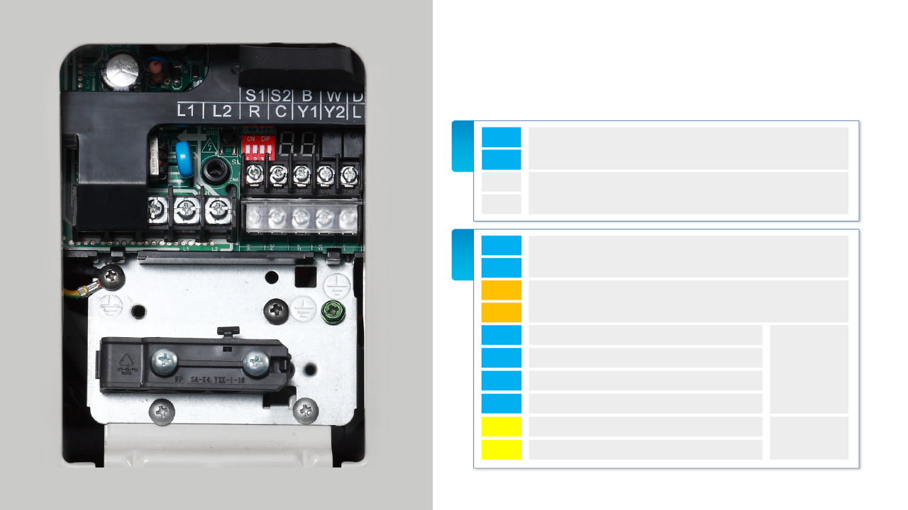
ODU 485 + 24V Connect Guide
485
L1
L2
Power
S1
To Midea Unit IDU
AHU /18K~60K
S2
24V
L1
L2
Power
R
24 V HOT
24 V COMM
C
Y1
HEAT/COOL STAGE 1
Y2
HEAT/COOL STAGE 2(High Demand)
B
Thermostat
Changeover valve energized in heating
W
Heat pump
D
Defrost（out put , back to AHU/Furnace）
Thermostat
or IDU
L
ODU Malfunction Indicator
(out put to Thermostat or identification )

Slide 24

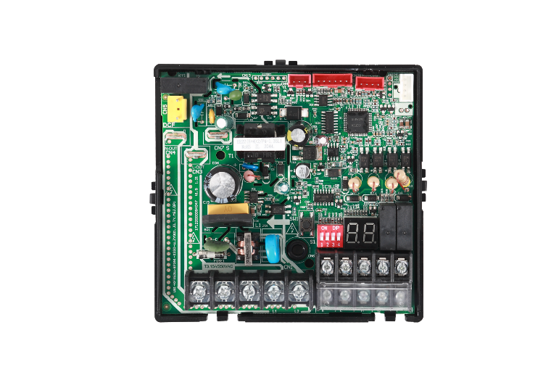
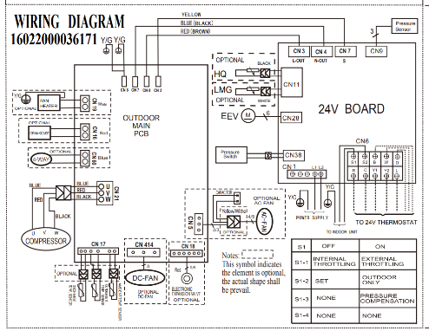
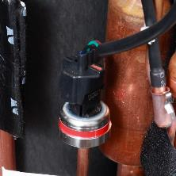



ODU Connect Guide
Dip switch
Check Button
Display Tube
Power Terminal
Communication Terminal
SW-1 | Reserve
SW-2 | ON for 24V communication protocol and OFF for 485 communication protocol
SW-3 | ON for activing with enhance cool/heat,off for not activing enhance cool/heat
SW-4 | Reserve
DIP SWITCH

Slide 25


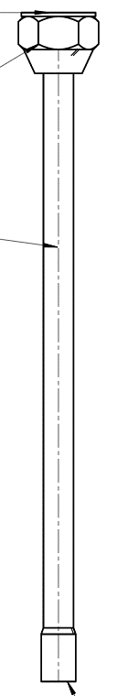

Accessory
Product line | Capacity | Model | Flare and Welding pipe
24V+485 AHU | 18K | MVC-18HWFN1-M | 3/4" size 15123000012887 | 3/8" size 15123000012948
 | 24K | MVC-24HWFN1-M
 | 30K | MVC-30HWFN1-M
 | 36K | MVC-36HWFN1-M
 | 48K | MVC-48HWFN1-M
 | 60K | MVC-60HWFN1-M | 7/8"size 15123100000608
Product line | Capacity | Model | Flare and Welding pipe
24V+485 Regular ODU | 18K | MOX330U-18HFN1-MR0 | flare 5/8' to welding 3/4' 15123000013007 | 3/8" size 15123000012948
 | 24K | MOX430U-24HFN1-MR0
 | 30K | MOD30U-30HFN1-MR0 | 3/4" size 15123000012887
 | 36K | MOD30U-36HFN1-MR0
 | 48K | MOE30U-48HFN1-MR0
 | 60K | MOE30U-60HFN1-MR0 | 7/8"size 15123100000608
24V+485 Hyper ODU | 18K | MOX430U-18HFN1-M | flare 5/8' to welding 3/4' 15123000013007 | 3/8" size 15123000012948
 | 24K | MOD30-24HFN1-MW
 | 30K | MOD30U-30HFN1-MR0(X) | 3/4" size 15123000012887
 | 36K | MOE31U-36HFN1-M
 | 48K | MOE30U-48HFN1-M-[X1]
Notes:
2021.2.6：优化

Slide 26
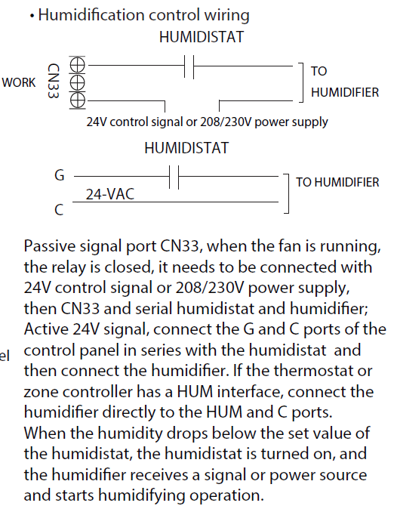
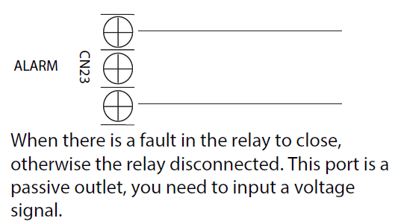
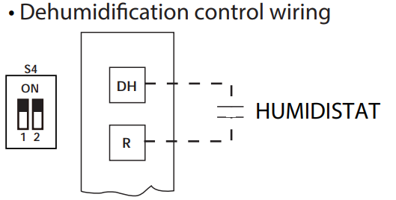
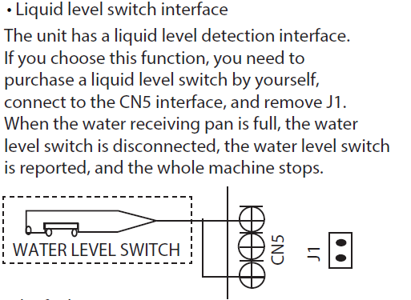
AHU Function Connection
Dry Contact
Dry Contact
Input

Slide 27
AHU Function Connection
1.If we use the Y/Y2 (state 2) then the unit will concern the demand is big,so the fan motor will running with high fan
2.Request a connection diagram for different scenario
3.Ask if we have manual button for checking the 4 ways valve,we don‘t have this manual button，but we can use the 24V signal to check,connection terminal B
4.How to access into the engineer mode,please check the attached of file(just have the function that we show in the PPT,the other function not available still)
5.For heat pump it is available with Turbo fan speed with Midea’s wire controller
6.When auxiliary is energize,the AHU will running with Turbo fan speed
7.The Auxiliary turbo fan speed available adjust (4 speeds optional)
8.Two water base pan have 2 drain pipe connections,both available for normal drain water,the higher one
Also available for water most of the time
9.When call DH（the dehumidify function),the unit will running with low frequency and low fan,we can use in zone control,but we need to concern that the output is low,we suggest use the return duct bypass the air low,the capacity output is around 30%

Slide 28
AHU Function Connection
10.When we want to set the DIP SWITCH,we have to power off then after we already done the setting,then
power on，because the setting just keep the setting after power on

