Slide 1
Standing by …
for an MVSOA Summer Training Session on
AID AND ATTENDANCE
July 28, 2021

Slide 2
AID and ATTENDANCE assistance FOR Veterans, Wives and SURVIVING SPOUSES
A BENEFIT FROM THE
U.S. VETERANS ADMINISTRATION
Douglas L. Horka
Former/Retired Massachusetts Veterans’ Service Officer (What I ain’t not no more)
Revision 4

Slide 3
Preparing an Aid and Attendance claim is fairly easy - that is, it’s mostly routine … ONCE you fully understand the ground rules.
Who qualifies?
How do they qualify
What are the “watch-outs”
Let’s figure this out together

Slide 4
AID AND ATTENDANCE – Definitions
Aid and Attendance (A&A) is a monetary benefit paid for being so helpless as to be permanently bedridden or in need of regular assistance with activities of daily living (“ADLs”) due to service-connected disabilities.
The VA defines A&A due to ADLs as:
FIRST OF ALL, VA Aid and Attendance is a MEDICAL NECESSITY (not just a response to a family in need of cash for Mom or Pop’s housing arrangements) GET A WRIST TATTOO TO REMEMBER THIS RED PHRASE
Inability to dress or undress or to keep ordinarily clean and presentable (Uh-oh; that is my life style in retirement)
Frequent need of adjustment of a special orthopedic or prosthetic appliance, which can not be done without assistance
Inability to feed oneself through loss of coordination of upper extremities or due to extreme weakness
Inability to properly attend to the wants of nature (toilet/bathroom hygiene)
Physical or mental incapacities which require care on a regular basis for protection 

Slide 5
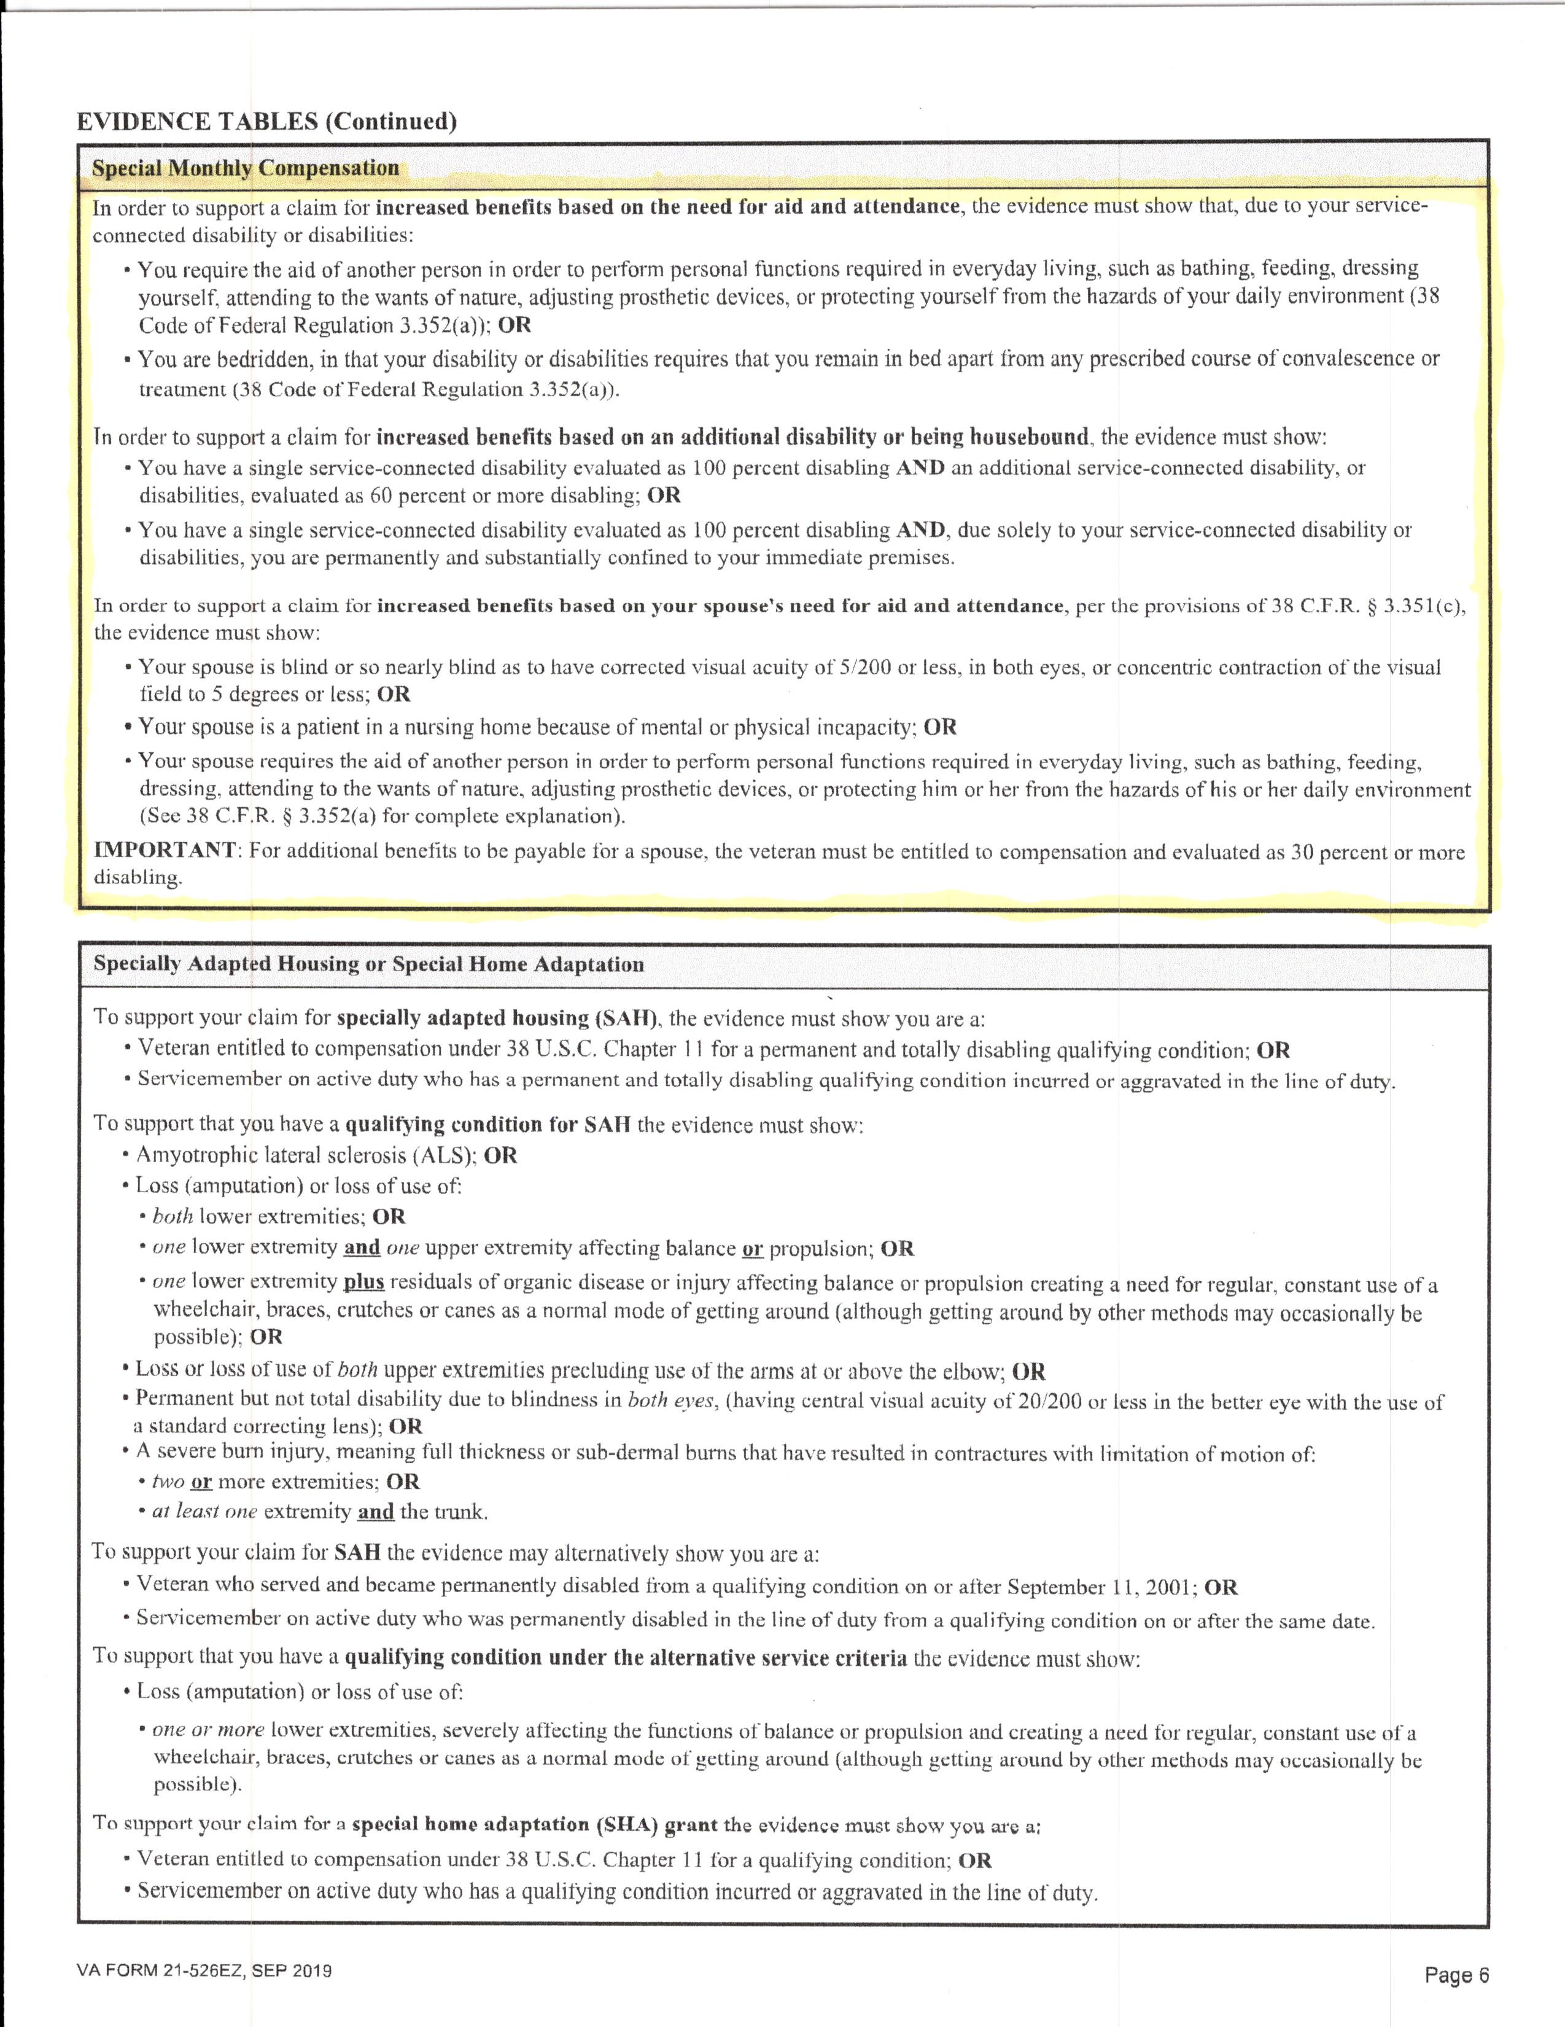
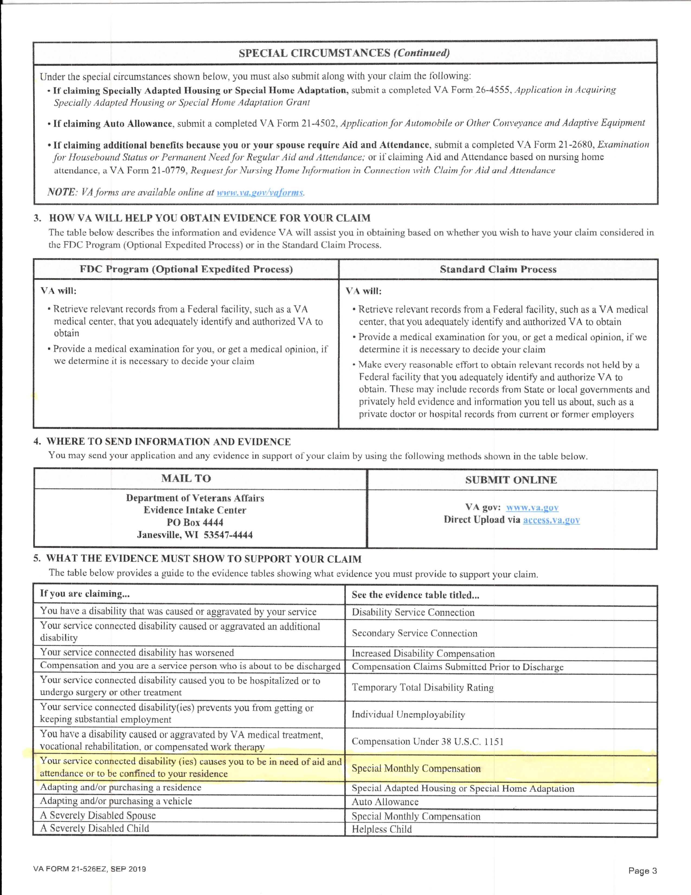
AID AND ATTENDANCE Special Monthly Compensation
21-526EZ, Page 1 21-526EZ, Page 3 21-526EZ, Page 6
See Special Monthly Compensation Special Monthly Compensation

Slide 6
AID AND ATTENDANCE – Special Monthly Compensation (SMC)
VA Form 21-526EZ, Page 6
The Veteran’s disability(ies) causes a need of AID AND ATTENDANCE or to be confined to the residence (housebound)
In order to support a disability claim (thus, the 21-526EZ) for increased disability benefits based on the need for Aid and Attendance, the evidence MUST SHOW that due to the service-connected disability or disabilities:
The Veteran requires the aid of another person to perform ADLs
The Veteran is bedridden and the Veteran’s circumstance(s) require that he/she remain bedridden apart from a situation of convalescence
In order to support a claim for increased benefits, based on an additional disability or being housebound, the evidence must show:
The Veteran has a single service-connected rating of 100% disabling AND there is an additional service-connected disability (or disabilities) evaluated as 60% or more disabling
The Veteran has a single service-connected disability evaluated as 100% disabling AND , due solely to the service-connected disability(ies), the Veteran is permanently and substantially confined to the immediate premises.

Slide 7
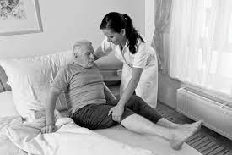
AID AND ATTENDANCE - SMC
A&A - BEDRIDDEN
A&A claimant must display relative “helplessness”
A condition which requires that the claimant remain in bed.
Voluntarily taking to a bed, or the fact that a physician has prescribed bed rest for the greater or lesser part of the day to promote convalescence or cure, WILL NOT, BY ITSELF, SUFFICE as reason for A&A/Bedridden status with VA (but you might try filing for temporary total disability – 21-526EZ)
In one case, the claimant/Veteran GENERALLY must have a service-connected disability, to include a single disease entity (such as diabetes, Parkinson’s, ALS) rated at 100% disabling to qualify for this special benefit
The requirement may also be satisfied by a PRIMARY service-connected disability in addition to secondary S-C disability or disabilities combining to a total of 100% disabling

Slide 8
AID AND ATTENDANCE - SMC
Special Monthly Compensation – BEDRIDDEN
As with Housebound, Bedridden benefits are payable when the claimant is substantially confined due to service connected disability(ies), to their bed and/or the immediate premises – and it is reasonably certain that this condition is permanent.
Special Monthly Compensation – HOUSEBOUND
Housebound benefits are payable when the claimant is substantially confined due to service connected disability(ies), to their dwelling and the immediate premises – and it is reasonably certain that this condition is permanent and will not improve.
Other factors for consideration of Housebound benefits are identical to Aid & Attendance – Bedridden, discussed above.

Slide 9
AID AND ATTENDANCE
DEFINING MEDICAL NEED
At least ONE of these situations must be true
You need another person to help with activities of daily living (ADLs), such as bathing, feeding dressing ... OR
You have to stay in bed, or must spend a large portion of the day in bed, because of illness … OR
You are a patient in a nursing home because of the loss of mental or physical abilities related to a service-connected disability … OR
You eyesight is limited (even with glasses or contact lenses) to 5/200 or less in both eyes, or concentric contraction of the visual field to 5° or less (like looking thru toilet paper tubes)
You MAY qualify for HOUSEBOUND benefits if you get a VA pension and spend most of your time in your house because of a permanent disability (one which doesn’t improve) 
NOTE: Aid and Attendance benefits and SMC Housebound benefits can not be granted at the same time.

Slide 10
AID AND ATTENDANCE
SPOUSAL A&A
Aid & Attendance may also be awarded to a Spouse who was caring for a claimant (Veteran) who meets all the criteria for A&A, but is effectively entirely helpless, for such problems as total blindness
OR
The Spouse is a patient in a nursing home because of mental or physical incapacity
OR
The Spouse requires the aid of another person for support of ADLs
Special Monthly DIC might apply instead of Aid and Attendance (See 21-534EZ, Page 1) 
If the Spouse is a widow of a deceased Veteran, the Veteran must have had at least a 30% disability rating.

Slide 11
AID AND ATTENDANCE
Up to this point, we’ve considered the 100% disabled Veteran.
There is another circumstance … the not 100% disabled veteran
That is, a Veteran on a non-service-connected pension

Slide 12
AID AND ATTENDANCE
Aid & Attendance is not a “stand-alone” benefit, but is awarded in addition to the granting of a Non-Service-Connected (NSC) Pension (unless the applicant is 100% service-connected – see SMC)
VETERANS PENSION
A Veterans Pension applicant must meet, and not exceed income and net worth limits set by law

Slide 13
AID AND ATTENDANCE
WHO QUALIFIES FOR A VETERAN PENSION
To qualify, the Veteran must answer YES to at least one of these situations:
Age 65 or older
Or have a VA-declared permanent and total disability
Or are a patient in a skilled nursing home, receiving nursing care
Or are receiving Social Security Disability Insurance (SSDI) or are receiving Supplemental Security Income (SSI)
The Veteran must have at least 90 days of ACTIVE DUTY SERVICE (not active duty for training) AND must have at least 1 day of duty during an active war time.
(The 90 day requirement is waived if the Veteran was discharged due to a service connected disability)

Slide 14
AID AND ATTENDANCE
VETERANS PENSION, continued
A Veterans Pension may be granted to LOW INCOME, WARTIME Veterans. The Veteran need not have seen combat, but must have been on active duty during a time of recognized conflict.
World War II – December 7, 1941 to December 31, 1946
Korean Conflict – June 27, 1950 to January 31, 1955
Vietnam Era – February 28, 1961 to May 7, 1975 for those who served in the Republic of Vietnam (on the ground)
Vietnam Era – August 5, 1964 to May 7, 1975 for all others who were not “in country”
Gulf War / GWOT – August 2, 1990 thru a future date to be set by law or a Presidential Proclamation

Slide 15
AID AND ATTENDANCE
VETERANS PENSION, continued
The Veteran’s discharge must not be “Dishonorable”
The Veteran’s disability(ies) must not be attributed to “willful misconduct”
Payments are made to bring the Veteran’s TOTAL INCOME, including other retirement or Social Security income, to a “reasonable” level set by Congress.
Unreimbursed medical expenses can be used to reduce the countable income for VA purposes

Slide 16
AID AND ATTENDANCE
CONSIDERING THE VETERAN’S NET WORTH
The Veteran’s net worth must be no greater than $130,773 when including income and assets (this value will increase annually as it is indexed for inflation as with Social Security COLA increases)
ASSETS (not every one, but the most frequently considered ones)
The house does not count as an asset until it is sold
If the house is sold, the proceeds from the sale count as an asset UNLESS the claimant buys another home within one calendar year. This applies only to home sales made AFTER the date of pension entitlement.
One vehicle can be excluded from the asset list
Land over 2 acres may count as an asset if it can be separated from the house (such as a farm or estate)
Salary, wages, bonus, tips
Checking and Savings account balances
Stocks, bonds, EFTs/CFEs, Mutual Funds, Crypto-currencies; insured collections/collectibles (stamps, coins, art, etc.)
401(k) / IRA valuation
A Reverse Mortgage counts as an asset (the unused portion)

Slide 17
VETERANS PENSION
Current Pension & A&A Rates (2021)
$$ SHOW ME THE MONEY $$

Slide 18
AID AND ATTENDANCE
The VA, when granting A&A, will only supply supplemental money … it is the responsibility of the Veteran/family to engage care-providers
The application process can be lengthy – this is not a benefit that should be considered only at the last moment
The VA must inspect and approve of the Veteran’s residence for suitability if the Veteran prefers to remain in his/her home
Among other things, the claimant’s bathroom and bedroom must be on the same floor
The VA requires that a medical doctor sign-off on the medical NECESSITY of Aid and Attendance (VA Form 21-2680) (Remember the tattoo???)
These two aspects of the application process are often the most time consuming elements of a submission
A healthy and able spouse can apply and be named as a “caregiver” to increase the financial benefit to the family of an A&A Veteran … but there is accurate and detailed record keeping required.

Slide 19
AID AND ATTENDANCE
Most Veterans qualify ONLY if they are:
In an assisted living facility
At home, receiving extensive home care (often extensive and expensive)
In a nursing home on “private pay”
CRITICAL CONDITION
The applicant’s medical monthly expenses have to EQUAL or EXCEED the monthly income
MEDICAL

Slide 20
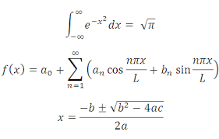
AID AND ATTENDANCE
VA MATH
The applicant’s monthly medical expenses have to EQUAL or EXCEED the monthly income
Hypothetical Example: The Veteran’s total gross monthly income is $3,100. Therefore, the total monthly amount of qualified medical expenses must be $3,100 or greater every month.
Qualified medical expenses can include:
Non-reimbursed expenses such as … Social Security Part B; medical insurance premiums; pharmaceuticals; doctor’s expenses; the invoiced costs of the Assisted Living or Nursing Home facility; dental visits; non-VA glasses; non-VA hearing aids; monthly required medical transportation expenses; in-home invoiced care-giver expenses; acquisition of hospital-type beds; potty-chairs; wheelchairs; walkers; certain orthotics not provided by VA; bathroom safety rails; bathroom toilet seat extensions; “Depends®” or incontinence underwear; contracts with care givers; “adult day care” costs, etc.
Each of these potentially claimed expenses should be confirmed with a receipt or paid invoice
Checkbook entries are generally not acceptable to VA unless the account is EXCLUSIVELY set up for qualified medical expenses.
Excel listings / legal pad records are not well received by the VA either, unless signed and dated daily, in ink, by the care giver.

Slide 21
AID AND ATTENDANCE
PAYMENT OF MEDICAL EXPENSES – ESPECIALLY ASSISTED LIVING OR NURSING HOME COSTS
The VA prefers that the Veteran or the Surviving Spouse make the payments from the Veteran’s banking account
If the family is going to/or has to assist, it is preferable to first deposit the assistance dollars in the Veteran’s or Surviving Spouse’s banking account
Make all the qualified medical payments from that account
Someone else can actually write the checks, but use the above-mentioned banking account, rather than from a son’s or daughter’s banking account.

Slide 22
AID AND ATTENDANCE
ONE OF THE TRICKY PARTS
LOOK-BACKS AND PENALTY PERIODS
Beginning in 2018, the VA established a 3-year (36 month) look-back period and penalty period for those who transferred assets in an attempt to qualify for a Pension
Remember, your friendly VA can check with their friendly pals over at IRS to CONFIRM look-backs. Tell your client not to try to fool the VA.
The look-back period does not cover any transaction dated prior to October 18, 2018.
Penalties are calculated based on the amount of covered assets
A COVERED ASSET is an asset that was part of the claimant’s net worth, but was transferred for less than the fair market value within the 36 month period prior to applying for the Pension benefit. Had it not been transferred, it would have partially or fully caused the claimant’s net worth to exceed allowable limits ($130,773 in 2021)
Examples: gifting stock or property below fair/current market value; or gifting cash to get it out of the Veteran’s asset holdings
EXCEPTION: Establishment of a Trust created for a child incapable of self-support, even at less-than fair market value, will not be included among the look-back or penalty period features.

Slide 23
HAVE YOUR APPLICANT BE VERY CAREFUL
Veterans’ Pension Scam
What it is: Veterans over age 65 are offered free seminars by financial advisers or financial service companies to help them qualify for an enhanced pension with Aid and Attendance, a benefit for low-income Vets with disabilities. Seminar sponsors convince Vets whose income or assets are above the threshold, to restructure their finances so that they will qualify, typically by buying a costly annuity or creating an expensive trust that pays the sponsors a hefty fee.
Another approach is that the scammers charge NOTHING, but will only take one month’s VA payment from the Vet – the FIRST MONTH … the one with a year’s worth of Retro-payment.

Slide 24
AID AND ATTENDANCE
Hey Man … we’ve listened to a bunch of your dialogue and lots of pages of text …
Now … please, get to the “how” part of filing for A&A

Slide 25
AID AND ATTENDANCE
SO … A GUY OR GAL CALLS YOUR OFFICE AND WANTS YOU TO APPLY FOR AID AND ATTENDANCE (usually for Mom or Dad)
If a guy walks in, be concerned that perhaps he is not appropriately disabled
WHICH VA FORMS ARE NEEDED
VA Form 21-22 (VA Representative and VA Power of Attorney)
VA Form 21-4138 (Wait a second … We’ll talk about the OPTIONAL Statement in Support of a Claim in a few minutes)
VA Form21P-527EZ (Application for a Non-Service-Connected Pension for a War Time Veteran)
OR
VA Form 21P-534EZ (Spousal Benefits including Aid and Attendance)
VA Form 21-2680 (Certification of Medical Necessity) There’s the damn tattoo again!
VA Form 21P-8416 (Medical Expense Report)
VA Form 21-686c (If claimant is married and/or with dependents)
VA Form 21P-0969 (Income and Asset Statement) NOT ALWAYS REQUIRED (The -527EZ or -534EZ will direct you)
VA Form 21-0779 (Nursing Home information for an A&A claimant)
Medical Necessity
Is that it? Is anything else required?

Slide 26
AID AND ATTENDANCE
WHAT OTHER PAPERWORK IS NEEDED FOR AN A&A APPLICATION?
Veteran’s Honorable Discharge (DD-214) (for both Veteran and Spousal applications)
VA letter confirming Veteran’s 100% disability (if Veteran is still alive, or at least 30% if Veteran is deceased)
Marriage Certificate (if applying for a Spouse or Widow)
Death Certificate (if applying for a Surviving Spouse)
Real Estate Property Card (from the Assessor’s Office if the property is greater than 2 acres)
Phew! Now we’re done, aren’t we?

Slide 27
AID AND ATTENDANCE
NOT QUITE … STILL A LITTLE MORE PAPERWORK
A letter/VA Form from the Assisted Living Facility (“Worksheet for Assisted Living” – part of 21P-527EZ and 21P-534EZ)
Two (or three) recent checking account statements (consecutive months) [ How close is the Vet to the $130K asset level? ]
Two (or three) recent savings account statements (consecutive months)
A recent civilian Pension / Annuity / Retirement Account statement
A recent IRA / 401(k) statement (including any Required Minimum Distribution Statement)
The annual (December) Social Security Statement for the current year (same as requested by Chapter 115)
A current brokerage statement (stocks, bonds, mutual funds, etc.)
A copy of the real estate trust document, if applicable
Long Term Care Insurance statement
Reverse Mortgage Statement (showing the unused portion, which is treated as an asset)
Medical Expense Evidence
PAID assisted living invoices
Paid home health care / care giver invoices
Paid medical care visits, disposables, pharma, glasses, dental, appliances, etc.
NOW we’re finally finished … right?

Slide 28
AID AND ATTENDANCE
AM I DONE NOW?
C’MON, DOUG! NOW WHAT?
Go back to VA Form 21-4138 and list all the VA Forms and other evidence/documents (statements and receipts) which are being included in this submission
This is not an absolute requirement but should make YOU and the VA Reviewer feel better about the completeness of the claim
Review each of the VA forms and make sure that EACH ONE is signed and dated
Send the completed application off to Providence or Boston via US Postal Service as it is (likely) too much for VetraSpec.
YOU DID IT! SEE, THAT WASN’T SO BAD, WAS IT?
JUST FOLLOW THE CHECKLIST

Slide 29
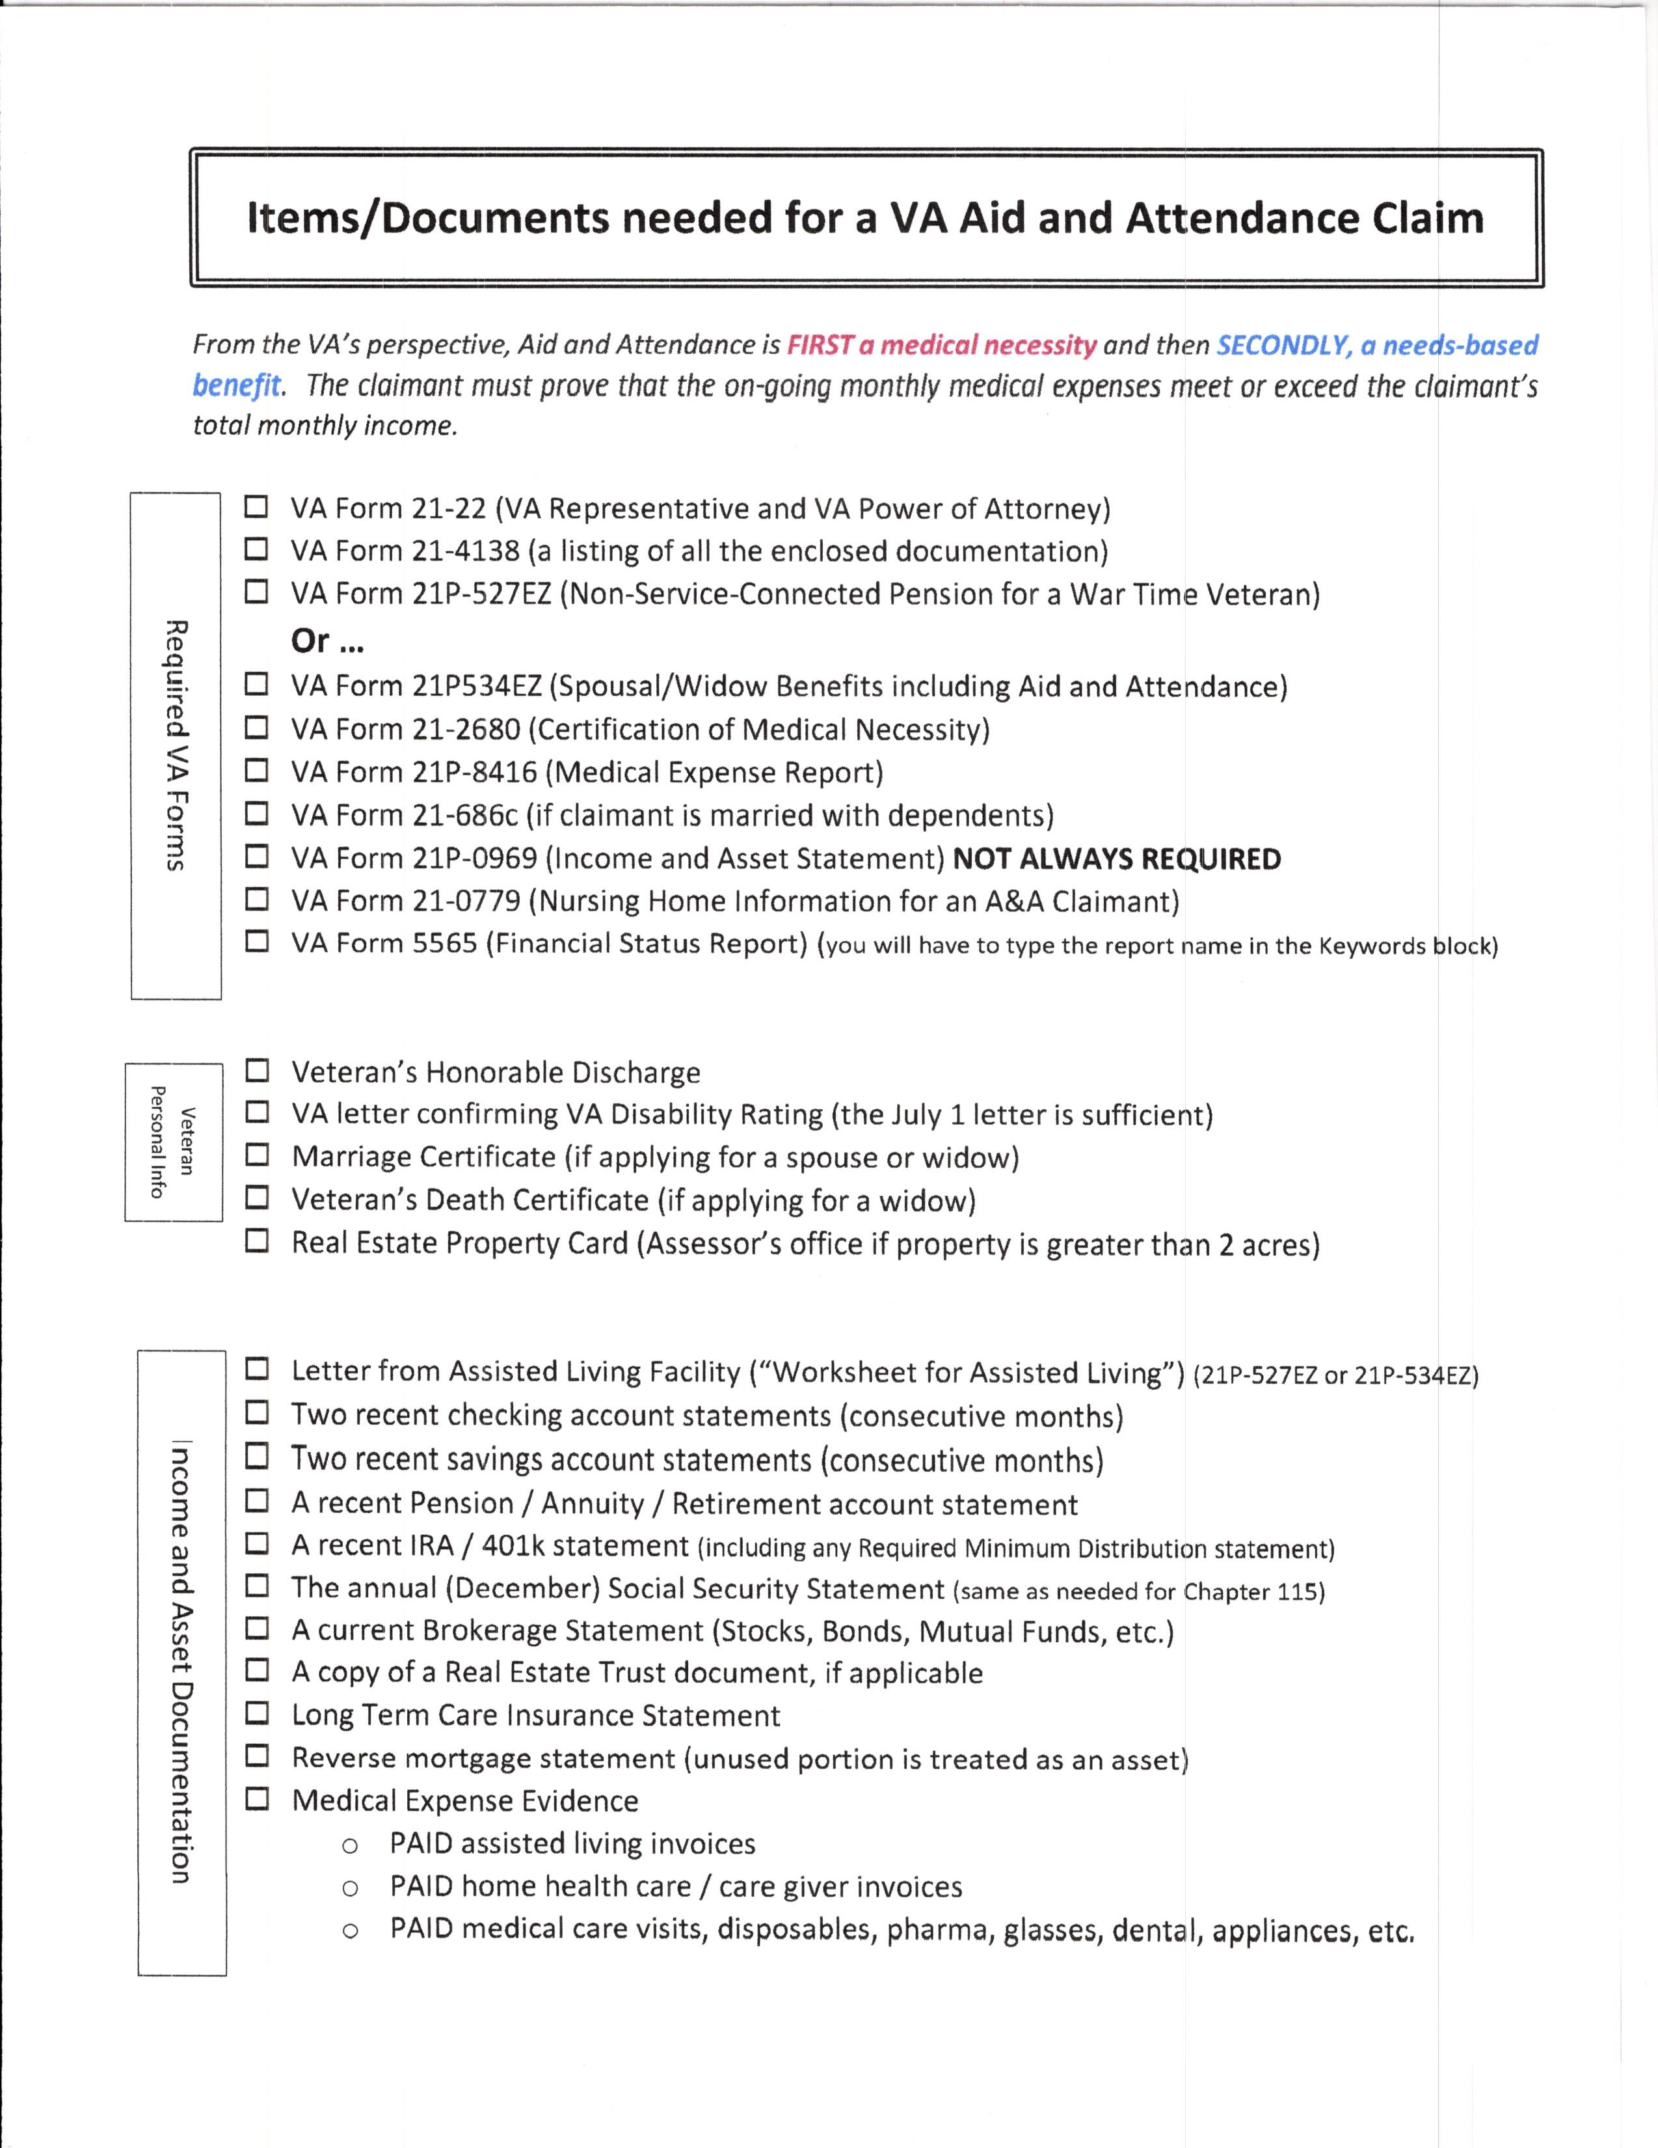
AID AND ATTENDANCE
Checklist of Items/Documents Needed for a
VA Aid and Attendance Claim

Slide 30
AID AND ATTENDANCE
Somehow, Magic Micaila, The Baroness of Britto-ville, is going to make this presentation available for download, should you desire.
QUESTIONS
Please don’t ask any hard questions that I can’t answer. Thank you.
I was Air Force so everything is a challenge

