Slide 1

Combat-Related Special Compensation (CRSC)
&
Concurrent Retirement Disability Pay (CRDP)
(CRSC) and (CRDP) are programs created by Congress to allow eligible military retirees to receive monthly entitlements in addition to retired pay.
The purpose of these entitlements is to recover some or all of the retired pay that military retirees waive for VA disability compensation.

Slide 2
(CRSC) & (CRDP)
CRSC is a special compensation for combat-related disabilities. It is non-taxable, and retirees must apply to their Branch of Service to receive it.
Eligible retirees must apply to receive CRSC.
CRDP is a restoration of retired pay for retirees with service-connected disabilities. It is taxed in the same manner as your retired pay, and it is normally considered taxable income.
No application is required. Eligible retirees receive CRDP automatically.

Slide 3
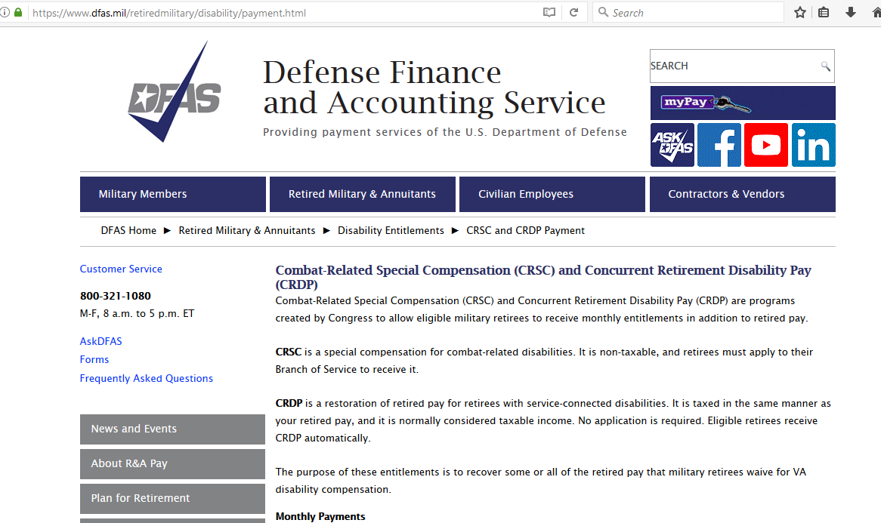

(CRSC) & (CRDP)
Where do I find this info?

Slide 4
(CRSC)
Combat Related Special Compensation (CRSC) – Eligibility
To qualify for CRSC you must:
Be entitled to and/or receiving military retired pay
Be rated at least 10 percent by the Department of Veteran’s Affairs (VA)
Waive your VA pay from your retired pay
File a CRSC application with your Branch of Service
Disabilities that may be considered combat related include injuries incurred as a direct result of:
Armed Conflict
Hazardous Duty
An Instrumentality of War
Simulated War
More Qualifications and Details:

Slide 5
(CRDP)
Concurrent Retirement and Disability Pay (CRDP) -- Eligibility:
Must be *eligible for retired pay (AD & Reserve) to qualify for CRDP.
*eligible for retired pay due to length of service
OR
Retired under Temporary Early Retirement Act (TERA)
AND
have a VA disability rating of 50 percent or greater.
May become eligible for CRDP at the time the veteran becomes eligible for retired pay.
More Qualifications and Details:

Slide 6
(CRSC) & (CRDP)
Retroactive Payment
Both (CRSC) & (CRDP) recipients may be eligible for Retroactive Payment on their benefit.
DFAS will audit the account to determine whether or not retroactive payment is due . An audit of an account requires researching pay information from both DFAS and VA.
Specific Details ON Retroactive Payments:

Slide 7
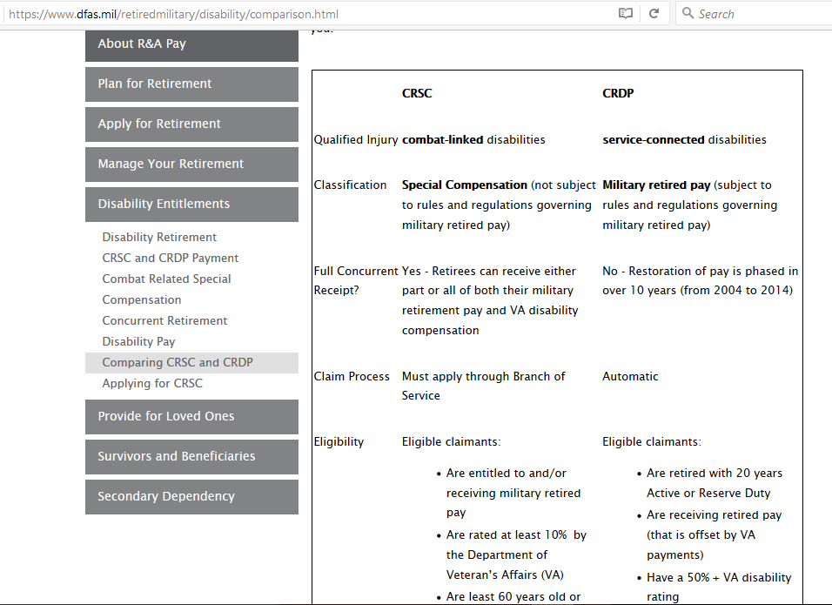
(CRSC) & (CRDP)
ALL THE DETAILS!

Slide 8




(CRSC) & (CRDP)
Q & A

