Slide 1
Department of
Veterans’ Services
Non-Service-Connected & Survivors Pension

Slide 2

References
Link to Regulation Name of Regulation
38 Code of Federal Regulation 3.23 Improved Pension Rates -Veterans and Surviving Spouses
38 Code of Federal Regulation 3.271 "Income" for VA Purposes (IVAP)
38 Code of Federal Regulation 3.272 Exclusions from Income
38 Code of Federal Regulation 3.273 Rate Computations
M21-1 III.ii.1.C.8 Handling Outdated Forms
M21-1 III.v.6.A Information Exchange Between Department of Veterans Affairs (VA) Regional Offices (ROs) and Medical Facilities
M21-1 V.i.3.D Reduction of Income Due to Unreimbursed Expenses
M21-1 V.iii.1.C Section 306 Pension and Old Law Pension
M21-1 V.iii.1.G Deductible Expenses
M21-1 V.iii.1.J Net Worth, Asset Transfers and Penalty Periods

Slide 3

Current Pension Programs
Old Laws
306
Improved Pension (All new claims)
If in receipt of 306 and claiming HB or A&A, must elect Improved Pension.

Slide 4
Eligibility for Non-Service-Connected Pension & Survivors Pension
There are four factors the VA must consider when determining eligibility for VA pension:
  Pension Wartime Service Requirement.
  The claimant's and dependent’s combined net worth
  The claimant’s and dependent’s unreimbursed, reoccurring out-of-pocket medical expenses.
  The Veteran’s age, disability and/or medical condition OR the claimant’s relation to the deceased Veterans.

Slide 5


Pension Wartime Service Requirement
90 or more consecutive days of active duty that began or ended during a wartime period.
A total of 90 or more days of active during one or more wartime periods, or
Any amount of time during a wartime period if the Veteran was discharges or released for a service-connected disability.
*Important:
Gulf War Veterans must additionally meet a minimum active duty service requirement, generally two continuous years that includes one day during a wartime period.
For survivors’ pension, the wartime service requirement is also met if the Veteran had at least one day of active duty wartime service and was receiving or was entitled to receive disability compensation at the time of death.
One-day must be during a wartime period.

Slide 6
Wartime Periods
Wartime Period Beginning and Ending Dates
Mexican Border Period May 9, 1916, through April 5, 1917 for Veterans who served in Mexico, on its borders, or adjacent waters
World War I April 6, 1917, through November 11, 1918; for Veterans who served in Russia, April 6, 1917, through April 1, 1920
World War II December 7, 1941, through December 31, 1946
Korean Conflict June 27, 1950, through January 31, 1955
Vietnam Era August 5, 1964, through May 7, 1975; for Veterans who served “in country” before August 5, 1964, February 28, 1961, through May 7, 1975
Gulf War August 2, 1990, through a date to be set by law or Presidential Proclamation

Slide 7
Minimum Active Duty Service for Pension
Veterans who entered active duty after September 7, 1980, must have met a minimum active duty service requirement in addition to the wartime service requirement to be eligible for pension or for the Veteran’s survivors to be eligible for death pension.
Note: The minimum active duty service requirements is specific to a period of service. Therefore, the minimum active duty period must include at least one day during wartime period for pension eligibility to exist.

Slide 8
The Claimant’s/Dependent’s Combined Net Worth
Claimants & dependent’s countable income is below the Maximum Annual Pension Rate (MAPR), and their combined net worth meets the net worth limitations, AND
  For purposes of entitlement to VA pension, net worth is defined as the sum of a claimant’s or beneficiary’s assets AND annual income.
  Effective December 1, 2021 the net worth limit is $138,489.00.
Total Net Worth Annual Income Prospective Annual Medical Expenses
Calculated Net Worth
At or Under the limit: Eligible for benefits over the limit:
Not Eligible for benefits.

Slide 9
The Veteran’s Age, Disability and/or Medical Condition OR Claimant’s Relation to Deceased Veteran
The Veteran must be 65 or older OR is shown by evidence to have a permanent and total non-service-connected disability, OR
Patient in a nursing home, OR
Receiving Social Security Disability Insurance (SSDI) OR Receiving Supplemental Security Income (SSI) OR
Claimant is the unmarried surviving spouse, OR the unmarried dependent child of the deceased Veteran.

Slide 10
Claimant’s/Dependent’s Unreimbursed, Reoccurring Out-of-Pocket Medical Expenses
Generally, medical expenses for VA needs-based benefits purposes are payments for items or services that are medically necessary; that improve a disabled individual’s functioning; or that prevent, slow, or erase an individual’s functional decline.
Examples of medical expenses may include, but are not limited to:
  Health insurance premiums
  In-home care
  Hospitals
  Nursing homes
  Medical foster homes
  Inpatient treatment centers
  Copays, dental, optical, doctor visits, OTC meds, ect..

Slide 11
Pension Levels
Pension – only requires permanent and total disability.
Housebound – requires assistance to leave home.
Aid and Attendance – requires the care of another person daily.
*NOTE: If claimant has long term healthcare policy payment, show income and expense.

Slide 12

What is Special Monthly Pension?
Housebound is an increase monthly pension paid to a Veteran or surviving spouse who is:
  Eligible for basic pension benefits AND
  Substantially confined to his or her home because of permanent disability.
  Additionally, if the claimant is a Veteran, he/she may qualify for the increase housebound amount if he/she has a permanent disability evaluated as 100% disabling AND, due to a disability or disabilities, are permanently and substantially confined to their immediate premises, OR
  Has a single permanent disability evaluated as 100% disabling AND another disability or disabilities, independently evaluated at 60% or more disabling.

Slide 13
What is Special Monthly Pension?
Aid and Attendance (A&A) is an increased monthly pension amount paid to a Veteran or surviving spouse who is:
  Eligible for basic pension benefits AND
  Requires the aid or another person in order to preform activities of daily living, OR
  Are bedridden, in that their disability or disabilities require that they remain in bed apart from any prescribed course of convalescence or treatment, OR
  Are a patient in a nursing home due to mental or physical incapacity, OR
  Have corrected visual acuity of 5/200 or less, in both eyes, or concentric contraction of the visual field to 5 degrees or less.
*NOTE: Dependency and Indemnity Compensations (DIC) is a pension available to the surviving spouses of veterans that died while on active duty or died as the result of a service-connected disability or disease. Income does not matter for DIC.

Slide 14

Time Out!
So far:
  Regulations
  Type of pensions
  Qualifications
  Pension levels & SMP
Questions:
  ?
  ?
  ?

Slide 15

How much does VA Pension Pay?
The Maximum Annual Pension Rates (MAPR) are determined by Congress. Current & historical pension rate tables are available at: https://www.benefits.va.gov/pension/rates.asp
How does the VA calculate your pension?
  VA calculates annual pension by first determining your particular circumstances and the MAPR, an amount set by Congress. Next, VA determines your countable income. VA determines countable income by subtracting income exclusions provided by law from your total annual income in a particular 12-month period. VA subtracts your annual countable income from MAPR; the difference is your annual pension entitlement. VA divides this amount by 12 and rounds down to the nearest dollar to obtain the amount of your monthly pension payment.
  VA will deduct certain expenses paid by you, e.g., unreimbursed medical expenses, from your annual household income, which may decrease your countable income and increase your monthky pension payment.

Slide 16
Would I be eligible to receive VA Pension while residing in a Medicaid paid Nursing Home?
Typically, the maximum pension rate a claimant residing in a Nursing Home, on Medicaid can receive is $90.00 per month.
Expansion of $90.00 Medicaid Rate to surviving children, $90.00 rate can now be expanded to surviving children.
No pension or survivors’ pension in excess of $90.00 per month will be paid to or for the beneficiary for any period after the month in which the Medicaid payments begin.
Applies to a Veteran without a spouse or child, to a surviving spouse without a child, and to a surviving child.

Slide 17

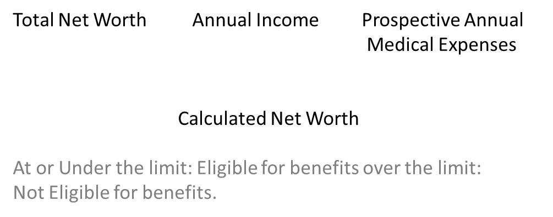


What does the VA consider “Net Worth” for Pension Benefits purposes?
For purposes of entitlement to VA pension, net worth is defined as the sum of a claimant’s or beneficiary’s assets AND annual income for VA purposes (IVAP).
A “bright-line rule” is a clearly defined rule or standard.
  Community Spouse Resource Allowance (CSRA) for Medicaid purposes
  Indexed for inflation.
  Will change annually by SSA COLA increase.
  Must exceed amount to be over the limit.
The bright-line net worth limit is the value that a claimants combined assets and annual income cannot exceed in order to qualify for pension benefits.
- At or Under the limit: Eligible for Benefits
- Over the limit: Not Eligible for Benefits

Slide 18
Assets
The fair market value of ALL property that an individual owns, including all real and personal property, less the amount of mortgage or other encumbrances specific to the mortgaged or encumbered property. (Examples include, but are not limited to: checking accounts, saving accounts, stocks, bonds, mutual funds, trusts, ect..)
Are there exclusions from assets?
  Yes. However, ALL assets should be reported on the application. Let the VA determine which assets the law allows to be excluded.
  (Examples include, but are not limited to: Claimant’s primary residence, Personal effects such as appliances and family transportation vehicle, Radiation Exposure Compensation, Ricky Ray Hemophilia Relief Fund payments, Energy Employees Occupational Illness.
  Compensation Program payments, Payments to Alerts and Statutory exclusions.)
  Trust Established for Child Incapable of Self-Support
    VA will not consider a transfer to a trust as a transfer for less that fair market value (FMV) if the trust is established on behalf of a child whom VA has rated incapable of self-support.
    This transfer will not result in a penalty period.

Slide 19


Annual Income
Annual Income: Payments of any kind from any source shall be counted as income during the 12-month annualization period; this includes income received by the Veteran, Veteran’s dependent spouse, as well as each child of the Veteran, in the Veteran’s custody or to whose support the veteran is reasonably contributing. In the case of Survivor's Pension, the surviving spouse’s annual income and the annual income of each child of the veteran in the custody of the surviving spouse to the extent that such child’s income is reasonably available to or for the surviving spouse in considered by the VA. (Examples include, but are not limited to : Social Security, Retirement Pensions, Inheritance, Salary, Distributions, Dividends, Interest, Business, farm or professional income, etc.)
Are there exclusion from income?
  Yes, and like assets ALL income should be reported on the application. Let the VA determine what income can be excluded based on the law. (Example included, but are not limited to Welfare, Maintenance, Department of Veterans Affairs Pension Benefits, Reimbursement for casualty loss, etc.)
*NOTE:
  * Report all income - VA will sort countable/non-countable
  * Report everything to the VA and understand the law! Review the Notification Letter to make sure they calculate correctly. It is better than not reporting something and harming your Veteran.

Slide 20

Is there a “look-back period” for Pension benefits?
Effective October 18, 2018, the VA defined a look-back period as the 36-month period immediately preceding the date on which VA receives either an original pension claim or a new pension claims after a period of non-entitlement. This definition does not include any date before October 18, 2018, however they can, and will inquire about claims where excessive net worth maybe a factor.
  Claimant who transfer $125,000 in covered assets incurs a longer penalty period than a claimant who transfer $75,000.
  The length of the period is calculated based on the amount of covered assets.
* Important: The look back period does not include any date before October 18, 2018.
* If I am already receiving monthly payments for a service-connected disability, can I also receive a VA pension?
  No, you cannot receive a VA pension and service-connected compensation at the same time. However, if you apply for pension and are ultimately awarded, VA will pay you whichever benefit is greater.
* What about military retirement?
  Yes, you can receive both.

Slide 21


Define and Clarify Medical Expenses for VA Purposes
New regulation defines:
  Activities of daily living (ADLs): Defined as “mean basic self-care activities and consist of bathing or showering, dressing, eating, toileting, transferring, and ambulating within the home or living area. Transferring means an individual’s moving himself or herself from one position to another, such as getting in and out of bed.”
  Instrumental activities of daily living (IADLs): Defined as “mean independent living activities, such as shopping, food preparation, housekeeping, laundering, managing finances, handling medications, using the telephone, and transportation for non-medical purposes.”
  Custodial care: Defined as regular assistance with two or more ADLs, or supervision because an individual with a physical, mental, developmental, or cognitive disorder requires care or assistance on a regular basis to protect the individual from hazards or dangers incident to his or her daily environment.
* Clarifies: The medical expenses deduction should be contingent on the sort of care the disabled individual is receiving in the facility and the necessity for the individual to be there, not the name of the facility.

Slide 22

Current Income Limits
(Veteran)
Veterans Pension Rate Table Veteran - Alone & With Dependents
  https://www.va.gov/pension/veterans-pension-rates/
22

Slide 23
Current Income Limits
(Surviving Spouse)
Improved Death Pension Rate Table Surviving Spouse/Child(ren) – Alone or With the Other
  https://www.va.gov/pension/survivors-pension-rates/
23

Slide 24
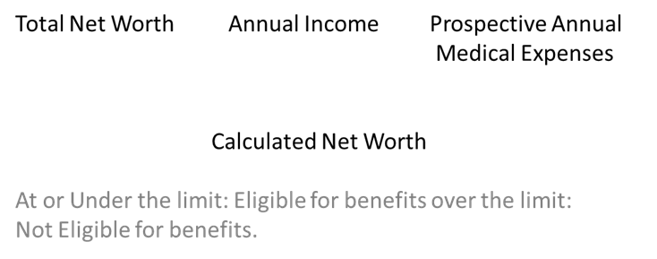
Net Worth
The market value of all assets owned by the Veteran
  Except his/her home and reasonable personal belongings
  Farms: 5 acres plus house exempt; all other acreage/equipment/livestock are reportable assets.
Minus debt owed on these assets.

Slide 25

Residential Lot Size Limit
The new regulation excludes from net worth the primary residence plus the residential lot area.
Residential lot area is the lot on which a residence sits that does not exceed 2 acres (87,120 square feet).
If the lot exceeds 2 acres, VA must develop for the value of the additional land.

Slide 26

Time out…Again!
A bit further:
  Payment amounts & MEDICAID
  NET-Worth, Assets, Annual Income
  Look-back
  Income limits
Questions:
  ?
  ?
  ?

Slide 27

Incarcerated Veterans
A Veteran who is in receipt of pension and is incarcerated in excess of 60 days following conviction for a misdemeanor or a felony will have his/her benefits terminated.
The benefit may be reinstated when the Veteran is released.
The Veteran MUST submit VAF 21-527EZ and supporting documentation to get the pension reinstated.

Slide 28
Incompetency of Claimant
If necessary, VA will propose a determination of incompetency to handle financial affairs.
Claimant will have to respond to incompetency notice, can identify a suitable fiduciary.
VA must investigate and approve fiduciary.
Regular monthly payments will begin upon approval of claim; retroactive amounts owed will be withheld until fiduciary is approved and appointed.

Slide 29
Forms
21-22 Power of Attorney
21-4138 Statement (if necessary)
VA Form 21P-527
VA Form 21P-527EZ
VA Form 21P-534
21-534EZ Application for DIC and Death Pension
21P-8416 Un-reimbursed Medical Expenses
VA Form 21P-0969
21-2680 (A&A/Housebound)
21-0779 (Nursing home/Assisted Living)
* Reminder: Outdated forms are accepted for one year. Outdated forms will not have required info.

Slide 30

Checklist of Documentation Most Commonly Needed
Military Discharge Document
  Must show the character of discharge (i.e. DD-214, WD AGO or NavPers)
Marriage License
  Marital History for Veteran AND Spouse or Surviving Spouse
  Date of previous marriage/s
  Location of previous marriage/s
  Name of former spouse/s
  How marriage/s ended? (i.e. Divorce, Death, etc.)
  Date previous marriage/s ended
  Location previous marriage/s ended.
Death Certificate of Veteran
Social Security Numbers for Veteran, Spouse or Surviving Spouse, & Dependent Children
Birth Certificate/s for dependent child/ren
  Child/ren must be under 18, OR 18-23 and attending school OR permanently incapable of self-support due to a disability before age 18.
  Proof of School enrollment or child’s disability for applicable dependents will also be required in addition to their birth certificates.
CURRENT Gross Income Statements for Veteran, Spouse & Dependents
  i.e. Income from employment, Pensions Statements, Social Security Award Letters, Annuities Statements, IRA, Black Lung, Unemployment, Rental Property, Farm, Business, Interest, Royalties, Distributions, etc.
CURRENT Statements for all Assets belonging to Veteran, Spouse, Surviving Spouse & Dependent Children
  i.e. Most recent Checking & Savings Account Statements, Stocks, Savings Bonds, Annuities, Mutual Funds, Life Insurance Policies, Real Estate etc.
Documentation of Discontinued Income from the prior tax year
  i.e. Any income no longer being received or was a one-time payment
Details & Documentation of Asset Transfers within the last 36 months
  i.e. Any assets that were sold, conveyed, traded or given away in the current year and/or prior 3 tax years.
All Non-Reimbursable monthly medical payments for Veteran and spouse.
  i.e. Assisted Living, Nursing Home, Medical Insurance Premiums, Prescriptions, Doctors Co-Pays, etc.
Direct Deposit Information
  i.e. Voided Check

Slide 31



Conclusion
Eligibility:
  Wartime service
  Honorable service
    90 days or 24 months or “full period”
  Income and net worth within limits
      and……
  Complete dependency information
  Medical evidence of permanent and total disability if veteran is under 65, not in a nursing home, and not receiving Social Security Disability benefits.

Slide 32

Questions & Contact
Ed Zackery
ezackery@nacvso.org

